Slide 1
Weekly update
Batbot hovering by means of evolutionary algorithm
安武
2023/04/17

Slide 2
TABLE OF CONTENT
Last Week Goals
Last Week Achievements
Next Week Goa

Slide 3


Last Week goals
Project complete Workflow
Successfully connect Data Logger to computer and achieve automatic measuring and data reading in Python. (Whole workflow completed)
Algorithm Design:
Flight Algorithm
Fitness Algorithm (score calculation from sensors)
n measurements
n solutions
n Tests in Testbench

Slide 4
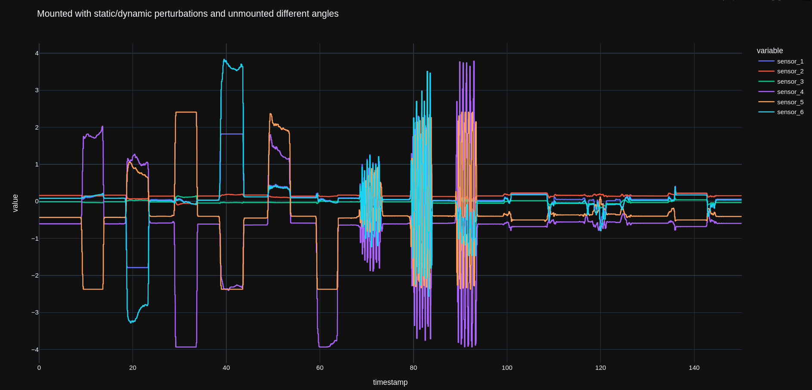
Last weeks achievements
Finally able to connect DAQ with Python. Advantage: Obtain measurements on Pythons command. Needed to go to byte level with Modbus protocol..

Slide 5
Last week achievements
Calibration Experiments (Drift and Hysteresis Analysis):
Why? If the Batbot’s goal is to achieve a neutral state on all sensors (force equals zero), then the sensor values at neutral state must be found.
Idea: Measure sensor values with the Batbot unmounted and define the obtained values as the neutral state.
Problem: Are the neutral state values always the same?
Experiment: Manually applied force for 5 seconds, and measured 55 seconds of neutral state. Repeated for forward, left, back, right, up and down, with respect to the Batbot mounted position.

Slide 6
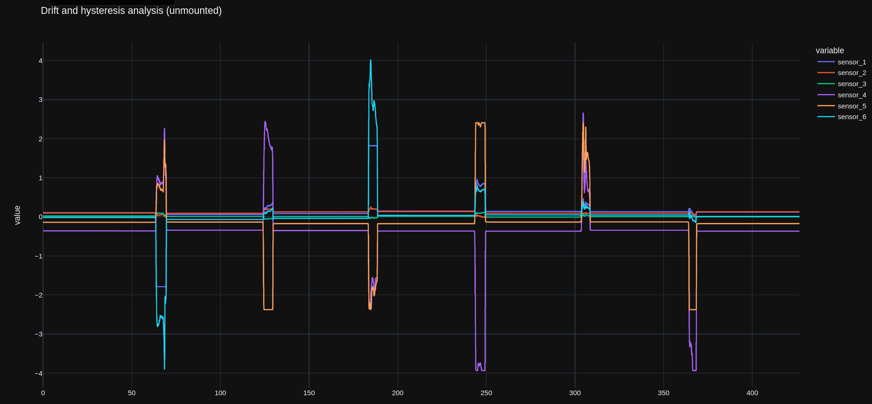
Last week achievements
Calibration Experiments Results:
h
Drift: Difference between start and end sensor value in a neutral state.
Neutral State Intervals
Initial
Post Front
Post Left
Post Back
Post Right
Post Up
Post Down

Slide 7
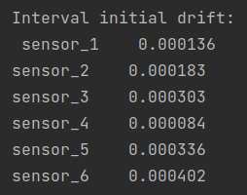
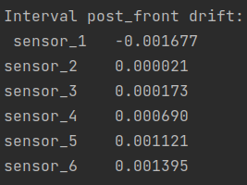
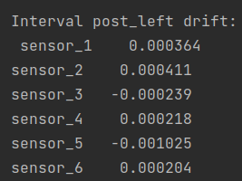
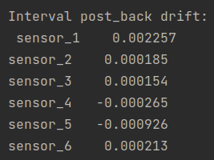
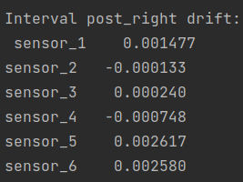
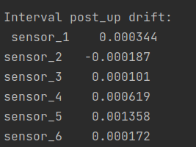
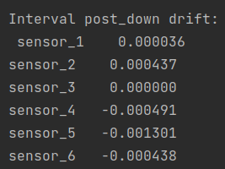
Last week achievements
Calibration Experiments Results (Drift Analysis):

Slide 8
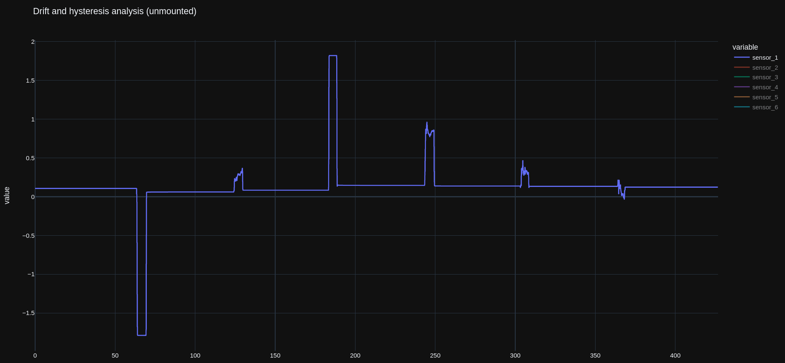
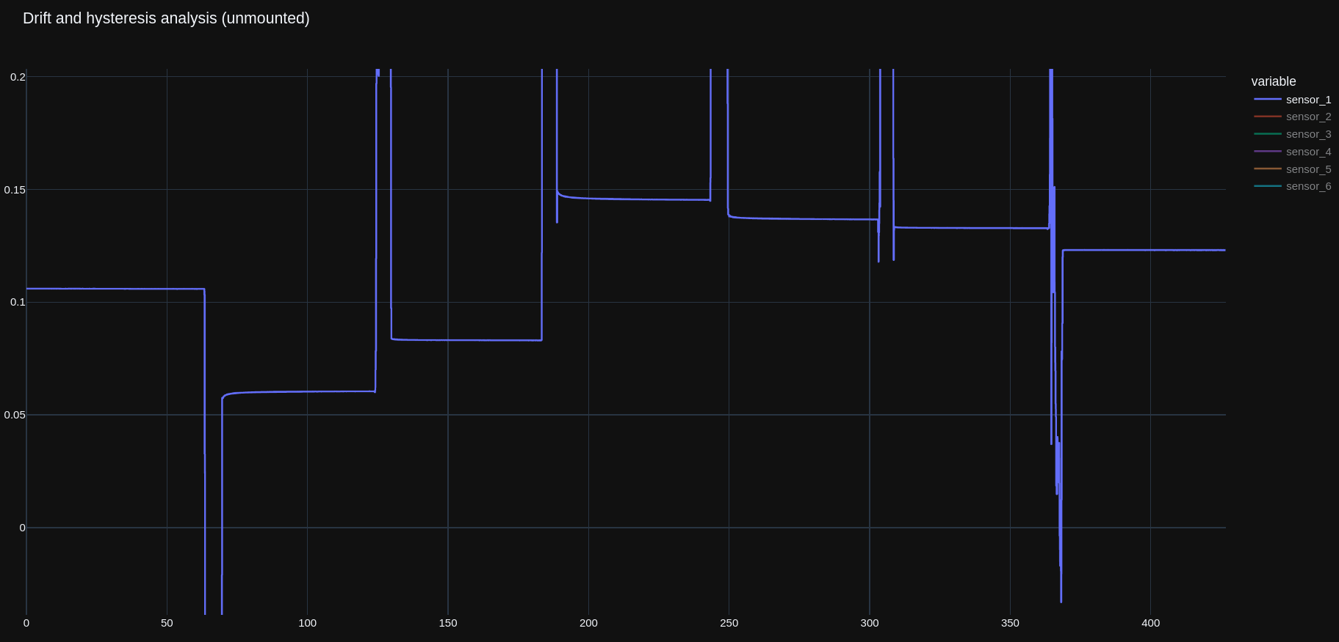
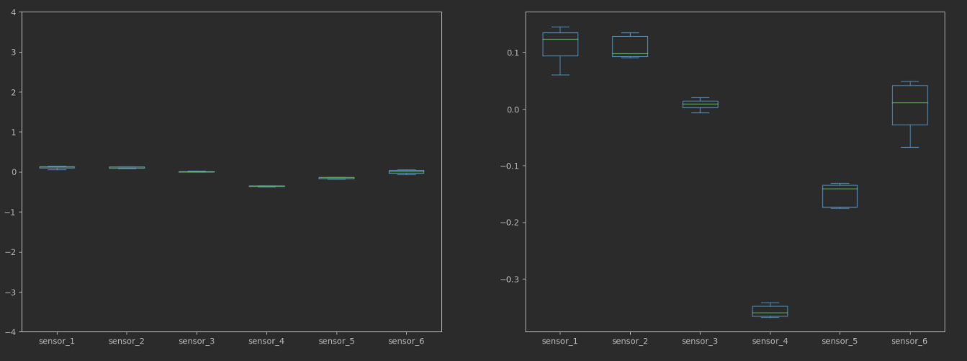
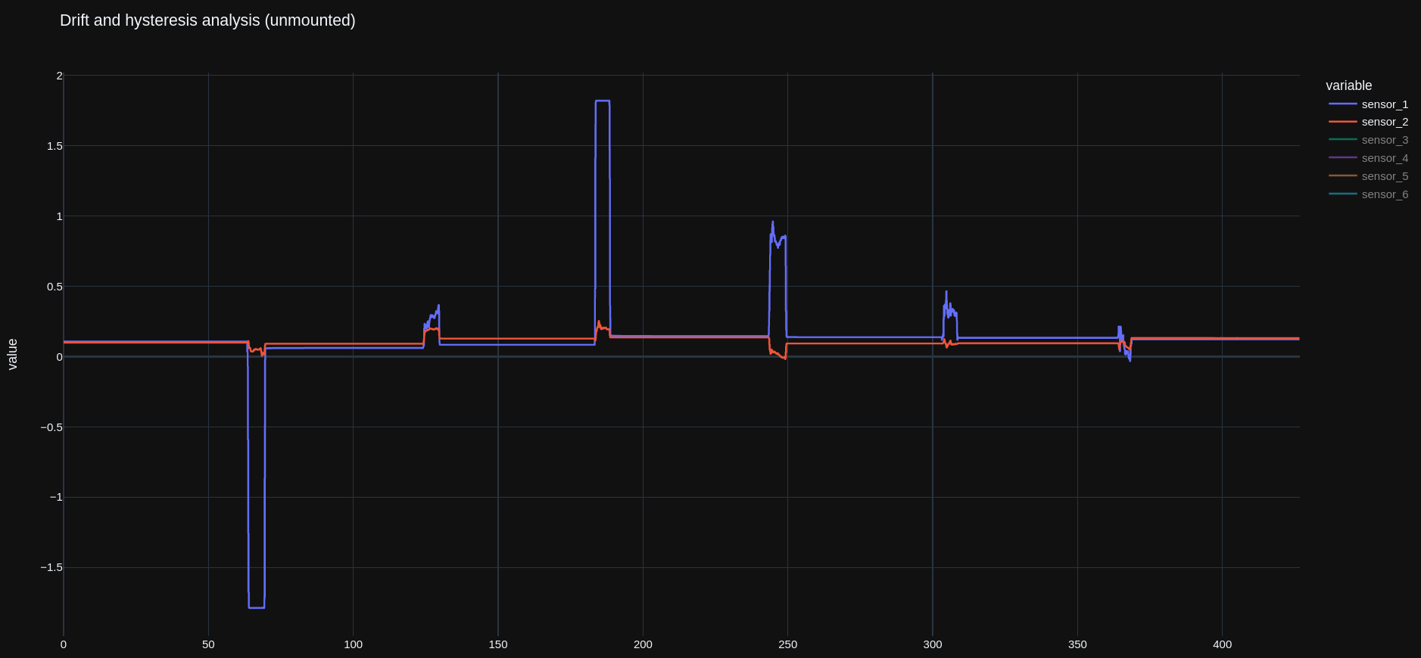
Last week achievements
Calibration Experiments Results (Hysteresis Analysis):
Sensor 1 max. Range
Max. Hysteresis Error Sensor 2
Sensor 1 max. Range

Slide 9
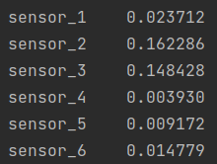
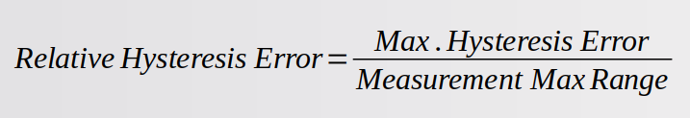
Last week achievements
Calibration Experiments Results (Hysteresis Analysis):

Slide 10
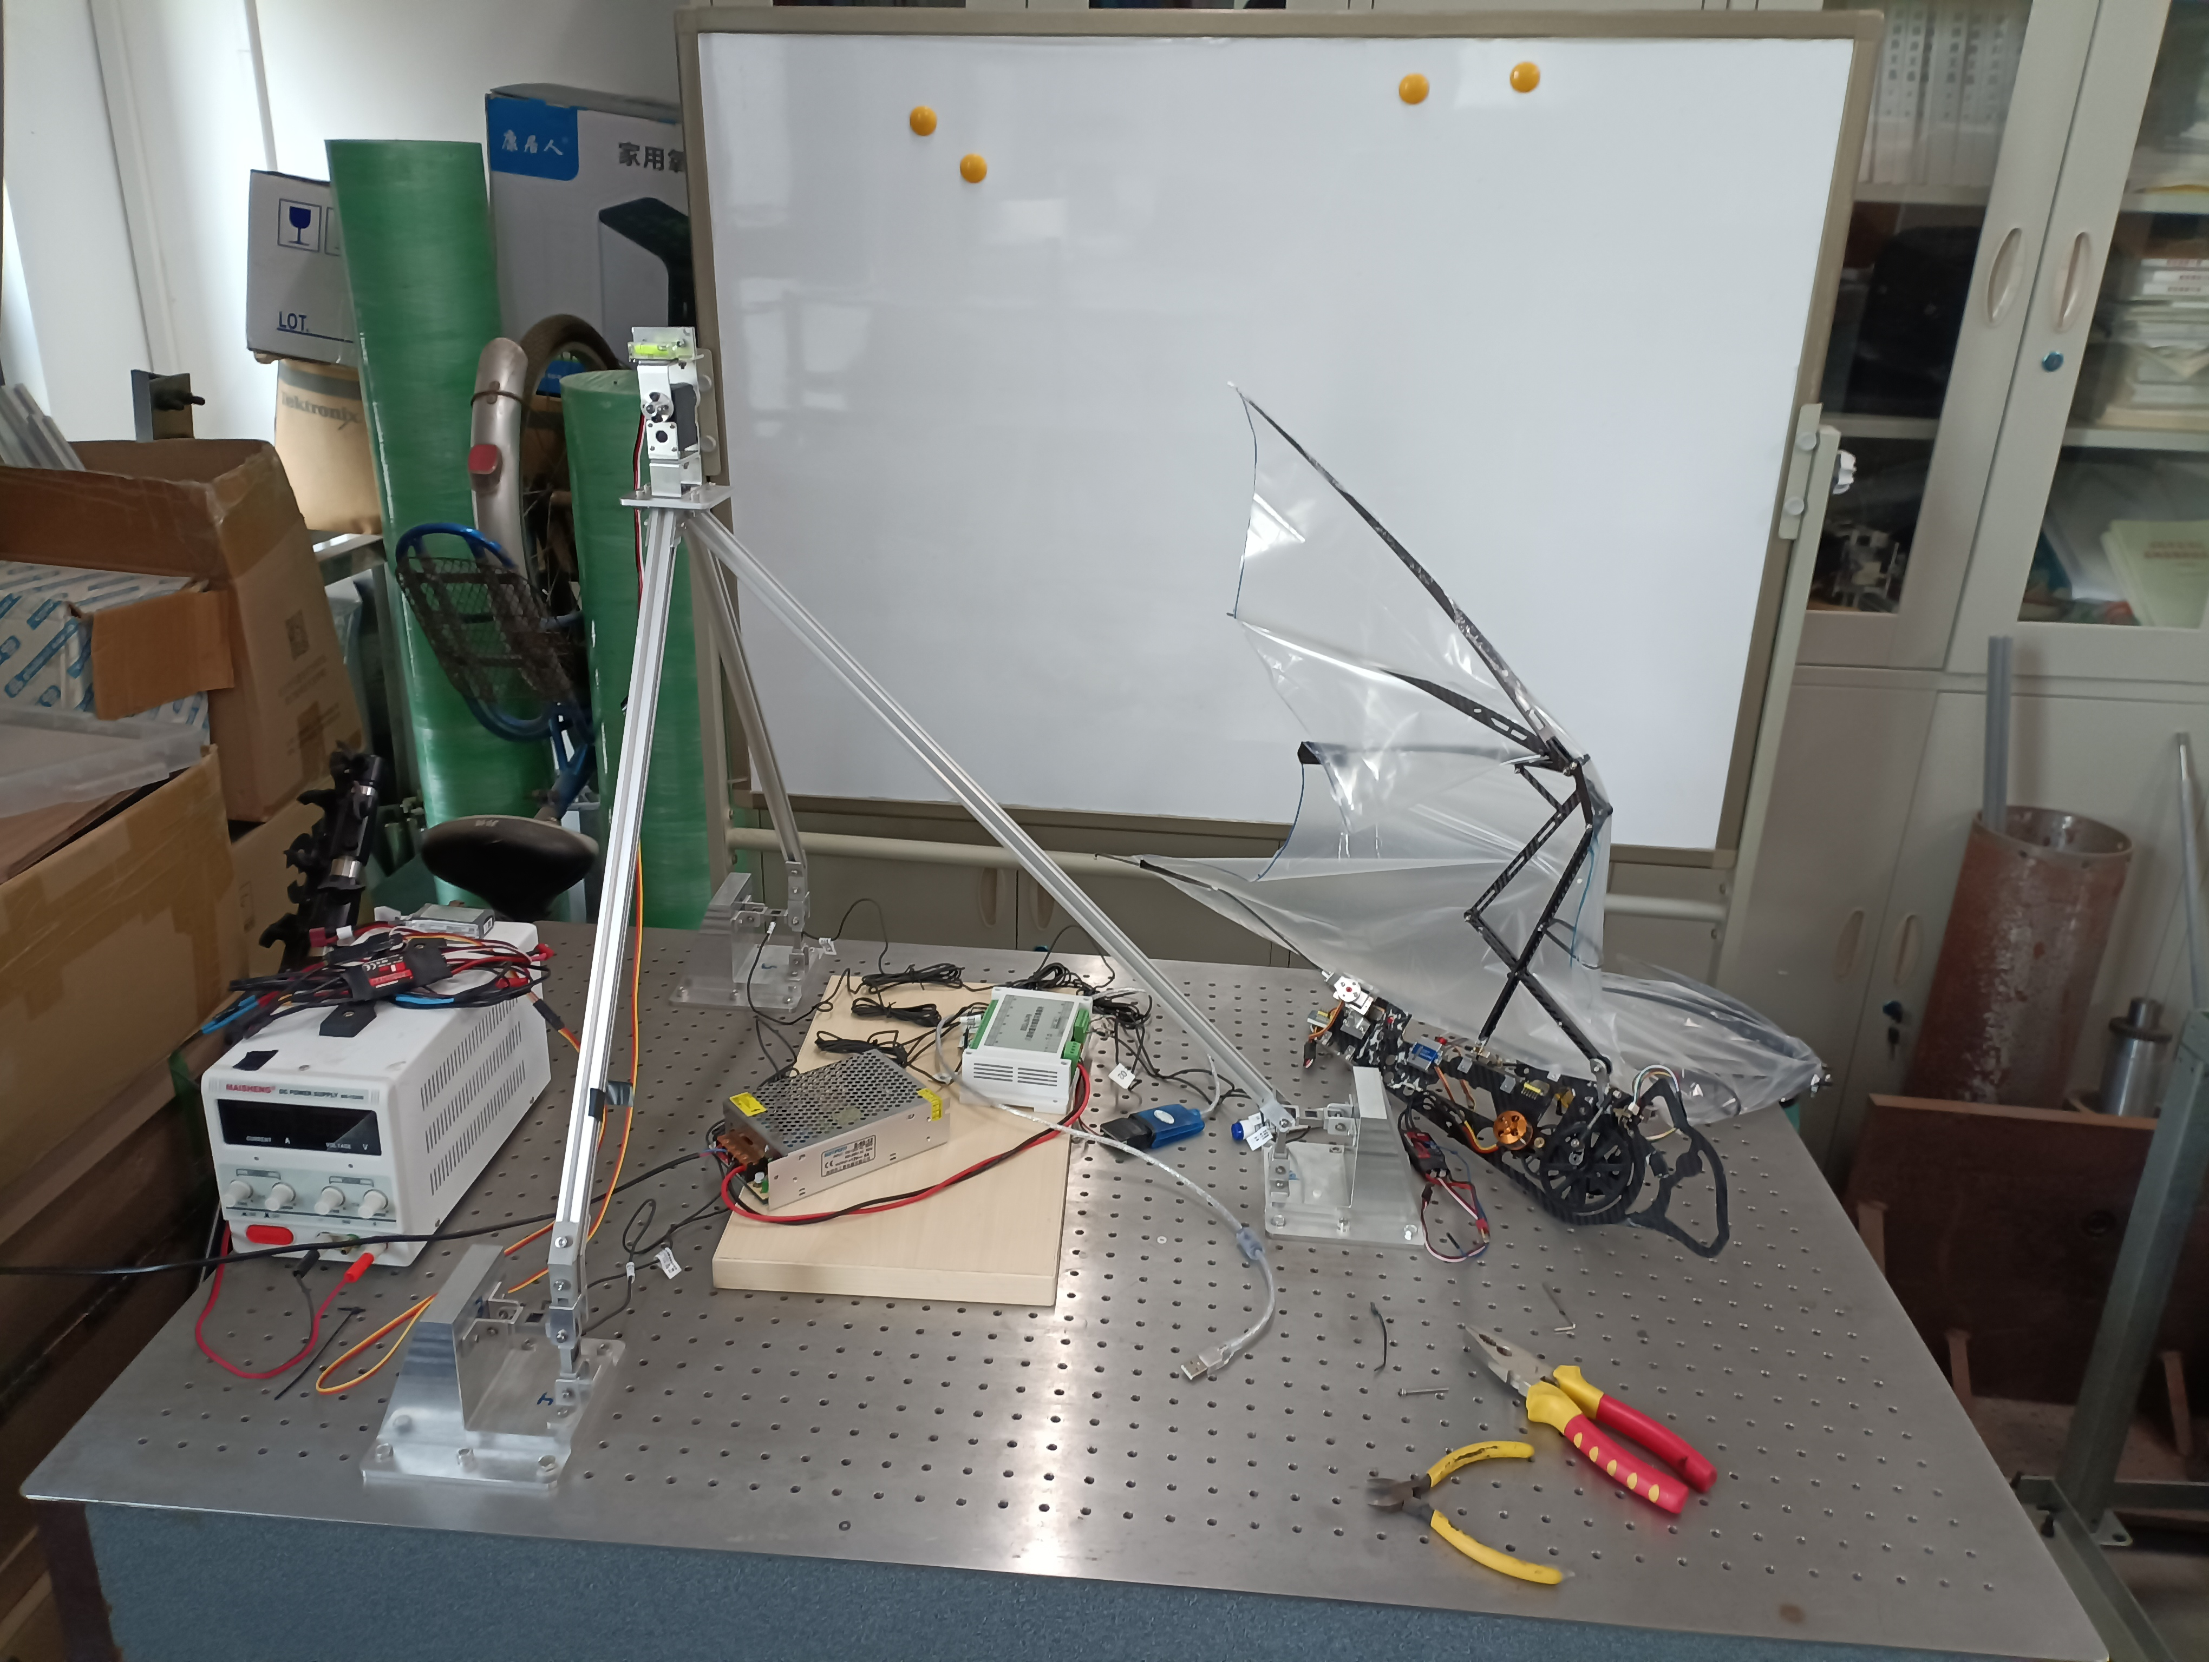
Last week achievements
Calibration Experiments Conclusion:
Drift Analysis: We can see that for a minute-long experiment (which is significantly longer than the 5-15 second experiments I plan to do) the drift is in the 10⁻³ range. Which means that the drift can be neglected.
Hysteresis Analysis: Relative hysteresis error for sensors 1, 4, 5 and 6 is not larger than 3% (acceptable). Nonetheless, sensors 2 and 3 have errors of 16% and 14% respectively. This is due to the small measurement range of this sensors.
Solution: Reposition Batbot in more central position with respect to sensors to obtain a more equal force distribution through the sensors.
Sensor 2
b
Sensor 3

Slide 11
next week goals
Redo the calibration experiments a couple of times to ensure that the values remain constant in different situations.
Prepare and give talk regarding scientific writing.
Thesis Proposal?
Start working on flight command algorithm with the STM32

Slide 12
Thank you!

