Slide 1
Updates 03 Jul 2026

Slide 2
Toy Examples
Our goal is a differentiable Monte Carlo simulation: a program that takes n and gamma as inputs
and returns a loss function that is optimizable with respect to both.
To build intuition, I first worked through some toy examples of the optimization idea.

Slide 3
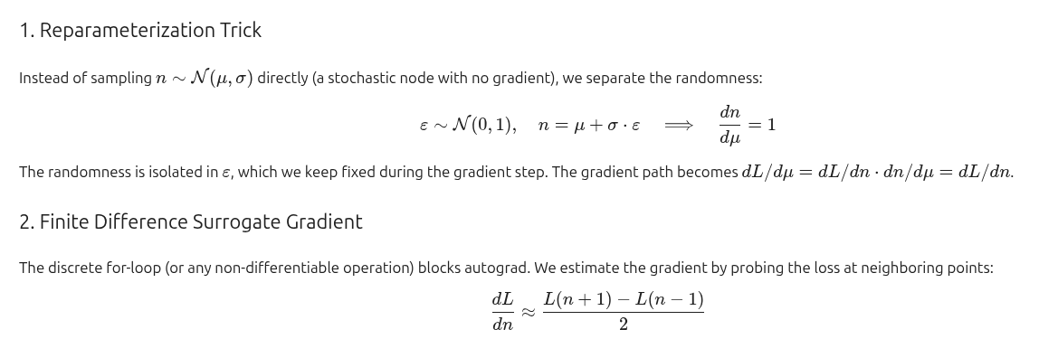
For n
I created a simple program that samples n from a N(n, sigma) distribution,
uses that sample to run a for loop that adds +1 to a prediction at each iteration,
and then compares the prediction against a target.
sample = normal(mean=n, std=sigma)
pred = 0
for i in range(round(sample)):
pred = pred + 1
loss = (pred - target)^2
# backprop loss -> optimize n

Slide 4
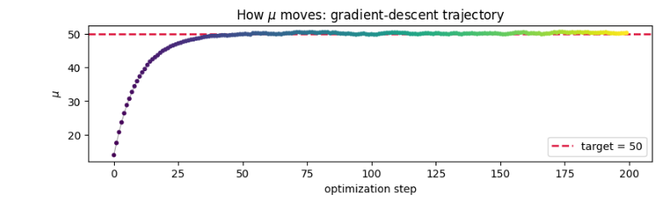
For n — Results

Slide 5
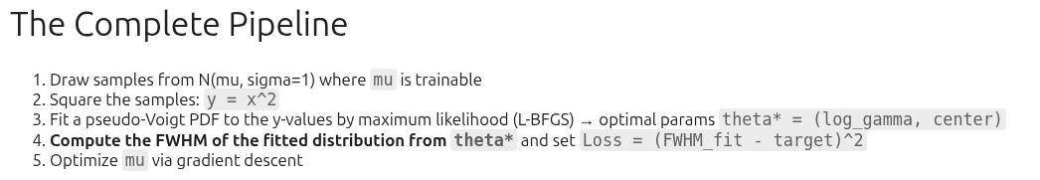
For sigma

Slide 6
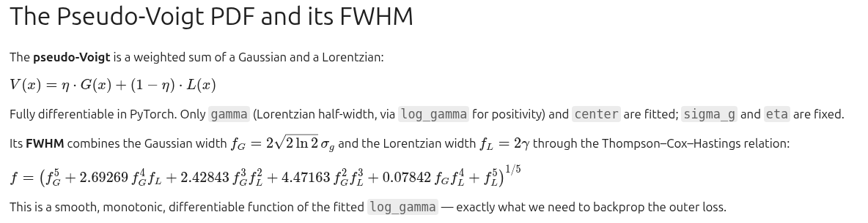
For sigma

Slide 7
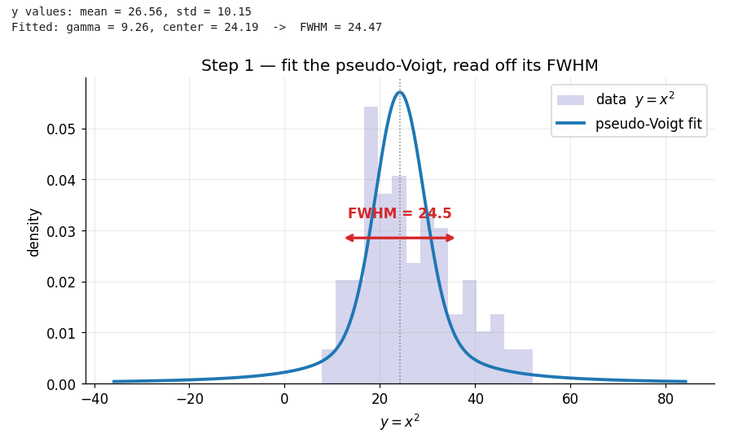
For sigma

Slide 8
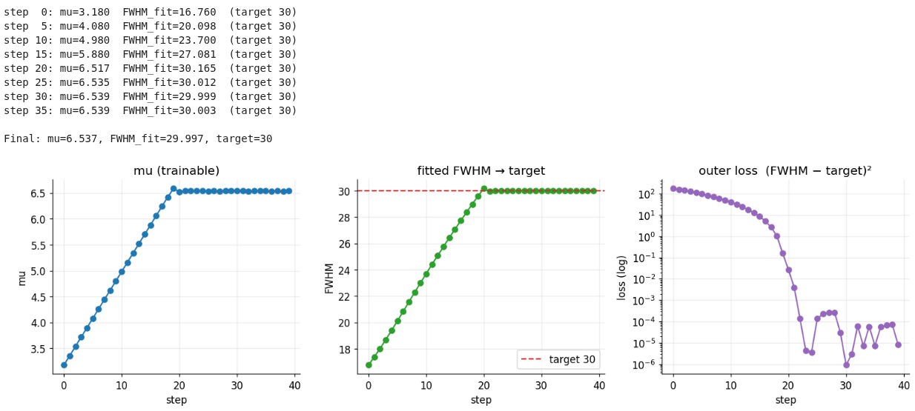
For sigma

Slide 9
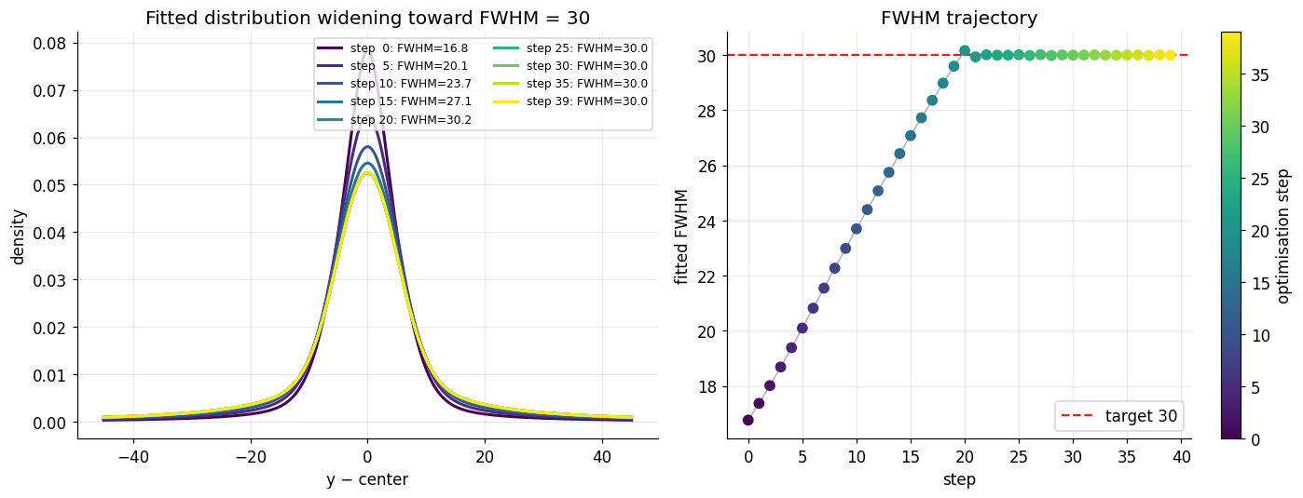
For sigma

Slide 10
EDA

Slide 11
Data Description
Once I had the data, I began analyzing it.
I built a single DataFrame with all experiments: 2 lasers (1 nW and 3 nW),
each measured across transmissions of [5, 10, 20, 40, 60, 80, 100].

Slide 12
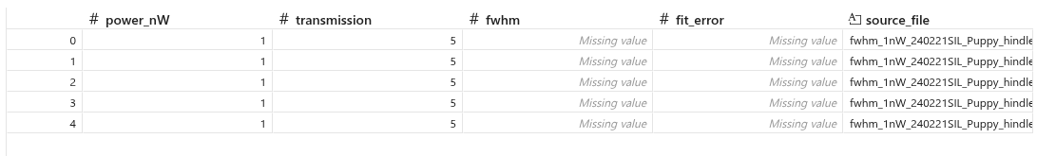
Experimental data overview

Slide 13
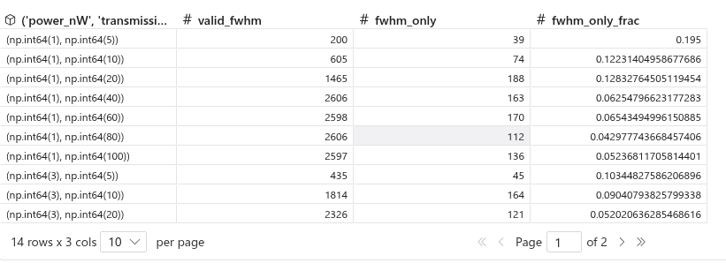
Experimental data overview (2)

Slide 14
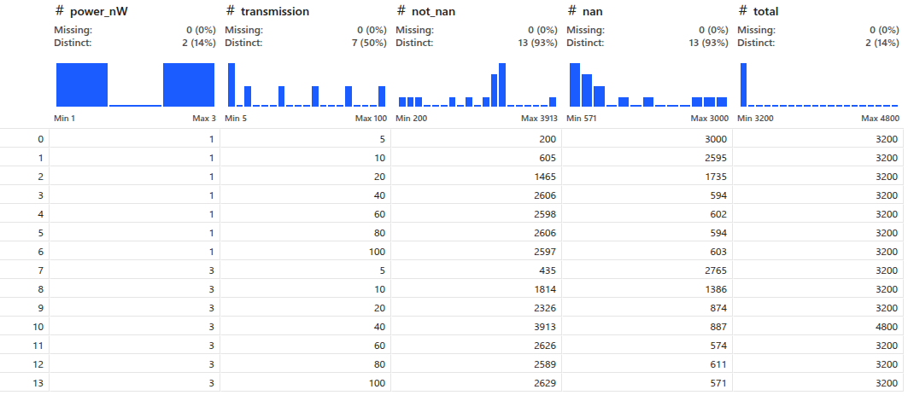
Amount of runs per PLE (with failed fwhm)

Slide 15
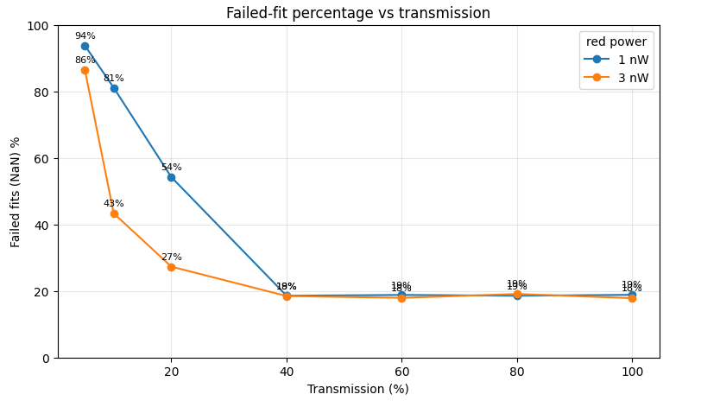
Success rate vs. transmission
Higher transmission yields fewer NaN values (failed fits) in both cases.

Slide 16
FWHM distribution per experiment

Slide 17
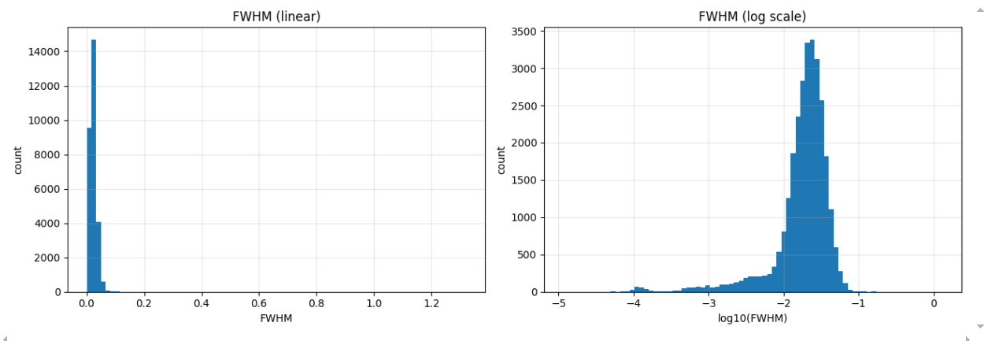
Using log scale

Slide 18
The FWHM values are widely spread, so log scaling is appropriate.

Slide 19
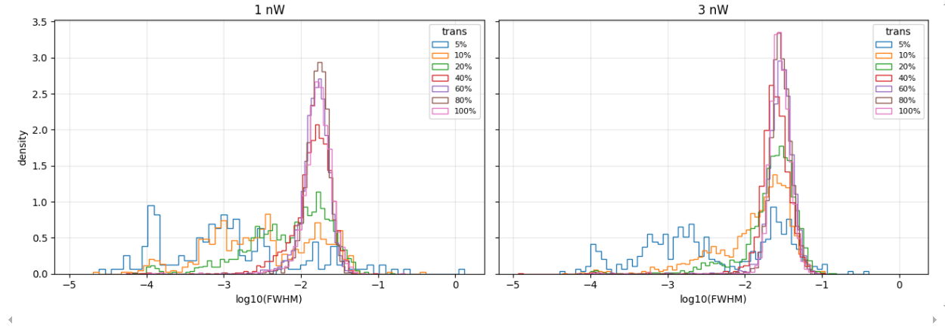
Distributions — High transmission gives clean FWHM

Slide 20
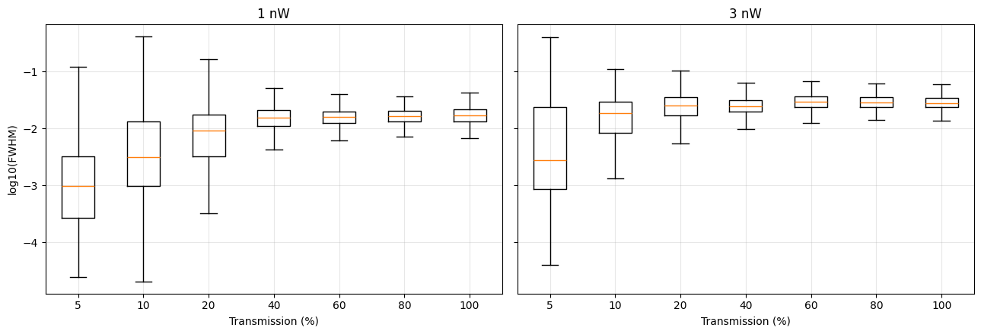
Distributions (2)

Slide 21
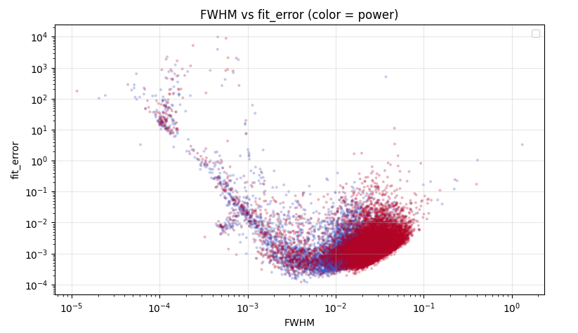
FWHM vs. fit error
The smaller the FWHM, the higher the fit error —
this is especially pronounced for the extremely small values.

Slide 22
Good news!
Key finding: the FWHM are continuous values, not binned as we had assumed.
This simplifies the final loss significantly.

Slide 23
MMD²

Slide 24
What is MMD²?
I found a loss function that compares two lists of samples and tested whether it optimizes on real data,
using (df["transmission"] == 60) & (df["power_nW"] == 3).
MMD² (Maximum Mean Discrepancy) measures how different two sets of samples are,
without needing to know their underlying distributions.
It maps the samples into a feature space via a kernel (here a Gaussian/RBF kernel)
and compares their mean embeddings:
MMD²(X, Y) = mean(k(x, x')) + mean(k(y, y')) - 2 * mean(k(x, y))
It is 0 when the two sample sets come from the same distribution and grows as they diverge.
Because it is built from a smooth kernel, it is differentiable —
which is exactly what we need to backpropagate through and optimize.

Slide 25
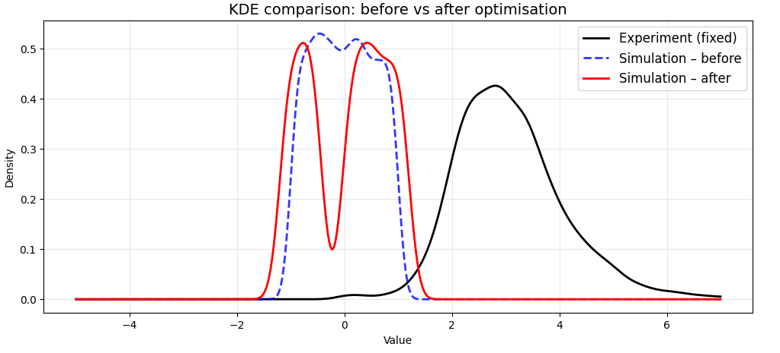
Development plot for test

Slide 26
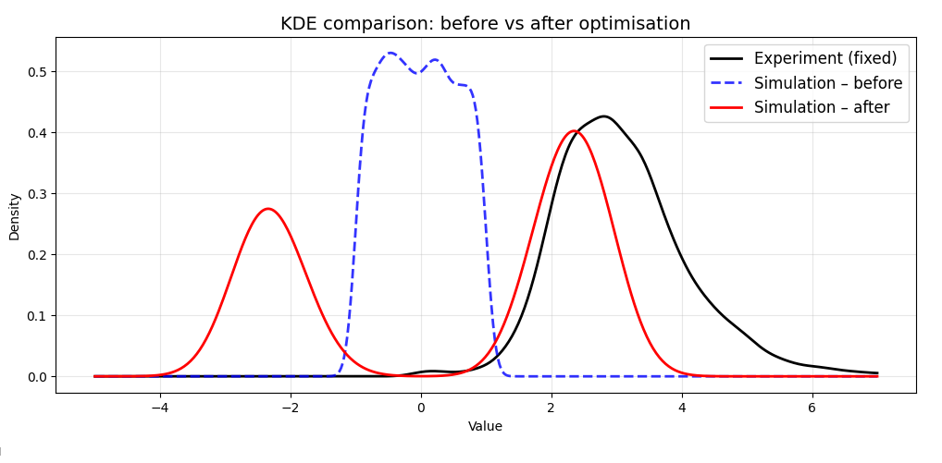

Slide 27
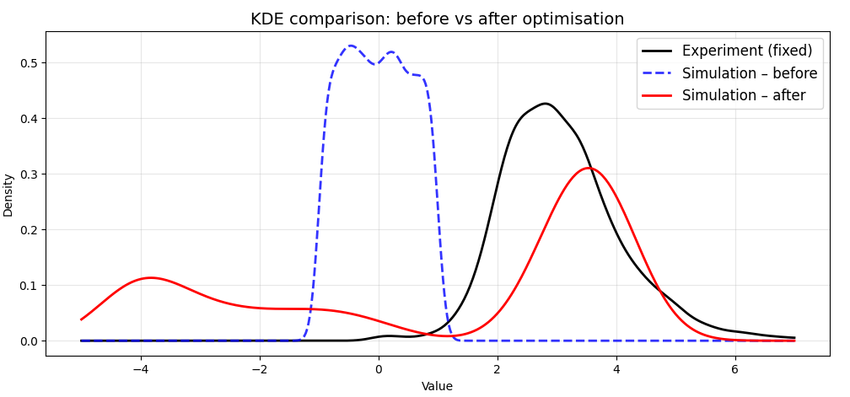

Slide 28
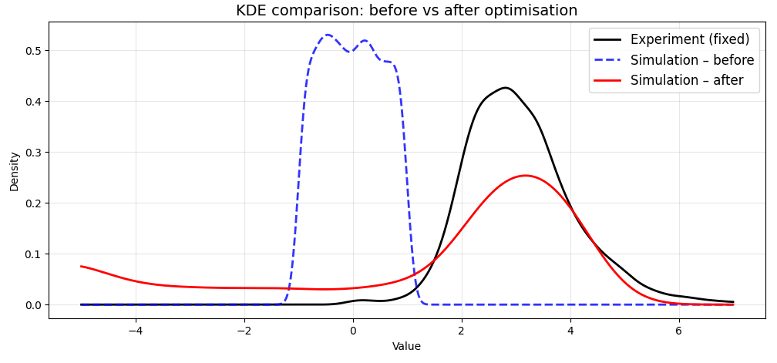

Slide 29
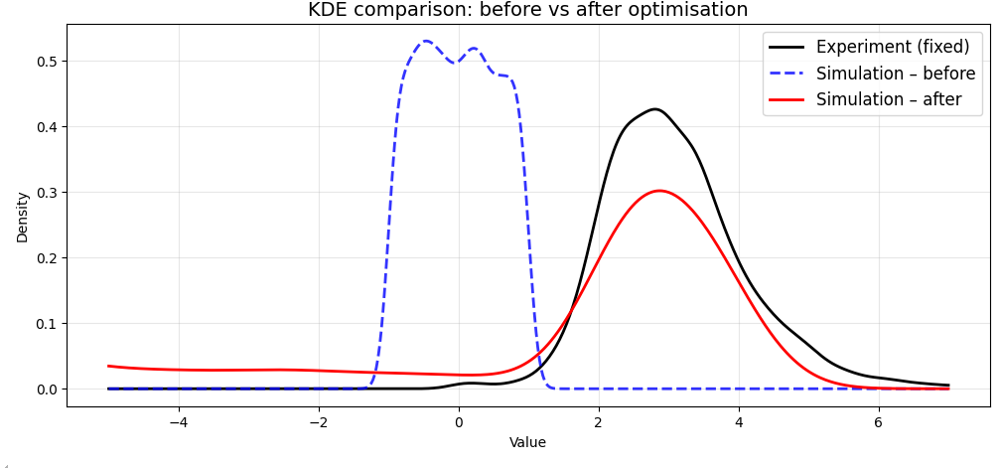

Slide 30
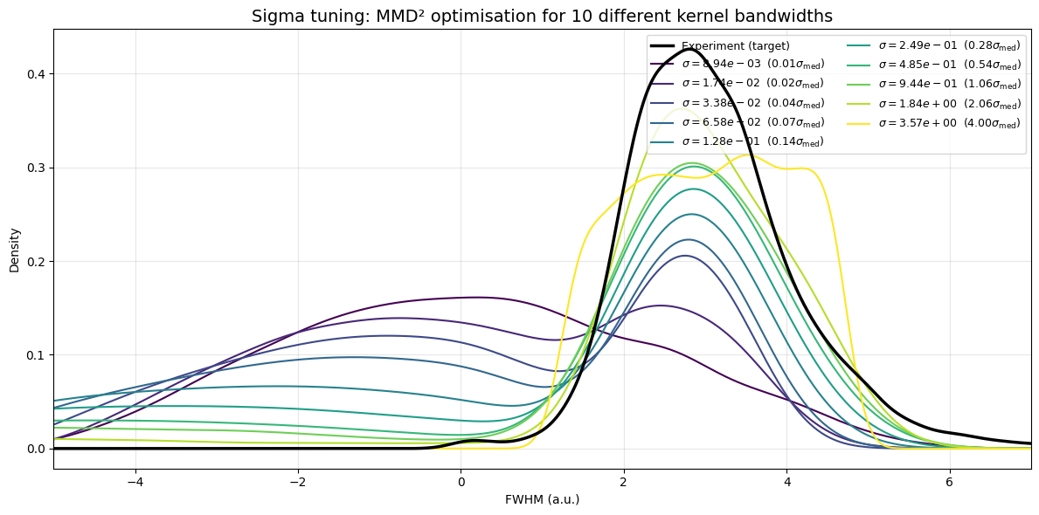
Sigma tuning
The choice of sigma in the loss affects the result.
This warrants further experimentation.

Slide 31
Conclusion
It works: dLoss/dFWHM is computed.
The next step is dFWHM / dfrequencies.

Slide 32
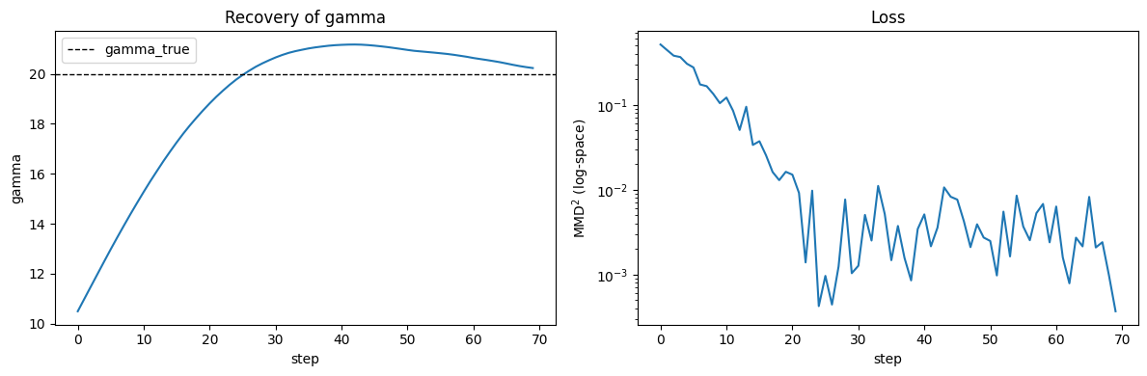
Gamma differentiable
We test it by creating a true gamma distribution
and building the MMD² loss from it.

