Slide 1
QUORA QUESTION PAIRS

Slide 2
Introduction
The goal is to predict which of the provided question pairs contain two questions with the same meaning.
Data fields include:
id - the id of a training set question pair
qid1, qid2 - unique ids of each question (only available in train.csv)
question1, question2 - the full text of each question
is_duplicate - the target variable, set to 1 if question1 and question2 have essentially the same meaning, and 0 otherwise.

Slide 3
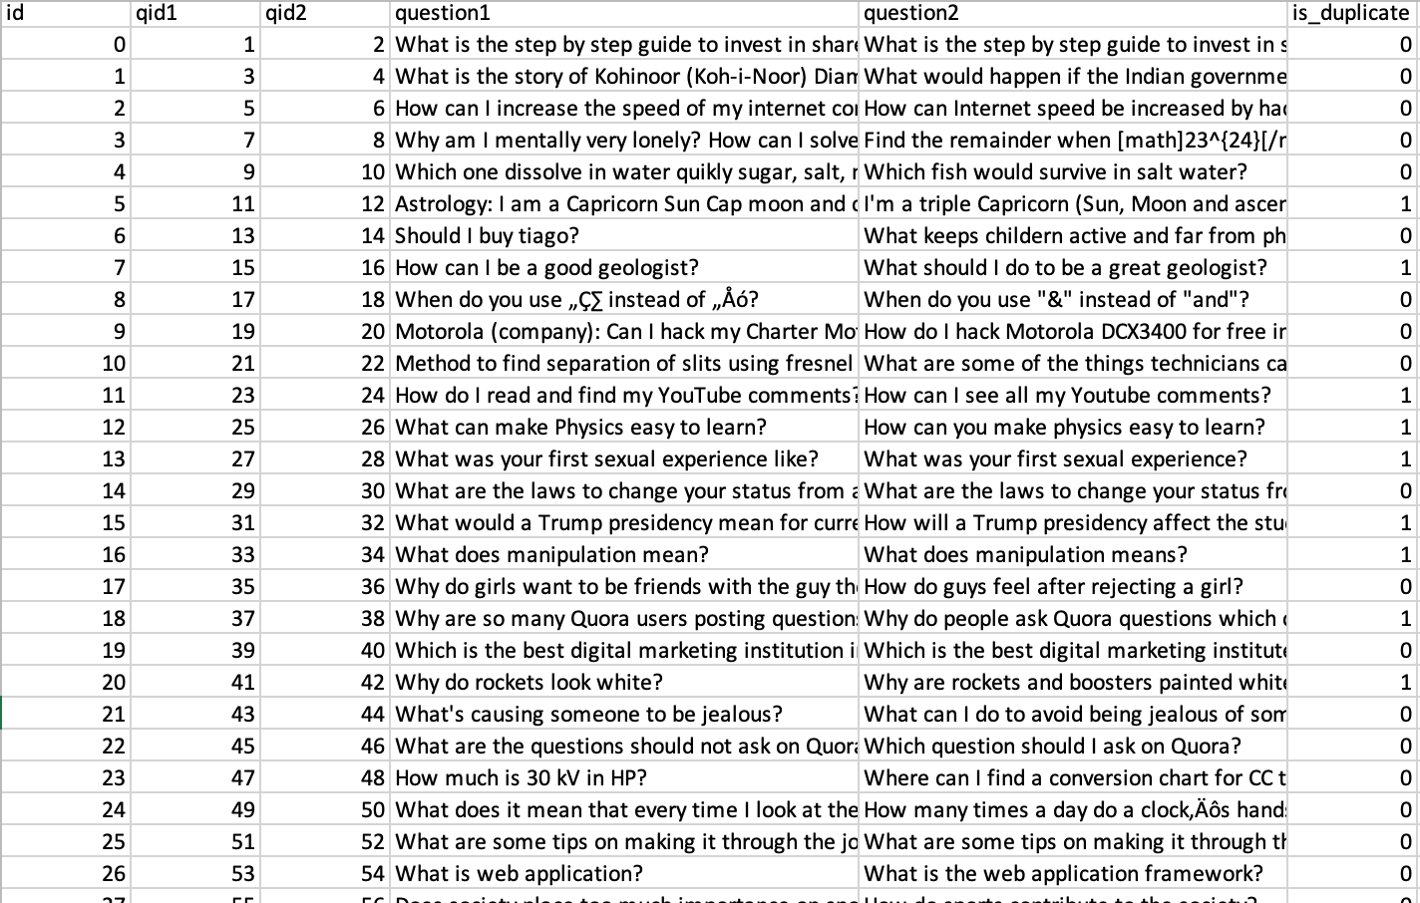
LOOK OF DATASET

Slide 4
Approach
Data Cleaning:
As the data is in text format and gathered by the responses from the users on quora, we can expect a lot of noise in the data, so the first problem is to cleanse the data.
We are using techniques like stemming, stop word removal, spell checking, lemmatization for basic processing of the text.

Slide 5
Data Processing
After cleaning the data the questions are processed into vectors so that we can fit the data into the machine learning model.
The data is processed using word2vec, glove methods to reduce the dimensionality of the data.
The data is processed as question pair TF-IDF encodings

Slide 6
Feature engineering
Some manual feature engineering is done like counting the number of important words in the question, ngrams and their embedding in lower dimensional spaces.

Slide 7
Modelling
LOGISTIC REGRESSION
XGBOOST
RANDOM FOREST
GRADIENT LINEAR MODEL
NAIVE BAYES

Slide 8
Evaluation
Evaluation is done using area under ROC curve.

Slide 9
THANK YOU !!

