Slide 1
E-Appliances Diagnosis and
Service Booking

Slide 2
Abstract
Every hardware is prone to some sort of malfunction in accordance with their usage over time. Hence its necessitates the need for a software the help you identify and fix those failures thus aiming to reduce the mean time between failures.
Existing system:
The current software in market that meet this purpose helps one to register with their professional service team and get your service done leaving you no choice to choose the type or the range of service you wish to have.
Proposed system:
The software to be developed aims at solving this issue where the customer having identified the device and inputted the likely symptoms during a failure is given an idea about what might likely be the issue with their systems and help them choose a service centre within their scope n budget.
Advantages of proposed system:
• Helps in diagnosing about what is likely to be the issue.
• Help choose the service on basis of your budget/locality.

Slide 3
Users Of System
Admin: a group of people involved in site maintenance,having overall control over the software. Responsibilities include adding more technician,updating service centers.
Technician: who responsible for responding to user complaints. Helps customer to have better understanding on what likely is to be there problem.
Customers: who are people accessing the site to avail its services such failure diagnostic or service center booking.

Slide 4
Table design

Slide 5
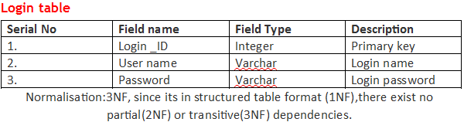
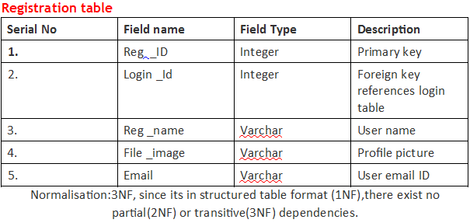

Slide 6
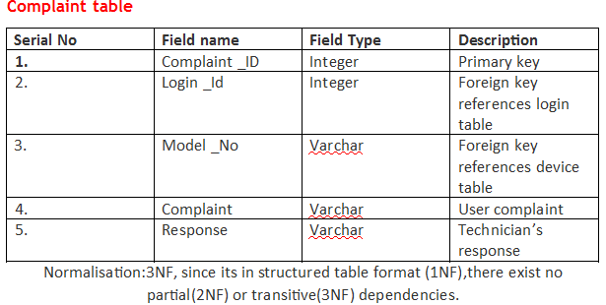
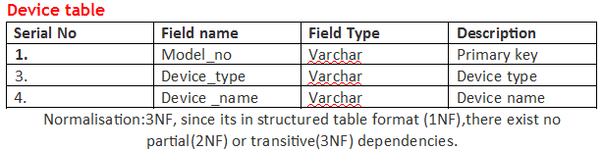

Slide 7
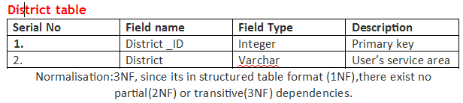
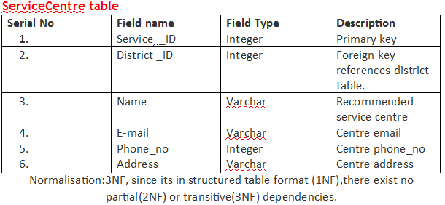

Slide 8
User Interface of E-Doc system

Slide 9
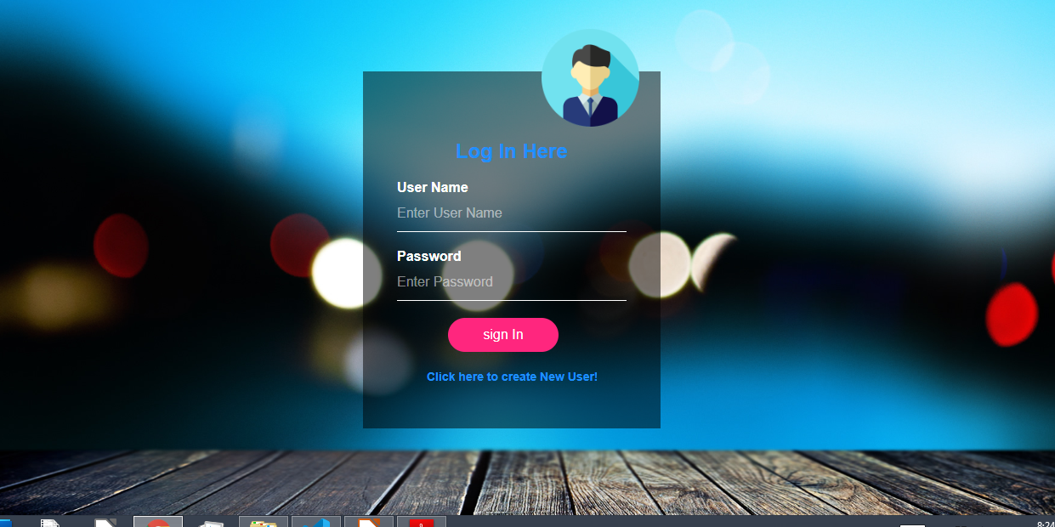
Login portal : Sign module

Slide 10
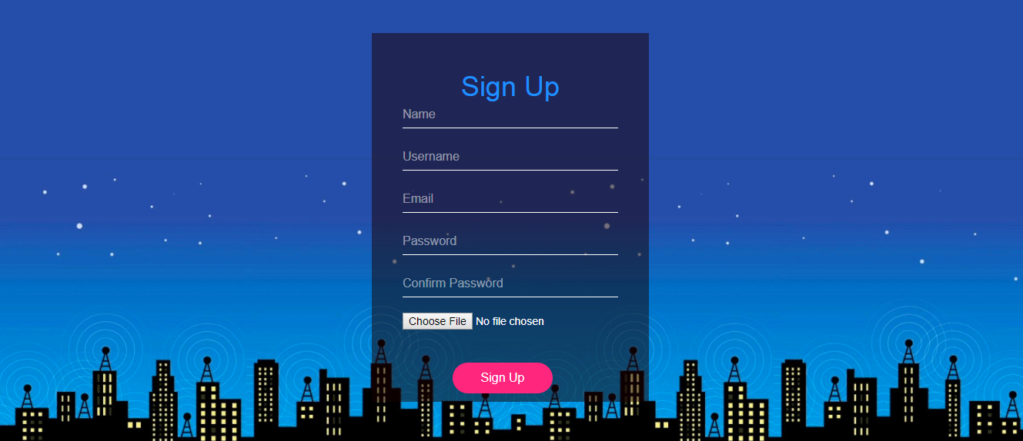
Register portal: Sign up module

Slide 11
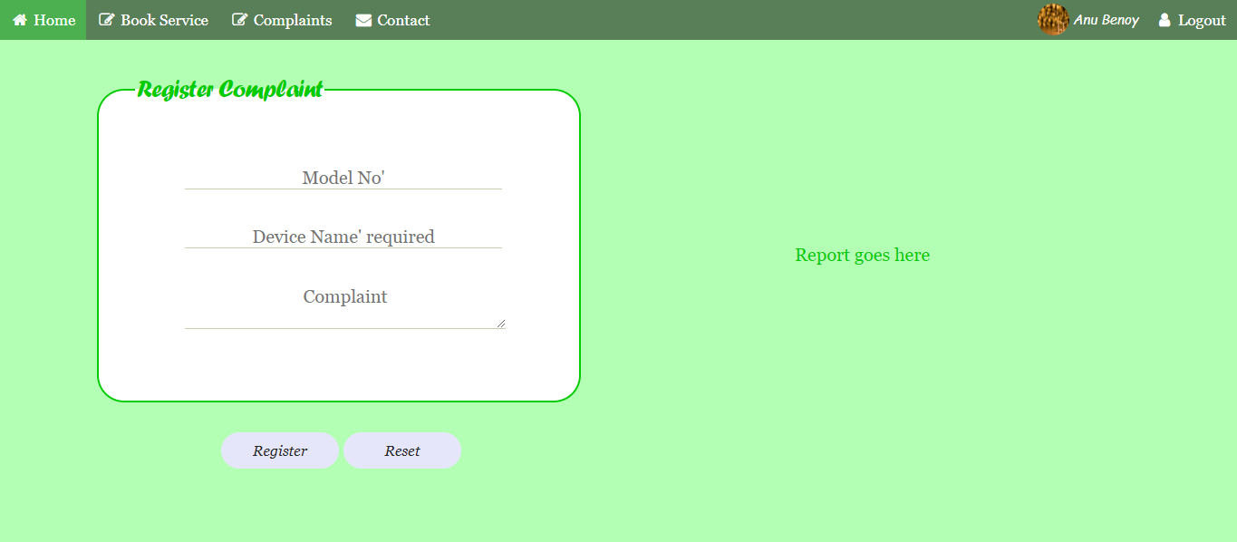
Customer portal: Complaint module

Slide 12
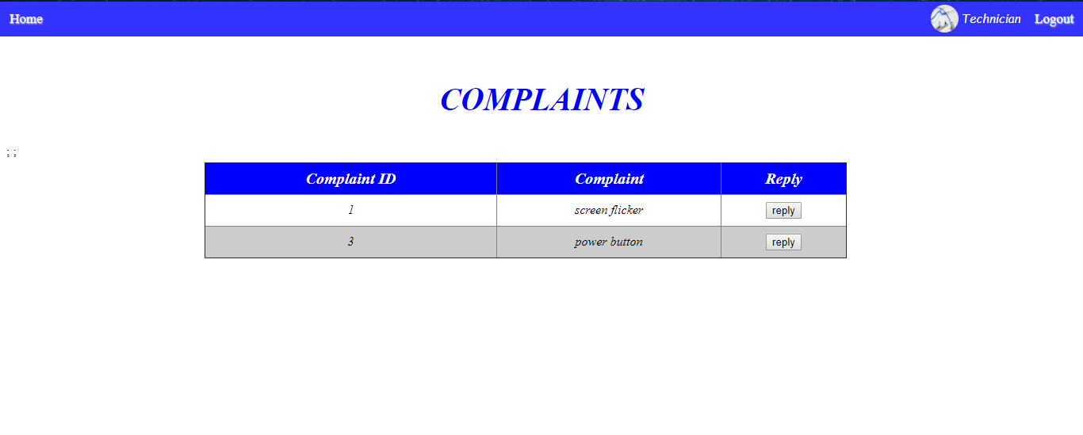
Technician portal: Response module

Slide 13
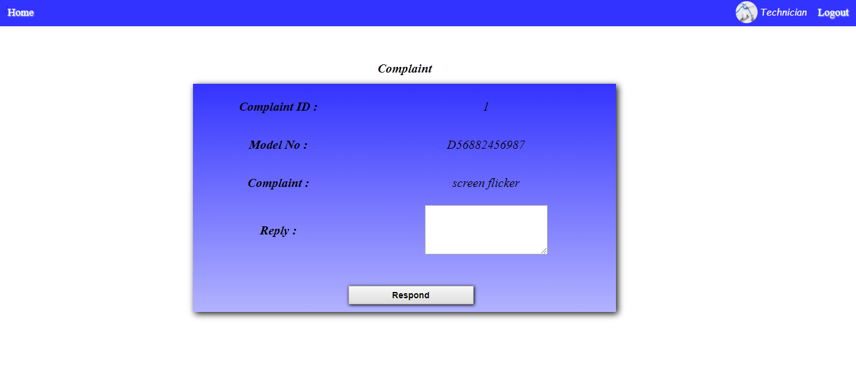
Technician portal: Reply module

Slide 14
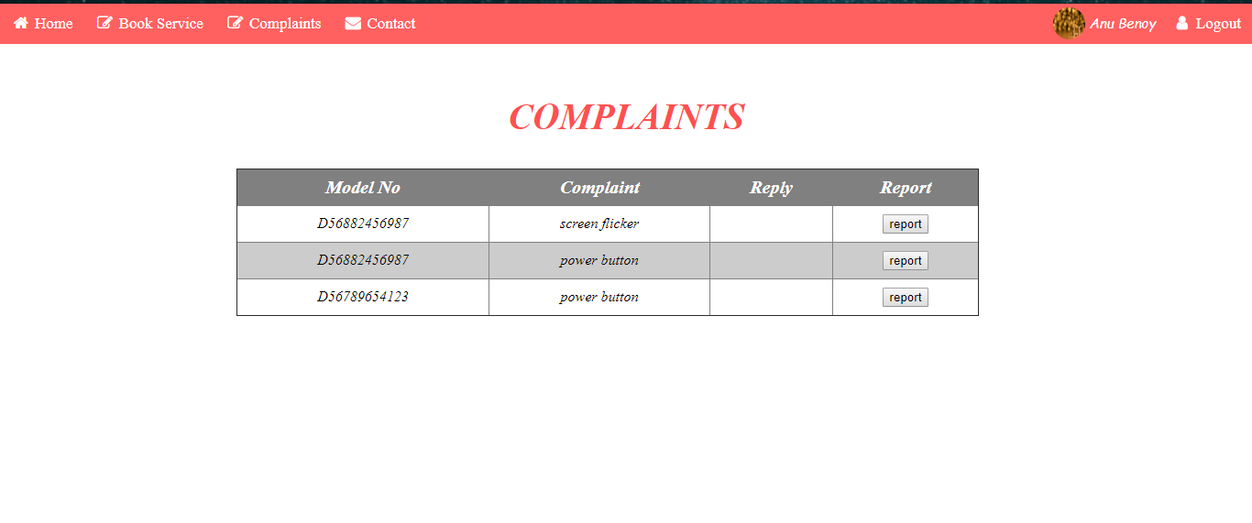
Customer portal: Complaints view module

Slide 15
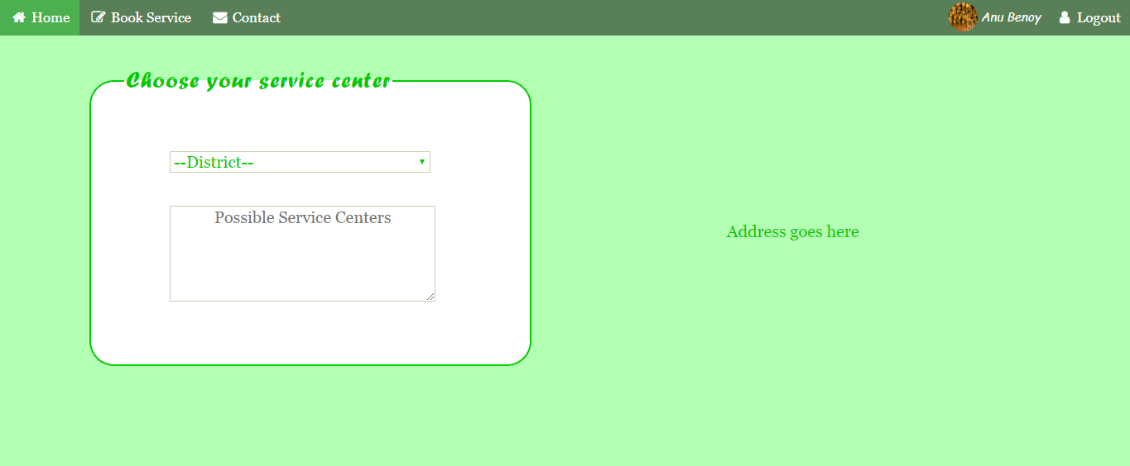
Later phase implementations: Service module

