Slide 1

MEDISHOP PHARMACY WORKSPACE
A clearer way to run your pharmacy
Medicine stock, supplier purchases, counter billing, and everyday shop records brought into one steady system.
Catalogue
Purchases
Counter Bill
Shop Ledgers
Independent retail pharmacy walkthrough · Practical operations overview
Notes:
Good morning. Running an independent pharmacy means juggling stock deliveries, customer rush hours, and supplier credit every single day. Today I want to show you MediShop, a single workspace designed specifically for counter operations. Say aloud: 'Think of MediShop as a tidy counter register that connects what you buy from distributors directly to what you hand over to the patient, without notebook scramble.'

Slide 2
DAILY PHARMACY ROUTINE
A shop runs on many connected tasks
When stock entry, billing counters, and customer ledgers sit in separate notebooks or point software, tracing what happened last week becomes heavy work.
Supplier delivery
Counter inquiry
Return or review
Distributor drops cartons with invoice and batch details
Locate exact strip on shelf and check live quantity
Handle strip exchange and check day-end register balance
Stock entry
Bill and pay
Record batch number, expiry date, purchase rate, and MRP
Apply customer payment by cash, UPI, card, or store credit
A common workflow topic: Disconnected records do not mean a shop is mismanaged; it simply means staff spend valuable counter time cross-checking notebooks instead of serving patients.
Notes:
Every chemist recognizes this flow. Stock arrives at 11 AM, customers crowd the counter by 6 PM, and reconciliations happen after closing. Say aloud: 'When these five steps live in different places—one notebook for purchases, a rough pad for customer credit, and mental memory for shelf stock—it is easy to lose track of what sold and what expired.'

Slide 3
SYSTEM ARCHITECTURE
One workspace for core pharmacy operations
MediShop joins each station so changes at the counter immediately update your records.
Inventory
Inward
Outward
Medicines and batches
Suppliers and purchases
Billing and returns
Brand names, salts, rack locations, batch codes, purchase rates, MRP, and expiry dates.
Distributor profiles, purchase bills, received quantities, and return-to-vendor records.
Counter invoices, split tenders, credit registers, return adjustments, and receipt prints.
Care
Insight
Control
Customers and doctors
Reports and exports
Staff roles and settings
Patient purchase histories, credit ledgers, prescribing doctor records, and refill notes.
Daily sales summaries, expiring stock lists, movement ledgers, and clear CSV/PDF exports.
Role-based counter logins, discount limits, receipt printers, and shop configuration.
The true value is connecting daily shop transactions, not merely displaying an administrative dashboard.
Notes:
Walk through these six modules. Notice that every module feeds into the next: inward purchases feed batch stock, counter sales deduct stock, and daily receipts compile into day-end reports. Say aloud: 'We are not giving you fancy charts to stare at; we are connecting your counter billing directly to your back-room stock ledger.'

Slide 4
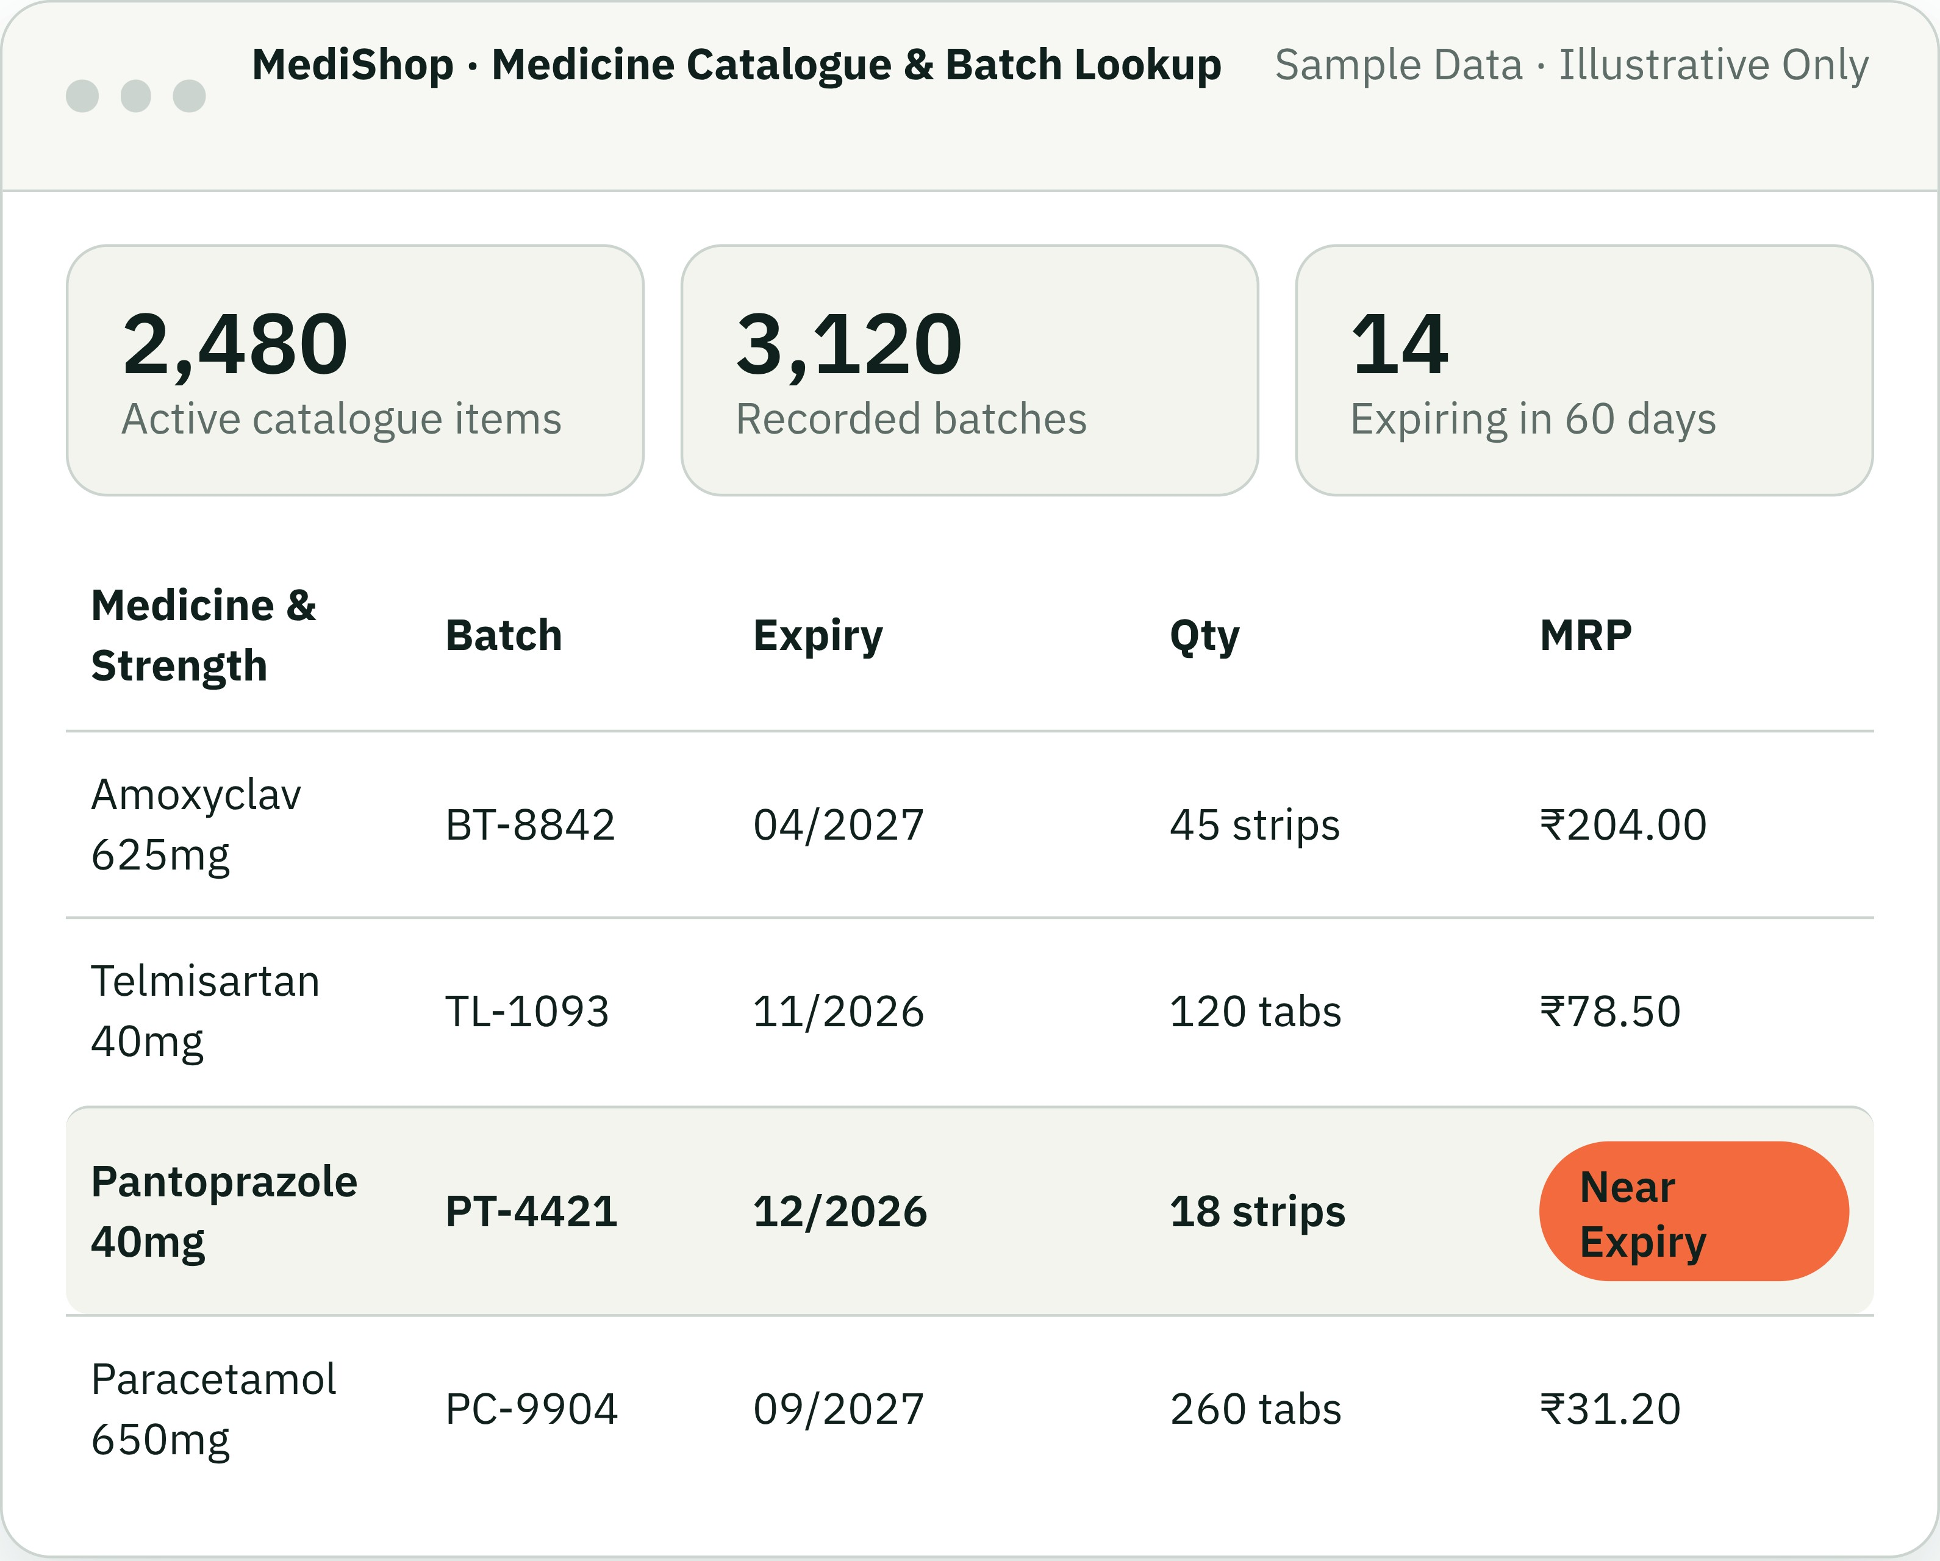
CATALOGUE AND INVENTORY
Start with a useful medicine catalogue
Quick lookup at the counter depends on clean master items, while billable stock stays organised by batch, cost, and expiry.
Master list vs. batch stock
Importing your catalogue creates searchable medicine names; items only become billable when received via a purchase record.
Batch-level tracking
Each batch carries its own quantity, purchase cost, selling price (MRP), and expiry month.
Add medicine records or import a catalogue from a spreadsheet during setup.
Notes:
Explain catalogue import versus stock entry. Chemist owners often ask: 'Can you import my entire medicine list?' Say aloud: 'Yes, we can import your product master from an Excel sheet so you don’t have to type 2,000 medicine names by hand. But remember, importing names does not put stock on your shelf—stock is created when you enter the batch number, purchase cost, and expiry from a supplier invoice.'

Slide 5
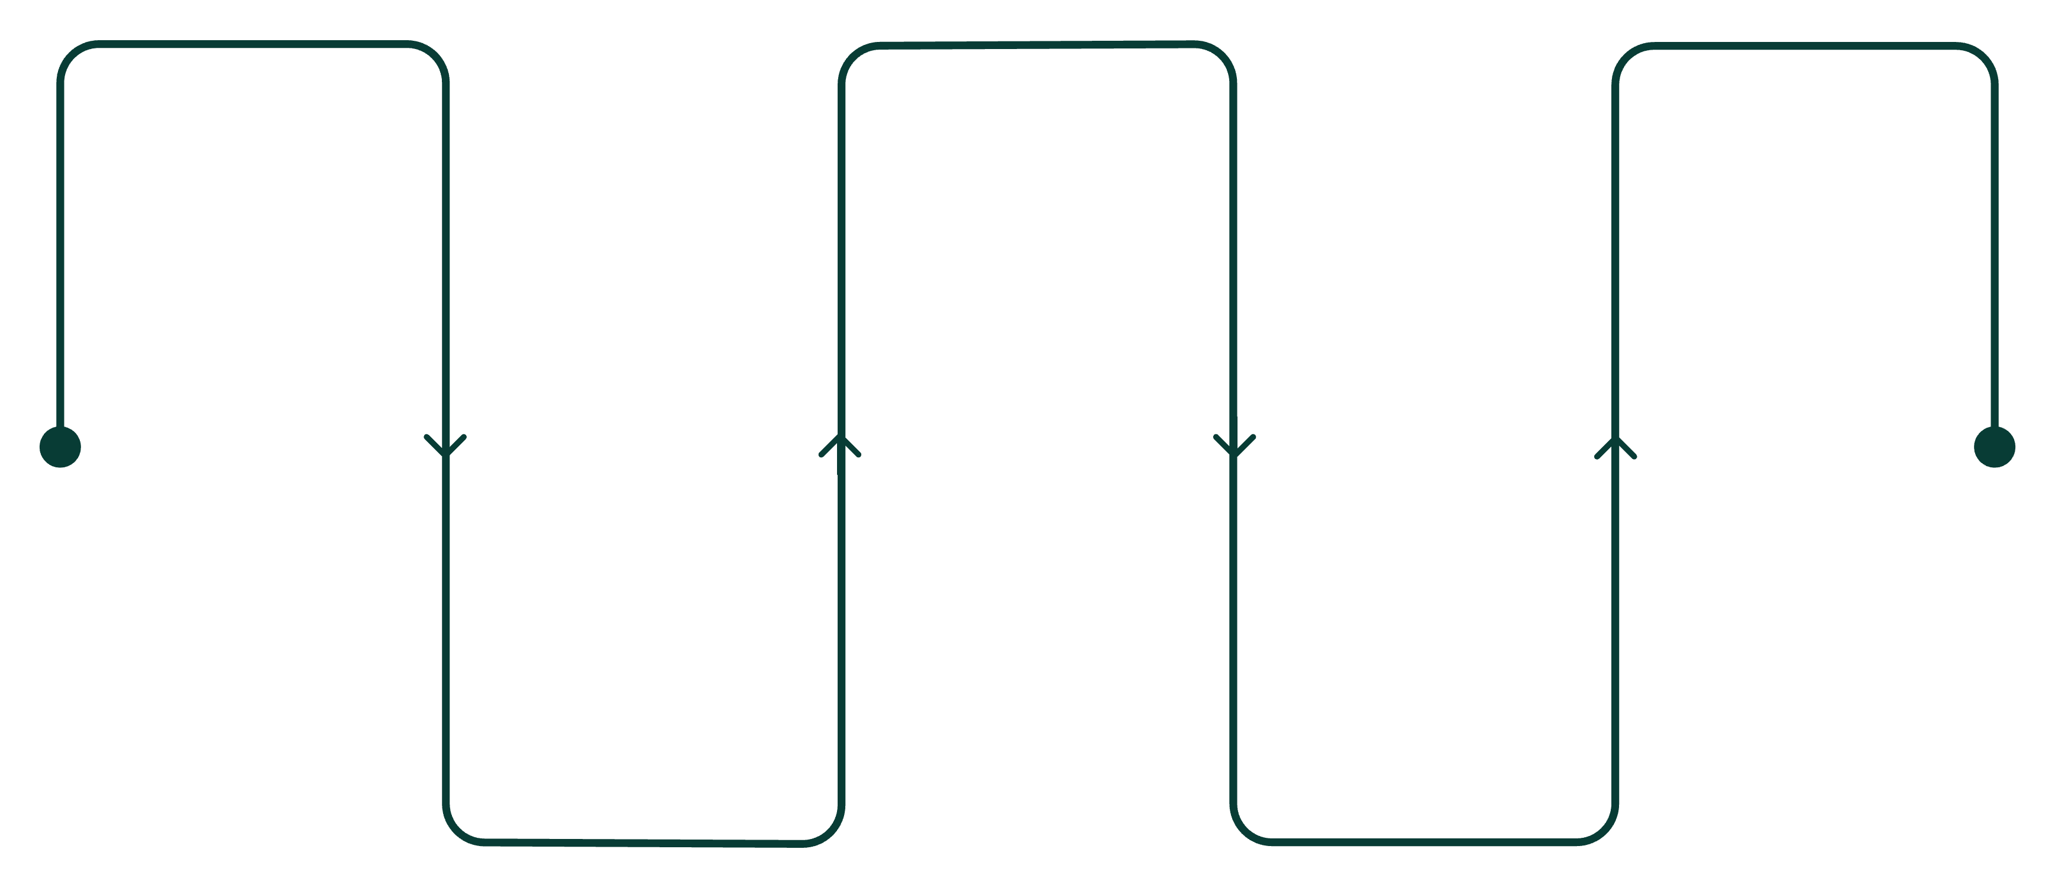
STOCK LIFECYCLE
Follow stock from purchase to sale
MediShop records the chronological trail of medicines entering and leaving your shop, based entirely on entries made by staff.
1. Supplier
3. Batch record
5. Sale or movement
Distributor invoice arrives at shop
Expiry and cost recorded
Bill or return logged in ledger
2. Purchase entry
4. Available stock
Staff logs quantity and batch
Medicines billable at counter
Clarification on verification: Batch records reflect the supplier details and dates recorded by your team. The system records your workflow; it does not physically count cartons or verify third-party supplier papers independently.
Notes:
Walk this road from step 1 to 5. Emphasize that software cannot physically weigh or count strips on the shelf; it relies on accurate inwards entry. Say aloud: 'When a customer comes back asking when a batch was purchased, you don’t have to search through cartons in the store room. You open the medicine history and see the supplier invoice date right away.'

Slide 6
BILLING COUNTER
A counter-focused billing workflow
Designed for rapid typing during evening peak hours, with clear batch selection and flexible payment modes.
01
02
03
04
Search item
Pick batch
Customer & payment
Save & receipt
Find by brand, salt name or barcode at the counter.
Choose available stock and quantity; see MRP and expiry.
Save the bill and print or save an 80 mm receipt or A4/PDF invoice.
Select a customer if needed. Choose cash, UPI, card, split payments or credit.
Ready to print
Hardware configuration: Printer and paper settings are confirmed with the shop during setup.
Notes:
Address printer compatibility and offline billing clearly. Owners often ask: ‘Will this work with my thermal receipt printer, and what happens if internet goes down?’ Say aloud: ‘We can confirm your printer and paper settings during setup before going live. If internet drops, only limited cash walk-in billing can continue provisionally until the connection resumes and syncs; other screens may not be available.’

Slide 7
PAYMENTS & SETTLEMENTS
Returns and payment records
MediShop supports returns and records payment information, including split payments and credit workflows.
1
2
3
4
Sale
Payment record
Return / adjustment
Updated shop records
Split payments
Credit workflows
Record part cash and part UPI on a single bill.
Record customer credit and payment information.
See the actual return flow in a guided demo.
Notes:
For example, a customer may return a medicine after paying partly in cash and partly by UPI. We can walk through the actual return and payment-record flow together in a guided demo. MediShop records shop activity; it does not replace an accountant or file tax returns.

Slide 8
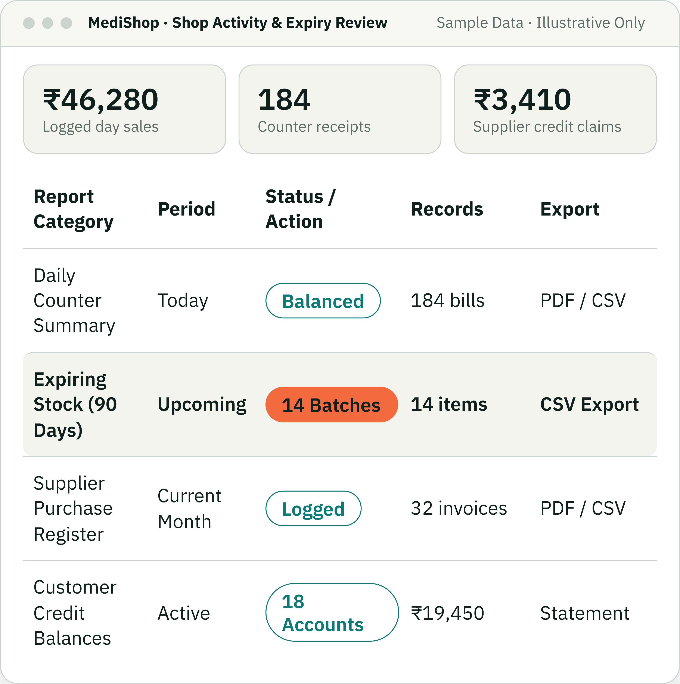
RECORDED ACTIVITY & AUDIT
Keep an eye on stock, expiry and shop activity
MediShop reports your recorded transactions to help you make decisions about your counter.
Stock & expiry reviews
Review medicines reaching expiry in 30, 60, or 90 days to arrange supplier return credits.
Sales & export ledgers
Export day-end registers to PDF or CSV for your records or accountant review.
Reports reflect recorded entries. System does not make automated profit guarantees or speculative forecasts.
Notes:
Be very careful with report promises. Chemist owners sometimes hope software will automatically predict future orders or guarantee zero stock loss. Say aloud: 'MediShop gives you clean, honest visibility over what actually happened—how much cash was collected today, which medicines will expire next month, and what distributors owe you credit for. We do not make automated reordering promises; the buying decisions always stay in your experienced hands.'

Slide 9



PATIENT & PRESCRIBER RELATIONS
Customer, doctor and follow-up tools
Keep customer and doctor records connected to practical, staff-managed follow-up tools.
Customer records
Doctor records
Message templates
Keep customer records and prepare announcements, with consent checks for applicable communications.
Maintain doctor records and support appointment-related workflows.
Reusable templates include customer name, shop, date, time and amount.
Staff-managed messaging: Staff prepare and send WhatsApp and email messages manually. SMS is optional and requires provider setup and approval.
Notes:
Clarify messaging workflows. Say aloud: 'For example, staff can prepare a message when a medicine arrives, check consent where applicable, and send it manually by WhatsApp or email. SMS is optional and needs provider setup and approval.'

Slide 10

GOVERNANCE & SECURITY
Prescription handling and staff access
Review: Counter staff can upload prescription copies for pharmacist review. Prescription-only items need an approved prescription linked to the selected customer; Schedule H and H1 medicines can be configured to require one before billing.
Access: Authorised roles control access. Cashiers can bill; only the shop owner or registered pharmacist can modify purchase bills, issue manual discounts or inspect margins.
History: Uploads and reviews, prescription approvals, bill deletions and stock adjustments are recorded in an audit history with staff username and timestamp.
A workflow capability, not a legal or regulatory certification. Routine local backups remain the shop owner's responsibility.
Notes:
Conclude with trust, compliance boundaries, and rollout. Say aloud: 'This feature helps your counter follow proper prescription protocol, but remember it is a workflow tool, not an automatic legal guarantee. When rolling out MediShop, we start with a supervised practice mode for 2 to 3 days so your boys behind the counter get completely comfortable before you rely on it live.'

Slide 11
MORE WAYS TO SUPPORT THE SHOP
More than stock and billing
Additional workflows help the shop manage day-to-day service and operations in one place.
Printed-text capture
Branch coordination
Customer retention
Bookings and delivery
Local OCR can extract printed text. Staff must review and confirm the result before using it.
Branch support includes stock transfers, with records for movement between locations.
Loyalty tools can help staff record customer rewards as part of the shop workflow.
Booking and delivery-tracking workflows support customer requests beyond the counter.
For the demo
Choose one workflow your shop actually uses. We can walk through its steps and confirm what configuration it needs.
Notes:
This slide shows that MediShop goes beyond the bill screen. Demonstrate only the workflows relevant to this shop. OCR is local and requires staff confirmation. Branch, loyalty, booking and delivery workflows should be shown in the configured environment and matched to the shop’s process.

Slide 12
CONTINUITY AND TRAINING
A practical way to prepare for interruptions
MediShop includes a limited offline billing workflow and an isolated practice mode for learning the system.
Limited offline billing
Practice before live work
Cash walk-in sales can be recorded from stock reserved on that device. The receipt is provisional; the final invoice is allocated after the device reconnects and synchronises.
Use practice mode to familiarise staff with common screens and steps before handling real shop records. Agree who will train, what will be practised and how the shop will switch to live use.
Offline mode does not cover every screen or every transaction type.
Notes:
Be precise about offline use. It supports cash walk-in sales of reserved non-prescription stock on that device. It is not full offline access. Explain that the receipt is provisional until synchronisation. Practice mode uses isolated data and is intended for training.

Slide 13
A GUIDED START
Set up MediShop around your shop
A clear onboarding sequence helps the owner and staff move from shop details to a tested counter workflow.
1
2
3
4
5
Shop profile
Medicine list
Suppliers and stock
Staff and devices
Practice and review
Enter shop details and operating preferences.
Add records or import a catalogue.
Add suppliers, record purchases and batches.
Set access roles and review printer settings.
Walk through billing, reports and returns before live use.
Catalogue import alone creates medicine records; a purchase entry is needed to record billable stock.
Notes:
Describe onboarding as a joint setup process, not one-click migration. The setup guide walks through shop details, the first medicine, a supplier and opening stock, then billing. Catalogue imports create catalogue records, not physical stock. Confirm existing data format, cleanup, printer, permissions and training needs before agreeing the timeline.

Slide 14
BEFORE THE SHOP GOES LIVE
Confirm the details that matter to your counter
A short workflow review helps make sure the software fits the shop’s real devices, records and staff routines.
✓
Medicine data
✓
Printer and receipts
✓
Staff access
What list can be imported, and what needs cleanup?
Which printer, paper size and receipt layout will the shop use?
Who can bill, review prescriptions, adjust stock or view reports?
✓
Internet and offline
✓
Customer messages
✓
Backup and support
Which tasks must continue during an interruption?
Which channels are enabled, consented and staff-managed?
Who owns backup checks, training and day-to-day support?
Agree the setup and pilot plan before relying on the system for live pharmacy operations.
Notes:
Use this slide to build trust. Ask about devices, current records, connectivity, staff responsibilities, messaging providers, backups and training. Confirm each item in the actual deployment environment. The current project is not yet verified as deployed for this specific shop, so do not describe the preview as production-ready.

Slide 15
MEDISHOP · PHARMACY WORKSPACE
See how it fits
your pharmacy.
NEXT STEP
Book a guided demo
Bring one real workflow:
Start with your real counter workflow. We’ll walk through the steps, answer staff questions and agree what setup is needed.
• Add stock
• Make a sample bill
• Review a return or report
• Discuss setup, training and support
Discuss purchase and onboarding
Pricing and rollout plan to be confirmed for your shop.
MediShop
Notes:
Close by inviting the owner to a guided demo with one real shop workflow. Ask what they want to see first and who should attend. Discuss price, onboarding, support and rollout only using the actual commercial terms you can provide. Do not promise business results or imply the shop is live until deployment and shop-specific checks are complete.

