Slide 1
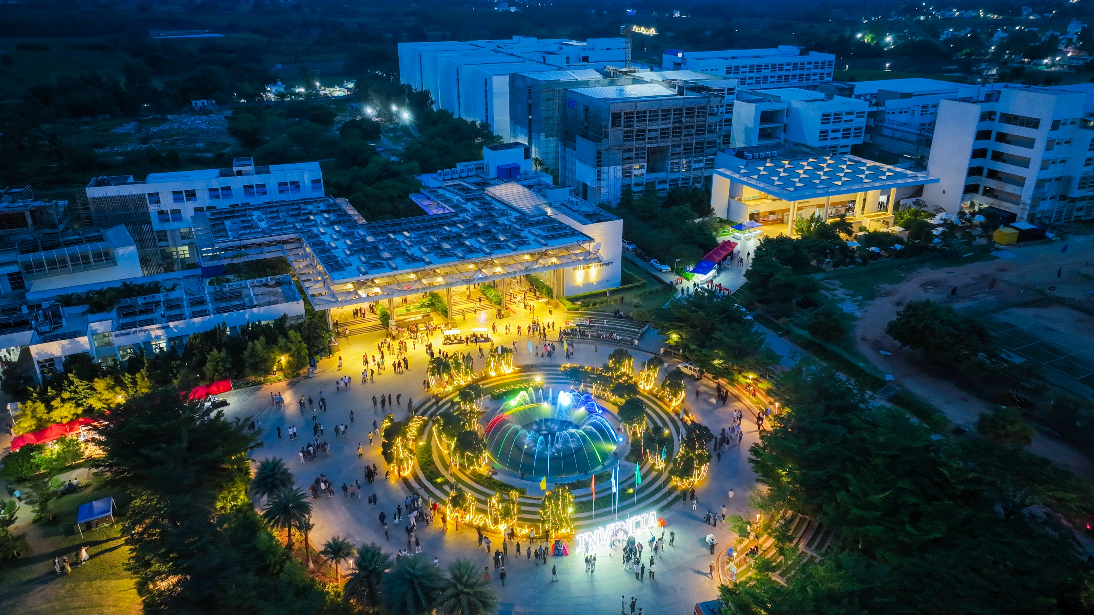

Presidency
Presidency
School of Artificial Intelligence and Advanced Computing

Slide 2
AI-Enabled Groundwater Level Prediction and Well Risk Assessment Using Climate Time-Series Data
CSS7102- Mini Project Review-1
Batch Number: [Enter Batch Number]
Under the Supervision of,
Mr. Muthuraj V
Assistant Professor
School of Computer Science and Engineering
Presidency University
Roll Number | Student Name
20231COM0043 | Anubhab Parashar
20231COM0088 | Aman Kundu
20231COM0082 | Avdhesh Ghansela
Name of the Program: [Enter Program Name]
Name of the HoD: [Enter HoD Name]
Name of the Program Project Coordinator: Mr. Muthuraju V
Name of the School Project Coordinators: Dr. Sampath A K

Slide 3
Content
Problem Statement
Github Link
Analysis of Problem Statement
Architecture Design
Literature Review
Expected Output
Timeline of the Project
References

Slide 4
Problem Statement
Problem Statement Number: PRJ-314
Organization: Presidency University (SDG 9 - Industry, Innovation and Infrastructure)
Category: Software
Problem Description: Design and develop a solution for AI-enabled water well predictor using modern technologies to improve performance, automation, security, scalability, and real-world usability.
Difficulty Level: Medium

Slide 5
Github Link
The Github link provided should have public access permission.
[Insert public GitHub repository link here]

Slide 6
Analysis of Problem Statement
Programming Language: Python 3.x
Data Handling: Pandas, NumPy
Machine Learning Models: Random Forest Regressor, XGBoost (scikit-learn, XGBoost library)
Model Evaluation: scikit-learn (R², RMSE, MAE)
Web Interface / Deployment: Streamlit
Data Visualization: Matplotlib, Seaborn
Dataset Source: Kaggle - India Groundwater Climate Time-Series (1994-2025)
Version Control: GitHub
Development Environment: Jupyter Notebook / Google Colab / VS Code

Slide 7
Analysis of Problem Statement (contd...)
Operating System: Windows / macOS / Linux (platform independent)
Programming Language: Python 3.8+
IDE: Jupyter Notebook, Google Colab, or VS Code
Libraries: Pandas, NumPy, scikit-learn, XGBoost, Matplotlib, Seaborn, Streamlit
Dataset Access: Kaggle account
Processor: Intel i3 or above
RAM: Minimum 4 GB (8 GB recommended)
Storage: At least 2 GB free space
GPU: Not required - tree-based models run efficiently on CPU
Special Hardware / IoT: None required - fully sensor-free, software-only solution

Slide 8
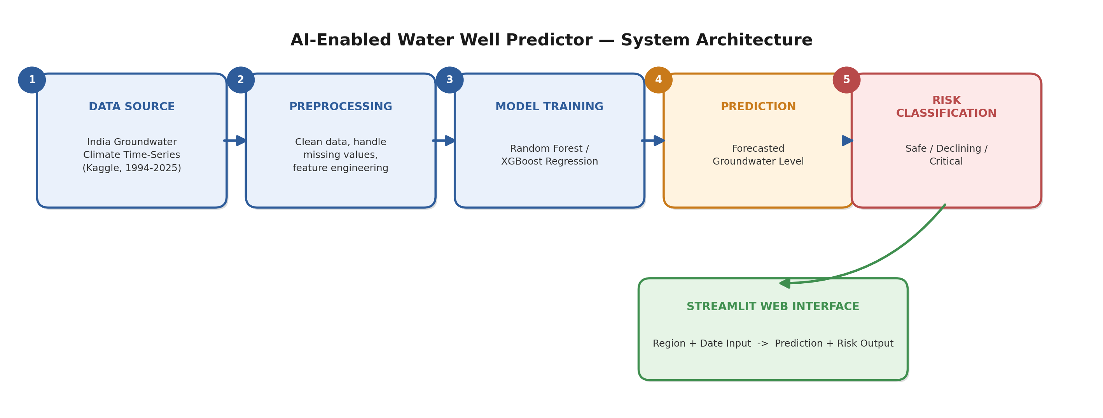
Architecture Design

Slide 9
Literature Review
# | Author(s) & Year | Method | Key Finding
1 | Rohde et al. (2021) Frontiers in Earth Science | Random Forest + satellite/climate data | 44% of GDEs declining; ML needs less calibration
2 | Davari et al. (2025) Scientific Reports | XGBoost vs RF vs SVM, 5 hydrogeological zones | XGBoost best: R²=0.848, RMSE=1.55m
3 | Jesse et al. (2025) Applied Computing & Geosciences | Systematic review of 223 papers (PRISMA) | RF/hybrid RF outperform ANN/SVM; ML models are “black-box”
4 | Sarkar et al. (2025) Hydrology Research | RF & Random Tree + field gravity data | Random Tree: R²=0.951 (single well, local scale)
5 | Pham et al. (2022) Neural Computing & Applications | 7 ML models compared, 36-year GWL dataset | Random Forest & Random Tree top performers

Slide 10
Literature Review (contd.)
# | Author(s) & Year | Method | Key Finding
6 | Chen et al. (2023) Water | LSTM + missing value imputation | Data quality > model choice; LSTM needs heavy compute
7 | Khan et al. (2023) Applied Sciences | Review: numerical vs ML vs DL models | ML/DL beat physics-based models; DL needs dense long time-series
8 | Thakur et al. (2025) J. of Hydroinformatics | Hybrid PCA-DWT-LSTM, 23-yr seasonal data | Hybrid improves noisy-input handling over plain LSTM
9 | Ali et al. (2024) Applied Comp. Intelligence | Review of 91 DL articles (RNN/LSTM/GRU) | Most DL models never reach real-world deployment
10 | Feng et al. (2024) Frontiers in Env. Science | 6 models compared (CNN, RNN, SVM, DT, RF, GAN) | No single model dominates; benchmark multiple is best practice

Slide 11
Expected Output
A predicted groundwater level (in meters) for the selected station and time period.
A model confidence indicator (prediction interval / error margin) based on validation performance.
Well-Risk Classification: Safe / Declining / Critical, for practical well-viability decisions.
Supporting visualizations: historical groundwater trend + feature-importance breakdown.
SDG 9 Alignment: a scalable, low-cost, sensor-free tool for groundwater management decisions.

Slide 12
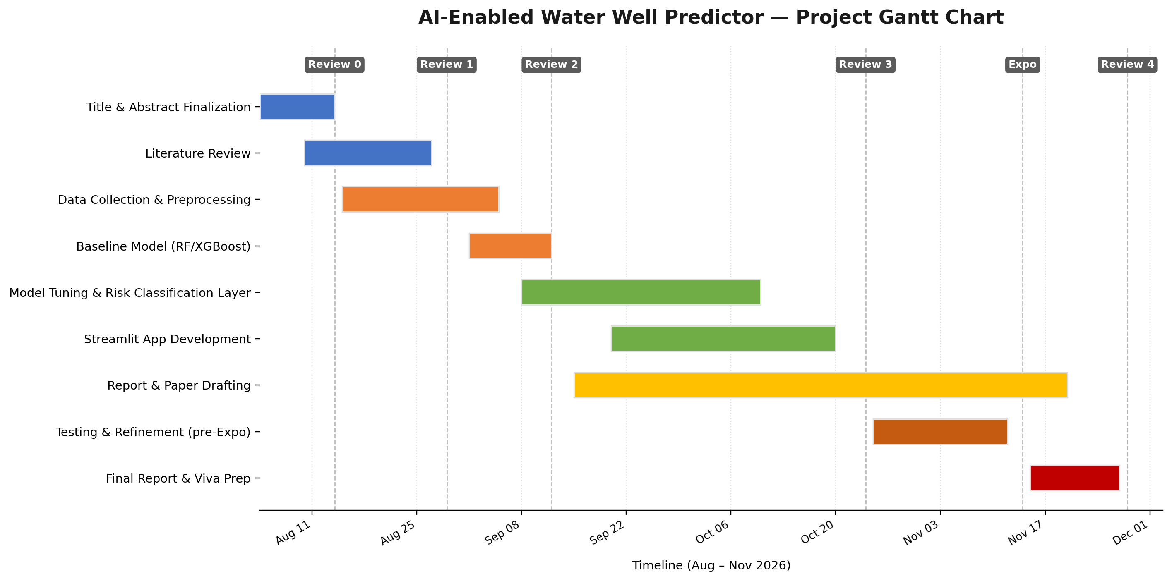
Timeline of the Project (Gantt Chart)

Slide 13
References (APA Format)
Rohde, M. M., Biswas, T., Housman, I. W., Campbell, L. S., Klausmeyer, K. R., & Howard, J. K. (2021). A machine learning approach to predict groundwater levels in California reveals ecosystems at risk. Frontiers in Earth Science, 9, 784499. https://doi.org/10.3389/feart.2021.784499
Davari, S., Eslamian, S., Jamali, M., & Safavi, H. R. (2025). Application of machine learning algorithms for groundwater level prediction in the Najafabad plain. Scientific Reports. https://doi.org/10.1038/s41598-025-32376-1
Jesse, G. et al. (2025). A systematic review of machine learning models for groundwater level prediction. Applied Computing and Geosciences, 28, 100303. https://doi.org/10.1016/j.acags.2025.100303
Sarkar, H., Mishra, R., & Ojha, C. S. P. (2025). Application of machine learning techniques in the evaluation of local groundwater level using field gravity data. Hydrology Research, 56(5), 383-396. https://doi.org/10.2166/nh.2025.108
Pham, Q. B. et al. (2022). Groundwater level prediction using machine learning algorithms in a drought-prone area. Neural Computing and Applications, 34, 10751-10773. https://doi.org/10.1007/s00521-022-07009-7
Chen, H.-Y., Vojinovic, Z., Lo, W., & Lee, J.-W. (2023). Groundwater level prediction with deep learning methods. Water, 15(17), 3118. https://doi.org/10.3390/w15173118
Khan, J., Lee, E., Balobaid, A. S., & Kim, K. (2023). A comprehensive review of conventional, machine learning, and deep learning models for groundwater level (GWL) forecasting. Applied Sciences, 13(4), 2743. https://doi.org/10.3390/app13042743
Thakur, A., Chandel, A., & Shankar, V. (2025). Prediction of groundwater levels using a long short-term memory (LSTM) technique. Journal of Hydroinformatics, 27(1), 51-68. https://doi.org/10.2166/hydro.2024.239
Ali, A. S. A., Jazaei, F., Babakhani, P., Ashiq, M. M., Bakhshaee, A., & Waldron, B. (2024). An overview of deep learning applications in groundwater level modeling. Applied Computational Intelligence and Soft Computing, 2024, 9480522. https://doi.org/10.1155/2024/9480522
Feng, F., Ghorbani, H., & Radwan, A. E. (2024). Predicting groundwater level using traditional and deep machine learning algorithms. Frontiers in Environmental Science, 12, 1291327. https://doi.org/10.3389/fenvs.2024.1291327

Slide 14


