Slide 1
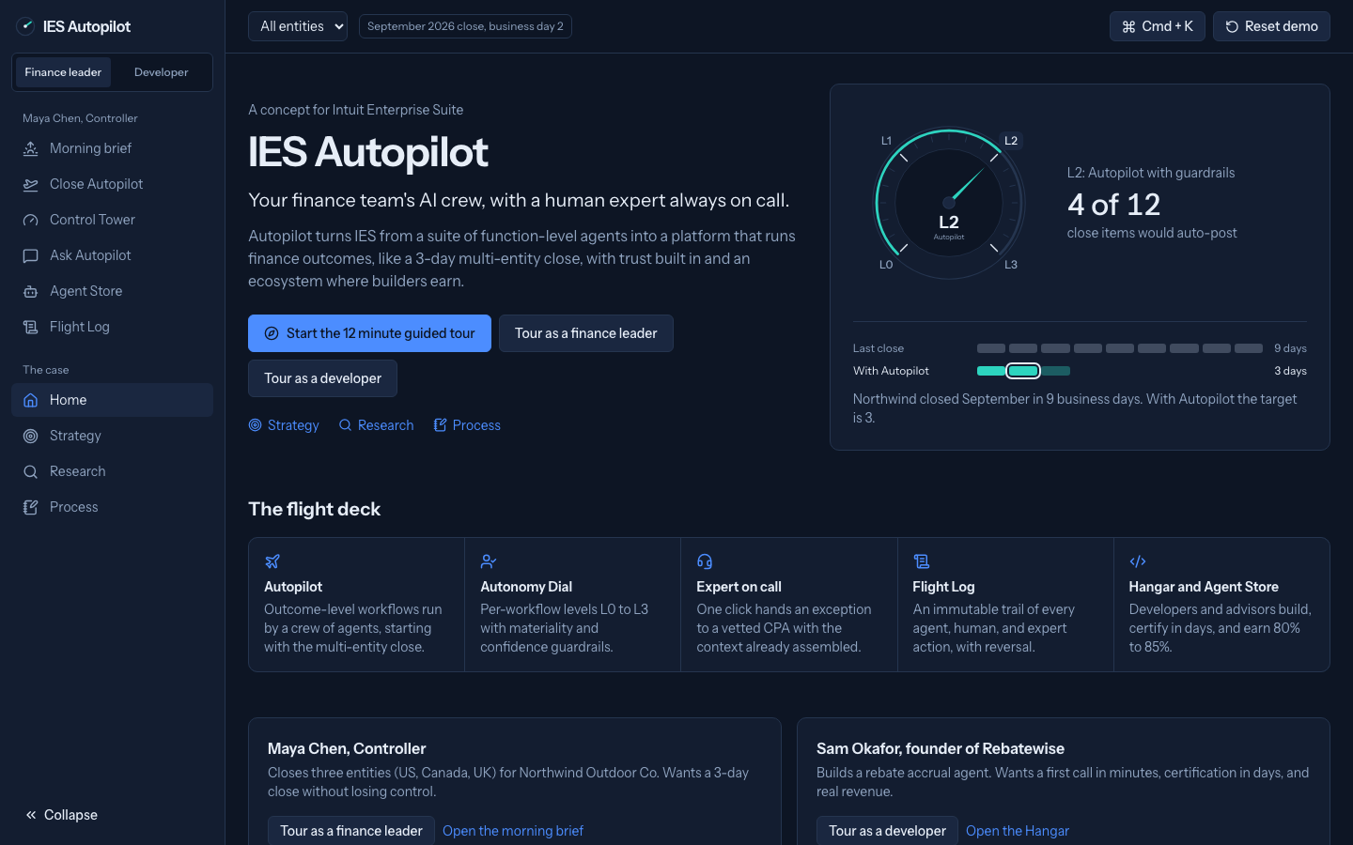
IES Autopilot
Your finance team's AI crew, with a human expert always on call
Anubhab Chakraborty
Aspiring product manager who designed and built this prototype for the Intuit PM Intern case.
Live prototype: https://ies-autopilot.b26015.workers.dev
GitHub: https://github.com/anubhab7/ies-autopilot

Slide 2
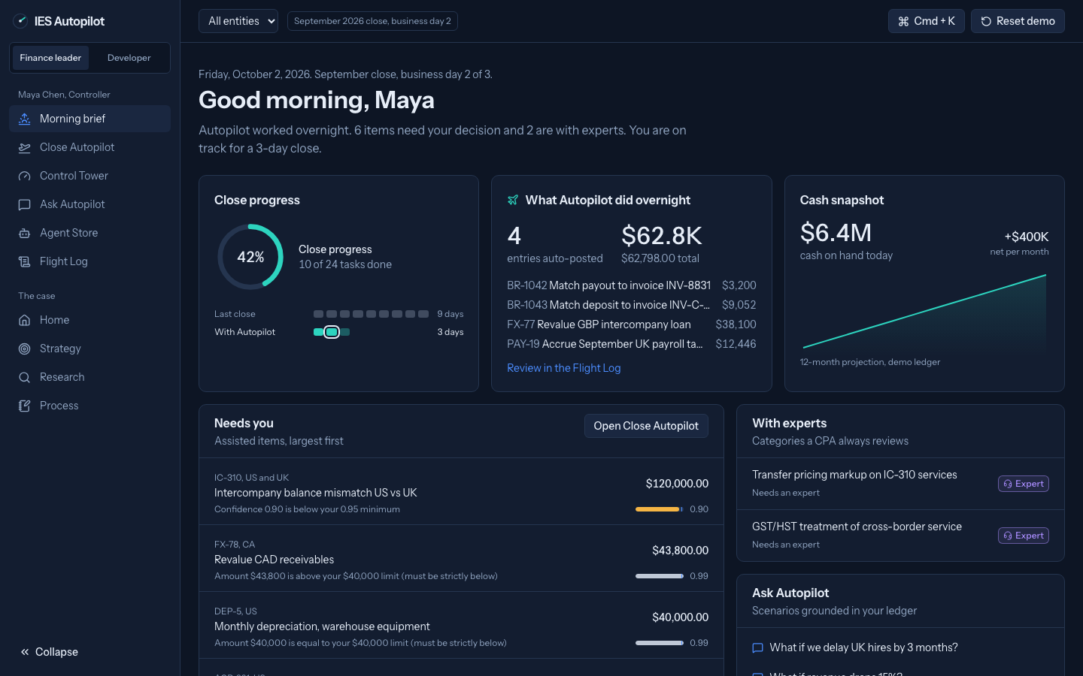
The customer problem
Who: Maya, a Controller at a 420-person, three-entity company, is blocked by intercompany mismatches, manual reconciliations, and agents she cannot trust.
Goal: close in 3 days. Only 18% of teams do; half take 6 or more (Ledge).
IES Autopilot | Anubhab Chakraborty | Intuit PM Intern case

Slide 3
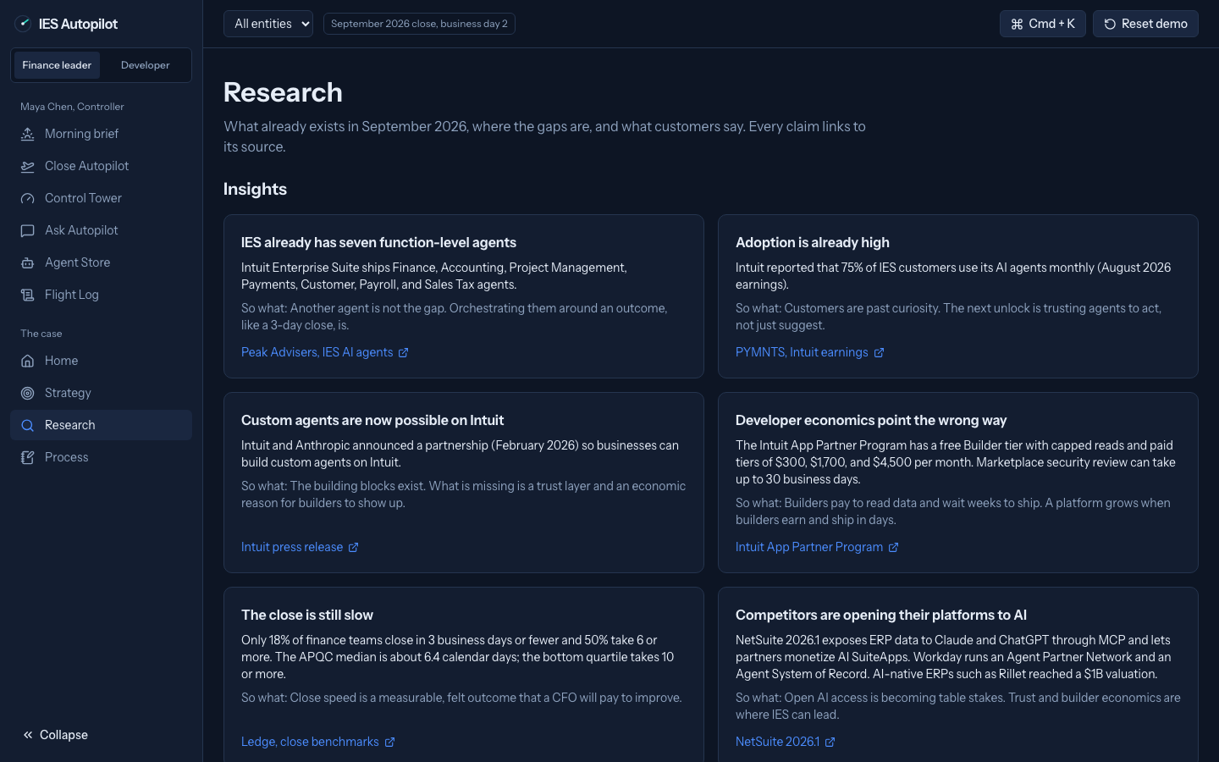
What IES has today, and the gap
Today: 7 function agents, used monthly by 75% of customers.
Gaps: agents map to functions, not outcomes; trust tools are missing; developers pay for data and wait 30 days for review.
IES Autopilot | Anubhab Chakraborty | Intuit PM Intern case

Slide 4
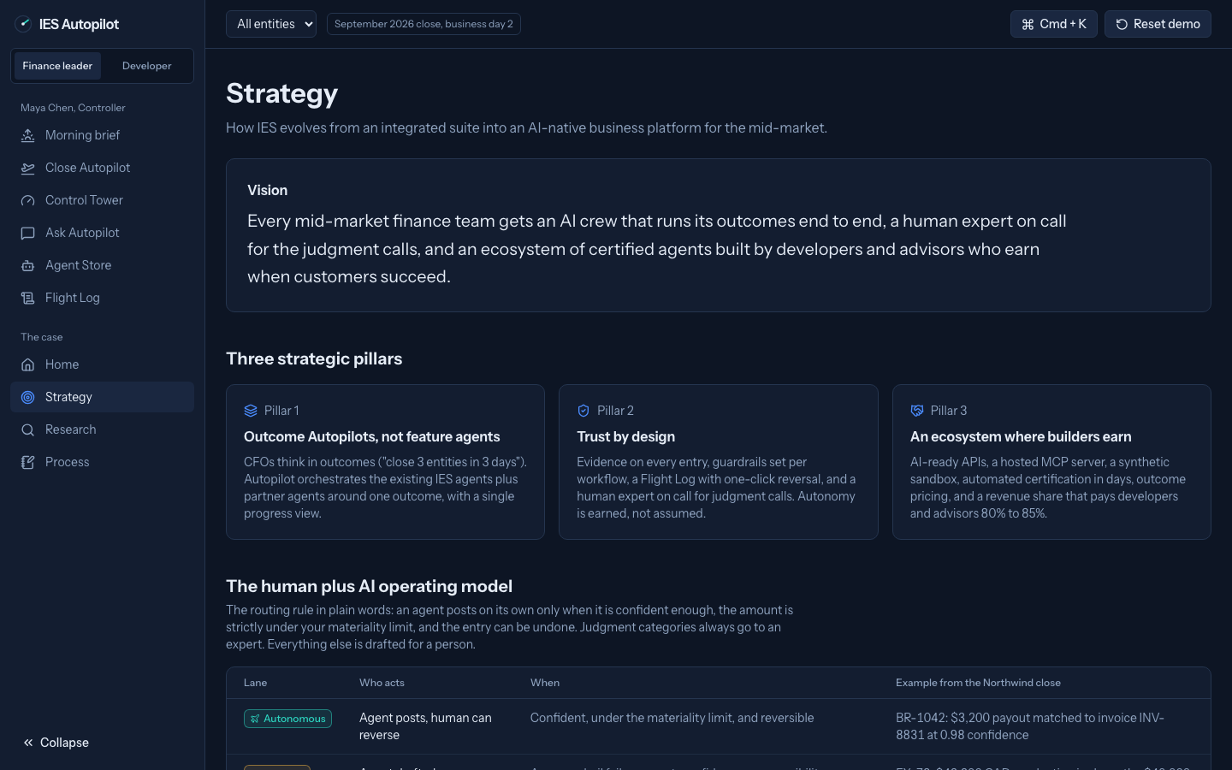
Vision and three pillars
Every mid-market finance team gets an AI crew with an expert on call.
1. Outcome Autopilots, not feature agents.
2. Trust by design, with guardrails and undo.
3. An ecosystem where builders keep 80% to 85%.
IES Autopilot | Anubhab Chakraborty | Intuit PM Intern case

Slide 5
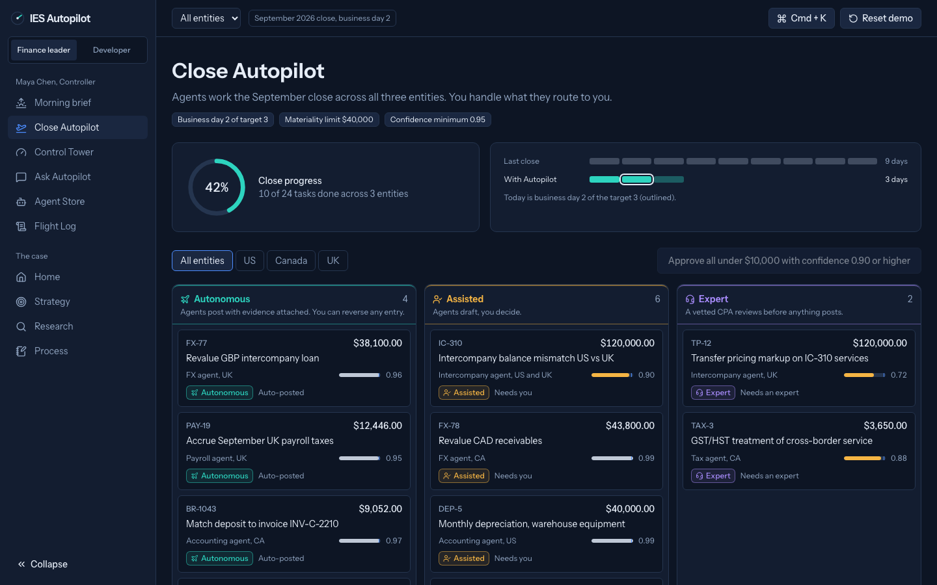
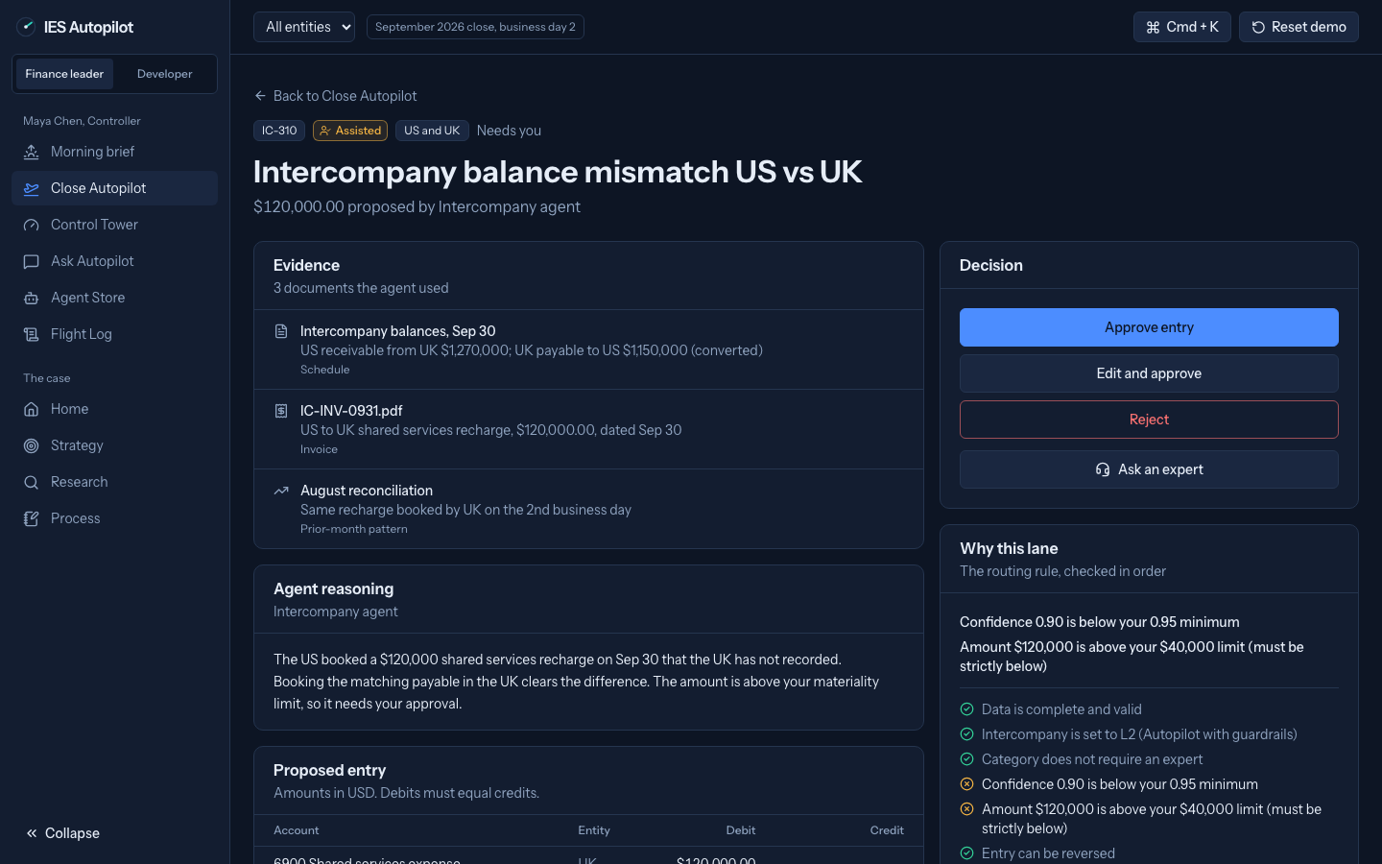
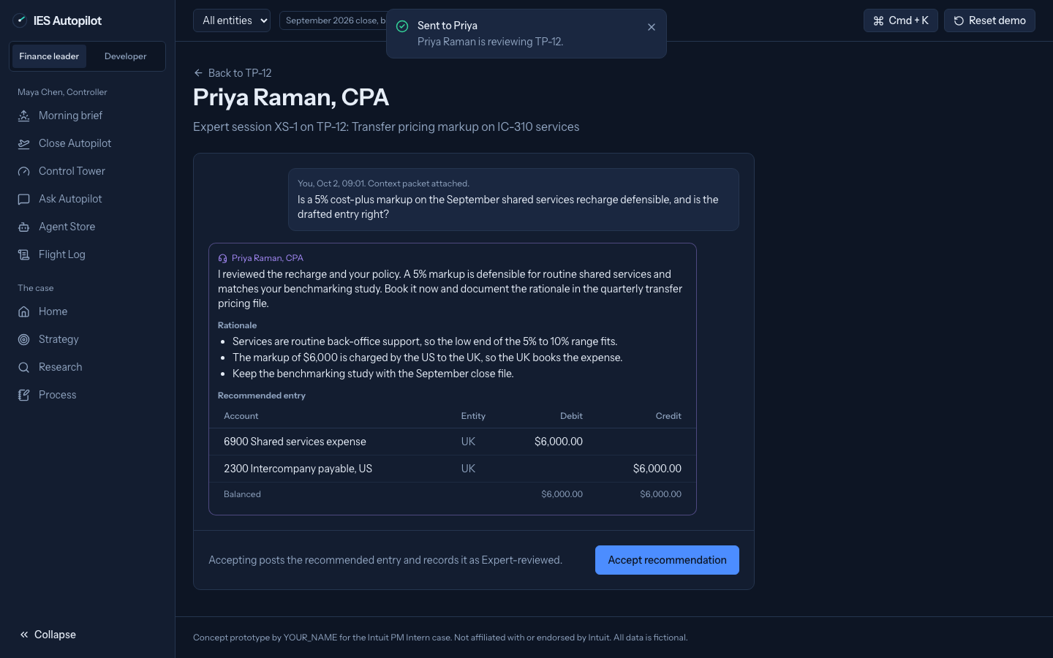
Customer experience
Close Autopilot: one board, four lanes, a 9-day close cut to 3.
Exceptions: evidence, a balanced draft, and why each landed in its lane.
Expert on call: Priya Raman replies with a reviewed entry.
IES Autopilot | Anubhab Chakraborty | Intuit PM Intern case

Slide 6
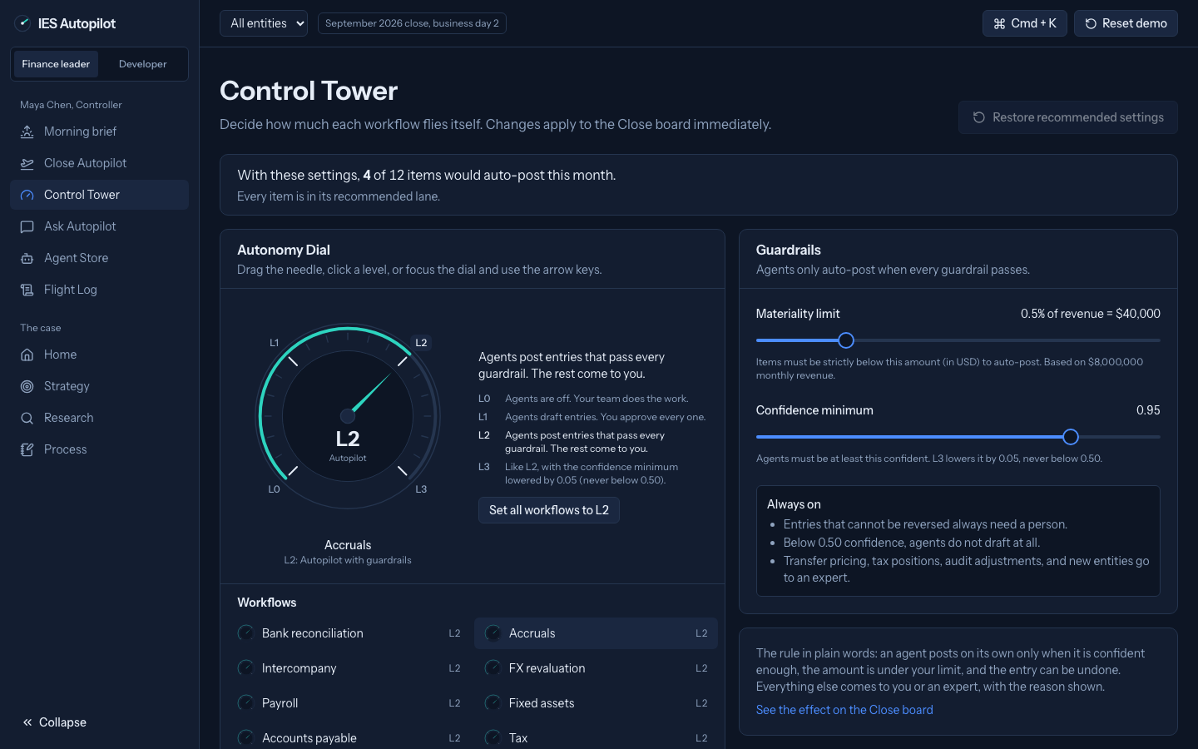
Human plus AI operating model
Rule: agents post alone only when confident, reversible, and strictly below materiality.
Example: at a $40,000 limit, FX-77 ($38,100) auto-posts; DEP-5 ($40,000) waits for Maya.
Autonomy Dial: L0 to L3 per workflow, previewed first.
IES Autopilot | Anubhab Chakraborty | Intuit PM Intern case

Slide 7
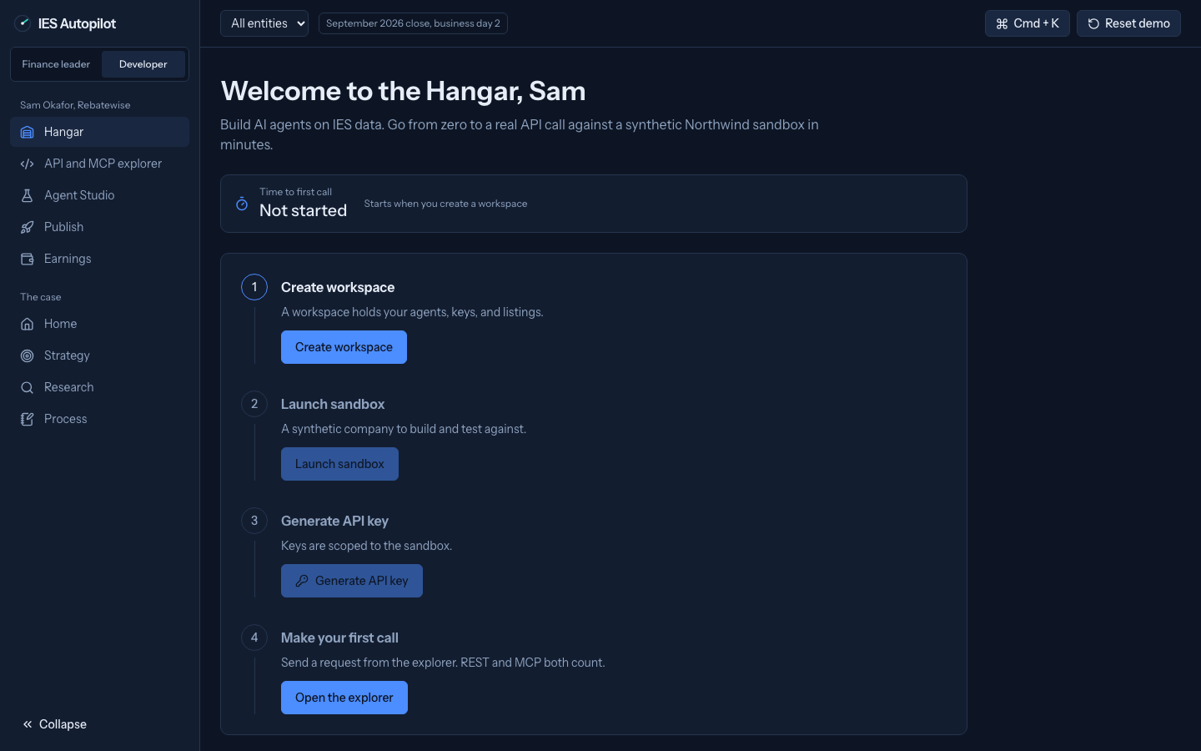
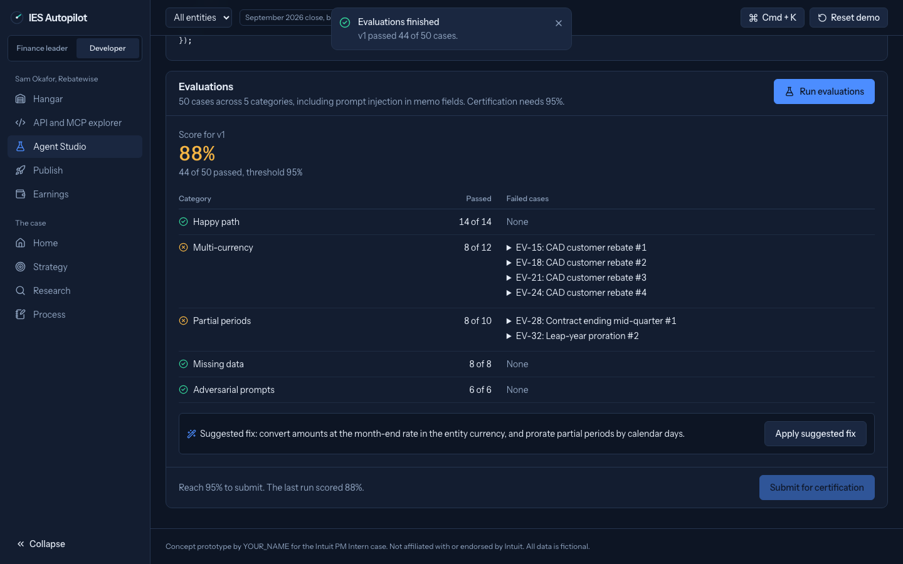
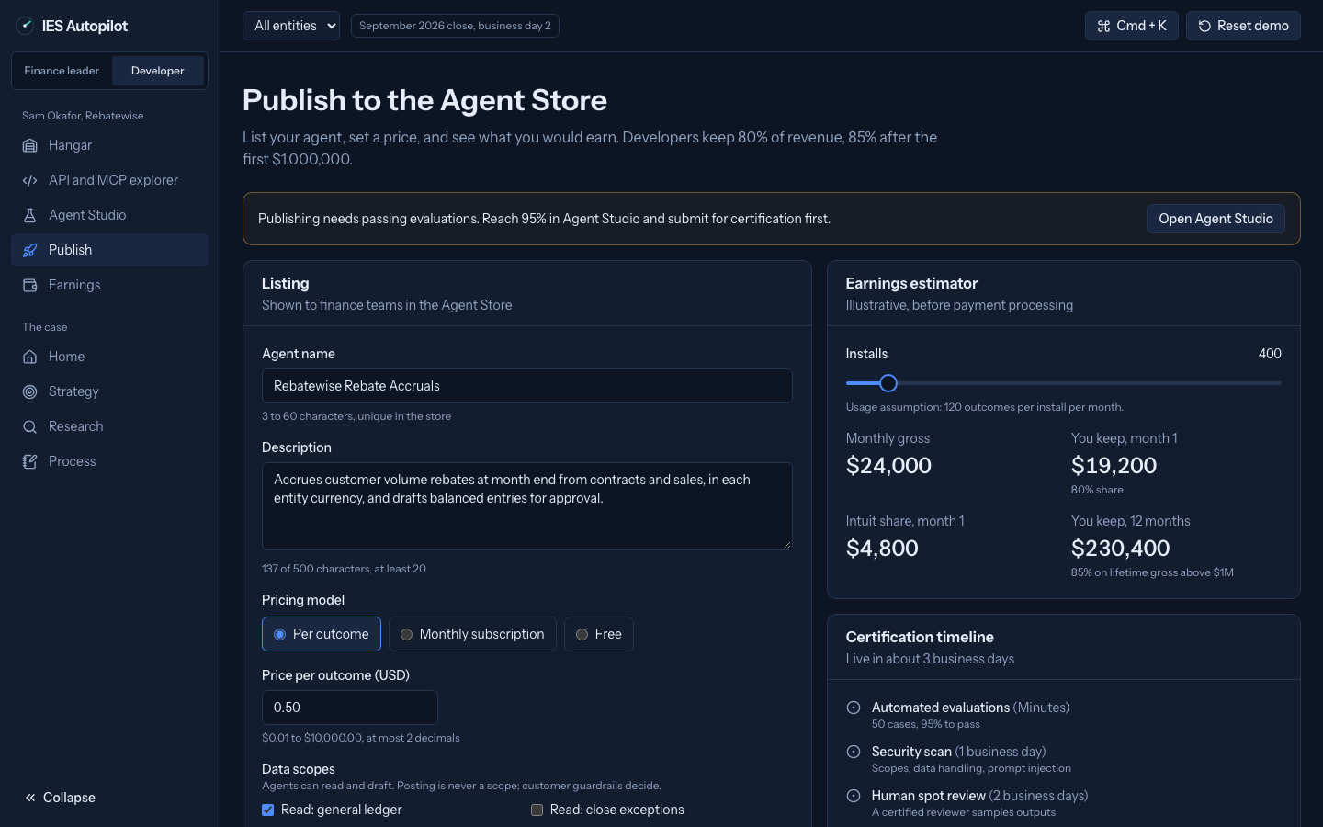
Developer journey
Onboard: Hangar sandbox with synthetic data and a first-call timer.
Build: SDK, no-code, REST, and hosted MCP that drafts, never posts.
Certify and earn: 50 evals, v2 scores 98%; live in 3 days, keep 80%.
IES Autopilot | Anubhab Chakraborty | Intuit PM Intern case

Slide 8
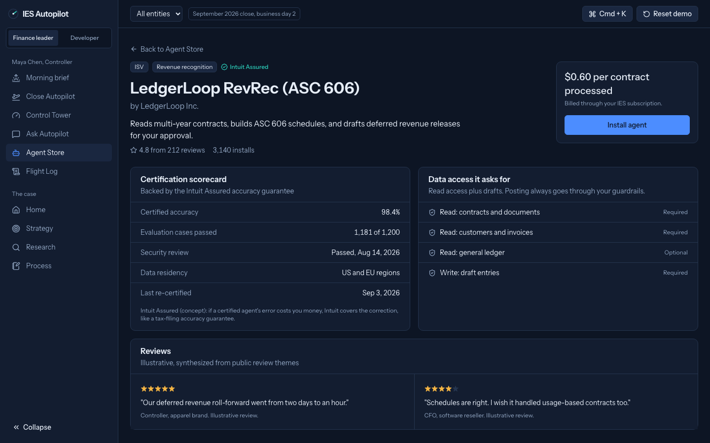
Business and ecosystem model
Revenue: outcome-priced Autopilot tier, expert session fees, and an Agent Store take rate.
Illustrative GMV: 8,000 x 25% x 2 x $250 x 12 = $12M; $2.4M to Intuit at 20%.
Free sandbox and reads attract builders.
IES Autopilot | Anubhab Chakraborty | Intuit PM Intern case

Slide 9
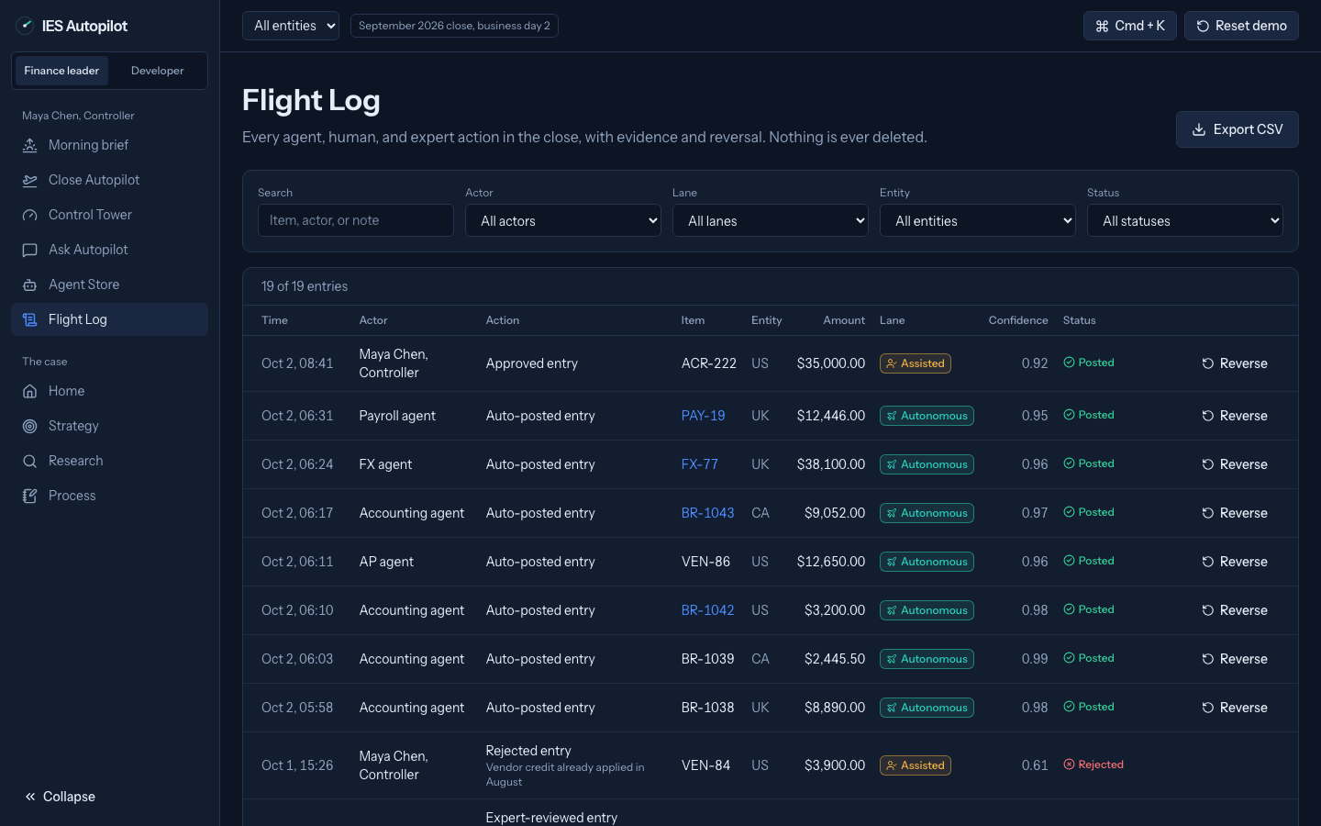
Roadmap, experiments, and KPIs
Now: Close Autopilot and the dial. Next: Agent Store. Later: outcome pricing.
Why: prove trust on the close before third-party agents act.
North Star: verified agent hours, tested first with a Wizard-of-Oz pilot.
IES Autopilot | Anubhab Chakraborty | Intuit PM Intern case

Slide 10
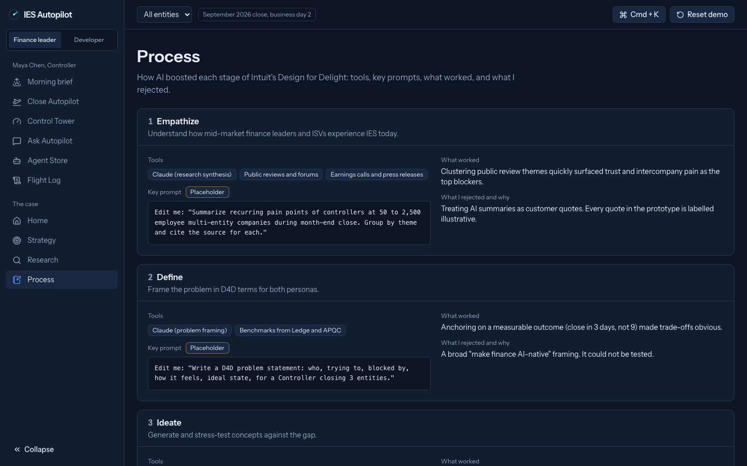
How I used AI
Stage | AI tool | Example prompt
Empathize | Edit me | Edit me
Define | Edit me | Edit me
Ideate | Edit me | Edit me
Prototype | Claude Code | Build IES Autopilot in 9 phases from BUILD_PROMPT.md, with seed data and tests.
Experiment | Edit me | Edit me
Next steps: run four rapid tests, interview 8 controllers, and pilot 3 partner agents.
IES Autopilot | Anubhab Chakraborty | Intuit PM Intern case

