Slide 1
Conversion of chemical equation into Searchable format
Prerana Jana & Anubhab Majumdar

Slide 2
Chemical Equation Segmentation

Slide 3
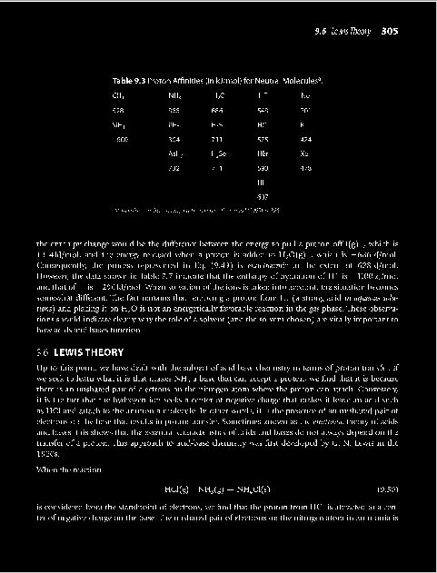

Text Line Segmentation
Text document
Horizontal Projection Profile

Slide 4
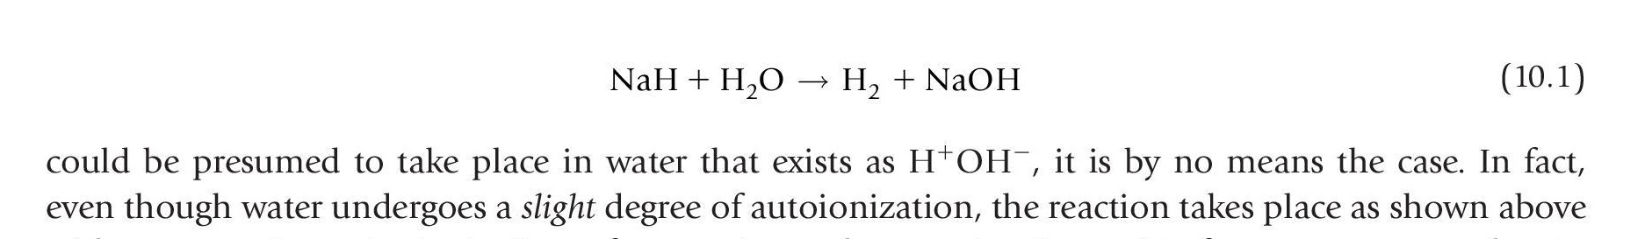
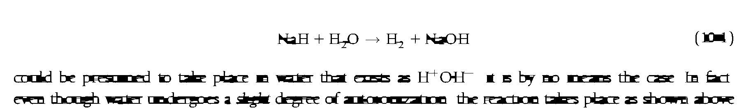
Blob Formation using Morphological Operations
Structural element used is a LINE
How to determine its length ?

Slide 5
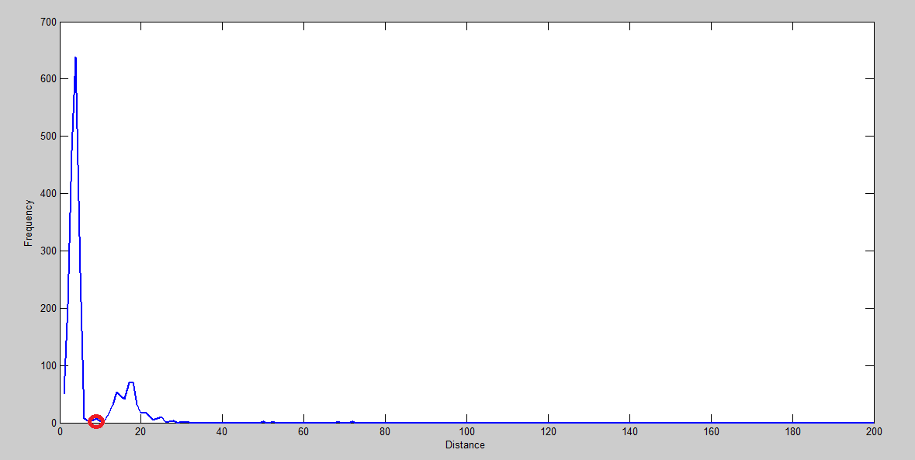
Determining Gap between Characters and Word
Length of structural element should be greater than the gap between 2 letters in a word but less than the gap between 2 words
Gap between letters
Length of Structural element
Gap between words
Document image
Histogram of character gap

Slide 6
Operator Identification – Single Character Extraction

Slide 7
Operator Identification–Euler Number based removal

Slide 8
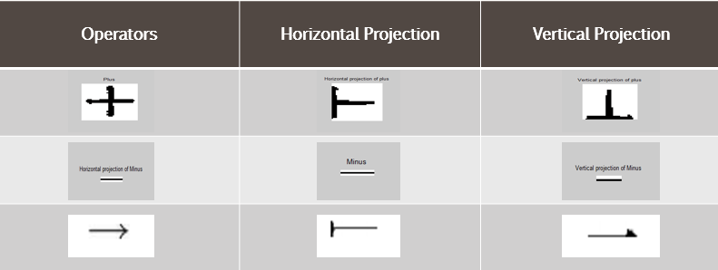
Operator Identification – Feature Extraction
The following features are considered for remaining single characters :
Aspect ratio of each component
Density (#object pixel/#total pixel)
Second and third order moments of horizontal and vertical projection profile
The location and magnitude of global maxima in horizontal and vertical projection profile
Perimeter of the component

Slide 9
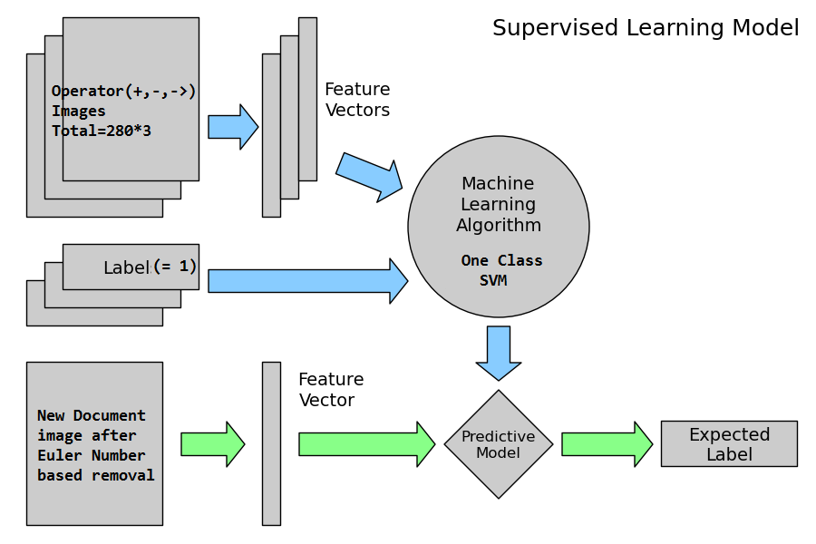
Operator Identification – One Class SVM
Accuracy on
752 equations – 98.4%

Slide 10
After Operator Identification - sample output

Slide 11
Identifying ‘=’ or ‘ ’
‘=’ or ‘ ’doesn’t form a word blob
The upper and lower part is identified as thin character : ‘-’ or ‘→’
For every thin character detection we place a mask of size (l*l/2) on top and bottom to check presence of another such symbol where l=length of the thin operator.
If present, we join them together and it forms one single operator.

Slide 12


Adding numerator and denominator
Original Equation
Lower Scan
Upper Scan
Final Equation

Slide 13
Segmentation of DE zones - Run Length Smoothing on Operands

Slide 14
Segmentation of DE zones - Equation Number Removal

Slide 15
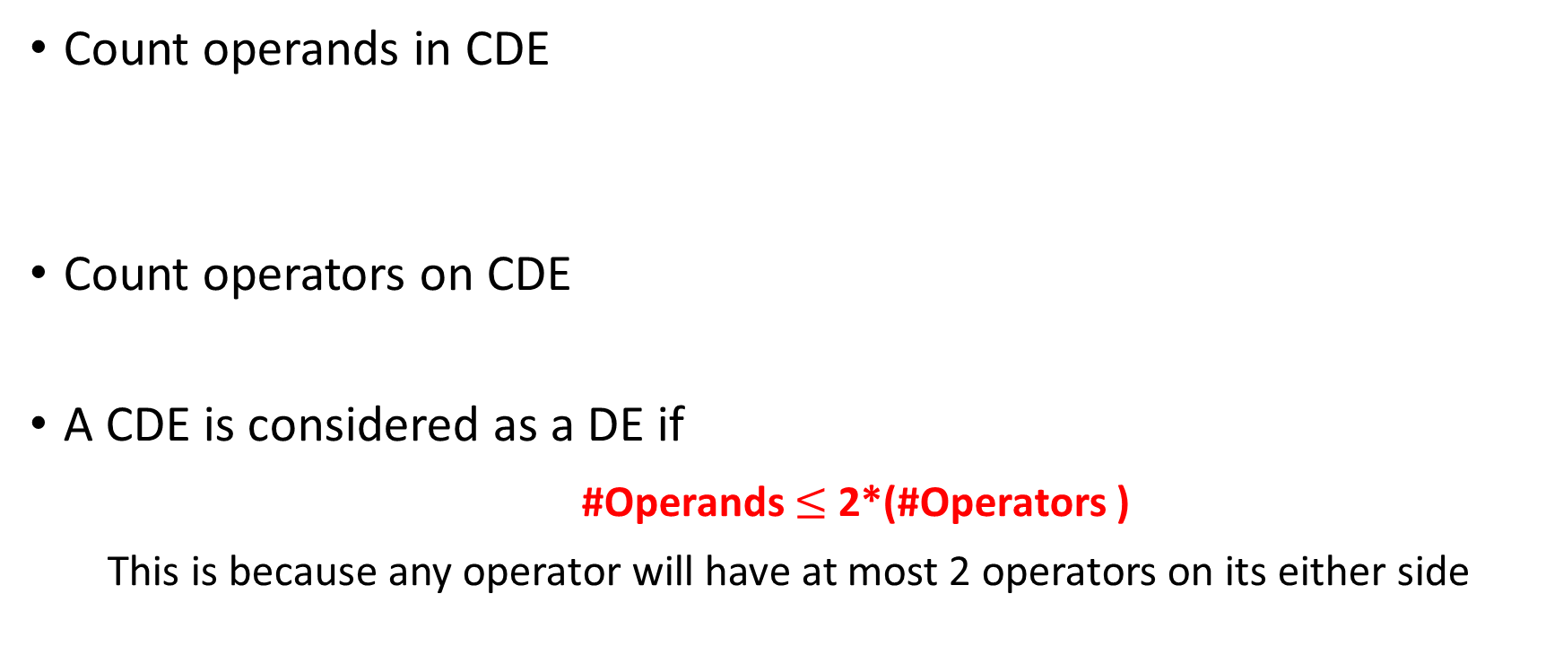
Segmentation of DE zones – Displayed or Embedded?
Count operands in CDE
Count operators on CDE
A CDE is considered as a DE if
#Operands $≤$ 2*(#Operators )
This is because any operator will have at most 2 operators on its either side

Slide 16
Classification of Segmented DE zones – Removal of Subscripts and Superscripts
Subscripts ᗴ (Lower middle zone, Bottom Zone)
Superscripts ᗴ (Upper middle zone, Upper zone)
Chemical elements won’t be subscript or superscript; so they are ignored

Slide 17

Classification of Segmented DE zones – OCR
Rest are input into Google Tesseract 3.02, an open-source OCR engine, which returns the text form.

Slide 18
Classification of Segmented DE zones – Parser
Regular expression for a periodic element
[A-Z][a-z]*
Grammar for substrings that can be an element:
start → capital . follow
follow → small . follow | ᗴ
capital → A|B|C|…|X|Y|Z
small → a|b|c|…|x|y|z

Slide 19
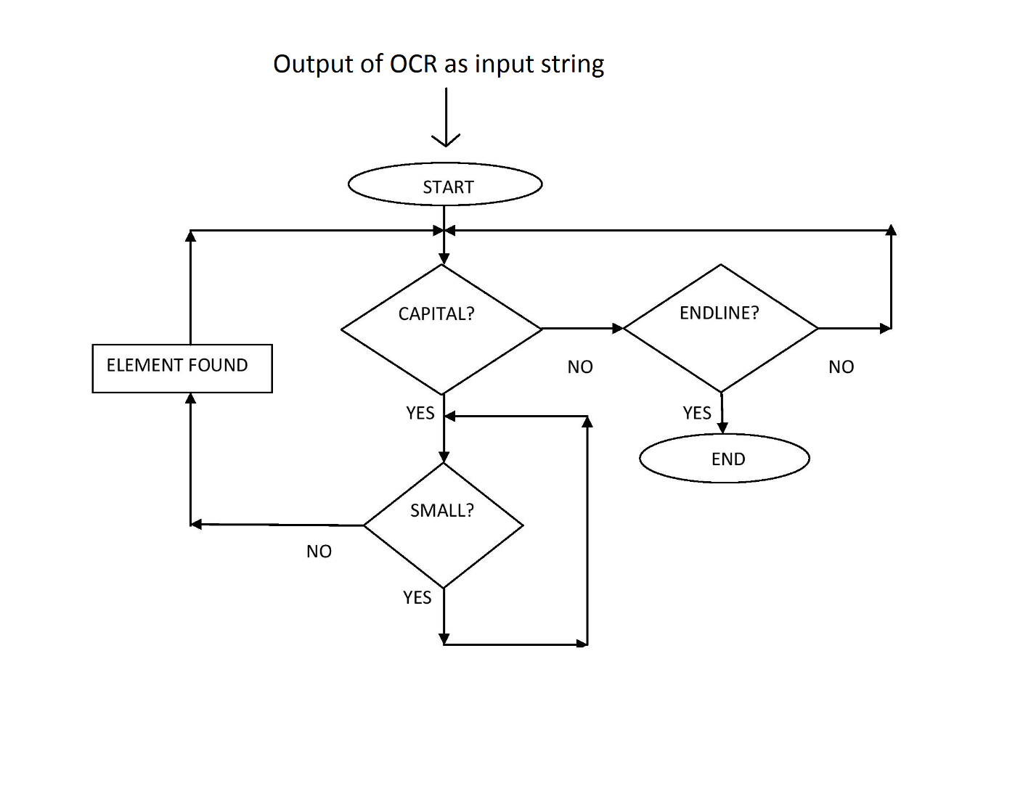
Flowchart of the working mechanism of the parser

Slide 20
Classification of Segmented DE zones – Chemical or Other?
The substrings are matched against a hash table consisting of all the elements in the Periodic Table
If #(elements matched) : #(total substrings) ≥ 0.7 then the DE is considered as chemical equation (according to our experiment with 733 equations)
Why 0.7, not 1?
Limitation of OCR
Presence of broken and touching character in DE zone

Slide 21
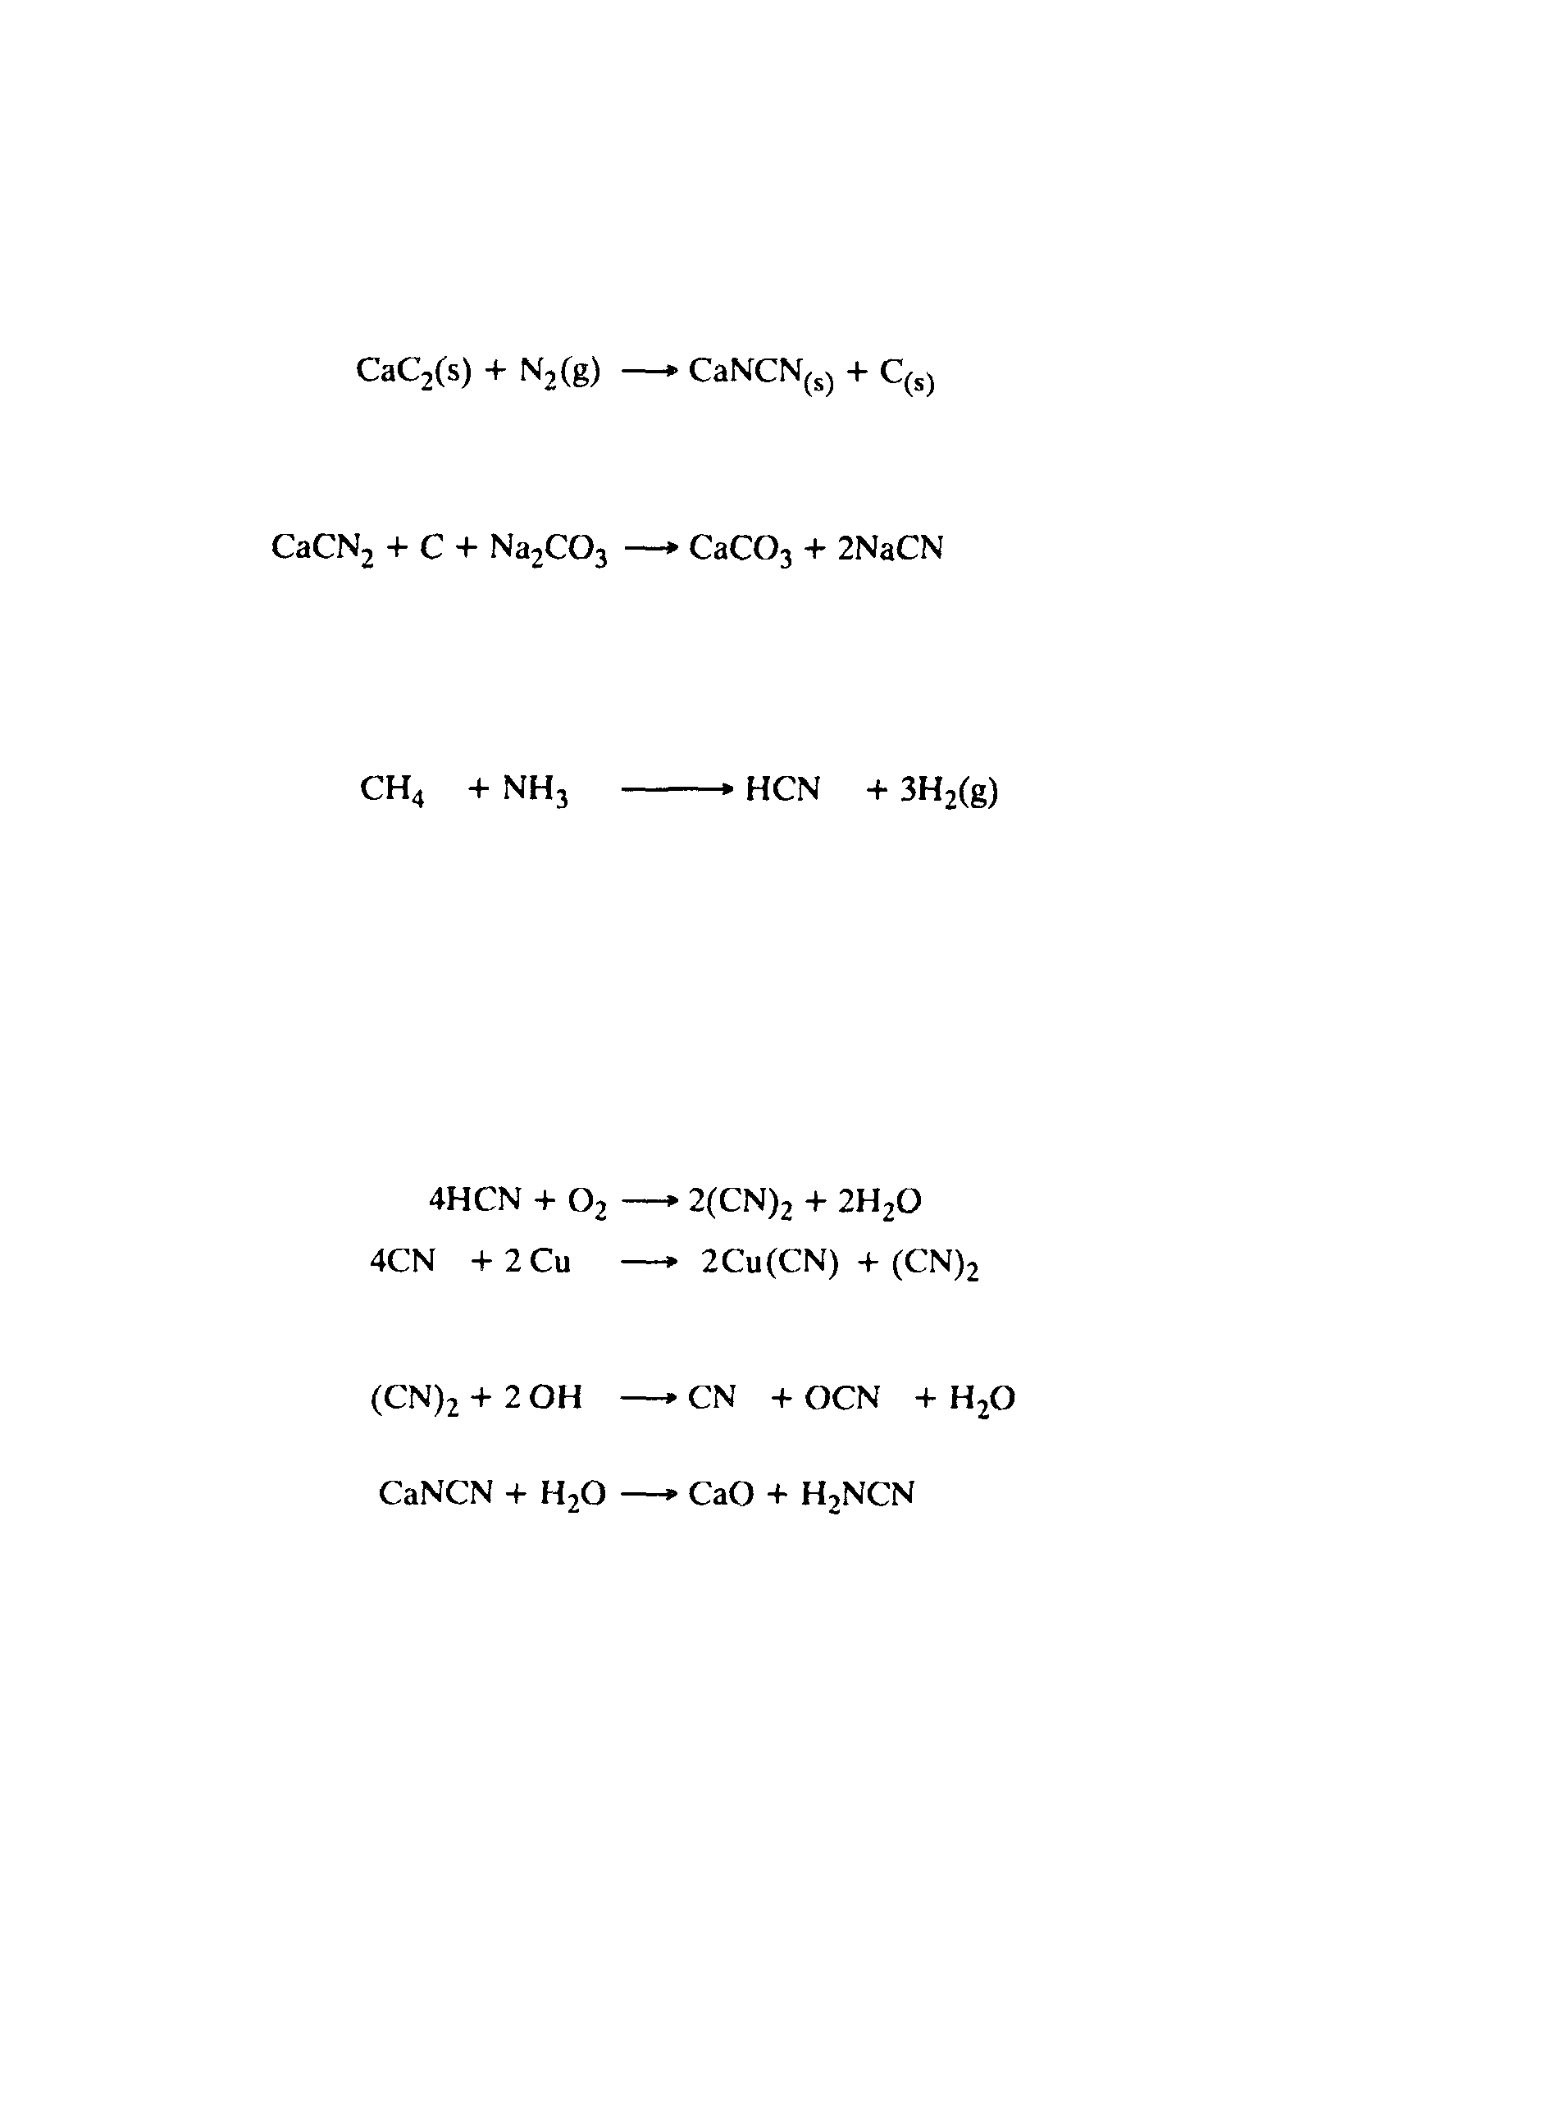
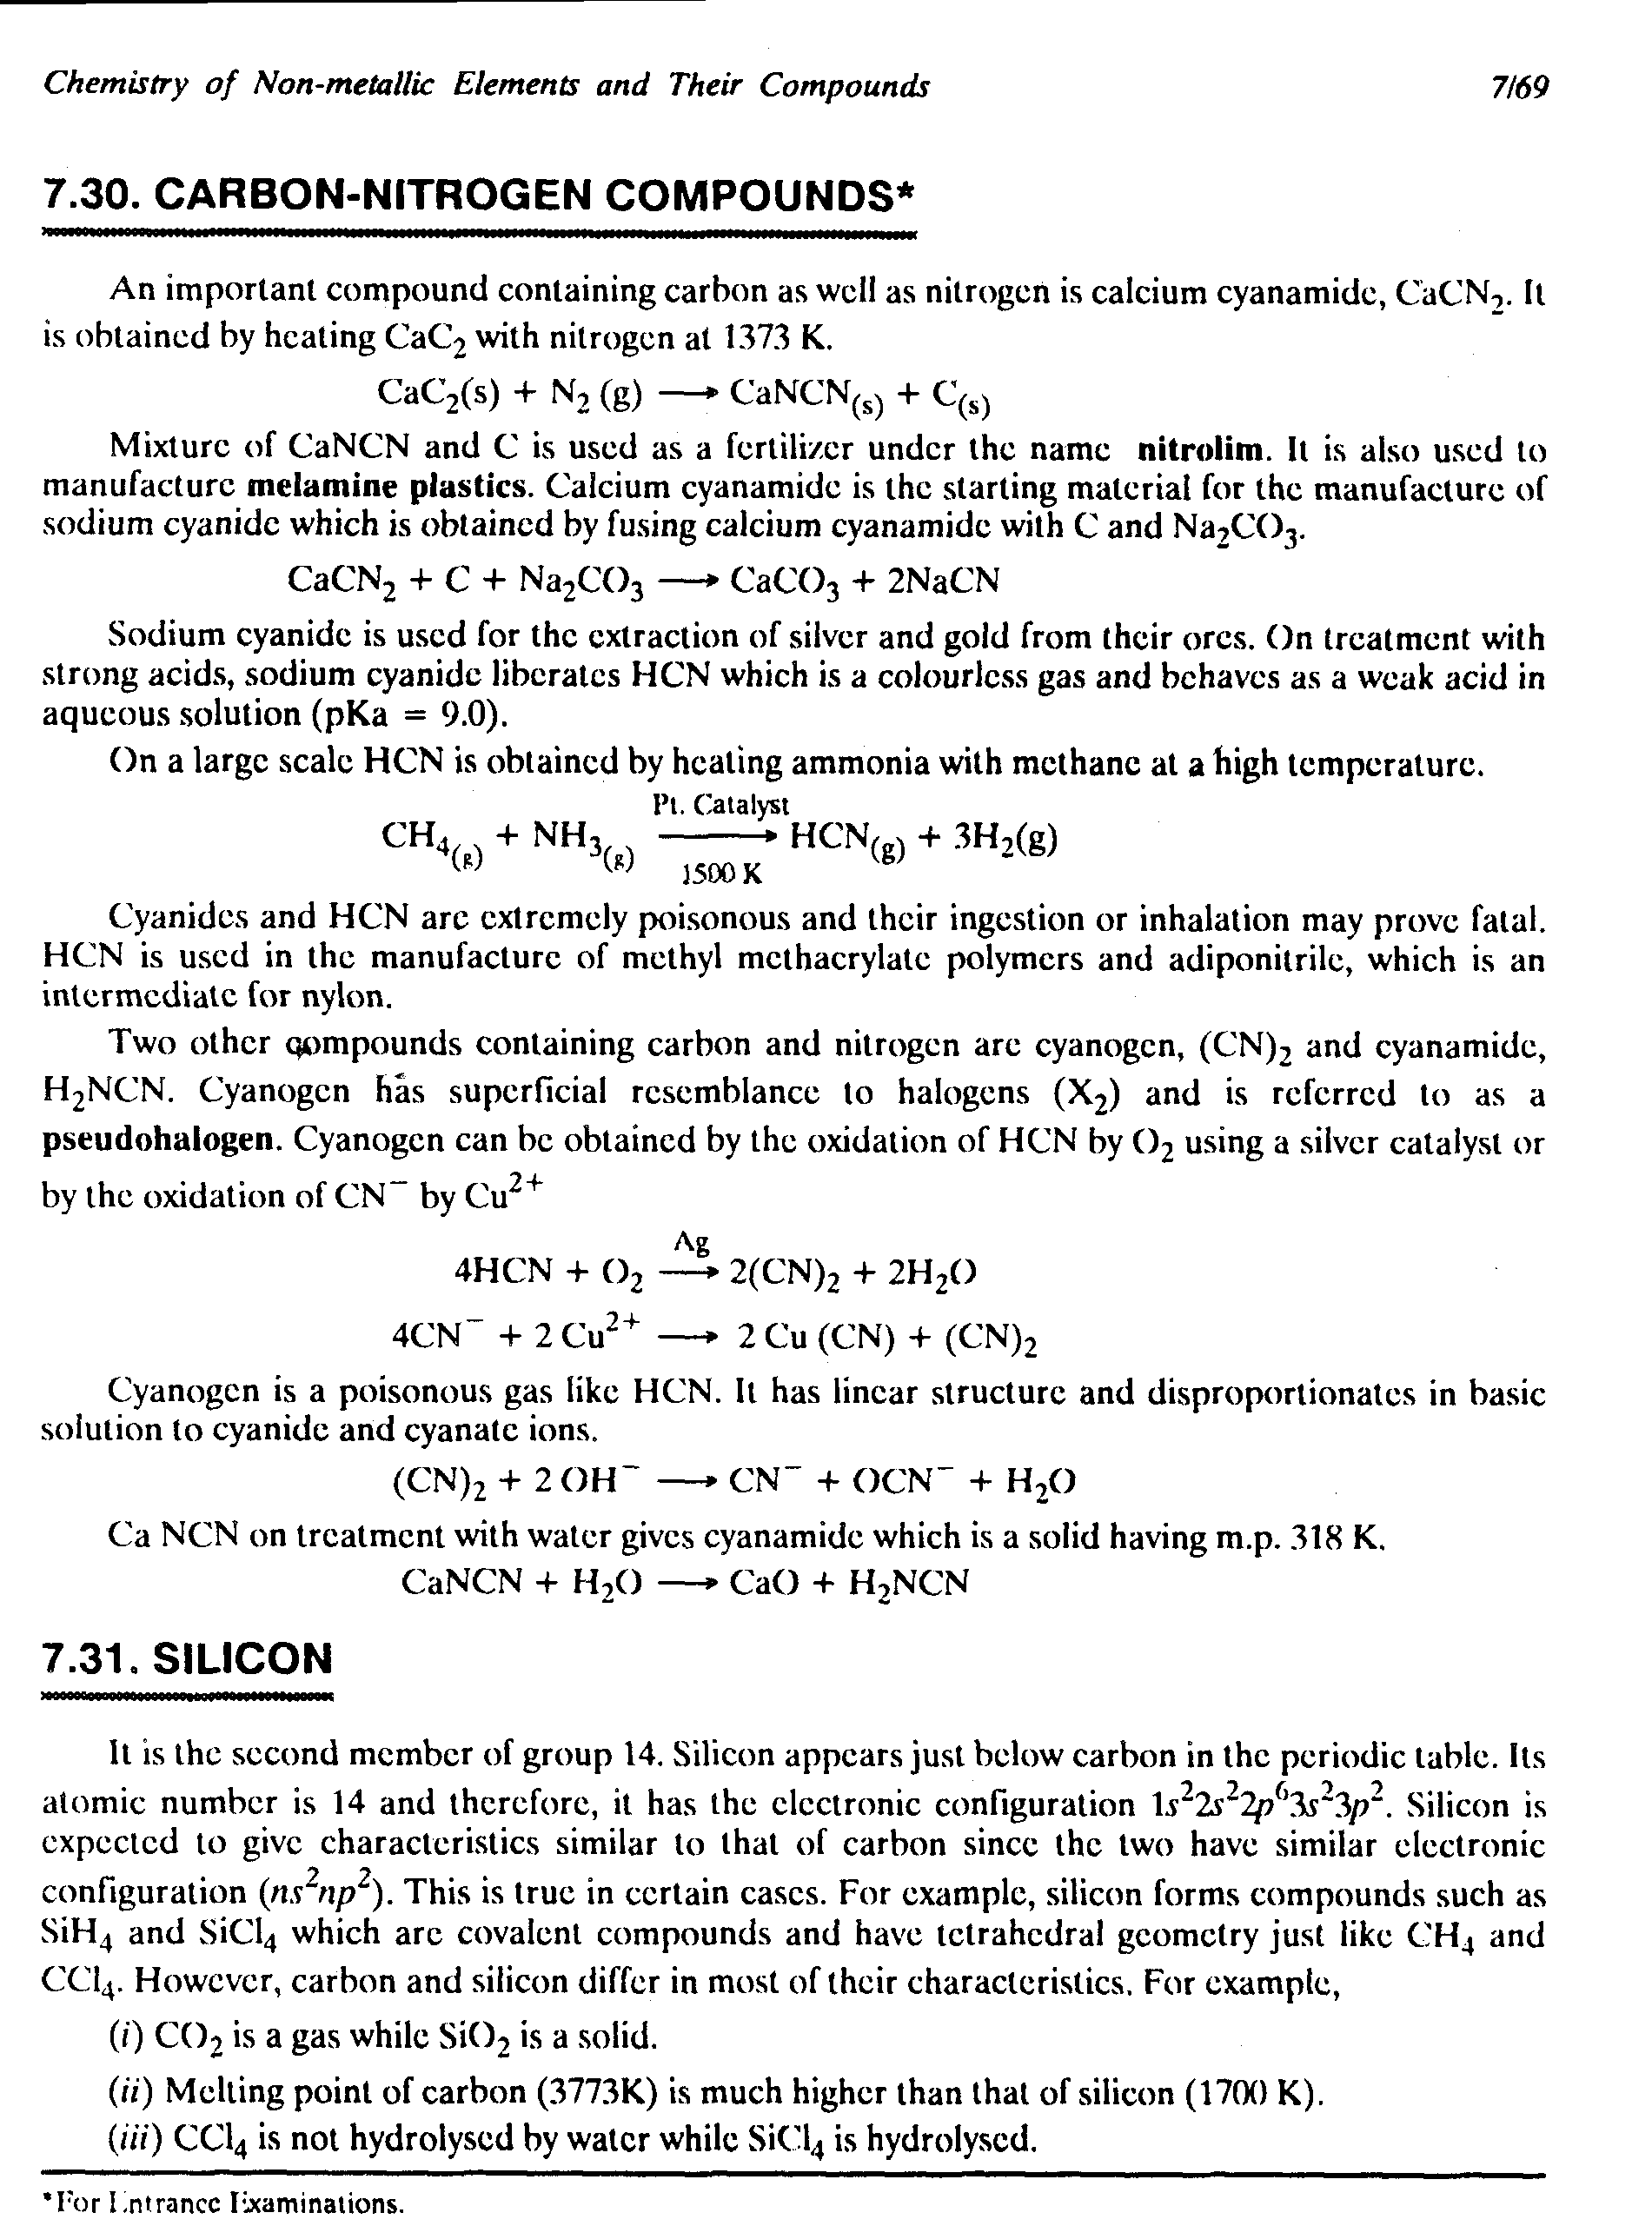

Slide 22
Chemical Symbol Recognition
Chemical context based Auto-correction

Slide 23
Equation Image
Matlab OCR output
- line
AgNo3 +HCl=AgCN +HN03
Matlab OCR output
– per component
A 8 N O 3 + H C 1 A S C I Jr + H N O 8

Slide 24
Original Equation
After word blob formation
Chemical symbols
Reactants

Slide 25
Chemical symbol recognition

Slide 26
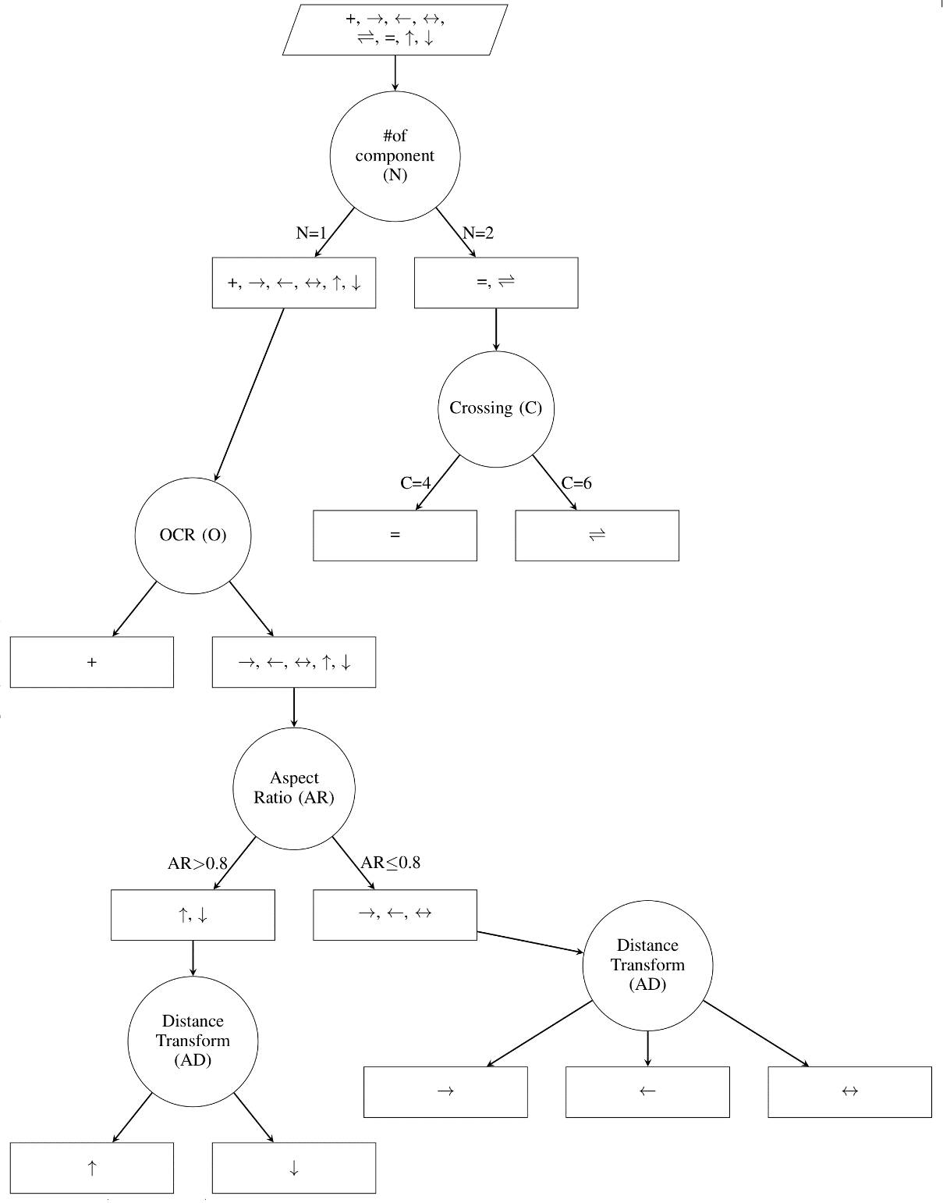
Operator List :
+ = v +

Slide 27
Error Table Formation

Slide 28
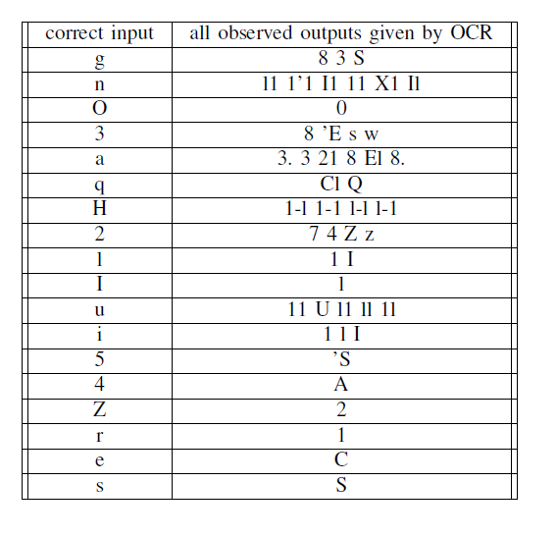
Error table

Slide 29
Error hash map (H)
Key | Values
8 | [ g, a, 3 ]
l1 | [ u, n ]
0 | [ O ]
… | …

Slide 30
Reactant format

Slide 31
Numeric co-efficient | Chemical Compound | State
[Coefficient][0,1][Chemical compound][state][0,1]

Slide 32
3H2(8)
Coefficient : [2-9]+[0-9]*
State : [(][a-z][1,2][)]
For e.g. (g), (l), (s), (aq)

Slide 33
Auto-correction of each reactants based on chemical context

Slide 34




A 8 N 0 _3
H C 1
A 8 C I
H N O _8

Slide 35

A 8 N O _3
4gNOg
AgNOg
43NOg
A3NOg
4aNOg
AaNOg
48NOg
A8NOg
4gNOa
AgNOa
43NOa
A3NOa
4aNOa
AaNOa
48NOa
A8NOa
4gNO3
AgNO3
43NO3
A3NO3
4aNO3
AaNO3
48NO3
A8NO3
A 8 N 0 3
H N O 3 ( 8 Cl )
[g, a, 3, 8]
[A, 4]
[q]
[g,a,3,8]
gq
aq
3q
8q
[N]
[0,O]
[3]

Slide 36
More than 1 match found

Slide 37

8
S
Corrected AgNO3
compound:
Ag
As
NO2 O2
Case 1
Case 2
Case 1 |  | Case 2
Left | Right | Left | Right
Ag | Ag | Ag | As
N | N | N | N
O | O | O | O

Slide 38
No Match found

Slide 39
2NaBr + H2SO4 = 2NaOH + Br2
N 21 B l -- Broken ‘r’
After correction : NaBI / NaBl – no match
LCS ( all combinations, Chemical compound list )

Slide 40
NaBr
NaBrO
NaBrO2
NaBrO3
NaBrO4
NaBH4
NaBI
NaBl
Longest Common
Substring
NaBr

Slide 41
Error Cases
Case 1:
Case 2:
LHS : Ag | RHS : As
Not in error list

