Slide 1
EVOLUTIONARY ALGORITHMS
Jaya Sil
Indian Institute of Engineering Science and Technology, Shibpur

Slide 2
Evolutionary Algorithms
A population of individuals exists in an environment with limited resources.
Competition for the resources causes selection of the individuals who are fitter in the environment (better adapt the environment).
Individuals act as seeds for the generation of new individuals.
The new individuals have their fitness evaluated and compete for survival.
Over time Natural selection causes a rise in the fitness of the population.

Slide 3
Evolutionary Algorithms
Due to population based approach EA have advantage over classical optimization techniques.
EA maintains a population of possible solutions, which are processed at every generation.
Multiple solutions mean multiple good solutions, rather than only the best solution.
This is against the natural tendency of EAs, which will always converge to the best solution, or a sub-optimal solution.

Slide 4
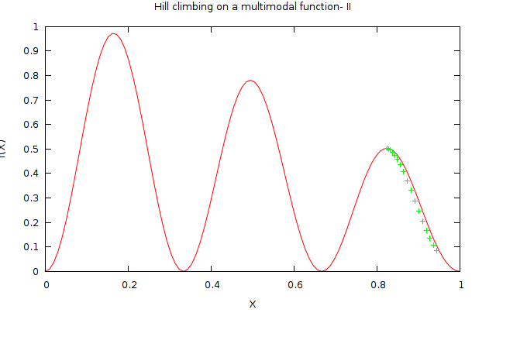
Multimodal Function Multimodal optimization deals with optimization tasks that involve finding all or most of the multiple solutions (as opposed to a single best solution) to a problem.

Slide 5
Evolutionary Algorithms
Evolutionary algorithms (EA) fall within the family of generate and test method.
EAs use recombination to mix information of more candidate solutions into a new one.
EAs are stochastic search procedure .
Evaluation or fitness function represents a heuristic estimation of solution quality.

Slide 6
GENERAL SCHEME OF EA
Parent selection
Parents
Initialization
Population
Recombination/
Crossover
Mutation
Termination
Offspring
Survivor selection/Fitness

Slide 7
Genetic Algorithm
Particle Swarm Optimization
Differential Evolution

Slide 8
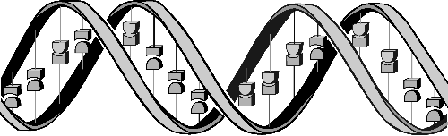
GA GENETIC ALGORITHM

Slide 9
Genetic Algorithm
Developed by Prof. J. Holland in 1970.
Applied to optimization problems using random search strategy.
Guided Randomness as historical information is used to direct the search into the region of better performance.
Adaptive heuristic search algorithm based on the evolutionary ideas of natural selection and genetics.
Based on Charles Darwin “Survival of the fittest” to handle scanty resources.
Genetic algorithms are categorized as global search heuristics.

Slide 10
Genetic Algorithm
Robust
Searching a large state-space, multi-modal state-space.
Analogy with the genetic structure and behaviour of chromosomes within a population of individuals.
Individuals in a population compete for resources and mates.
Individuals most successful in each 'competition' will produce more offspring than those individuals that perform poorly.

Slide 11
Genes from `good' individuals propagate throughout the population so that two good parents produce offspring that are better than either parent.
Thus each successive generation will become more suited to their environment.

Slide 12
Key Terms
Individual - Any possible solution
Population - Group of all individuals
Search Space - All possible solutions to the problem
Chromosome - Blueprint for an individual
Trait - Possible aspect (features) of an individual
Allele - Possible settings of trait (black, blond, etc.)
Locus - The position of a gene on the chromosome
Genome - Collection of all chromosomes for an individual

Slide 13
Search Space
A population of individuals .
Each individual representing a possible solution.
Each individual is coded as a finite length vector of components, in terms of some alphabet, usually the binary alphabet {0,1}.
Analogy: Individuals are chromosomes and the variables are genes.
A chromosome (solution) is composed of several genes (variables).

Slide 14
A fitness score is assigned to each solution representing the abilities of an individual to `compete'.
The individual with the optimal (or generally near optimal) fitness score is sought.
The GA aims to use selective `breeding' of the solutions to produce `offspring' better than the parents by combining information from the chromosomes.

Slide 15
Representation
GA requires two things to be defined:
a genetic representation (chromosome) of the solution domain,
a fitness function to evaluate the solution domain.
The representation of a solution in the form of a string that conveys the necessary information
Just in chromosome each gene controls a particular characteristic of the individuals, similarly each bit in the string represents characteristic of the solution,
Binary coded chromosomes are represented as
[ 0100001010]

Slide 16
Representation
The fitness function is defined over the genetic representation and measures the quality of the represented solution.
The fitness function is always problem dependent.
A fitness function quantifies the optimality of a solution. The fitness value is used to rank a particular solution against all the other solution.
The fitness value of the solution is resultant value of the function for given solution
In some problems, it is hard or even impossible the fitness expression; in these cases, interactive genetic algorithms are used.

Slide 17
Working Principle of GA
Begin
Initialize population
Gen=0
Evolution
Assign fitness
condition
no
Gen=Gen+1
Selection
yes
Crossover
Stop
Mutation

Slide 18
The Algorithms
Randomly initialize population(t)
Determine fitness of population(t)
repeat
Select parents from population(t)
Crossover on parents creating population(t+1)
Mutation of population(t+1)
Determine fitness of population(t+1)
until best individual is good enough

Slide 19
GA operator
Selection
Crossover
Mutation

Slide 20
Selection
Select the best and discard the rest
The primary objective of selection is to make duplicate of good solutions and eliminate bad solution in a population while keeping the population size constant
During each successive generation, a proportion of the existing population is selected to breed a new generation
Individual solutions are selected through a fitness-based process, where fitter solutions are typically more likely to be selected

Slide 21
Selection
There are different techniques to implement selection in Genetic Algorithms.
They are:
Tournament selection
Roulette wheel selection
Rank selection
Steady state selection

Slide 22
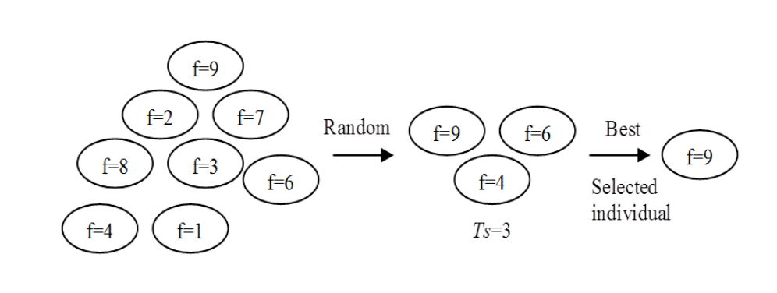
Tournament selection
Tournament selection is a method of selecting an individual from a population of individuals in a genetic algorithm
It involves running several "tournaments" among a few individuals chosen at random from the population
The winner of each tournament (the one with the best fitness) is selected for crossover
Selection directly varies with the tournament size - the more competitors, the higher the resulting selection pressure
Selection strategy with tournament mechanism

Slide 23
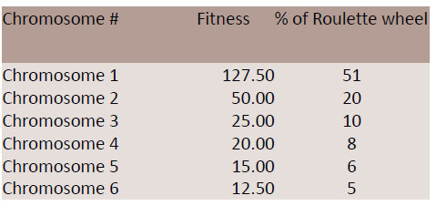
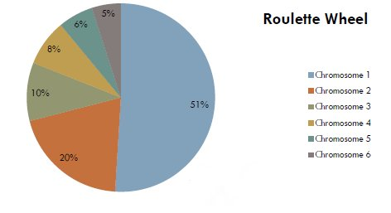
Roulette wheel selection
A way of choosing members from the population of chromosomes in a way that is proportional to their fitness.

Slide 24
selection
To choose a chromosome all you have to do is spin the ball and grab the chromosome at the point it stops.
It does not guarantee that the fittest member goes through to the next generation.
The Roulette wheel selection will have problems when the fitness values differ very much.
Steady state selection:
A few good chromosomes are used for creating new offspring in every iteration.
Some bad chromosomes are removed and the new offspring is placed in their places.
The rest of population migrates to the next generation without going through selection process.

Slide 25
Crossover
The crossover operator is used to create new solutions from the existing solutions available in the mating pool after applying selection operator.
This operator exchanges the gene information between the solutions in the mating pool.
The most popular crossover selects any two solutions strings randomly from the mating pool and some portion of the strings is exchanged between the strings.
The selection point is chosen randomly.
A probability of crossover give freedom to an individual solution string to determine whether the solution would go for crossover or not.

Slide 26
If S1=000000 and s2=111111
Crossover point is 2
S1'=110000 and s2'=001111
The two new offspring are put into the next generation of the population.
By recombining portions of good individuals, likely to create even better individuals

Slide 27
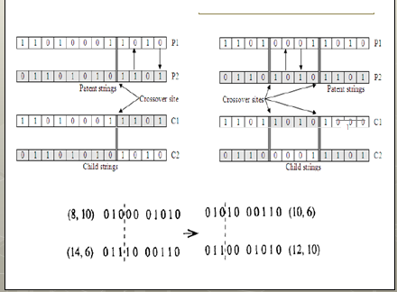
Crossover

Slide 28
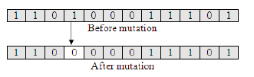
Mutation
Mutation is the occasional introduction of new features into the solution strings of the population pool to maintain diversity in the population.
Mutation operator changes a 1 to 0 or vice-versa
The mutation probability is generally kept low
The crossover probability is higher than Mutation probability

Slide 29
Elitism
Crossover and mutation may destroy the best solution of the population pool.
Elitism is the preservation of few best solution of the population pool.
Elitism is defined in percentage or in number.

Slide 30
Example
Given the digits 0 through 9 and the operators +, -, * and /, find a sequence that will represent a given target number. The operators will be applied sequentially from left to right as you read.
Say, the target number 23, the sequence 6+5*4/2+1 would be one possible solution.
If 75.5 is the chosen number then 5/2+9*7-5 would be a possible solution.

Slide 31
ENCODING
Four bits are required to represent the range of characters used:
0: 0000
1: 0001
2: 0010
3: 0011
4: 0100
5: 0101
6: 0110
7: 0111
8: 1000
9: 1001
+: 1010
-: 1011
*: 1100
/: 1101

Slide 32
6+5*4/2+1 would be represented by nine genes like so:
0110 1010 0101 1100 0100 1101 0010 1010 0001
6 + 5 * 4 / 2 + 1
chromosome:
011010100101110001001101001010100001

Slide 33
Fitness Function
A fitness score is inversely proportional to the difference between the solution and the value a decoded chromosome represents.

Slide 34
PSO particle swarm optimization

Slide 35
What is PSO ?
Particle swarm optimization (PSO) is a population (swarm intelligence) based stochastic optimization algorithm to find an optimum solution in a search space.
Developed by Eberhart and Kennedy in 1995, inspired by social behavior of bird flocking or fish schooling.
A number of agents (particles) constitute a swarm moving around in the search space looking for the best solution.
Each particle is a point in a N-dimensional space which adjusts its “flying” according to its own flying experience as well as the flying experience of other particles.

Slide 36
How does it work ?
Each particle keeps track of its coordinates in the solution space, associated with the best solution (fitness) that has achieved so far. This value is called personal best , pbest.
Another value that is tracked by the PSO is the best value obtained so far by any particle in the neighbourhood of that particle. This value is called global best or gbest.
The basic concept of PSO lies in accelerating each particle toward its pbest and the gbest locations, with a random weighted acceleration at each time step.

Slide 37
Flow chart of PSO
Initialize particles with random position (S) and velocity (V)
Particle m
……..
Particle 1
Evaluate position (fitness)
If fitness(S) >fitness(Pbest)
Pbest=S
If fitness(S) >fitness(gbest)
gbest=S
Max-iter ation reached
Update Position
Update velocity
yes
Stop: giving gbest, optimal solution

Slide 38
Overview of PSO
Each particle tries to modify its position using information:
the current positions,
the current velocities,
the distance between the current position and pbest,
the distance between the current position and the gbest.
The modification of the particle’s velocity modeled as:
V_{i}^{k+1}= wV_{i}^{k} + c₁ rand₁ * (pbest_{i} - s_{i}^{k}) + c₂ rand₂* (gbest - s_{i}^{k}) ….. (1)
where, v_{i}^{k} : velocity of agent i at iteration k, w: weighting function, c_{j} : weighting factor, rand : uniformly distributed random number between 0 and 1, s_{i}^{k} : current position of agent i at iteration k, pbest_{i} : personal best position of agent i, gbest: global best position of the group

Slide 39
Overview of PSO
s^{k} : current searching point. s^{k+1}: modified searching point. v^{k}: current velocity. v^{k+1}: modified velocity. v_{pbest} : velocity based on pbest v_{gbest} : velocity based on gbest
Vector space
Concept of modification of a searching point by PSO

Slide 40
Overview of PSO
The weight function is usually utilized in (I) as:
w = wMax-[(wMax-wMin) × iter]/max-iter …………… (II)
where wMax = initial weight,
wMin = final weight,
max-iter = maximum iteration number,
iter = current iteration number.
The modification of the particle’s position mathematically modeled as:
s_{i}^{k+1} = s_{i}^{k} + V_{i}^{k+1} ……………………..(III)

Slide 41
Overview of PSO
V_{i}^{k+1} = w V_{i}^{k} +c₁ rand₁ * (pbest_{i}-s_{i}^{k}) + c₂ rand₂* (gbest-s_{i}^{k})…….(I)
Previous velocity V_{i}^{k}
Inertia Component
Memory of previous
flight direction
prevents particle from drastically change direction
Social Component
Quantifies performance relative neighbors
Cognitive Component
Quantifies performance relative to past performances
Memory of previous best position
pbest_{i} (t) : personal best position of agent i at time t
pbest_{i} (t+1) =
pbest_{i} (t) if f(s_{i}^{k+1})≥ f(pbest_{i} (t) )
s_{i}^{k+1} if f(s_{i}^{k+1}) <f(pbest_{i} (t) )
gbest(t) : global best position of the neighbor
f(gbest(t+1) )= min {f(pbest₀(t)), f(pbest₁(t)) ………..f(pbest_{n} (t))}

Slide 42
Exploration-Exploitation Trade-off
Exploration : The ability to explore regions of the search space
Exploitation : The ability to concentrate the search around a promising area to refine a candidate solution
The inertia weight function
Control Exploration-Exploitation dilemma
Control the momentum
Velocity changes : V_{i}^{k+1} = wV_{i}^{k} +c₁ rand₁ * (pbest_{i}-s_{i}^{k}) + c₂ rand₂* (gbest-s_{i}^{k})
For w ≥1
Velocities increase over time
Swarm diverges
Particles fails to change direction towards more promising region
For 0 < w <1
Particles decelerate
Convergence also depend on the values of c1 and c2
Exploration-Exploitation
Large values→ favor exploration
Small values→ promote exploitation
Inertia weight is problem dependent

Slide 43
Comparison with GA
Unlike in genetic algorithms, evolutionary programming and evolutionary strategies, in PSO, there is no selection operation.
All particles in PSO are kept as members of the population through the course of the run
PSO is the only algorithm that does not implement the survival of the fittest.
No crossover operation in PSO, Updation of individual resembles mutation in GA.
in PSO the balance between the global and local search can be adjusted through the inertial weight factor (w)
Both PSO and GA are generational , that is both repeat the same set of process for a predetermined amount of time

Slide 44
DE Differential Evolution

Slide 45
The Basics of
Differential Evolution
Many practical problems have objective functions that are non differentiable, discontinuous, non-linear, noisy, flat, multi-dimensional or have many local minima.
Such problems are difficult if not impossible to solve analytically, DE can be used to find approximate solutions to such problems.
The goal is to find a solution m for which f(m) ≤ f(p) for all p in the search-space, which would mean is the global minimum.
DE uses a population of vectors where the stochastic perturbation of the vectors can be done independently.

Slide 46
The Basics of
Differential Evolution
Population is comprised of NP vectors each of dimension D.
NP does not change during the algorithm’s life time.
The initial population is chosen randomly and should cover the entire parameter space.
The usual assumption is that all features or attributes vary in a uniform manner, unless otherwise stated.
If an initial or preliminary solution can be computed or is available, the initial population can be obtained by adding normally distributed random deviations to the preliminary solution.

Slide 47
Differential Evolution
DE was designed to be a stochastic direct search method.
It can be used to minimize any function for which a global minimum exists.
Introduced by Storn and Price in 1996
Developed to optimise real parameter, real valued functions.
General problem formulation is:
For an objective function f : X⊆ R^{D} →R where the feasible region X ≠⌽,
the minimization problem is to find
x* € X such that f(x*)≤ f(x) for all x € X
Where :f(x) ≠-∞

Slide 48
The Basics components of
Differential Evolution
Mutation or Peturbation: DE generates new individuals in the population by adding weighted difference between two population vectors to a third vector (the mutated vector).
Crossover or Diversity: The mutated vector’s parameters are then mixed with the parameters of another pre-determined vector, the target vector, to yield a trial vector.
Selection: If the trial vector yields a lower cost function value than the target vector, the trial vector replaces the target vector in the next generation.
Each population vector must serve once as the target vector so that NP competitions take place in one generation.
Main stages of DE algorithm
Initialization of vectors
Difference vector based mutation
Crossover/ Recombination
Selection

Slide 49
Initialization of the parameter vectors
DE searches global optimum point in a D-dimensional real parameter space R^{D}
It begins with a randomly initiated population of size NP, D-dimensional real-valued parameter vectors.
Each vector, also known as chromosome, forms a candidate solution to the multidimensional optimization problem.
For each parameter of the problem, there may be a certain range within which the value of the parameter should be restricted.

Slide 50
The i-th vector of the population at the current generation:
Xi,G = [x1,i,G, x2,i,G, x3,i,G, ....., xD,i,G]
The initial population (at G = 0) should cover the range as much as possible by uniformly randomizing individuals within the search space constrained by the prescribed minimum and maximum bounds:
Xmin = {x1,min, x2,min, ..., xD,min} and
Xmax = {x1,max, x2,max, ..., xD,max}.
Hence we may initialize the j-th component of the i-th vector as
xj,i,0 = xj,min + randi,j[0, 1] · (xj,max− xj,min)

Slide 51
Mutation
DE mutation is seen as change or perturbation with a random element
Let the population in generation G be X_{i,G} ,where i = 1,2,………….NP
Each member of the current generation is known as a target vector
For each target vector x_{i,G} in generation G, a mutant vector (donor vector) is generated for generation G + 1 according to
V_{i,G+1} = x_{r1,G} + F * (x_{r2,G} – x_{r3,G} )
with random indexes r₁,r₂, r₃ ε {1 ,2……..,NP}.
The three indexes are mutually different and also different from index i.
F is a scalar number typically lies in the interval [0.4,1] and controls the amplification of the differential variation F * (x_{r2,G} – x_{r3,G} )
(x_{r2,G} – x_{r3,G} ) this generate a new vector

Slide 52
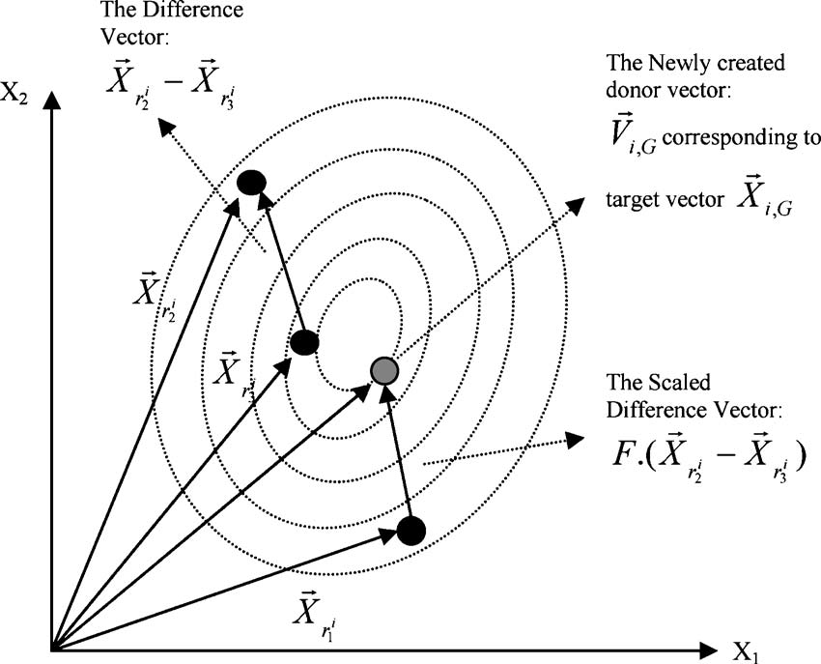
Mutation

Slide 53
Crossover
The goal is to increase the diversity of the perturbed population vectors.
The donor vector exchanges its components with the target vector to form trial vector.
The trial vector for generation G + 1 is given as
U_{i,G+1} =( u_{1,i,G+1} , u_{2,i,G+1} ,…………………..,u_{D,i,G+1} )
Each component of the trial vector for generation G + 1 is formed in the following manner.
u_{j,i,G} = v_{j,i,G,} if (rand_{i,j}[0, 1] ≤ Cr or j = j_{rand} )
x_{j,i,G}, otherwise,
Here, rand_{j}[0,1] is the j^{th} evaluation of a uniform random number generator with outcome ε [0,1]. Cr is the crossover constant ε [0, 1], given by the user.
j_{rand} is a randomly chosen index ε 1, 2,…………….,D, which ensures that u_{i,G+1} gets at least one parameter from v_{i,G+1}.

Slide 54
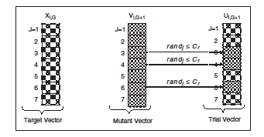
Crossover

Slide 55
Crossover
The DE family of algorithms can use two kinds of crossover methods
exponential (or two-point modulo)
binomial (or uniform)
In exponential crossover, we first choose an integer n randomly among the numbers [1,D]
This integer acts as a starting point in the target vector, from where the crossover or exchange of components with the donor vector starts
We also choose another integer L from the interval [1,D]. L denotes the number of components the donor vector actually contributes to the target vector.
After choosing n and L the trial vector is obtained as
u_{j,i,G} = v_{j,i,G} for j = ‹ n ›_{D} ‹ n+1 ›_{D,} , ..., ‹ n+L-1 ›_{D}
x_{j,i,G} for all other j ∈ [1,D] (4)
where the angular brackets ‹›_{D} denote a modulo function with modulus D.

Slide 56
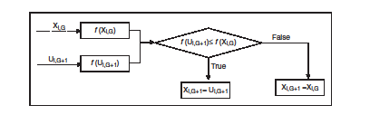
selection
To keep the population size constant over subsequent generations selection is called.
To decide whether the target or trail vector survives to its next generation or it should become a member of generation G + 1
The trial vector u_{i,G+1} is compared with the target vector x_{i,G}. if vector u_{i,G+1} yields a smaller value than x_{i,G}, then x_{i,G+1} is set to u_{i,G+1}; otherwise, the old value x_{i,G} is retained
X_{i,G+1} = U_{i,G} if f (U_{i,G)} )≤ f (X_{i,G}),
= X_{i,G} otherwise.
f(.) is the object function to be minimized

Slide 57
Pseudo-code for DE
Step 1: Set the control parameters of DE: scale factor F, crossover rate Cr, and the population size NP.
Step 2: Set the generation number G = 0 and randomly initialize a population of NP individuals
P_{G} = {X_{1,G,} ......, X_{NP,G}} with X_{i,G} = [x_{1,i,G} ,x_{2,i,G} x_{3,i,G}, ....., x_{D,i,G}] and
each individual uniformly distributed over the range [X_{min}, X_{max}],
where X_{min} = {x_{1,min}, x_{2,min}, ..., x_{D,min}} and
X_{max} = {x_{1,max}, x_{2,max}, ..., x_{D,max}} with i = [1, 2, ....,NP].
Step 3. WHILE the stopping criterion is not satisfied
DO
FOR i = 1 to NP //do for each individual sequentially
Step 3.1 Mutation Step
Generate a donor vector Vi,G = {v_{1,i,G}, ......., v_{D,i,G}} corresponding to the i-th target vector X_{i,G} via the differential mutation scheme of DE as:
V _{i,G} = X_{r}^{i}_{1,G} + F · (X_{ri2,G}− X_{ri3,G}).

Slide 58
Pseudo-code for DE
Step 3.2 Crossover Step
Generate a trial vector Ui,G = {u_{1,i,G}, ......., u_{D,i,G}} for the i^{th} target vector X_{i,G} through binomial crossover in the following way:
u_{j,i,G} = v_{j,i,G,} if (rand_{i,j}[0, 1] ≤ Cr or j = j_{rand} )
x_{j,i,G}, otherwise,
Step 2.3 Selection Step
Evaluate the trial vector U_{i,G}
IF f (U_{i,G)} )≤ f (X_{i,G}),
THEN X_{i,G+1} = U_{i,G}
ELSE X_{i,G+1} = X_{i,G}.
END IF
END FOR
Step 2.4 Increase the Generation Count
G = G + 1
END WHILE

Slide 59
Variants of DE
The scheme DE/x/y/z is used to describe variants of DE
x specifies the vector to be mutated; examples: rand for random, best for the lowest cost vector from the current population
y is the number of difference vectors used.
z is the crossover scheme.
The scheme described earlier can be written as DE/rand/1/bin where bin stand for binary crossover using random numbers discussed earlier

Slide 60
Variants of DE
There are total 10 strategies suggested by Storn and Price
DE/rand/1: V _{i,G} = X_{r}^{i}_{1,G} + F · (X_{r}^{i}_{2,G}− X_{r}^{i}_{3,G})
DE/best/1 : V_{i,G} = X_{best,G} + F · (X_{ri1,G} − X_{ri2,G})
DE/best/2 : V_{i,G} = X_{best,G} + F · (_{Xri1,G}− X_{ri2,G})+F · (X_{ri3,G}− X_{ri4,G})
DE/rand/2 : V_{i,G} = X_{ri1,G} + F · (X_{ri2,G}− X_{ri3,G)}+F · (X_{ri4,G} − X_{ri5,G})
DE/target − to − best/1 : V_{i,G} =X_{i,G}+F · (X_{best,G} − X_{i,G}) + F · (_{Xri1,G} − X_{ri2,G})
Each strategy of the above five types of mutation strategies are combined with either exponential or binomial cross over, so this yeilds (5*2)=10 strategies.

Slide 61
Features
DE exhibits much better performance for unimodal, multimodal, separable and non-separable problems.
The gross performance of DE in terms of accuracy, convergence speed, and robustness is very high.
The number of control parameters in DE is very few (Cr, F, and NP in classical DE). The effects of these parameters improve the performance of the algorithm to a large extent without imposing any serious computational burden.
The space complexity of DE is low as compared to some of the most competitive real parameter optimizers. This feature helps in extending DE for handling large scale and expensive optimization problems

Slide 62
References
Kalyanmoy Deb, “Multi-objective Optimization using evolutionary Algorithms”
James Kenedy and Russell Eberhart “Particle Swarm Optimization”
Swagatam Das and Ponnuthuai Nagaratnam Suganthan “Differential evolution: A Survey of the State-of-the-Art”
Applications of Evolutionary Algorithms in VLSI: Parameter Extraction of Advanced MOSFET Models and Automatic Analog Circuit Design Paperback by Rajesh A. Thakker , Mahesh B. Patil , Maryam Shojaei Baghini.
Genetic algorithm based design optimization of CMOS VLSI circuits, Anthony M. Hill, Sung-Mo (Steve) Kang

Slide 63
THANK YOU

