Slide 1
Topic9: Density-based Clustering
DBSCAN
DENCLUE
Remark: “short version” of Topic9

Slide 2
Density-Based Clustering Methods
Clustering based on density (local cluster criterion), such as density-connected points or based on an explicitly constructed density function
Major features:
Discover clusters of arbitrary shape
Handle noise
One scan
Need density parameters
Several interesting studies:
DBSCAN: Ester, et al. (KDD’96)
DENCLUE: Hinneburg & D. Keim (KDD’98/2006)
OPTICS: Ankerst, et al (SIGMOD’99).
CLIQUE: Agrawal, et al. (SIGMOD’98)

Slide 3
Density Concepts
DBSCAN is a density-based algorithm.
Density = number of points within a specified radius r (Eps)
Two global parameters:
Eps: Maximum radius of the neighbourhood
MinPts: Minimum number of points in an Eps-neighbourhood of that point
Core Object: object with at least MinPts objects within a radius ‘Eps-neighborhood’
Border Object: object that on the border of a cluster
p
MinPts = 5
Eps = 1 cm
q

Slide 4
Density-Based Clustering: Background
N_{Eps}(p): {q belongs to D | dist(p,q) <= Eps}
Directly density-reachable: A point p is directly density-reachable from a point q wrt. Eps, MinPts if
1) p belongs to N_{Eps}(q)
2) |N_{Eps} (q)| >= MinPts
(core point condition)
p
MinPts = 5
Eps = 1 cm
q

Slide 5
Density-Based Clustering: Background (II)
Density-reachable:
A point p is density-reachable from a point q wrt. Eps, MinPts if there is a chain of points p₁, …, p_{n}, p₁ = q, p_{n} = p such that p_{i+1} is directly density-reachable from p_{i}
Density-connected
A point p is density-connected to a point q wrt. Eps, MinPts if there is a point o such that both, p and q are density-reachable from o wrt. Eps and MinPts.
p
p₁
q
p
q
o

Slide 6
DBSCAN: Density Based Spatial Clustering of Applications with Noise
Relies on a density-based notion of cluster: A cluster is defined as a maximal set of density-connected points
Discovers clusters of arbitrary shape in spatial databases with noise
Border point: is a point which is not a core point but lies with in the neighborhood of a core point.
Noise point: is a point which is not a core or border point.

Slide 7
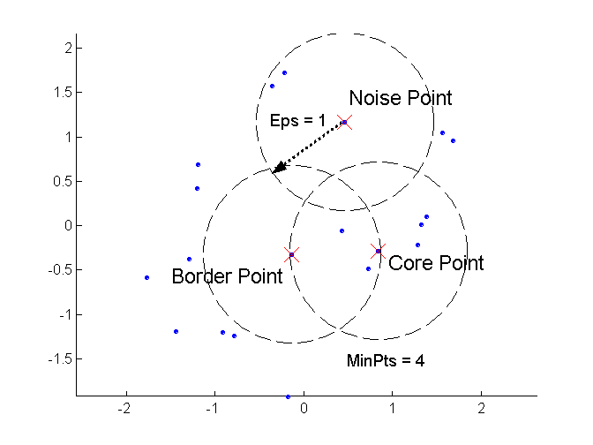
DBSCAN: Core, Border, and Noise Points

Slide 8
DBSCAN: The Algorithm (1)
Arbitrary select a point p
Retrieve all points density-reachable from p wrt Eps and MinPts.
If p is a core point, a cluster is formed.
If p is a border point, no points are density-reachable from p and DBSCAN visits the next point of the database.
Continue the process until all of the points have been processed.

Slide 9
DBSCAN Algorithm 2
Create a graph whose nodes are the points to be clustered
For each core-point c create an edge from c to every point p in the ε-neighborhood of c
Set N to the nodes of the graph;
If N does not contain any core points terminate
Pick a core point c in N
Let X be the set of nodes that can be reached from c by going forward;
create a cluster containing X∪{c}
N=N - (X∪{c})
Continue with step 4
Remark: points that are not assigned to any cluster are outliers;

Slide 10
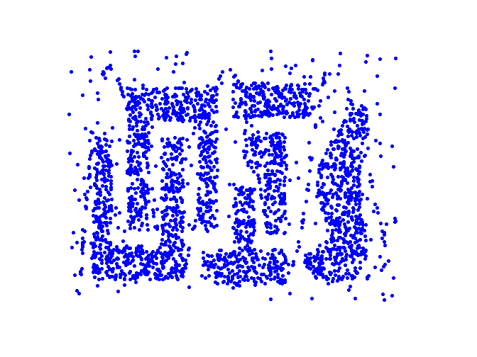
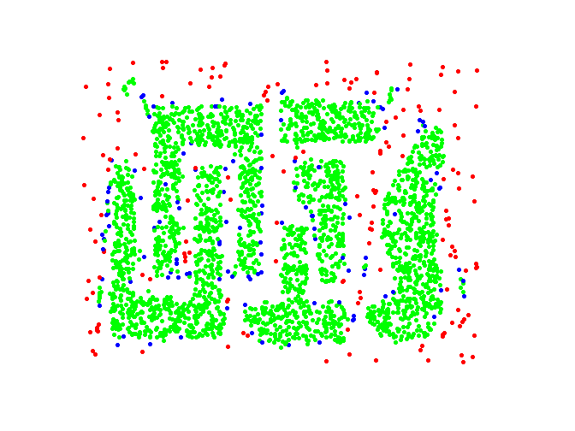
DBSCAN: Core, Border and Noise Points
Original Points
Point types: core, border and noise
Eps = 10, MinPts = 4

Slide 11
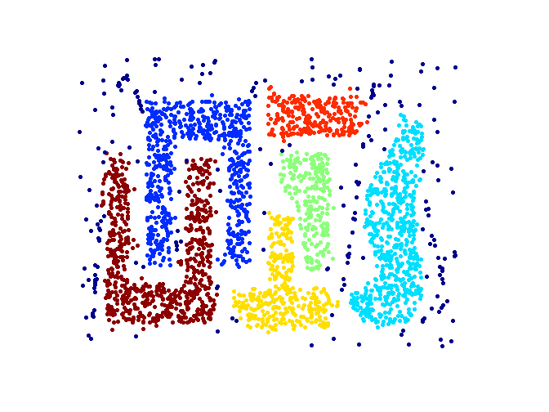
When DBSCAN Works Well
Original Points
Clusters
Resistant to Noise
Can handle clusters of different shapes and sizes

Slide 12
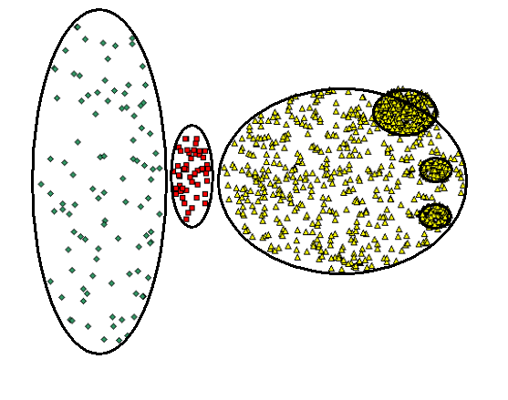
When DBSCAN Does NOT Work Well
(MinPts=4, Eps=9.75).
Original Points
Varying densities
High-dimensional data
(MinPts=4, Eps=9.92)

Slide 13
R*-Tree(1)
R*-Tree: A spatial index
Generalize the 1-dimensional B+Tree to d-dimensional data spaces

Slide 14
R*-tree(2)
R*-Tree is a height-balanced data structure
Search key is a collection of d-dimensional intervals
Search key value is referred to as bounding boxes

Slide 15
R*-Tree(3)
Query a bounding box B in R*-Tree:
Test bounding box for each child of root
if it overlaps B, search the child’s subtree
If more than one child of root has a bounding box overlapping B, we must search all the corresponding subtrees
Important difference between B+tree: search for single point can lead to several paths

Slide 16
DBSCAN Complexity Comparison
Time Complexity | A single neighborhood query | DBSCAN
Without index | O(n) | O(n²)
R*-tree | O(log n) | O(n*log n)
The height of a R*-Tree is O(log n) in the worst case
A query with a “small” region traverses only a limited number of paths in the R*-Tree
For each point, at most one neighborhood query is needed

Slide 17
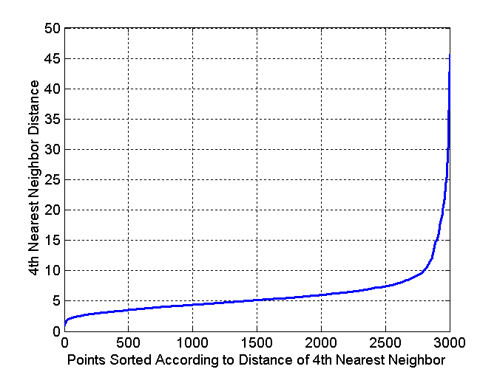
DBSCAN: Determining EPS and MinPts
Idea is that for points in a cluster, their k^{th} nearest neighbors are at roughly the same distance
Noise points have the k^{th} nearest neighbor at farther distance
So, plot sorted distance of every point to its k^{th} nearest neighbor
Core-points
Non-Core-points
Run K-means for Minp=4 and not fixed

Slide 18
Heuristic for Eps and Minpts
K-dist (p): distance from the kth nearest neighbour to p
Sorting by k-dist (p)
Minpts: k>4 no significant difference, but more computation, thus set k=4

Slide 19
Performance Evaluation compared with CLARANS (1)
Accuracy
CLARANS:
DBSCAN:

Slide 20
Summary DBSCAN
Good: can detect arbitrary shapes, not very sensitive to noise, supports outlier detection, complexity is kind of okay, beside K-means the second most used clustering algorithm.
Bad: does not work well in high-dimensional datasets, parameter selection is tricky, has problems of identifying clusters of varying densities.

Slide 21
DENCLUE (http://www2.cs.uh.edu/~ceick/ML/Denclue2.pdf )
DENsity-based CLUstEring by Hinneburg & Keim (KDD’98)
Major features
Solid mathematical foundation
Good for data sets with large amounts of noise
Allows a compact mathematical description of arbitrarily shaped clusters in high-dimensional data sets
Significant faster than existing algorithm (faster than DBSCAN by a factor of up to 45) ????????
But needs a large number of parameters

Slide 22
Denclue: Technical Essence
Uses grid cells but only keeps information about grid cells that do actually contain data points and manages these cells in a tree-based access structure.
Influence function: describes the impact of a data point within its neighborhood.
Overall density of the data space can be calculated as the sum of the influence function of all data points.
Clusters can be determined using hill climbing by identifying density attractors; density attractors are local maximal of the overall density function.
Objects that are associated with the same density attractor belong to the same cluster.

Slide 23
Gradient: The steepness of a slope
Example

Slide 24
Example: Density Computation
D={x1,x2,x3,x4}
f^{D}_{Gaussian}(x)= influence(x,x1) + influence(x,x2) + influence(x,x3)
+ influence(x4)=0.04+0.06+0.08+0.6=0.78
x1
0.04
x3
y
0.08
x2
x4
0.06
x
0.6
Remark: the density value of y would be larger than the one for x

Slide 25
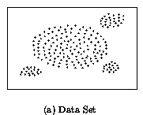
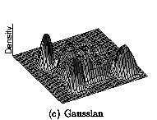
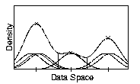
Density Attractor

Slide 26
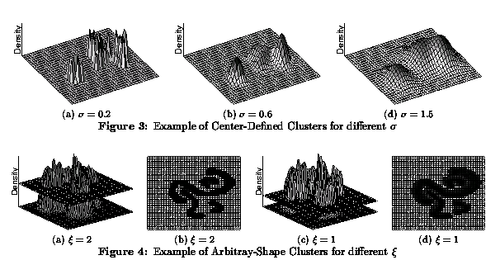
Examples of DENCLUE Clusters

Slide 27
Basic Steps DENCLUE Algorithms
Determine density attractors
Associate data objects with density attractors using hill climbing
Possibly, merge the initial clusters further relying on a hierarchical clustering approach (optional; not covered in this lecture)

