Slide 1
Cluster Validation

Slide 2
Cluster Validation
Many interesting algorithms applied to analyze very large datasets. Most algorithms don’t provide any means for its validation and evaluation.
So it is very difficult to conclude which are the best clusters and should be taken for analysis.

Slide 3
Cluster Validation
whatever the intention of clustering may be, the number of clusters sought is always unknown (more or less).
Some internal measures:
compactness, connectedness, separation and combinations

Slide 4
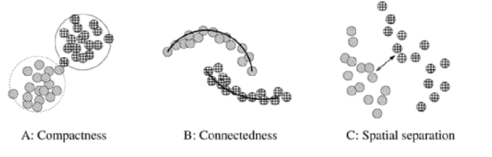
Internal measures

Slide 5
Optimal Clusters
There are several robust strategies for predicting optimal clusters:
(1) silhouette index
(2) Dunn’s index, and
(3) Davies-Bouldin (DB) index.
(4) Xie-Beni (XB) index
(5) I-index
(6) CS-index

Slide 6
Distance
Calculate a distance between 2 points p (x₁, y₁) and q (x₂, y₂) in XY-plane.
Euclidean distance
Chebyshev distance
Manhattan distance
Mahalanobis distance
Minkowski distance

Slide 7
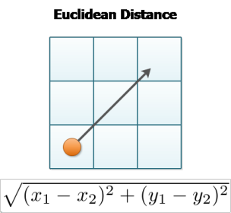
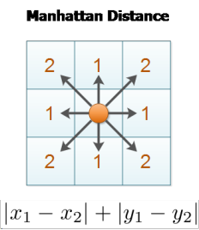
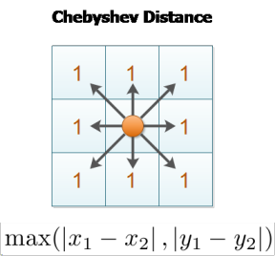
Distance

Slide 8
Intercluster distance (δ)
Let S and T are clusters formed using partition U. d(x, y) is the distance between two objects x and y belonging to S and T respectively. d (x, y) is calculated using well known metrics such as Euclidean, Manhattan and Chebychev. |S| and |T| are the number of objects in clusters S and T respectively.

Slide 9

Intercluster distance (δ)
(1) The single linkage distance is the closest distance between two objects belonging to two different clusters defined as:-.

Slide 10

Intercluster distance (δ)
  (2) The complete linkage distance represents the distance between the most remote objects belonging to two different clusters, given as:-

Slide 11

Intercluster distance (δ)
(3) The average linkage distance defines the average distance between all the objects belonging to two different clusters, described as:-

Slide 12

Intercluster distance (δ)
  (4) The centroid linkage distance reflects the distance between the centers vs and vt of two clusters S and T respectively, presented below:-
where,

Slide 13

Intercluster distance (δ)
(5) The average of centroids linkage represents the distance between the center of a cluster and all the objects belonging to a different cluster, explained as:-

Slide 14

Intracluster distance (Δ)
There are basically three types of intracluster distances:
(1) The complete diameter distance is the distance between the most remote objects belonging to the same cluster, as given below:-

Slide 15

Intracluster distance (Δ)
(2) The average diameter distance represents the average distance between all the objects belonging to the same cluster, as defined below:-

Slide 16


Intracluster distance (Δ)
(3) The centroid diameter distance defines the double average distance between all of the objects and the cluster’s center, as illustrated below:-
where

Slide 17

Dunn’s Index
the Dunn’s validation index, DIndex, is defined as:
δ (X_{i}, X_{j}) is the intercluster distance i.e. the distance between cluster X_{i} and X_{j} and Δ(X_{k}) is the intracluster distance of cluster X_{k} i.e. distance within the cluster X_{k}.

Slide 18
Dunn’s Index
The goal is to maximize the intercluster distances and minimizing the intracluster distances.
The large values of Dindex corresponds to good quality cluster.
Thus the number of clusters that maximizes DIndex is taken as the optimal number of clusters k

Slide 19

Davies-Bouldin index DBIndex
Davies-Bouldin Index finds the set of clusters that are compact and well separated.
The Davies-Bouldin index DBIndex is defined as:
Small values of DBIndex (U) represents the good quality clusters k.

Slide 20
Optimal Cluster
By combining the intercluster distances and intracluster distances, many possible DIndex and DBIndex can be formulated for clusters with different values of k
The validity indices help to choose the good quality cluster.

Slide 21
Stability Based Validation
In paper of Famili and Liu, it is described that various indices cannot always determine the optimal number of clusters.
Also, the index value cannot identify proper clusters of a data set containing some redundant or outliers.

Slide 22
Stability Based Validation
They proposed a stability-based method that assesses the stability of objects in each cluster when it is partitioned
Here, a set of clustering results, with the number of clusters from 2 to n, has been collected from the same clustering algorithm.

Slide 23
Stability Based Validation
Let C_{c,l} be a set of objects in cluster l resulting from a clustering result with c (2 ≤ c ≤ n) clusters
When c=2, C₂₁ and C₂₂ be the objects in two clusters
When c=3, C₃₁ , C₃₂ and C₃₃ be the objects in three clusters and so on.
Let k (0 < k ≤ n – c) be the threshold at which the stability calculation of a cluster will stop

Slide 24

Stability Based Validation
Then, the cluster stability of cluster l is:
Then Sc,l calculates the k maximum number of overlapping objects between the considered cluster l and each of the clusters in a clustering results with the number of clusters i (c < i ≤ c + k).

Slide 25
Stability Based Validation
Then it takes the minimum of the k maximum values as the stability of the considered cluster l
To make the stabilities of different clusters comparable, the stability value is normalized to the range from 0 to 1 by dividing it with the number of objects in l. The closer the stability to 1, the more stable the cluster is.

Slide 26

Stability Based Validation
Let S_{c,l} be the stability of cluster l resulting from a clustering result with c clusters, then the general stability of the entire clustering with c clusters is:
The optimal number of clusters is a value q at which the general stability is the largest.

Slide 27
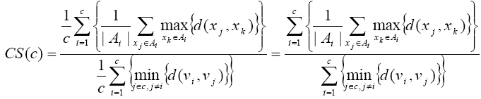
CS Index
Chein-Hsing Chou proposed the CS validity index that evaluates clusters when densities and sizes are different,

Slide 28
CS Index
where, d is the distance function and max{d(x_{j}, x_{k})} measures the ratio of the sum of within cluster scatter while min{d(v_{i}, v_{j})} measures the between cluster separation. Thus, CS index cluster validity measures scattering as a function of between cluster seperation.

Slide 29
Silhouette Index
The Silhouette validation technique calculates the silhouette index for each sample, average silhouette index for each cluster and overall average silhouette index for a dataset. Using the approach each cluster could be represented by silhouette index, which is based on the comparison of its tightness and separation.

Slide 30
Silhouette Index
The average silhouette index could be applied for evaluation of clustering validity and also could be used to decide how good are the number of selected clusters.
S(i) = (b(i) – a(i)) / max{(a(i), b(i))}
where, a(i) is the average dissimilarity of i-th object to all other objects in the same cluster and b(i) is the average dissimilarity of i-th object with all objects in the closest cluster.

Slide 31
Silhouette Index
Clearly, -1 ≤ s (i) ≤ 1.
If silhouette value is close to 1, sample is “well-clustered” and already assigned to a very appropriate cluster.
If silhouette value is about to zero, sample could be assign to another cluster closest to it, and the sample lies equally far away from both the clusters.
If silhouette value is close to –1, sample is “misclassified” and is merely placed somewhere in between the clusters.

Slide 32
Silhouette Index
The overall average silhouette index for the entire plot is simply the average of the S(i) for all objects in the whole dataset.
The largest overall average silhouette value indicates the best clustering (number of cluster) solutions. Therefore, the number of clusters with maximum overall average silhouette index is taken as the optimal number of clusters.

