Slide 1
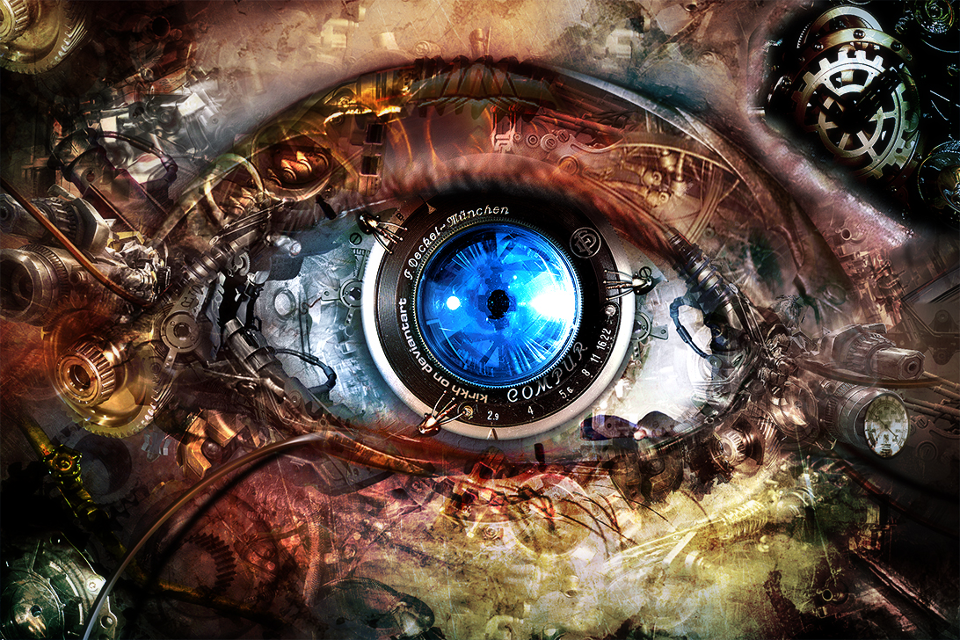
Object Recognition using CalTech-256 Dataset

Slide 2
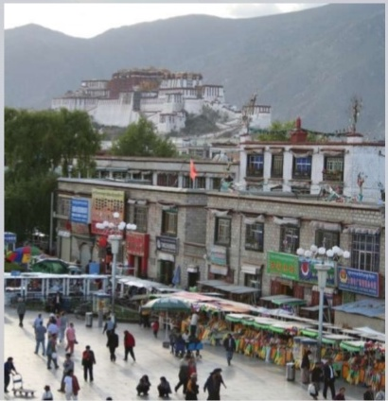
Introduction

Slide 3
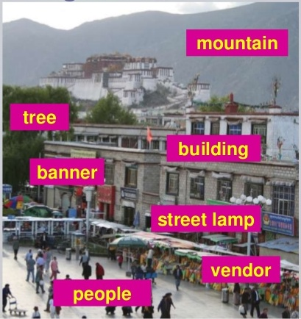
Introduction

Slide 4
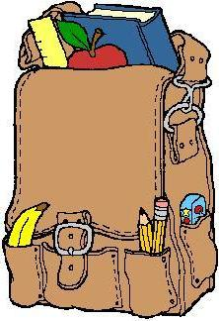
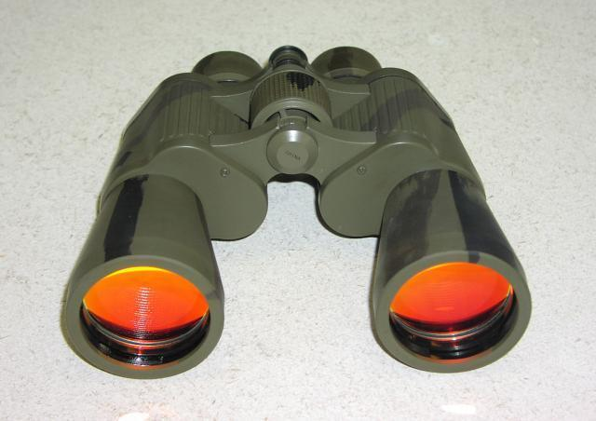
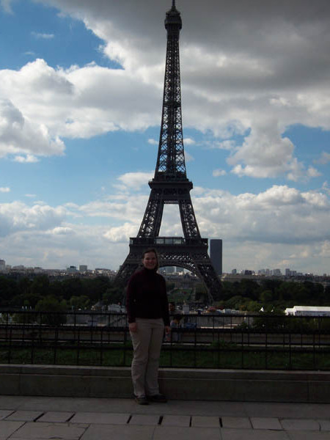
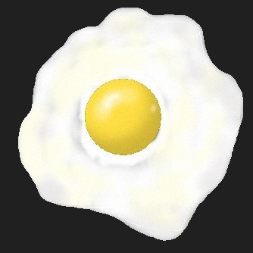
Problem statement
Bag
Binocular
Eiffel Tower
Fried egg

Slide 5
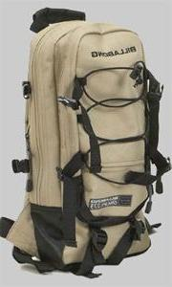
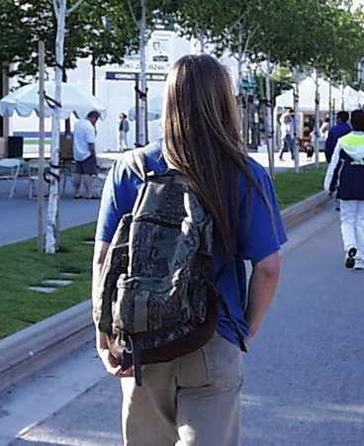
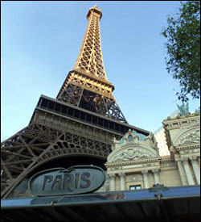
Challenges
Large variety
Clutter, illumination
Scale, orientation, occlusion

Slide 6
Traditional approach
Input Image
Machine Learning Algorithm
Training data
Feature Engineering
Classifier

Slide 7
Feature engineering
Gabor filters
Provides texture of an image
Similar to how human distinguish texture

Slide 8
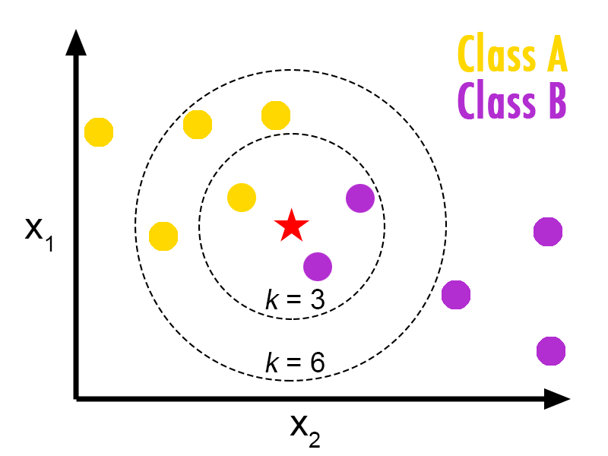
Method 1: KNN
Important parameters
Distance measure
Suitable value of K
Sample representation

Slide 9
KNN: Results
k | Distance measure | Test accuracy
1 | euclidean | 55.71
5 | euclidean | 56.9755
25 | euclidean | 51.9138
50 | euclidean | 53.1792
1 | cosine | 54.4446
5 | cosine | 55.71
25 | cosine | 50.6483
50 | cosine | 48.1175
1 | cityblock | 55.71
5 | cityblock | 60.7718
25 | cityblock | 54.4446
50 | cityblock | 51.9138
1 | correlation | 54.4446
5 | correlation | 55.71
25 | correlation | 50.6483
50 | correlation | 48.1175

Slide 10
Method 2: SVM
Important parameters
Kernel (linear, polynomial, Radial Basis Function, sigmoid)
C (error penalty) and gamma (relax constraint)

Slide 11
SVM: Results
c | gamma | Kernel | Train accuracy | Test accuracy
128 | 3.05175E-05 | linear |  | 42.50%
128 | 3.05175E-05 | poly | 42.80% | 25%
128 | 3.05175E-05 | RBF | 66.59% | 56.25%
128 | 3.05175E-05 | sigmoid | 62.22% | 57.50%

Slide 12
Method 3: ANN
Method 1 : Gabor filter
Method 2 : Linearization
Hidden layers use sigmoid activation function
Neurons in output layer use softmax activation function

Slide 13
ANN: Results
Method | Input Size | Hidden layer | # of neurons in hidden layer | Train | Test
Gabor filter | 4096 | 1 | 2048 | 81.10% | 50.60%
Gabor filter | 4096 | 1 | 4096 | 63.60% | 54.30%
Gabor filter | 4096 | 1 | 8192 | 81.10% | 50.60%
Linear | 784 | 1 | 1024 | 99% | 70.40%
Linear | 784 | 1 | 2048 | 92% | 71%

Slide 14
A State of the art technique : Deep Convolutional Neural Network
Popularized by LeCun et. al. in their pioneering work LeNet-5, a 7-level network by that classifies digits
A convolutional neural network (CNN, or ConvNet) is a type of feed-forward artificial neural network (ANN)
The connectivity pattern between its neurons is inspired by the organization of the animal visual cortex

Slide 15
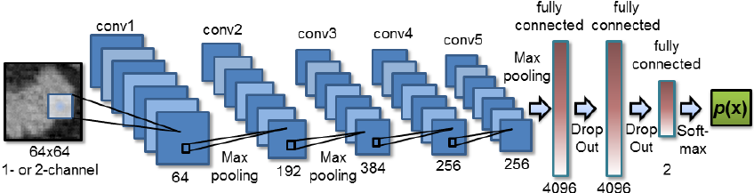
Typical ConvNet architecture

Slide 16
Typical ConvNet architecture

Slide 17
Typical ConvNet architecture

Slide 18
Results
Index | Input Image Size | # of conv layer | # of features in conv layer 1 | # of features in conv layer 2 | # of features in conv layer 3 | # of fully connected layer | Fully connected layer 1 | Fully connected layer 2 | Train Accuracy | Test Accuracy
CNN 1 | 28x28 | 2 | 32 | 64 | NA | 1 | 64 | NA | 45.43% | 26.25%
CNN 2 | 28x28 | 2 | 32 | 64 | NA | 1 | 1024 | NA | 79.78% | 27.50%
CNN 3 | 64x64 | 3 | 32 | 64 | 128 | 1 | 1024 | NA | 91% | 42.50%
CNN 4 | 28x28 | 2 | 64 | 128 | NA | 2 | 1024 | 1024 | 96.82% | 69.69%
CNN 5 | 28x28 | 2 | 128 | 256 | NA | 2 | 1024 | 1024 | 96.54% | 67.81%

Slide 19
Comparison

Slide 20
Conclusion
Handcrafted features for large variety of images is unreliable and fragile

Slide 21
Conclusion
Handcrafted features for large variety of images is unreliable and fragile
Featureless approach to computer vision problem is more robust

Slide 22
Conclusion
Handcrafted features for large variety of images is unreliable and fragile
Featureless approach to computer vision problem is more robust
Deep convolutional neural nets trained with large dataset yield better accuracy than learning algorithm with traditional hand crafted feature (Ref: ImageNet)

Slide 23
Conclusion
Handcrafted features for large variety of images is unreliable and fragile
Featureless approach to computer vision problem is more robust
Deep convolutional neural nets trained with large dataset yield better accuracy than learning algorithm with traditional hand crafted feature (Ref: ImageNet)
Modern computer vision research is moving towards featureless approach with ConvNet
ImageNet
GoogLeNet

Slide 24
References
Zhang et. al. - SVM-KNN: Discriminative Nearest Neighbor Classification for Visual Category Recognition
Lecun et. al. - Backpropagation Applied to Handwritten Zip Code Recognition
Krizhevsky et. al. - ImageNet Classification with Deep Convolutional Neural Networks
Zeiler et. al. - Visualizing and Understanding Convolutional Networks
Deep MNIST for Experts using TensorFlow

