Slide 1
Real-time face recognition project with OpenCV and Python

Slide 2
Introduction
Briefly introduce the topic and provide an overview of the presentation.
Mention the importance of face recognition technology in various fields such as security, marketing, and entertainment.

Slide 3
Overview of OpenCV and Python
Explain what OpenCV is and its use in computer vision applications.
Discuss the advantages of using Python with OpenCV.

Slide 4
Face detection using OpenCV and Python
Explain the basic face detection algorithm used in OpenCV.
Demonstrate how to use OpenCV and Python to detect faces in images and video streams.

Slide 5
Face recognition using OpenCV and Python
Explain the concept of face recognition and how it differs from face detection.
Demonstrate how to use OpenCV and Python to train a face recognition model and recognize faces in real-time.

Slide 6
Improving face recognition accuracy
Discuss the various factors that can affect the accuracy of face recognition systems.
Explain how to improve face recognition accuracy by optimizing parameters such as face detection threshold, image resolution, and training data.

Slide 7
Real-world applications of face recognition technology
Discuss the various real-world applications of face recognition technology such as security systems, social media, and marketing.
Explain the benefits and potential drawbacks of using face recognition technology.

Slide 8
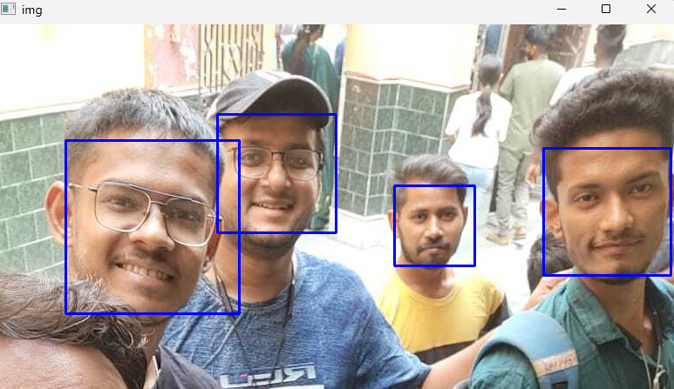
Samples

Slide 9
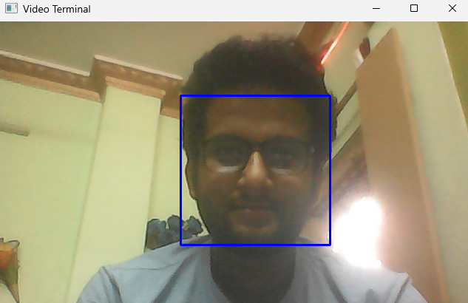
Samples

Slide 10
Conclusion
Summarize the main points of the presentation.
Encourage the audience to explore face recognition technology further and consider its potential uses and implications.

