Slide 1
Credit Card Fraud Detection Using Anomaly Detection Techniques
Presented by: Anubhav Sharma
Last Updated: 16th October 2023
Notes:
Hello

Slide 2
Table of Contents
Executive Summary
Problem Statement
Related Works
Proposed Work
Evaluation
Timeline
Conclusion
References

Slide 3
Executive Summary
In recent years due to COVID Pandemic and increasing growth of computing power the whole world has seen a wider acceptance of Artificial Intelligence and Machine Learning Technologies and this has not only led to good things but also bad things like increasing number of Credit Card Frauds. US alone has seen Credit Card Frauds increasing by more than Three Times from 2018 to 2022 due to increasing number of ways one can do these Frauds.
To handle new threats, we need to handle new tools too, and in this project we will cover multiple Anomaly Detection Techniques and apply them to a Real World Credit Card Fraud Transaction Dataset. We will follow KDD process, namely Data Procurement and Preprocessing, Data Analysis or EDA, Data Modelling, Model Evaluation, and Conclusion.
We will be applying different types of techniques, from Traditional Ones to more complex ones like Auto Encoders and compare them. By doing this project on a Local Hardware and free Cloud one we aim to show with this project that as Perpetrators get more power to do fraud, we also have more powerful techniques to stop them even with Computing Resources anyone can access freely on net.

Slide 4
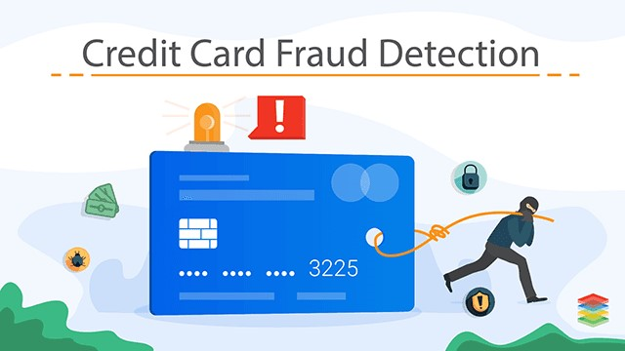
Problem Statement
Credit Card Frauds are harmful for both customers and companies leading to issues like identity theft and credit card decline for crucial purchases made by the customer because of breach of Credit Card limits by the Perpetrators, and for companies these events show the vulnerability in their system leading to decrease in confidence in the financial companies.
And due to increasing overall computational power these attacks have increased around three times, from 2018 to 2022. This has also led to increasing need to create better Credit Card Fraud Detection Systems and Techniques. In this project we will cover multiple modern Anomaly Detection techniques on a real-world dataset.

Slide 5
Related Works
Anomaly Detection especially the Credit Card Fraud Detection has been an important topic for consideration and there are a lot of pre-established techniques, among which we will cover the following ones:
Modified Z-Score
Interquartile range (IQR)
Density-Based Spatial Clustering of Applications with Noise (DBSCAN)

Slide 6
Related Works
LOF (Local outlier factor)
Isolation Forest/iForest
Deep Neural Network
Note: Detailed Explanation of the Related works is in the Section 2 of the PDF Report which is a companion work to this presentation.

Slide 7
Proposed Work
The whole project is divided into following parts following Plan-Analyze-Construct-Execute (PACE) Framework and KDD Process:
Data Procurement and Preprocessing
Exploratory Data Analysis (EDA)
Application of Anomaly Detection Techniques
Evaluation
Conclusion

Slide 8
Data Procurement and Preprocessing
After the initial Proposal we have obtained the Dataset and cleaned it properly so that we can perform EDA and apply various Anomaly Detection Algorithms.
In the raw Dataset we have 28 PCA Scaled columns, in order to have uniformity we have scaled the Time and Amount column with Robust Scaler which is robust to the datasets having outliers and scale on the basis of percentiles.
Also, in this stage we have decided to create three Datasets, Training Dataset – Unbalanced, Training Dataset – Balanced by Oversampling Fraud Transactions with Borderline SMOTE technique, and Testing Dataset. EDA will be performed on raw scaled Dataset and these three datasets will be utilized in Modelling and Evaluation stage.

Slide 9
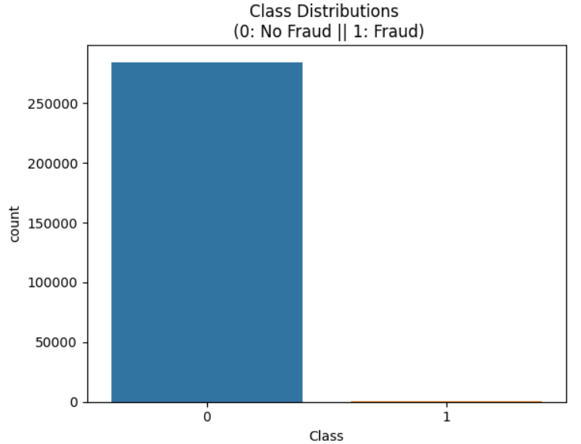
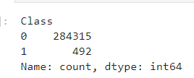
Exploratory Data Analysis (EDA)
We are finished with EDA at this point. This slide and few following slides will have key findings from EDA process:
Only a fraction of transactions are Fraud Transactions. This is a highly unbalanced Dataset and due to this we also decided to utilize Borderline SMOTE technique to see if Balancing will help us or not.

Slide 10
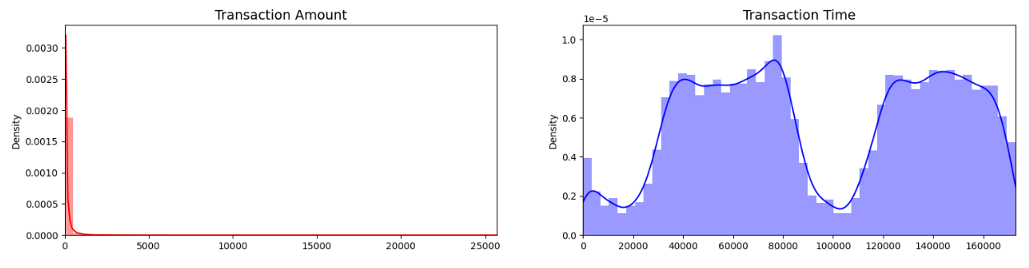
Time and Amount Analysis
Transaction Amount has a left skewed distribution and Transaction Time is cyclic in nature. We will further analyse them in following slides.

Slide 11
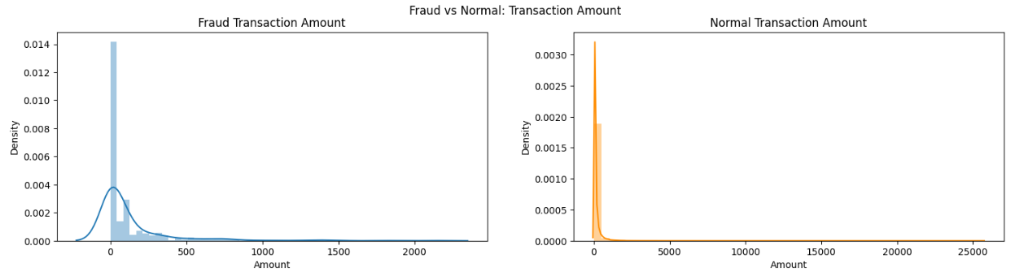
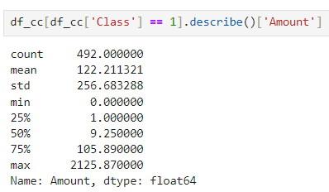
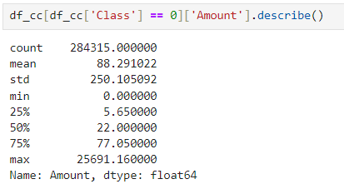
Transaction Amount
Normal Transactions peak earlier than Fraud Transactions and this can be confirmed with the help of Fraud Transactions statistics below.
Mean of Fraud Transaction amounts 122.21 In contrast, mean of the Normal Transactions is 88.29 which is much less. However, overall both Normal Transactions and Fraud Transactions have visibly similar Skewed Distributions with most transactions below 500:

Slide 12
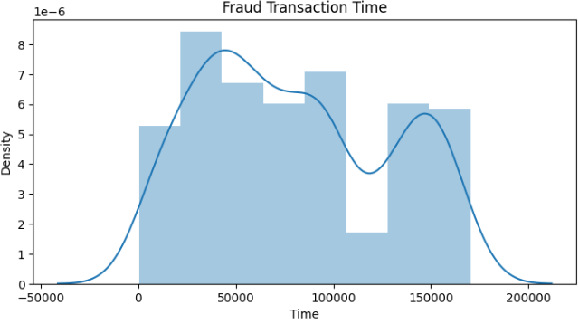
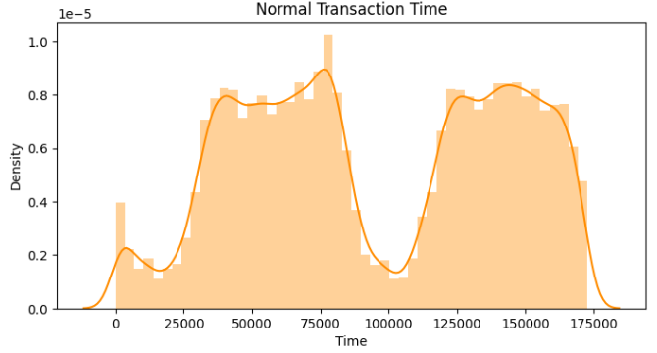
Transaction Time
More in-depth analysis of the Time column tells us that it is quite uniform across both Normal and Fraud Transactions with peaks of both types transactions happening at similar time in a cyclic nature.
We will add more EDA details in Report and Final Slides.

Slide 13
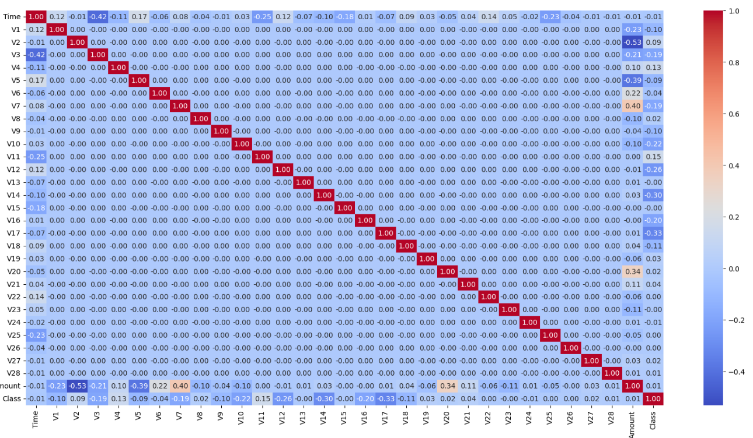
Correlation Heatmap

Slide 14
Application of Anomaly Detection Techniques
After the EDA we will move to Step 3 where we will Apply Different Anomaly Detection Techniques and this part will be biggest part of the project. Complete details of these techniques and their methodologies including Hyperparameter Tuning are mentioned in Project Report:
IQR
Modified Z-Score
DBSCAN
LOF
Isolation Forest
Gaussian Mixture Model
Logistic Regression
Dense Neural Network with Focal Loss
Auto-Encoder with Focal Loss

Slide 15
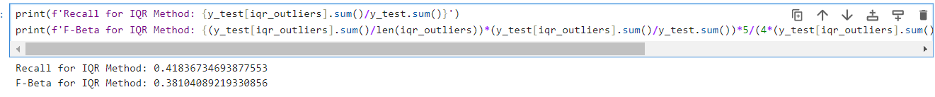
IQR and Modified Z-Score Methods
The only two Traditional Techniques covered in the Project.
To apply them properly, we classified an observation as Fraud only that observation contains Outlier Data in 15 or more columns out of 30 columns. In other words, we will record the Outliers in all the columns depending on respective method and then flag the transactions as fraud if it has 15 or more column values as outliers.

Slide 16

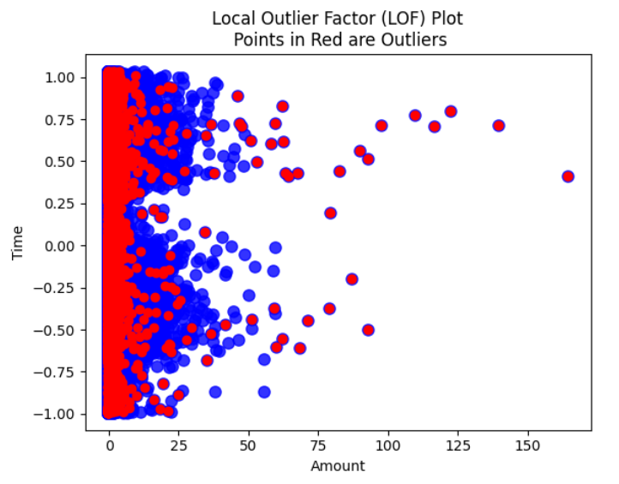
DBSCAN, Gaussian Mixture Model, and LOF
Three basic Unsupervised Techniques
While all three Unsupervised Techniques are more complex than IQR and Modified Z Score, Local Outlier Factor failed to get even acceptable results, and both Gaussian Mixture Model and DBSCAN were able to produce good results only on Test Dataset.

Slide 17
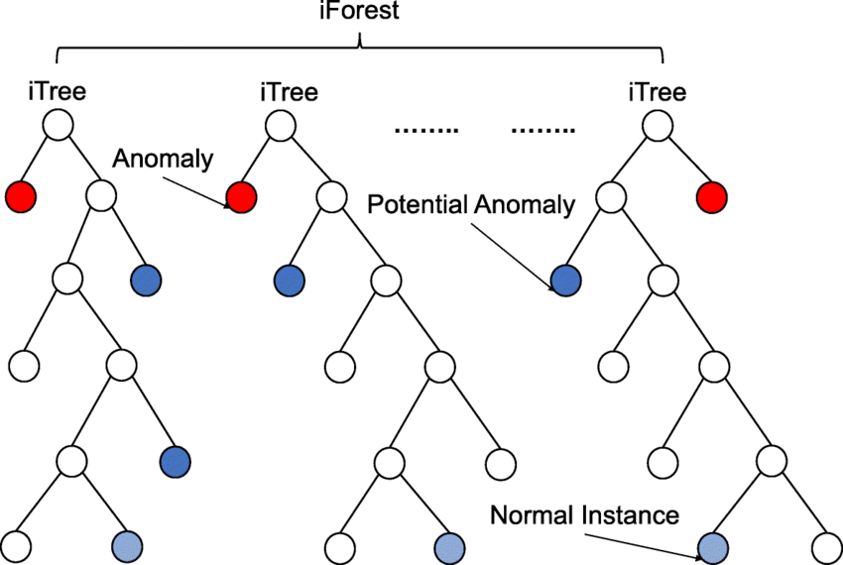
Isolation Forest and Logistic Regression
Isolation Forest or iForest is the last Unsupervised Anomaly Detection Technique in the project and is one of the most famous one since it was introduced in 2008. However, it is not always the better one as it gave results worse than IQR Method when trained on Training Balanced Dataset.
Logistic Regression is a basic Supervised Machine Learning Technique, and it is first technique till now which is able to use extra information in Training Balanced Dataset properly.

Slide 18
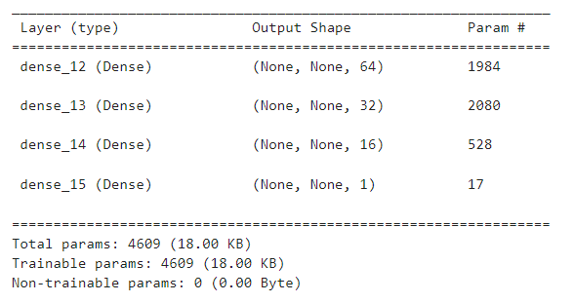
Dense Neural Network
For this project we created Four Different Dense Neural Networks:
DNN Trained on Balanced Dataset with Focal Loss
DNN Trained on Un-Balanced Dataset with Focal Loss
DNN Trained on Balanced Dataset with Binary Cross Entropy Loss
DNN Trained on Un-Balanced Dataset with Binary Cross Entropy Loss
All these models follow similar architecture, with difference in Loss and Training Dataset:

Slide 19
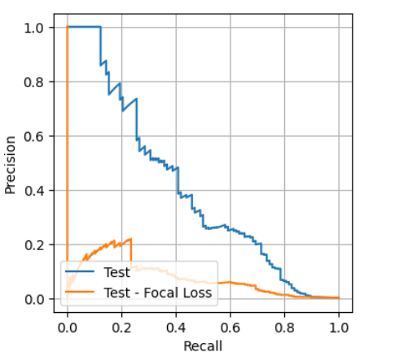
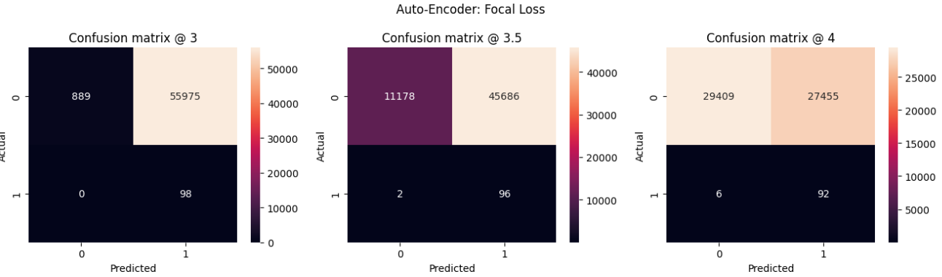
Auto-Encoders
Auto-Encoder is a very powerful Deep Learning Unsupervised Technique which can be used in the Anomaly Detection. Due to Resource constraints we were not able to run sophisticated Auto-Encoder Architecture but it still worked quite well if we consider only Recall metric.
We made Two Auto-Encoders, one with Focal Loss and other with Binary Cross Entropy.

Slide 20
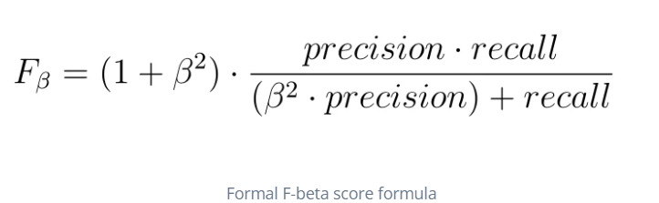
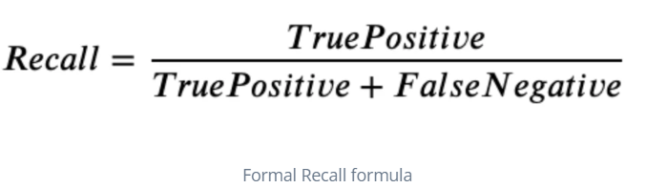
Evaluation
After Preliminary Modelling we have found the limitations in Accuracy and ROC Curve and have decided to focus specifically on Recall and F1 Beta Score or F Beta Score.
We will apply 16 Anomaly Detection Algorithms on the Training Balanced and Training Unbalanced Dataset and Test the Models by evaluating the Recall and F Beta Scores on the Test Dataset specifically.

Slide 21
Evaluation
Model/Technique | Recall | F Beta Score
Auto-Encoder Focal Loss | 1.000 | 0.008
Auto-Encoder Mean Squared Error | 0.990 | 0.008
Isolation Forest Unbalanced | 0.898 | 0.072
Gaussian Mixture Model Unbalanced | 0.898 | 0.020
DBSCAN | 0.888 | 0.062
Logistic Regression SMOTE (Balanced) | 0.867 | 0.321
DNN SMOTE Focal Loss | 0.847 | 0.788
DNN SMOTE Binary Cross Entropy | 0.796 | 0.788
DNN Unbalanced Binary Cross Entropy | 0.786 | 0.785
DNN Unbalanced Focal Loss | 0.776 | 0.788
Logistic Regression Unbalanced | 0.561 | 0.604
IQR Method | 0.418 | 0.381
Modified Z Score | 0.388 | 0.377
Isolation Forest SMOTE | 0.378 | 0.142
Local Outlier Factor | 0.265 | 0.021
Gaussian Mixture Model SMOTE Balanced | 0.010 | 0.013

Slide 22
Timeline
The whole project was be broken down into following Four Milestones
Milestone 1- Planning
Milestone 2- EDA
Milestone 3 - Anomaly Detection
Completed
Completed
Completed
Milestone 4- Evaluation and Conclusion
Completed

Slide 23
Conclusion
We started with raw Credit Card Fraud Dataset and passed it through a complete KDD Process and analysed results of 16 Anomaly Detection Techniques.
While Auto-Encoders and Isolation Forest are Top 3 Performing Models if we consider Recall, due to low F-Beta Scores we can see that they are flagging a good number of normal transactions as Fraud. Considering this DNN Trained on Borderline SMOTE Balanced Trained Dataset with Focal Loss is appearing as a safe middle ground with around 15% reduction in Recall Performance but with around 100 Times better F-Beta Performance.
There are a lot of things we can improve in this project. Get bigger dataset, more Computing Resources, better tools, research better Architectures for Auto-Encoders. But still we were able to utilize Readily available Computing Resources and apply Traditional to Modern Anomaly Detection Techniques and got models which are able to perform at least 2 Times better than best Traditional Model-IQR with good F-Beta Performance.

Slide 24
References

Slide 25
PDF Report
Types of Credit Card Frauds -https://www.bajajfinserv.in/insurance/types-of-credit-card-fraud-and-how-you-can-avoid-them
Anomaly Detection Wiki-https://en.wikipedia.org/wiki/Anomaly_detection
Victims of credit card fraud tell their stories -https://www.computerworld.com/article/2591492/victims-of-credit-card-fraud-tell-their-stories.html#:~:text=She%20had%20been%20writing%20checks,small%20purchase%20at%20a%20drugstore
Modified z score- https://www.ibm.com/docs/en/cognos-analytics/11.1.0?topic=terms-modified-z-score
Hoaglin, David C.. “Volume 16: How to Detect and Handle Outliers.” (2013). https://www.semanticscholar.org/paper/Volume-16%3A-How-to-Detect-and-Handle-Outliers-Hoaglin/d524a172b49e25f888376d662ee364aa77d99e8a
Unsupervised Learning: Clustering using Gaussian Mixture Model (GMM) https://behesht.medium.com/unsupervised-learning-clustering-using-gaussian-mixture-model-gmm-c788b280932b#:~:text=Clustering%20is%20a%20fundamental%20task,a%20mixture%20of%20Gaussian%20distributions
Handling Imbalanced Data by Oversampling with SMOTE and its Variants https://medium.com/analytics-vidhya/handling-imbalanced-data-by-oversampling-with-smote-and-its-variants-23a4bf188eaf
Note: There are total 17 References and all of them are linked properly in the PDF Project Report. Please refer to the report for more information.

