Slide 1
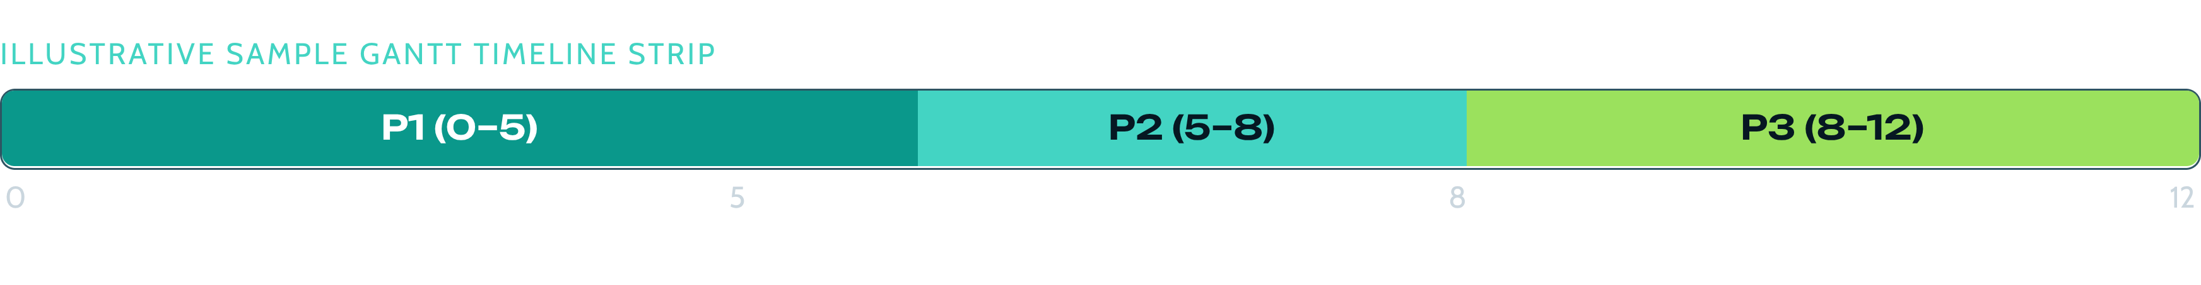
OPERATING SYSTEMS · COURSE PROJECT
CPU Scheduling Simulator with Gantt Charts & Comparison Views
An Interactive Tool for Understanding CPU Scheduling Algorithms
Project Team
Faculty & Course
Institution
Anubhav Kayal (24BCE2204)
Inesh Ingid (24BCE0407)
Yash Pandey (24BCE0398)
Dr. Niha K Basha
Operating Systems (Python Desktop App)
Vellore Institute of Technology
Vellore Campus
Notes:
Introduce the project: a Python desktop application that simulates six CPU scheduling algorithms, plots real-time Gantt charts, and computes comparative metrics on identical workloads.

Slide 2
Hand-drawn Gantt charts are slow and easy to get wrong
The Challenge
Objectives
CPU scheduling decides which process gets CPU time, and when
Manual Gantt charts and metric calculations are time-consuming and error-prone
Preemption and multi-algorithm comparison add complexity
Implement six scheduling policies
Generate Gantt charts automatically
Calculate per-process and average metrics
Compare algorithms on identical inputs
Ensure reliability through modular code and automated tests

Slide 3
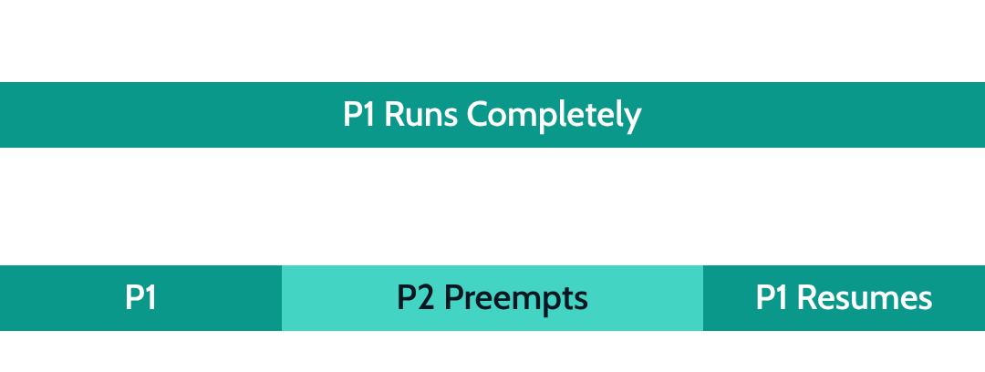
SCHEDULING POLICIES
Six algorithms, three of them preemptive
Algorithm | Scheduling rule | Preemption
FCFS | Earliest arrival first | No
SJF | Shortest available burst | No
SRTF | Shortest remaining time | Yes
Priority | Highest priority first (lower number = higher priority) | No
Preemptive Priority | Re-evaluate priority as processes arrive | Yes
Round Robin | Fixed time quantum per turn | Yes
Execution Mechanics
Illustrative Mini-Timelines
Lower numerical value represents higher priority level across priority algorithms.
Notes:
Highlight the fundamental division: non-preemptive policies allow a process to hold the CPU until completion or I/O, whereas preemptive policies allow dynamic context switches upon new arrivals or time quantum expiration.

Slide 4
GUI & WORKFLOW
A Tkinter app that takes processes in and puts a Gantt chart out
Process input form with validation · Algorithm selection and simulation.
INTERACTIVE EXECUTION PIPELINE
01
02
03
04
Enter Processes
Validate Input
Select Algorithm
Execute Scheduler
05
06
07
08
Generate Timeline
Calculate Metrics
Display Results
Compare Algorithms (optional)
Invalid input: error message, then back to input. Automatic Gantt chart, including CPU idle periods. Results table: arrival, burst, start, completion, waiting, turnaround, response. Comparison dashboard across all six algorithms.
Notes:
Walk through the user journey: input validation prevents invalid integers or duplicate process IDs. Once scheduled, the view instantly populates both a visual timeline and a per-process accounting table.

Slide 5
MODULAR ARCHITECTURE
A scheduling core that tests without the GUI
GUI LAYER (TKINTER / MATPLOTLIB)
input_form.py — Input and validation
gantt_chart.py — Matplotlib timeline
comparison_view.py — Comparison graphs
app.py — Main window and tabs
TECHNOLOGY STACK
Python 3.11+ — Modern core typing
Tkinter — Native desktop framework
Matplotlib 3.7+ — Canvas visualization
Pytest 7.4+ — Headless test runner
Git — Version-controlled workflow
SCHEDULING CORE (DECOUPLED · NO GUI DEPENDENCIES)
models.py — Process data model
algorithms/ — Scheduling implementations
scheduler.py — Algorithm selection
metrics.py — Performance calculations and rankings
Notes:
A critical software engineering strength: the core logic has zero GUI imports, enabling headless unit and integration testing inside Pytest before visual rendering.

Slide 6
EVALUATION METRICS
Five metrics measure efficiency and responsiveness
Turnaround Time (TAT)
Waiting Time (WT)
Turnaround Time = Completion Time − Arrival Time
Waiting Time = Turnaround Time − Burst Time
WORKED TRACE: P2 ON FCFS
Total duration spent in the system.
Total periods spent in ready queue waiting for CPU.
Arrival: 1 · Start: 5 · Burst: 3 · Completion: 8
Turnaround: 8 − 1 = 7
Response Time (RT)
CPU Utilization & Throughput
Waiting: 7 − 3 = 4
Response Time = First CPU Start Time − Arrival Time
CPU Utilization = (Busy CPU Time / Total Timeline Length) × 100%
Response: 5 − 1 = 4
Time elapsed before initial execution starts.
Throughput = Completed Processes / Total Time
Notes:
Explain each standard metric. Emphasize that while Turnaround and Waiting coincide on simple non-preemptive setups, Response Time critically diverges under preemptive policies like Round Robin.

Slide 7
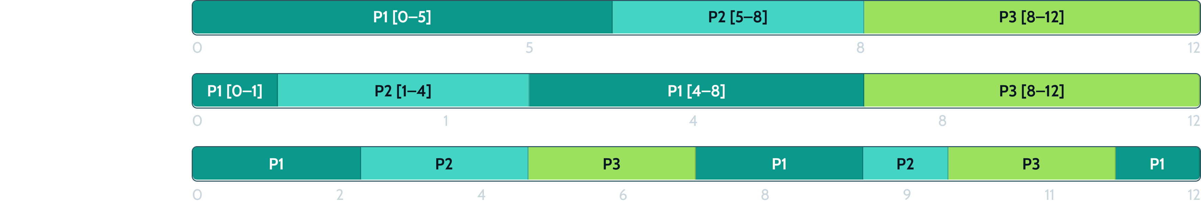
COMPARATIVE EXECUTION
The same three processes look very different on the timeline
Sample Workload: P1 (Arrival 0, Burst 5, Priority 1) · P2 (Arrival 1, Burst 3, Priority 2) · P3 (Arrival 2, Burst 4, Priority 1) · RR Quantum = 2
FCFS: Follows arrival order.
SRTF: Interrupts P1 when P2 arrives with less work left (3 < 4).
Round Robin: Gives fixed slices; idle gaps appear as their own IDLE blocks (none in this workload).
Notes:
Point to the Gantt charts: in FCFS, P1 hogs the CPU until t=5. In SRTF, P2 preempts P1 at t=1 because remaining time 3 is less than 4. In Round Robin, all processes make steady incremental progress.

Slide 8
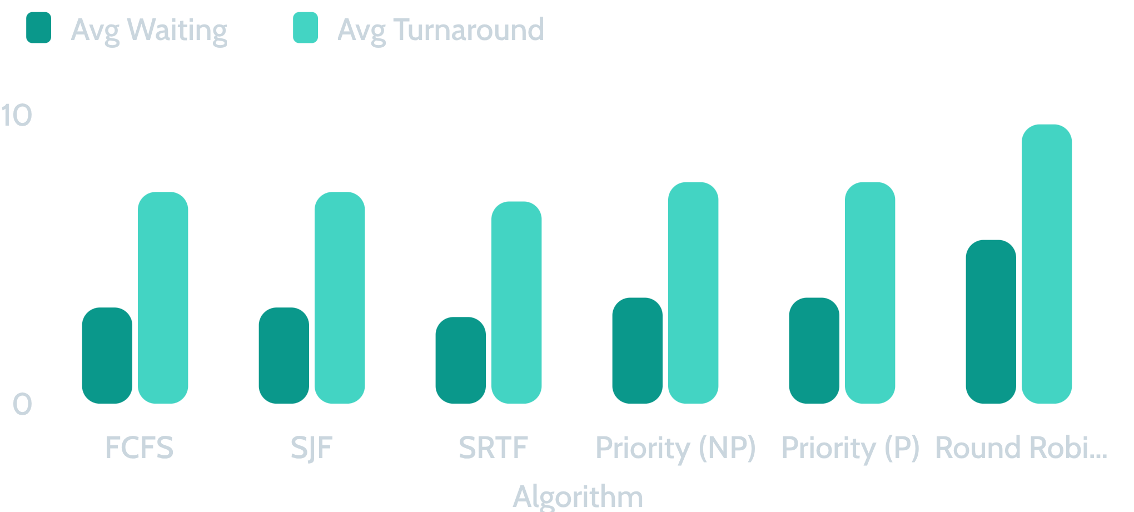
PERFORMANCE COMPARISON
SRTF waits least; Round Robin responds fastest
Policy | Avg WT | Avg RT
SRTF | 3.00 | 2.00
Round Robin | 5.67 | 1.00
FCFS / SJF | 3.33 | —
Priority (NP/P) | 3.67 | —
Round Robin achieves the fastest initial response (1.00) but pays with higher waiting (5.67) and turnaround (9.67). Results reflect this test workload rather than universal rank.
Sample evaluation workload (3 processes) · Graph values in time units.
Notes:
Explain the trade-off clearly: SRTF mathematically minimizes waiting time for this batch (3.00), but Round Robin provides superior interactive responsiveness (1.00 response time) at the expense of higher overall waiting.

Slide 9
VERIFICATION & CONSTRAINTS
39 automated tests passed; limits are stated plainly
39
Challenges
Limitations
Preemptive algorithms and Round Robin queue ordering
Consistent tie resolution
Python without Tkinter on macOS
Single CPU, whole-number time units
No context-switch overhead or I/O waiting
Textbook model, not a real kernel
Automated Tests Passed
Cover algorithms and metrics
Cover invalid inputs and empty input
Cover duplicate IDs
Cover identical arrivals and idle gaps
Deterministic tie-breaking gives repeatable schedules
Notes:
Emphasize test rigor: edge cases like identical arrival times and CPU idle gaps are covered in 39 automated Pytest cases. Concurrently, acknowledge realistic constraints like idealized zero-cost context switches.

Slide 10
PROJECT SUMMARY & OUTLOOK
Six policies, automated charts, and a tested core
Conclusion
References
Demonstrates six CPU scheduling policies
Automates Gantt charts and metric calculations
Gives per-process results and algorithm comparisons
Modular design with automated testing
Silberschatz, Galvin and Gagne, Operating System Concepts
Tanenbaum and Bos, Modern Operating Systems
Arpaci-Dusseau and Arpaci-Dusseau, Operating Systems: Three Easy Pieces
Liu and Layland, Scheduling Algorithms for Multiprogramming in a Hard-Real-Time Environment
Linux kernel scheduler documentation
Future scope
Multilevel Queue and Multilevel Feedback Queue
Context-switch overhead and priority aging
CSV import and result export
Animated visualization
Multi-core scheduling
Thank You — Questions?
Notes:
Conclude the presentation by summarizing delivery milestones, acknowledging authoritative academic literature, and opening the floor for faculty evaluation and questions.

