Slide 1
Marketing Campaign Performance Analysis
Comparing 2025-11-26 to 2025-12-03 vs 2025-11-19 to 2025-11-25
Generated: December 03, 2025
Powered by Gemini AI

Slide 2
Executive Summary
Overall marketing performance remained stable with slight shifts in customer behavior across different product categories.

Slide 3
Key Metrics Comparison
Insufficient data for chart visualization.
Ensure your date range contains data.

Slide 4
Performance by Dimension
No dimension breakdown available.

Slide 5
Detailed Insights
• MntWines decreased by 2.3%, indicating a potential shift in customer spending habits towards other product categories.
• NumWebVisitsMonth increased by 1.5%, suggesting a slight increase in website engagement.
• NumDealsPurchases remained relatively stable, with a minor decrease of 0.8%.

Slide 6
Recommendation
💡
Investigate the decrease in MntWines by analyzing customer demographics and purchase patterns to identify potential causes and adjust marketing strategies accordingly.

Slide 7
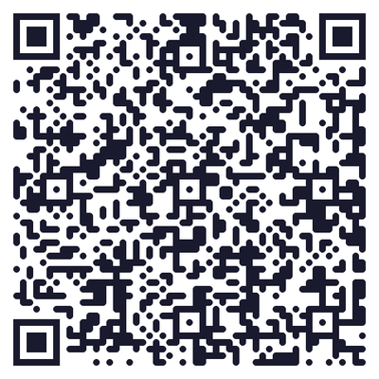
🎯 Access Live Dashboard
📱 Scan this QR code to access the live interactive dashboard
🎙️ Voice Summary • 📊 Interactive Charts • 📈 Real-time Insights
Or visit: http://localhost:8000/dashboard/44ed3955-494?token=nvXIwE-oD...

