Slide 1

Getting Started
With
Typescript
Anubhav Tarar
Trainee Software Consultant
anubhav.tarar@knoldus.in

Slide 2
Agenda
What is TypeScript
Benefits
Typescript Vs. JavaScript
New features of Typescript
Installation
How to compile Typescript file
How to compile multiple Typescript file into a single js file
Enable the Typescript Compiler
.demo

Slide 3
What is TypeScript ?
TypeScript is a superset of JavaScript
TypeScript is a free and open source programming language developed and maintained by Microsoft.
TypeScript files are compiled to readable JavaScript
Notes:
Well, it's actually simple. Aurelia is just JavaScript. However, it's not yesterday's JavaScript, but the JavaScript of tomorrow. By using modern tooling we've been able to write Aurelia from the ground up in ECMAScript 2016. This means we have native modules, classes, decorators and more at our disposal...and you have them too.

Slide 4
Benefits
TypeScript is statically typed
Big advantage of Typescript is we identify Type related issues early before going to production
You can even set the JS version that you want your resulting code on.
TypeScript allows us to define new classes and new
interfaces.
.
Notes:
So, Aurelia is a set of modern, modular JavaScript libraries for building UI...and it's open source. Great. There are other projects that might describe themselves in a similar way, so what makes Aurelia unique?
Clean and Unobtrusive - Aurelia is the only framework that lets you build components with plain JavaScript. The framework stays out of your way so your code remains clean and easy to evolve over time.
Convention over Configuration - Simple conventions help developers follow solid patterns and reduce the amount of code they have to write and maintain. It also means less fiddling with framework APIs and more focus on their app.
Simple, But Not Simplistic - Aurelia is simple to learn, but extremely powerful. Because of the simple, consistent design, developers are able to learn a very small set of patterns and APIs that unlock limitless possibilities.
Promotes the "-ilities" - Testability, maintainability, extensibility, learnability, etc. These are often referred to as the "-ilities". Aurelia's design helps developers naturally write code that exhibits these desirable characteristics.
Amazingly Extensible - Aurelia is highly modular and designed to be customized easily. Almost every aspect of Aurelia is extensible, meaning developers will never hit a roadblock or have to "hack" the framework to succeed.

Slide 5
TypeScript Vs. JavaScript
JavaScript has ambiguity because of having no datatype declaration which is now possible in Type Script. It makes the code more understandable and easy
It allows us to use javascript as if an object oriented code which is much more clear than javascript due to its syntax.
Typescript include function overloading but javascript does not
TypeScript is optionally typed by default
For a large JavaScript project, adopting TypeScript might result in more robust software, while still being deployable where a regular JavaScript application would run.
Notes:
However, it’s difficult to compare the two at this point because Angular 2.0 is not finished and we’ve only seen what has been work-in-progress. Therefore, I don’t think it’s too fair to do an apples-to-apples comparison.

Slide 6
Features Of TypeScript
TYPES

Slide 7
Type Annotation
The type annotation we can add to a variable we define should come after the variable identified and should be preceded by a colon.
var id:number = 123123;
var name:string = "mosh";
var tall:boolean = true;

Slide 8
Dynamic Type
TypeScript is optionally statically typed programming language. The types are checked in order to preventassignment of invalid values in term of their types.
We can optionally change the variable into a dynamic one.
var demo:any =5;
demo:any =''john”;
demo = new Object();

Slide 9
Automatic Type Inferring
When assigning a variable, that was just created, with a value, the TypeScript execution environment automatically identifies the type and from that moment on the type of that variable is unchanged.
var demo = 1;
demo ='abc' // result in compilation error

Slide 10
Type Eraser
When compiling the TypeScript code into JavaScript all of the type annotations are removed.
App.ts
var a: number = 3;
var b: string = 'abc';
App.js after Compilation
var a = 3;
var b = 'abc';

Slide 11
Constructor
When we define a new class it automatically has a constructor. The default one. We can define a new
constructor. When doing so, the default one will be
deleted.
When we define a new constructor we can specify each one of its parameters with an access modifier and by doing so indirectly define those parameters as instance variables

Slide 12
Constructor
class Person {
constructor(public name:String){
this.name = name;}
greet():String={
return “my name is”+this.name);
}
}
var person = new Person(“john);
Console.log(person.greet);

Slide 13
Interfaces(ts file)
interface LabelledValue {
label: string;
}
function printLabel(labelledObj: LabelledValue) {
console.log(labelledObj.label);
}
let myObj = {size: 10, label: "Size 10 Object"};
printLabel(myObj);
The interface LabelledValue is a name we can now use to describe the requirement in the previous example.
It still represents having a single property called label that is of type string.
Notice we didn’t have to explicitly say that the object we pass to printLabel implements this interface like we might have to in other languages. Here, it’s only the shape that matters. If the object we pass to the function meets the requirements listed, then it’s allowed.

Slide 14
Function Overloading(.ts file)
class Customer {
name: string;
Id: number;
add(Id: number);
add(name:string);
add(value: any) {
if (value && typeof value == "number") {
//Do something
}
if (value && typeof value == "string") {
//Do Something
}
}
}

Slide 15
Function Overloading(.js file)
var Customer = (function () {
function Customer() {
}
Customer.prototype.add = function (value) {
if (value && typeof value == "number") {
}
if (value && typeof value == "string") {
}
};
return Customer;
}());

Slide 16
TypeScript Support Optional Properties
In JavaScript, every parameter is considered optional. If no value is supplied, then it is treated as undefined. So while writing in TypeScript, we can make a parameter optional using the “?” after the parameter name.
interface SquareConfig {
color?: string;
width?: number;
}
function createSquare(config: SquareConfig): {color: string; area: number} {
let newSquare = {color: "white", area: 100};
if (config.color) {
newSquare.color = config.color;
}
if (config.width) {
newSquare.area = config.width * config.width;
}
return newSquare;
}
let mySquare = createSquare({color: "black"});

Slide 17
How to install TypeScript?
1. install git
2.install node.js vs0.12
3.install typescript by command
npm install -g typescript tsd

Slide 18
How Do You Compile TypeScript Files?
The extension for any TypeScript file is “.ts”. And any JavaScript file is TypeScript file as it is a superset of JavaScript. So change extension of “.js” to “.ts” file and your TypeScript file is ready. To compile any .ts file into .js, use the following command.
tsc <TypeScript File Name>
For example, to compile “Helloworld.ts”:
tsc helloworld.ts
And the result would be helloworld.js.

Slide 19
Is It Possible to Combine Multiple .ts Files into a Single .js File?
Yes, it's possible. While compiling add --outFILE [OutputJSFileName] option.
tsc --outFile comman.js file1.ts file2.ts file3.ts
This will compile all 3 “.ts” file and output into single “comman.js” file. And what will happen if you don’t provide a output file name.
tsc --outFile file1.ts file2.ts file3.ts
In this case, file2.ts and file3.ts will be compiled and the output will be placed in file1.ts. So now your file1.ts contains JavaScript code.

Slide 20
Working Example(func.ts)
class customer{
name:String;
constructor(name:String){
this.name= name;
}
}

Slide 21
Working Example(func1.ts)
class cust {
name:string;
Id:number;
add(Id:number);
add(name:string);
add(value:any){
}
}
tsc --outFile comman.js func1.ts func.ts

Slide 22
Working Example(comman.js)
var customer = (function () {
function customer(name) {
this.name = name; }
return customer;
}());
var cust = (function () {
function cust() {
}
cust.prototype.add = function (value) {
};
return cust;
}());

Slide 23
Enabling the TypeScript Compiler
In order to develop code in TypeScript using the
PHPStorm or the WebStorm IDE we should perform following steps
In the Default Preferences setting window, enable the
TypeSciprt compiler, specifying the node interpreter and
specify the main file we want to compile.

Slide 24
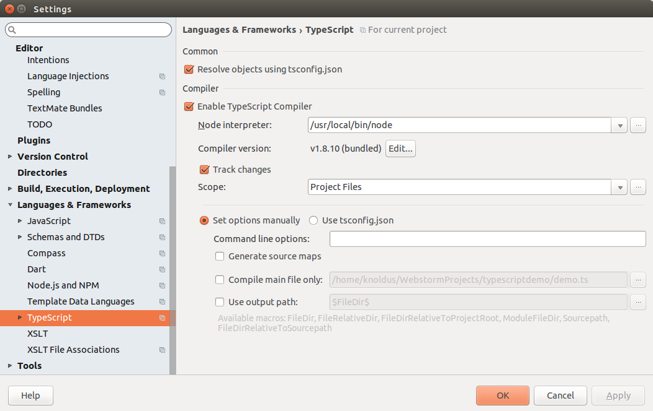

Slide 25
Designing a Demo.ts File
class Demo{
name:String;
constructor(name:String) {
this.name = name;}
display():String{
return "my name is"+name;
}
}
var demo = new Demo("anubhav");
console.log(demo.display());

Slide 26
Automatically Generated Demo.js File
var Demo = (function ()
{
function Demo(name) {
this.name = name;
}
Demo.prototype.display = function () {
return "my name is" + name;
};
return Demo;
}());
var demo = new Demo("anubhav");
console.log(demo.display())

Slide 27
Working demo
Angular 2 With TypeScript
.

