Slide 1
English Premier League Scheduling with Genetic Algorithm
Team 524
Anubhav Gupta
Rishi Jatania

Slide 2
Problem Statement
Problem - find an optimal schedule for a set of teams over a period of time that satisfy a particular set of constraints
Ex: For 4 teams where each teams play against each other twice once at home and once away over a course of a season
No team can play two games at the same time
No team should be playing against each other
Ex: Team A should never play against Team A.

Slide 3
Sequence of Steps
Create initial Genotypes with random assignment
Create Phenotype from Genotype i.e create a whole season schedule.
Repeat for N generations until is obtained
Calculate the fitness of each genotype, which is inversely proportional to how many constraints it violates i.e. number of clashes in our case.
Perform crossover on the genotype by selecting the fittest parent from the previous generation and 2nd parent using roulette wheel
Perform Mutation on each new genotype
Calculate fitness of current population and repeat if the best solution is not achieved

Slide 4
Example: 4 teams Below is an example of feasible solution
 | Match 1 | Match 2
Match Day 1 | Team D (H) Vs Team B (A) | Team C (H) Vs Team A (A)
Match Day 2 | Team A (H) Vs Team D (A) | Team B (H) Vs Team C (A)
Match Day 3 | Team B (H) Vs Team D (A) | Team A (H) Vs Team C (A)
Match Day 4 | Team B (H) Vs Team A (A) | Team C (H) Vs Team D (A)
Match Day 5 | Team D (H) Vs Team A (A) | Team C (H) Vs Team B (A)
Match Day 6 | Team A (H) Vs Team B (A) | Team D (H) Vs Team C (A)

Slide 5
Implementation Details
Season schedule is a summation of Match Days
For each Match Day we consider the following the constrains
Each team plays only once on a given match day
Check if the match has already been played
Team can’t play with itself.

Slide 6
Genotype
Each genotype contain a chromosome that encodes an array of integers initially filled by randomly selecting one of the teams Id.
Chromosome Length = (n – 1) * 2 * n, n is the number of teams
Ex : For 4 teams, chromosome length is 24 which is (Total Number of Matches played * 2)
An array of sequence starting with 4231 suggests the following:
Match 1 – Team 4 (H) Vs Team 2 (A)
Match 2 – Team 3 (H) vs Team 1 (A)
(H) – Home, (A) - Away

Slide 7
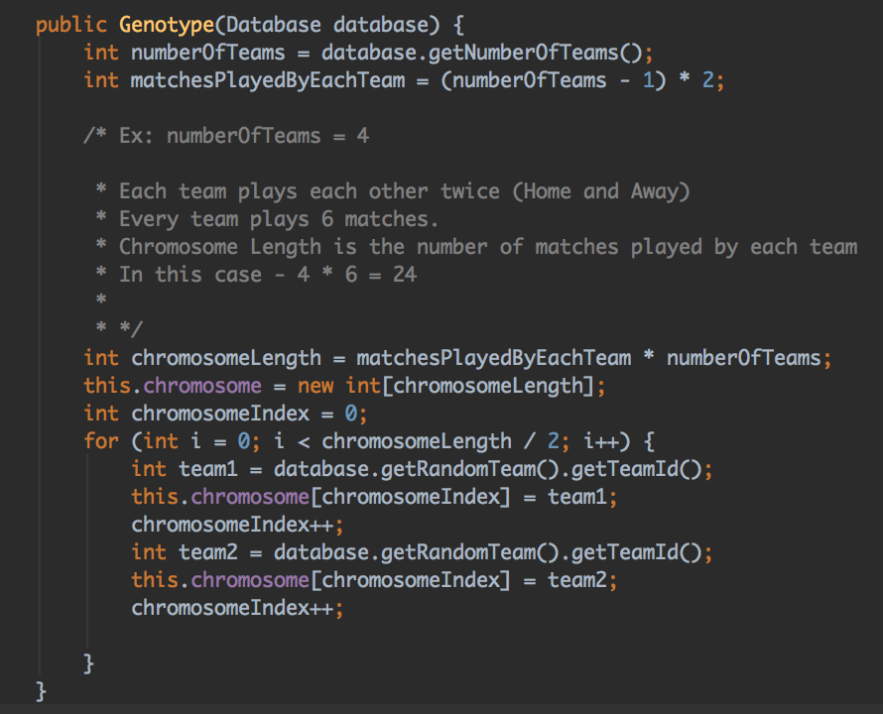
Implementation details – Randomizing
Code to generate random genotype

Slide 8
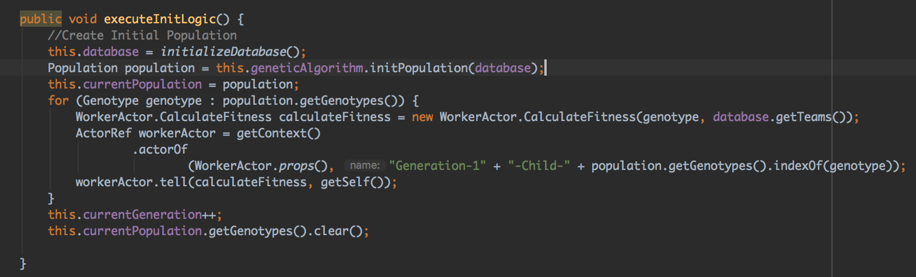
Implementation Details – Initialization
Master Actor creating worker Actors equal to number of genotypes to calculate fitness of generation 1 genotype in parallel.

Slide 9
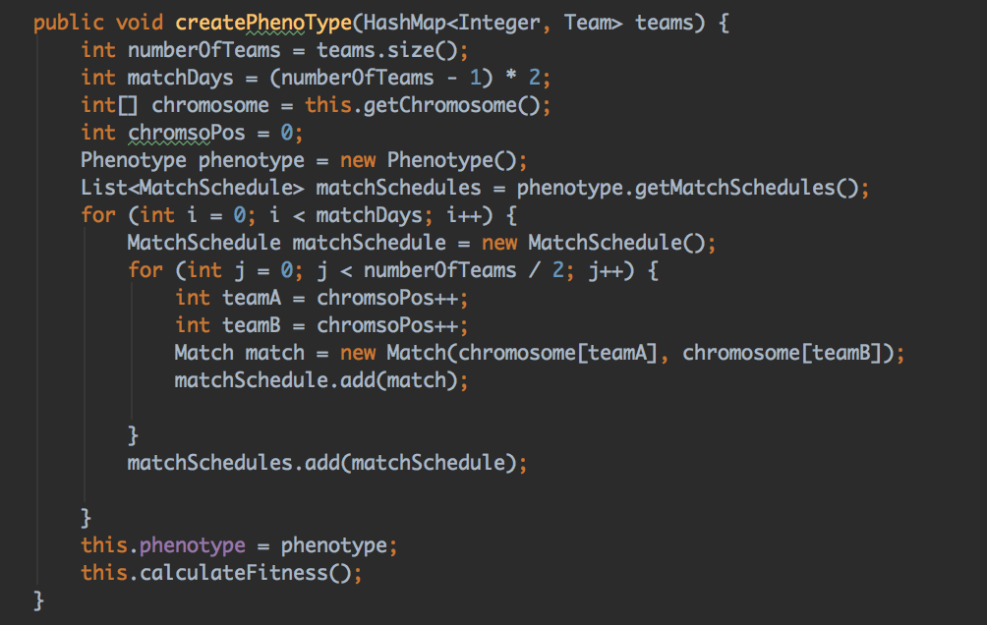
Implementation Details – Phenotype
Create Phenotype from Genotype i.e create a whole season schedule. Full season schedule in nothing but a list of MatchDays and each MatchDay is a list of matches on a day.

Slide 10
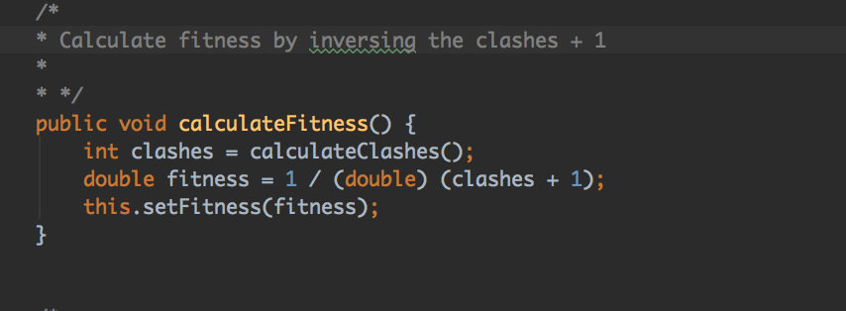
Fitness Score and Clashes
Our initial population has been created, and we need to evaluate those individuals and assign them fitness values. This means a genotype fitness value will be inversely proportional to how many constraints it violates i.e. number of clashes in our case.
Calculate Clashes logic: 1) Calculate number of times same match being played 2) Calculate the number of time a team is playing multiple matches on the same day. 3) Sum 1) and 2) and return back.

Slide 11
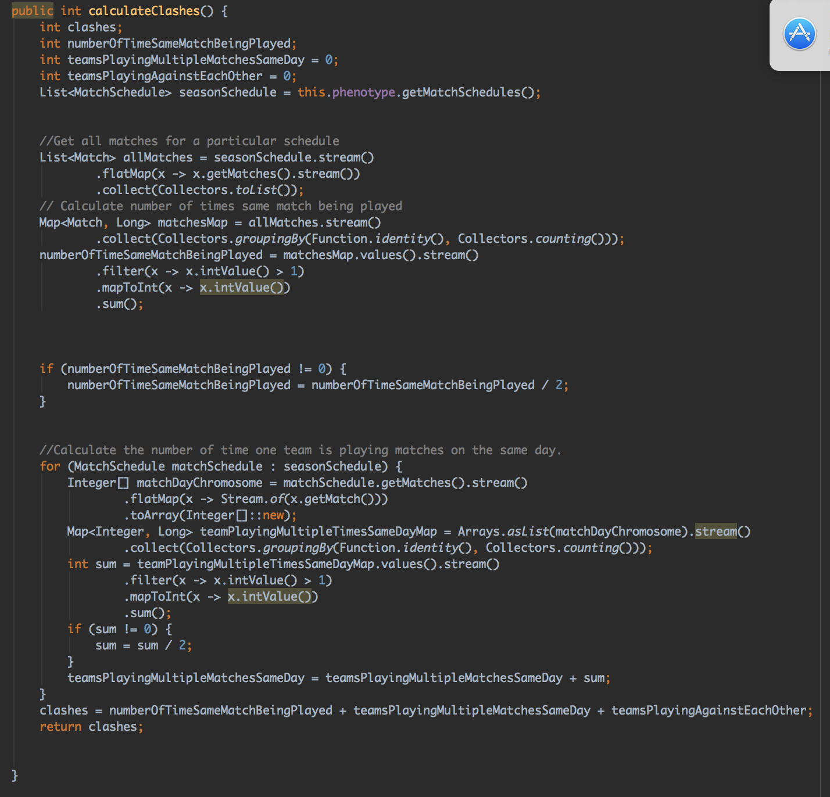
Calculate Clashes Logic

Slide 12
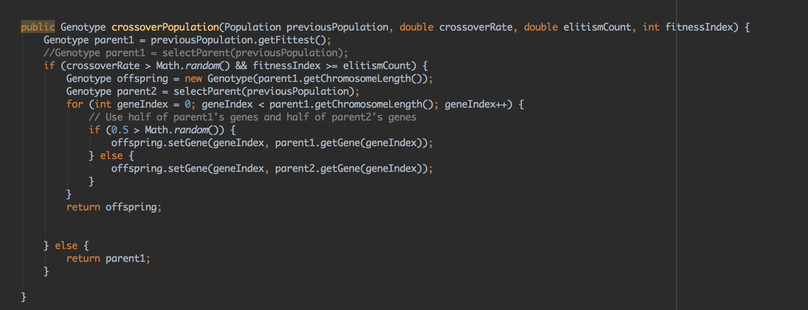
Crossover
Select fittest parent of the population as Parent 1
Select parent 2 using roulette wheel selection i.e The higher the fitness of the genotype, the more space it’s allocated on the roulette wheel and more the chances of it getting selected.
The crossover method we have implemented here is uniform crossover. In this method each gene of the offspring has a 50% change of coming from either its first parent or its second parent.

Slide 13
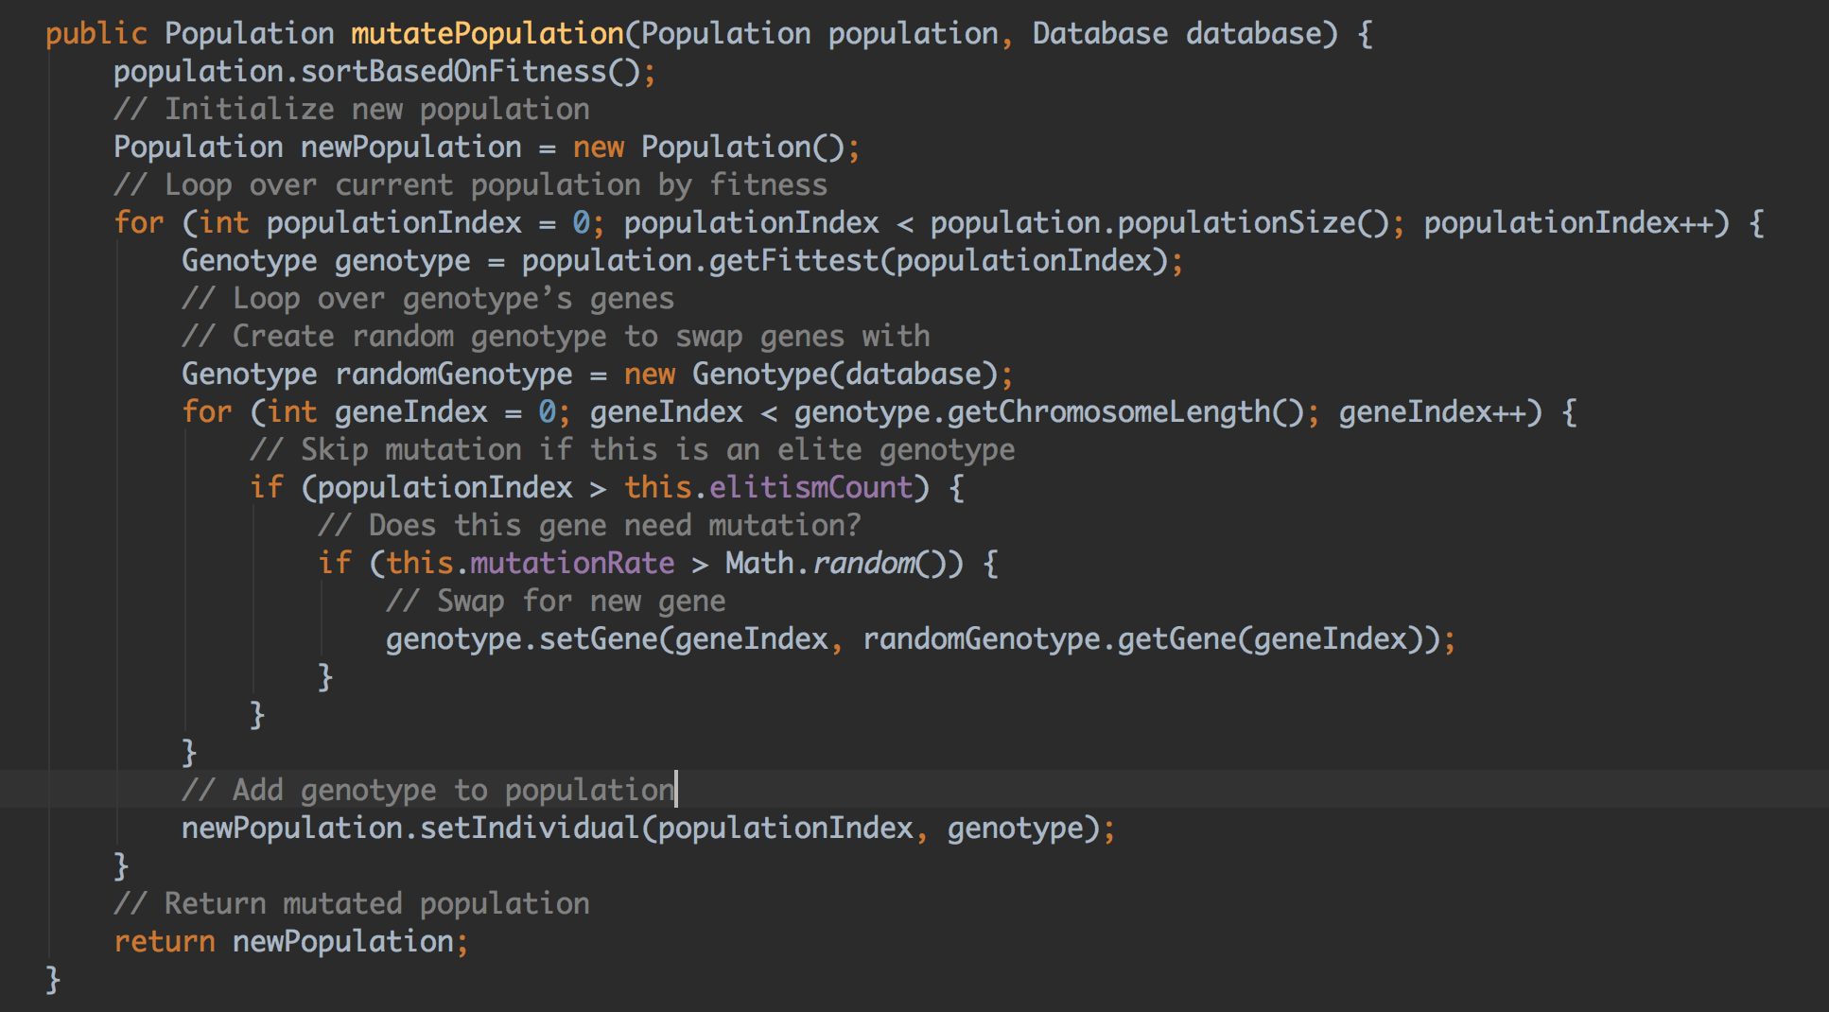
Mutation
Instead of choosing a random number for a random gene in the chromosome, we create a new random but valid individual and essentially run uniform crossover to achieve mutation! That is, we use Genotype constructor to create a brand new random Individual, and then select genes from the random genotype to copy into the genotype to be mutated. This makes sure that all of our mutated individuals are fully valid, never selecting a gene that doesn’t make sense.

Slide 14
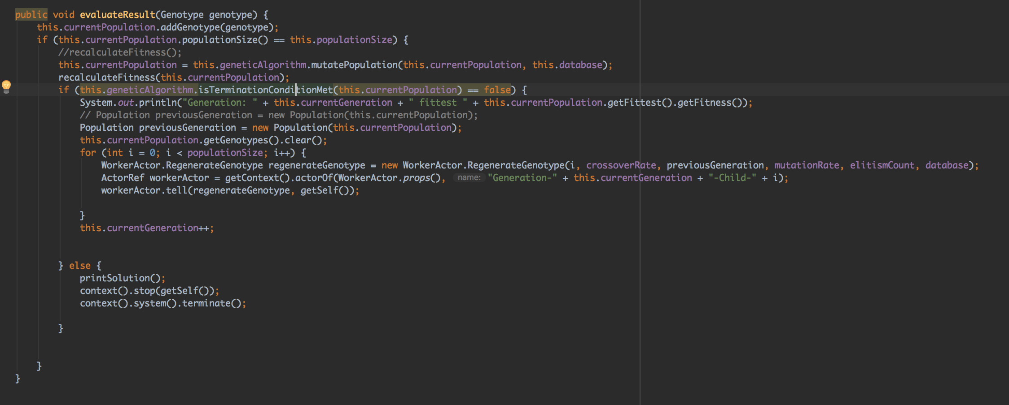
Evaluate Result
For every subsequent generation, its fitness score is checked to see if we found an optimal solution. (i.e. A Season schedule with no clashes). Else we spawn new worker actors to create new generation based on previous generation and then perform crossover and mutation on the new population.

Slide 15
Implementation Architecture
EplGAParallel
Master Actor
Return Result
Create genotype/regenerate genotype
Worker Actor
….spawn child node for every member of the population….
Worker Actor

Slide 16
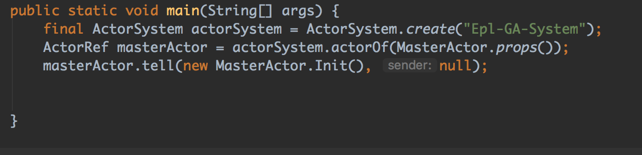
Implementation Architecture
EplGAParallel(edu.neu.psa.GA)
Initializing actor system
Creating the master actor

Slide 17
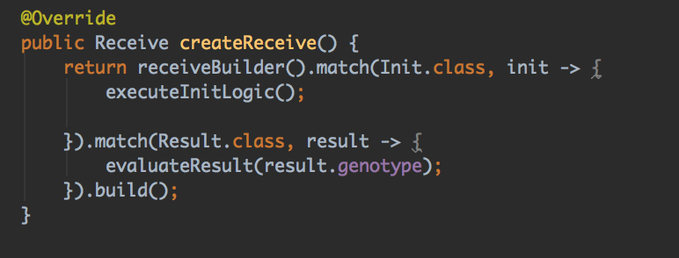
Implementation Architecture
Master Actor (edu.neu.psa.Actors)
Spawns Worker Actors for calculating fitness/ regeneration
Perform mutation on new population
Determines if terminal condition has been met

Slide 18
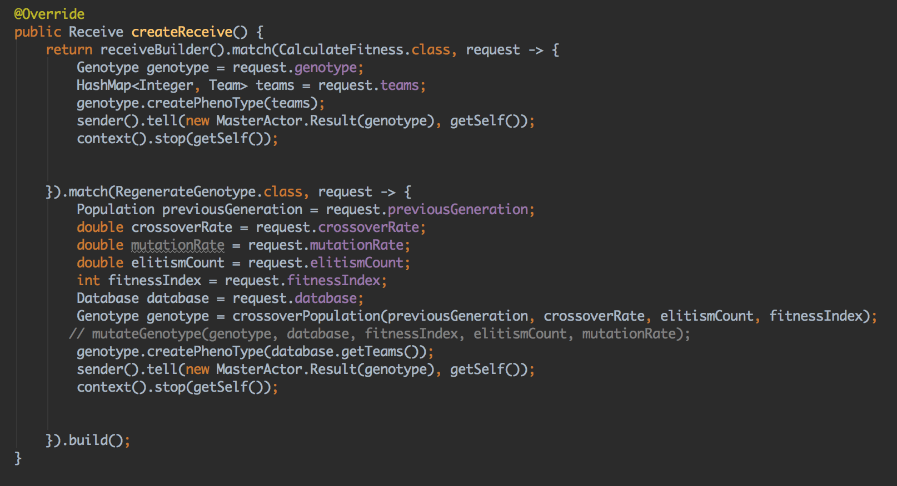
Implementation Architecture
Worker Actor (edu.neu.psa.Actors)
Calculate fitness score of each Genotype
Create new genotype objects using crossover
Kills itself after each task is completed (Calculate fitness score and Regeneration)

Slide 19
Result And Conclusion
We have been able to find the best Season Schedule for 6 teams with below statistics:
Total teams = 6
Genotype Length = 60
Total Solution = 60!
Best Solution found between 2000 & 3000 generations

Slide 20
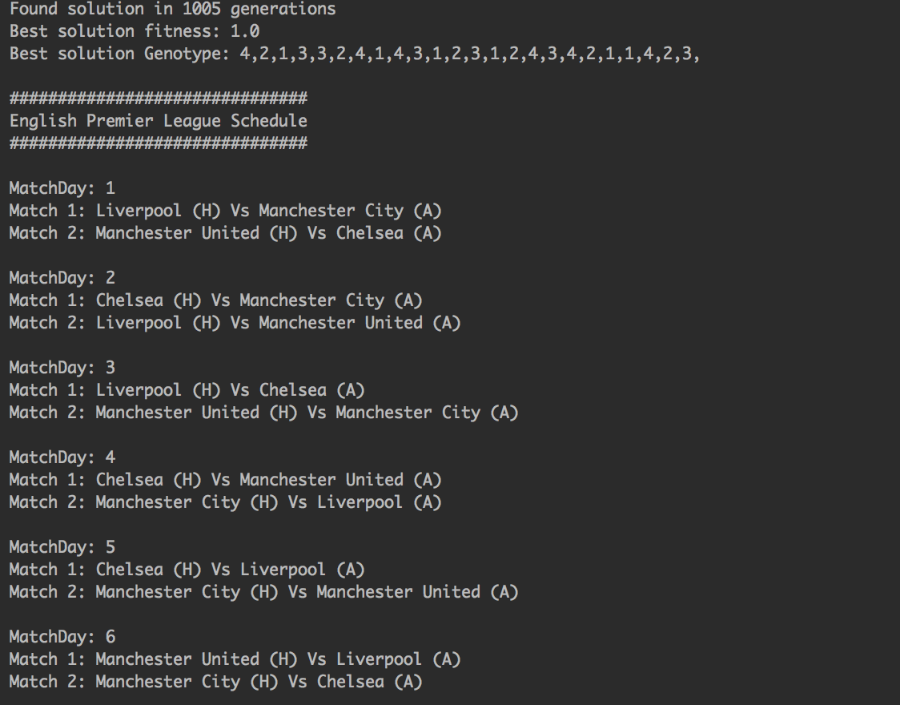
Result And Conclusion
Sample log cross over and fitness function calculation

Slide 21
Running the Application
Download the source code from https://github.com/anubhav1011/INFO6205_524
mvn clean install (Have Maven and Java preinstalled)
After successfully running unit test cases and maven build
java -jar ./target/epl-scheduler-1.0-SNAPSHOT.jar

