Slide 1

Introduction
Med Me is a revolutionary platform designed to provide quick and efficient medical services to those in need. From urgent ambulance services to on-demand doctors and prescription delivery, we prioritize timely care for every individual.

Slide 2
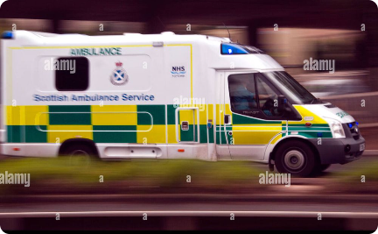


Overview of the Med Me Website
The Med Me website serves as a centralized hub for all medical needs, featuring a simple and intuitive user interface. Users can access a wide range of medical services, from emergency response to booking doctor consultations and ordering medicines.
Quick Ambulance Services
Quick Doctors
Quick Medicines
Connects users with qualified medical professionals for instant consultation.
Enables swift and convenient delivery of prescribed medications to the user’s doorstep.
Instantly dispatches emergency medical assistance to the user's location.

Slide 3
Quick Ambulance Services: How It Works
1
User Requests Ambulance
User inputs location and requests immediate ambulance assistance.
2
Dispatch & ETA
Med Me dispatches the nearest ambulance with real-time tracking and ETA.
3
Professional Care
Trained medical personnel provide timely and expert care and route to the user

Slide 4
Quick Doctors: How It Works
Doctor Consultation
Virtual Appointment
Medical Advice & Prescription
Users select the preferred doctor and book an instant consultation.
Connects users with the doctor through a secure and seamless virtual interface.
Doctors provide medical advice and prescribe necessary medication electronically.

Slide 5




Quick Medicines: How It Works
Prescription Upload
Medicine Selection
Doorstep Delivery
User uploads the prescription on the Med Me app or website.
Users choose from a range of available medicines and brands.
Med Me ensures prompt delivery of the prescribed medicines to the user's doorstep.

Slide 6
Benefits of Using Med Me
1
Time-Efficient
2
Convenience
Instant access to crucial medical services, eliminating long wait times.
Seamless and hassle-free medical care at the user's fingertips.
3
Reliable & Trained Professionals
4
Peace of Mind
Access to certified medical professionals for accurate diagnosis and care.
Assurance of quick and efficient medical assistance in emergency situations.

Slide 7




Marketing Strategy for Med Me
Digital Campaigns
Social Media Presence
Strategic Alliances
Community Engagement
Utilizing online platforms for targeted digital marketing campaigns.
Cultivating a strong social media presence to engage with users and promote services.
Forging partnerships with medical institutions and healthcare facilities for mutual benefit.
Building a sense of community and trust through local events and initiatives.

