Slide 1





sss
WorldWide Suicidal Rate
By : Anubhav Chauhan

Slide 2
Introduction
About Dataset
Objective of Analysis
Problem Statement
Outcome/Results
Analysis And Visualization
Conclusion

Slide 3
Introduction
I have chosen a dataset on worldwide suicidal rate from 1985 – 2015.
Official dataset was gathered from Kaggle.
This dataset was built to find signals correspond to increase suicide rates among different divisions worldwide.
My task is to find correlation between different attributes of dataset and estimate features of suicide rate with association of different problem statements.

Slide 4
About Dataset
The dataset I used is downloaded from Kaggle.
Dataset consist of 27821 rows and 12 columns.
Columns containing interrelated data such as country, year, sex, age, suicide no., population, suicides/100k pop., country-year, HDI for year, GDP for year, GDP per capita, and generation.

Slide 5
Objective of Analysis
The objective of this study was to estimate the features of suicide rate and its association with population, age, gender, generation, country, year, and economic development.
And presenting all my visualization in a single attractive dashboard.

Slide 6
Problem Statement
Given a dataset of worldwide suicide rate, aim is to…
Find in which year most of the cases occurred.
Find In which country most of the cases occurred.
Find which age attempts more suicides.
Find which gender attempt more suicides.
Find top 10 countries in correlation with highest suicidal attempts.

Slide 7
Problem Statement
Find top 10 countries population with highest suicidal attempts.
Find worldwide suicides by generation of different age/gender.
Find count of people committed suicide by different age, country, gender, and year.
Compare suicides per 100k population by human development index and find out the direct link between them.
Find out the direct link between suicidal rate and gdp for year and for capita.

Slide 8
Outcome/Results
Worldwide highest suicidal cases occurred in 1995.
The country in which overall most of the cases occurred is Russian federation.
75+ age group attempts more suicide, actually highest peak of 75+ age group was in 1995.
Globally 79% male and 21% female committed suicide from 1985 – 2015.
Silent in generation attempted most of the suicide cases in which 55 – 74, and 75 + age groups are involved the most.
Russian federation terms to be most populated, then comes japan, and Ukraine correlated with suicide rate.
My project presentation video link is below:
https://drive.google.com/drive/folders/1s7zPmADrtJvMfK4ltftiwj7G907bI_uP?usp=sharing

Slide 9
Analysis and Visualization
As we can see, 75+ age group attempted most of the suicides globally, then comes 55-74 years, 35-54 years and so on.

Slide 10
Analysis and Visualization

Slide 11
Analysis and Visualization

Slide 12
Analysis and Visualization

Slide 13
Analysis and Visualization

Slide 14
Analysis and Visualization

Slide 15
Analysis and Visualization

Slide 16
Analysis and Visualization

Slide 17
Analysis and Visualization

Slide 18
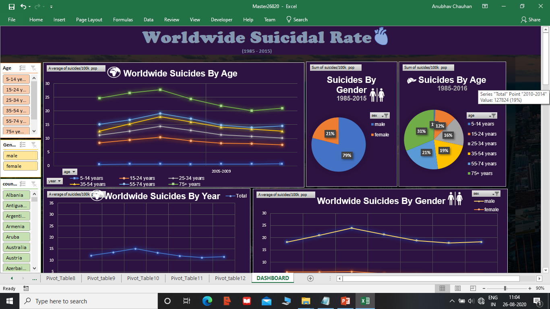
My DashBoard

Slide 19

My DashBoard

Slide 20
Conclusion
Overall this study gives a clear visualization on suicidal rates from 1985 – 2015 by age, gender, year, country, population, generation.
From 1985 HDI continuously increased and in relation suicide cases also increased at the highest peak of 1995, after that till 2002 suicide cases were at constant pace. But after 2002 still the HDI was at same pace till 2014, at this phase suicide cases were decreasing slowly.
Therefore after 2002 it is unclear whether there is a direct link between HDI and suicide rate.
GDP per capita kept on increasing in every 5 years worldwide till 2010-2014 after that sudden decrease can be seen from 2015-2019.

Slide 21
THANK YOU

