Slide 1
ReportCheck
A Python Script which will help you a lot ☺

Slide 2
Agenda
What is ReportCheck ?
What ReportCheck can do for me 😛
Live Demo 😀
Now it’s your turn: please USE IT ☺
What Next ?
I am ready for Queris/ Ideas/ Suggestions 😎

Slide 3
What is ReportCheck ?
A Python Script
Simple to Use but Complex to Read 😜
A Tool, which will check for the basic but IMPORTANT contents in the report.

Slide 4
What ReportCheck can do for me ? 😛
Check the Client Name and Print it
Check the Application Name and Print it
Check the Offering Name and Print it
Check the Assessor Name and Print it
Check the TO Name and Print it
Check the Client Manager Name and Print it
Check the Client Address and Print it
Check the Executive Summary
Check the Introduction part
Check the Findings Categories and match it with total number of findings.

Slide 5

Live Demo

Slide 6
Now it’s your turn : Please USE IT ☺
Things you need :
  Python 2.7
  Python-docx library (pip install python-docx)
Command :
  python ReportCheck.py
Note : For detail information, Please read the Readme file present in the zip.

Slide 7
What’s Next ?
Checks for baisc formatting issues.
Checks for Severity matching. Etc.

Slide 8
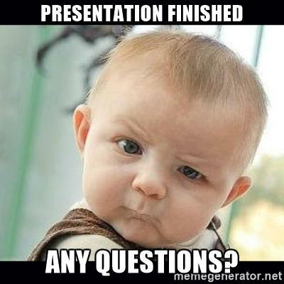
I am ready for Queries/Ideas/Suggestions 😎
THANK YOU ☺

