Slide 1
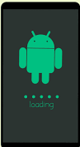
MINI PROJECT on ANDROID 2-D GAME ANUBHAV JOSHI ROLL NO -1918247 / 22 SECTION-A

Slide 2
Software used (IDE)
Android Studio
Android Studio is the official integrated development environment (IDE) for Google's Android operating system, built on JetBrains' IntelliJ IDEA software and designed specifically for Android development. It is available for download on Windows, macOS and Linux based operating systems or as a subscription-based service in 2020. It is a replacement for the Eclipse Android Development Tools (E-ADT) as the primary IDE for native Android application development.
Android Studio was announced on May 16, 2013 at the Google I/O conference. It was in early access preview stage starting from version 0.1 in May 2013, then entered beta stage starting from version 0.8 which was released in June 2014. The first stable build was released in December 2014, starting from version 1.0.
On May 7, 2019, Kotlin replaced Java as Google's preferred language for Android app development. Java is still supported, as is C++.

Slide 3
Introduction to 2D gamming
2D games use flat graphics, called sprites, and don’t have three-dimensional geometry. They’re drawn to the screen as flat images, and the camera (orthographic camera) has no perspective.
2D games are also called Platform game. The word platform also describes that something held on a platform. Here the player can run, jump, shoot, collect powers on a platform. Since 2D games are flat, the environment created in the games is also visually flat. They do not focus much on the environment of the game.
Benefits of 2D Design
Simple Controls: since the controls in 2D games are simple and straight forward, it is more of a choice for the beginners. This brings them more audience.
Easy development: The development of 2D games is much easier and cheaper. It takes less time in developing a 2-dimensional game as the design is flat. Also, it is easier to update the games later.
Easy Instructions: 2D games are simple ‘tap to play’ games with easy instructions. It has a simple interface and flat visuals. 2D games have very limited or no plot and the size 2D game is small.

Slide 4
Challenges faced
The first challenge was to select what type of game to make.
Second task was to learn how to work with android studio.
Then during development of game the game was crashing in middle of the game.
Lastly the game keeps progressing same as it was it on the start and was very easy to play.
How Overcame them
By taking help with YouTube and google I learned about how android studio works and decided what type of game to make.
After finding some errors in the game the game was working normally.
For making the game interesting I increased the speed of the enemy after every 10-points scored by the player this made the game more challenging.

Slide 5
How to play
For playing the game we first have to install the app.
After installing and running the game player has to click on the play text shown in the screen which will launch the next screen containing player villain and the background.
If we touch the upper left side of the screen the player goes up and if we touch the lower left side the player goes down for shooting a beam the player has to touch the right side of the screen the game is over if the cell crosses the screen or touches the player

Slide 6
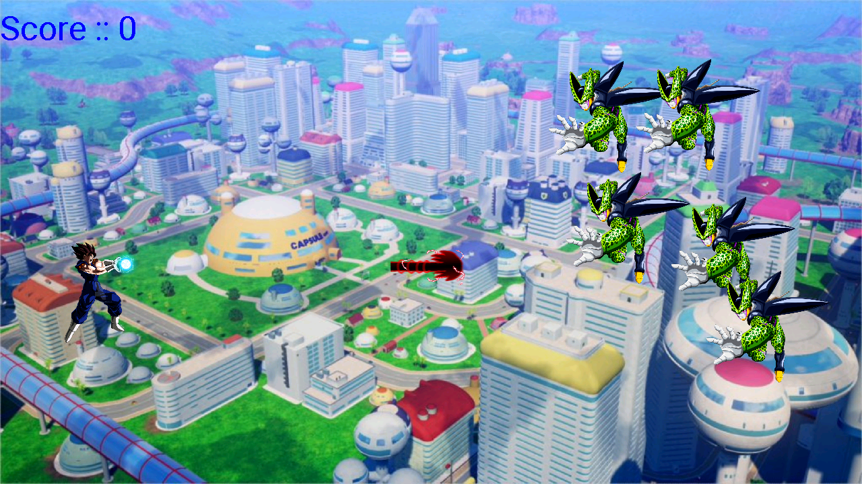
SCREENSHOT OF THE GAME

Slide 7
Summary
The developed game is a one player game. The player has to shoot the enemy before it crosses the screen or touches the player. The speed of enemy keeps on increasing after every 10-score obtained.
The player can move up and down to shoot upcoming enemy by clicking on the right side of the screen.
Learned about java programing and about how to use android studio to make a simplest 2-d game.
Future works
The game can be made more interesting by giving some powerups to the player or by giving health bar to the player.
We can also add some different enemies with different characteristics that will make the game more enjoyable and user friendly.

