Slide 1
Information Security
Collaborate & manage content digitally

Slide 2
Topics for discussion
What is information? Digital Information?
Local Storage
Cloud Storage
Why collaboration?
Different types of collaboration tools and how to use them
Types of information
Risks
How to mitigate the risk?
Do’s and Don’t’s
Are we safe?

Slide 3

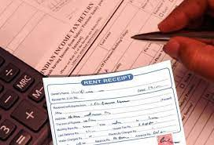
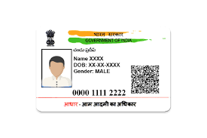
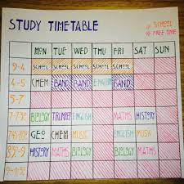


What is information? Digital Information?
Information: Which conveys something meaningful.

Slide 4
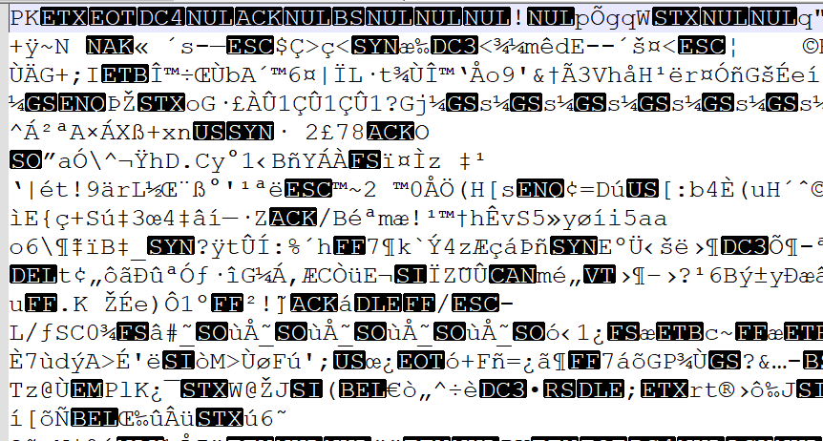


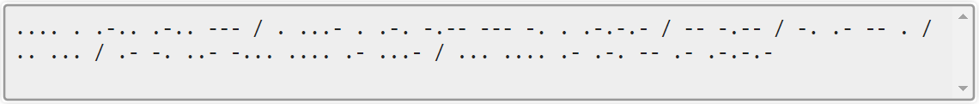
What is information? Digital Information?
Digital information – Just bring information on a digital device
What is NOT an information?

Slide 5
What is information? Digital Information?
This is my password for this machine
The audio says : “Hello everyone.
My name is Anubhav Sharma.”
This is this presentation itself
This text says : “Hello everyone. My name is Anubhav Sharma.”
This text says : “Hello everyone. My name is Anubhav Sharma.”

Slide 6
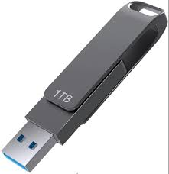
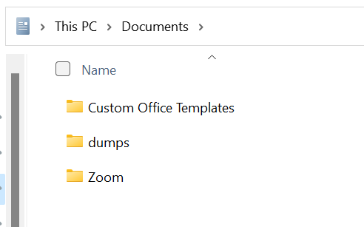
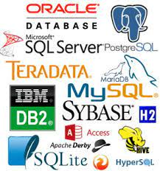

Local Storage

Slide 7
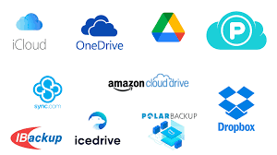
Cloud Storage

Slide 8








Why collaboration?
Before we answer why collaboration, lets ask who we are?

Slide 9


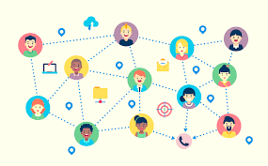
Why collaboration?
So in todays world we will always need support from others. So we must have a collaborating platform. So we have some choices.
Due to diversity in place, timezone and platform, we must find a way to have a collaborated information repository

Slide 10



Different types of collaboration tools and how to use them
Cloud storages (public or private) – Google, IBM, Amazon, Microsoft, . . .
Social platforms – Whatsapp, Instagram, snapchat, tweeter
Private shared locations (these are also generally on cloud) – Sharepoints, shared hardrives on intranet
Professional tools (Objective specific) – Github, Digilocker, Google photos

Slide 11
Types of information
Now, before we start sharing various informations, lets first classify the information we have.
NEVER-EVER-SHARE kind of information – Credit Card details, Credentials, Secret infos
Share only if mandatorily required and recipient is authorized – Aadhaar Number (SSN), Bank account number, IP config details, Certificates
Can share with friends – Contact number, email, photograph, Social account address, mailing address
No restriction needed – Thoughts, public knowledge, already available online publicly
Please note that these are not the actual terms we use. Actual terminology is Confidential, Restricted, Non-restricted and public in IT field.

Slide 12
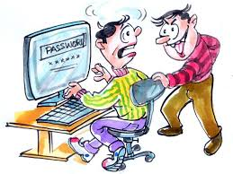
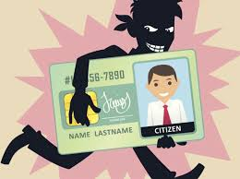

Risks
Financial Risk
if someone gets your bank account/credit card credentials?
If someone gets your company’s trade secrets?
If someone gets your digital/physical signature?
Physical/Personal Risk
if someone gets your address details?
Social Risk
if someone gets access to your social accounts

Slide 13



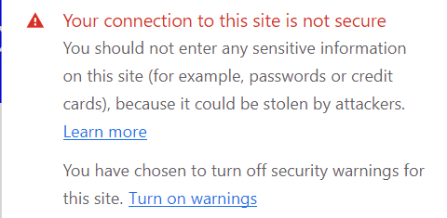
How to mitigate risks?
Keep your software updated
Restricted access
Get rid of unwanted hardware/software
Ensure signed software policies
Avoid intrusion
Stay away from single-factor autnetication

Slide 14
Dos for information security
Use hard to guess password
Keep changing password regulary
Lookout for phishing attacks and traps in mail
Destroy the information when it is no longer in use
Lock your phone or computer when not in use
Report any suspicious activity immediately without hesitation
Make sure to keep secrets encrypted

Slide 15
Don’ts for information security
Do not click on random links
Do not respond to suspicious mails or calls
Do not install software from random websites
Do not surf web over insecure channel
Do not right down your password/credentials anywhere
Do not connect to apparently free network lines which you do not completely trust
Do not post sensitive information online

Slide 16
Are we safe? (In context of digital information security) NO! Please do not try any URL mentioned in this page, they are just to showcase malicious URLs
To know why we are not safe, check below links.
Google Website
http://www.google.com
http://www.gooogle.com
https://www.google.com
Also you can leave your feedback on below government websites:
http://www.india.gov.com
http://www.india.gov.uk
https://www.2ef35uasdf328a.com
http://www.india.gov.in
https://www.india.gov.in

Slide 17
Thank you

