Slide 1

Mini Project on Canteen Ordering App Using PowerApps
By:
Anubhav Tyagi
University Roll no:2016651
B.Tech CSE , 6 Semester
Under the mentorship of
Mr. Arnav kotiyal​
(Assistant Professor)

Slide 2
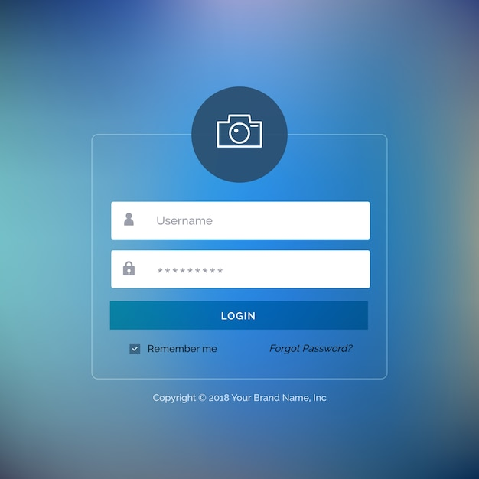
Introduction
The Canteen Ordering App is a user-friendly and intuitive mobile application designed specifically for the employees of ICICI Bank. This app serves as a convenient platform for bank staff to order their meals online without leaving the premises. By leveraging this technology, the bank aims to save valuable time during peak hours and enhance the overall banking experience for its employees.
Problem Statement:
There must be reason for making a project. So, the problem to which we wants to solve is “How Food is delivered to bank Employees and reduce traffic at canteen & can save their Time. , I made a project that implements the Power platform of Microsoft Along with JavaScript and provide a reliable Fully Functional App.

Slide 3
Methodology
This section provides a step-by-step explanation of the key stages involved in the app's creation, including requirements gathering, design, development, testing, and deployment.
1)Requirements Gathering:
Conducted interviews and surveys with ICICI Bank employees to identify their needs and preferences regarding an online canteen ordering system.
Analyzed existing canteen processes and identified pain points and areas for improvement.
Documented the functional and non-functional requirements for the app, including user interface, menu options, payment integration, and reporting capabilities.
2)System Design:
Created a high-level system architecture, outlining the components and their interactions.
Designed the user interface, focusing on intuitive navigation, menu categorization, and search functionality.
Defined the database schema, considering the storage and organization of menu items, user profiles, and order history.
Planned the integration of secure payment systems and real-time inventory management.
3)Development:
Implemented the front-end of the app using model-driven PowerApps, ensuring a user-friendly and visually appealing interface. Developed the back-end functionality, including order processing, payment integration, and database connectivity.

Slide 4
Implemented data validation and security measures to protect user information and ensure secure transactions. Integrated Power Automate to automate workflows, such as order confirmation notifications and real-time inventory updates.
4)Testing:
Conducted comprehensive testing to ensure the app's functionality, usability, and performance.
Performed unit testing of individual components, including user interfaces, database operations, and payment integration.
Conducted integration testing to verify the seamless interaction between different modules of the App. Involved ICICI Bank employees in user acceptance testing to gather feedback and make necessary refinements.
5)Deployment:
Prepared the app for deployment by packaging the necessary files and configurations.
Conducted a final round of testing in the live environment to ensure compatibility and stability.
Collaborated with ICICI Bank's IT team to deploy the app on the bank's internal Infrastructure. Conducted user training sessions to familiarize employees with the app's features and functionalities.

Slide 5
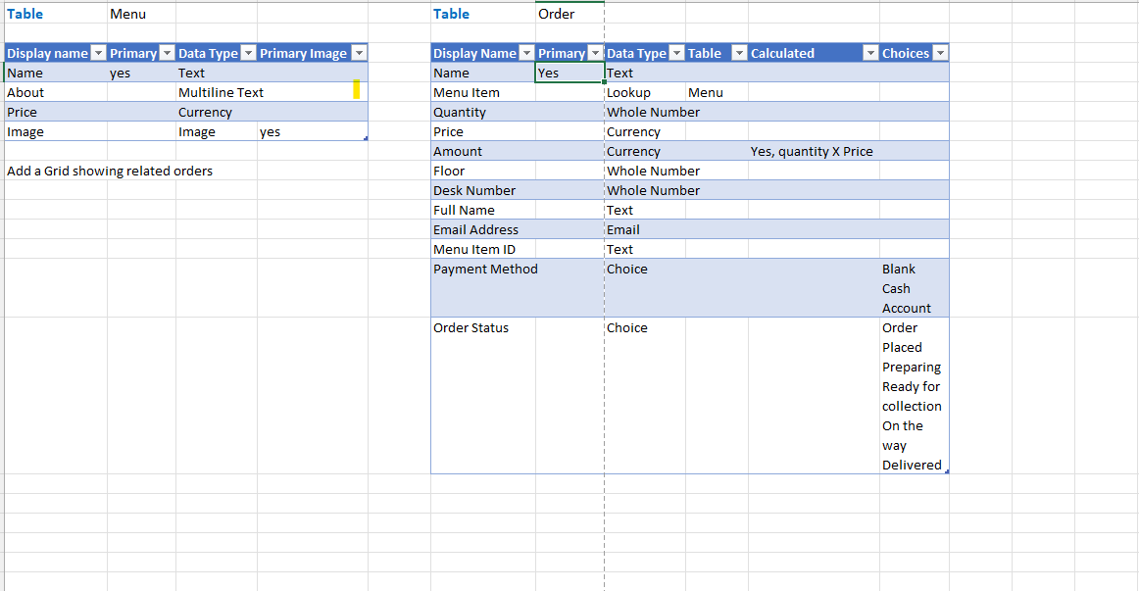

Slide 6
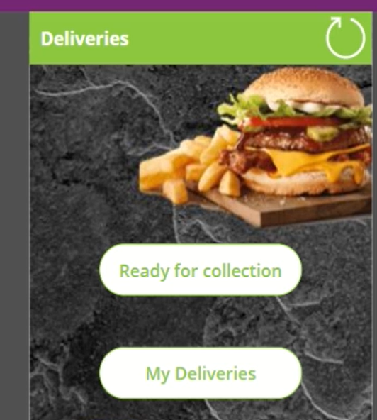
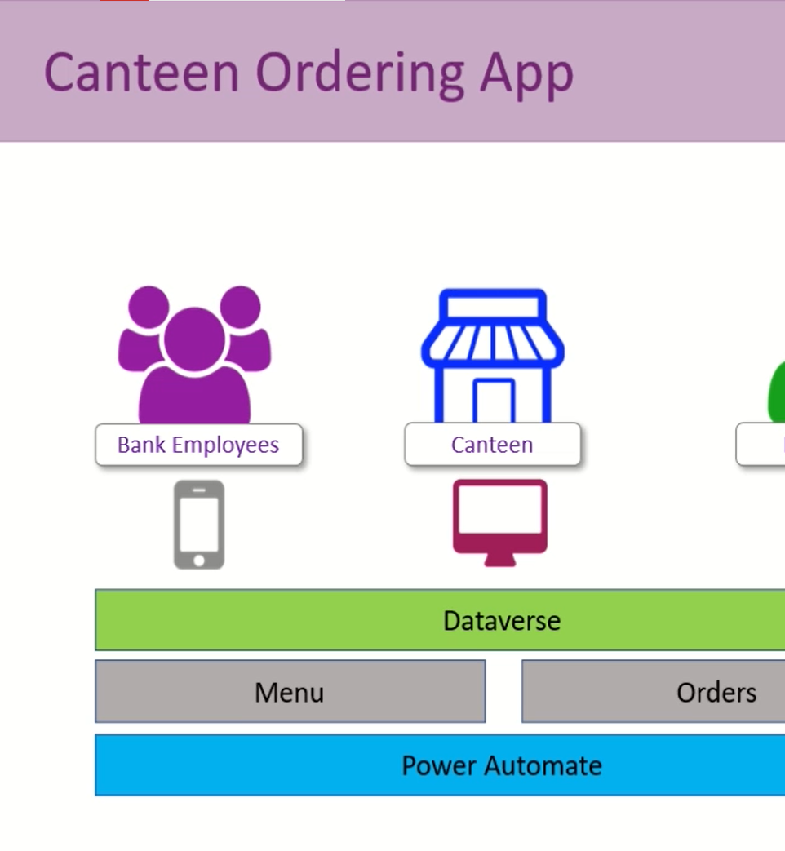

Slide 7
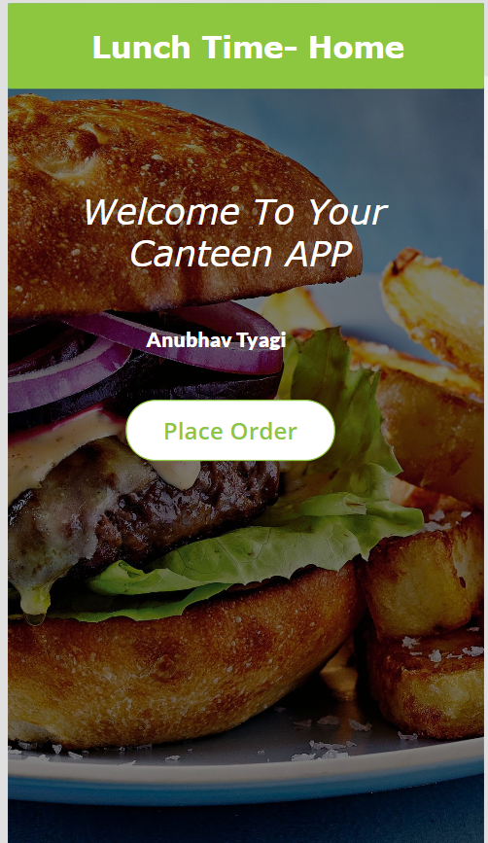

Slide 8
Result 1)One of the key objectives of the Canteen Ordering App was to save time for employees during peak hours at the bank. The results indicated a significant reduction in the time spent by employees in queuing up at the canteen. This time-saving aspect of the app was well-received by employees and contributed to increased productivity within the bank. 2)Operational Efficiency and Management The implementation of the Canteen Ordering App had a notable impact on the operational efficiency of the bank's canteen. The automated order processing and inventory management capabilities of the app resulted in smoother operations, eliminating manual errors and reducing delays. Real-time inventory updates ensured that popular menu items were always available, minimizing instances of unfulfilled orders. The reporting capabilities of the app provided valuable insights into consumption patterns, enabling better planning and forecasting for the canteen management team. Users appreciated the intuitive user interface, allowing them to browse menus, customize orders, and make payments seamlessly. The app's responsiveness and real-time updates were also highly appreciated, as they contributed to a smooth and efficient ordering experience.
The combine result of these models:
For Combine Model:

Slide 9
Summary:
The results obtained from the implementation and evaluation of the Canteen Ordering App for ICICI Bank demonstrate its effectiveness in saving time, improving operational efficiency, and enhancing the overall user experience. The positive feedback from users indicates a high level of satisfaction with the app's functionality and convenience. The app's secure payment integration ensures a smooth transaction process while maintaining data security. Although some limitations and areas for improvement were identified, the overall impact of the app on bank operations and employee experience is commendable.
Conclusion:
In conclusion, the results obtained from the implementation and evaluation of the Canteen Ordering App highlight its effectiveness in streamlining canteen operations, enhancing employee experience, and improving overall efficiency within ICICI Bank. The positive feedback and insights gained from users provide valuable input for future enhancements and refinements.

Slide 10
THANK YOU
I

