Slide 1
VERSION CONTROL SYSTEM
Presented by :
Anubhav Antony PD
Paul John Subhishram
Jose M Surenthar S

Slide 2
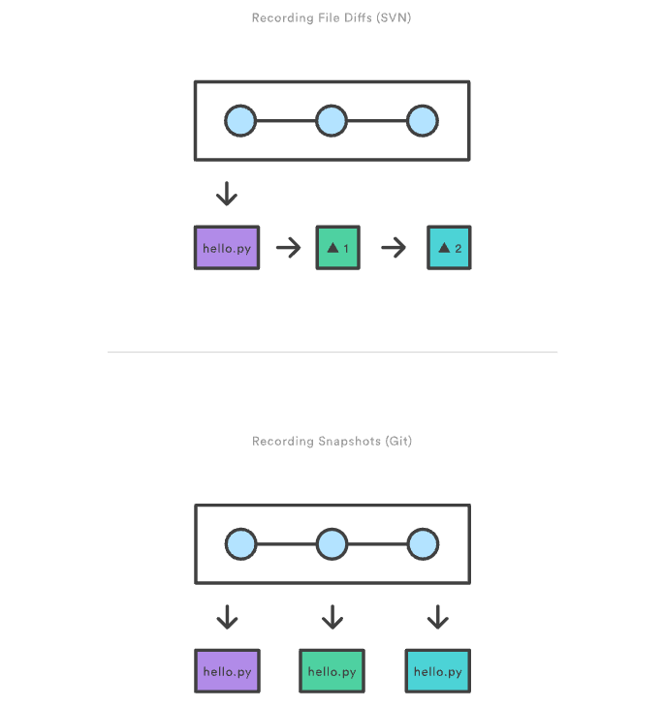
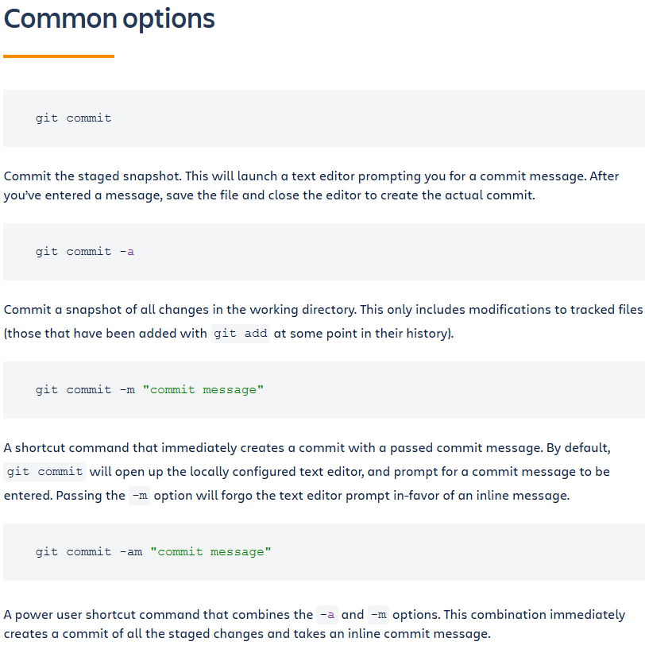
GIT COMMIT

Slide 3
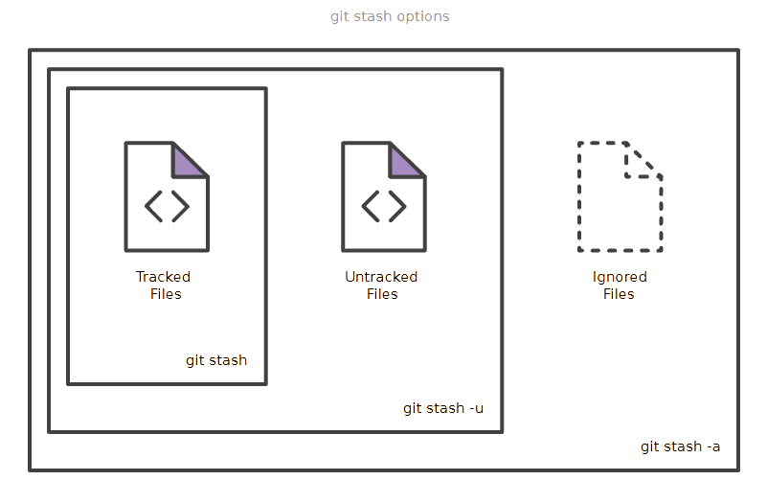
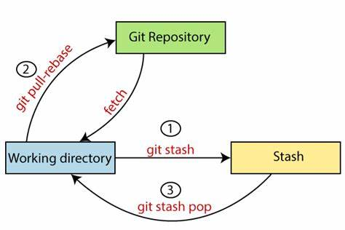
GIT STASH
Git stash temporarily shelves (or stashes) changes you've made

Slide 4
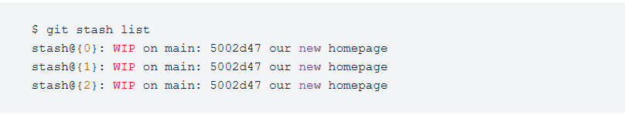
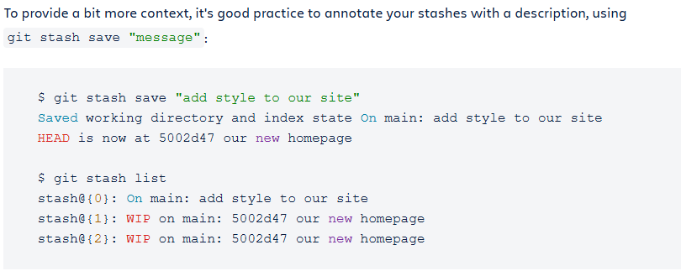

Slide 5
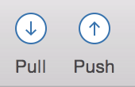
SURENTHAR S
Pull changes from a remote repository (Git)
If someone on your team has made a change to your remote repository, you want to pull those changes locally.
Pull updates from the remote repository by clicking the “Pull” button.
A pop up appears to indicate that you are merging the file from git to your local repository.
Click OK from this pop up.
This will download and merge changes from the remote repository into your local repository.
Navigate to your repository folder on your local system and you'll see the file you just added.
Source-tree updates with a new file in your History view.

Slide 6
SURENTHAR S
Push changes to a remote repository (Git)
If someone on your team has made a change to your remote repository, you want to pull those changes locally.
Pull updates from the remote repository by clicking the “Pull” button.
A pop up appears to indicate that you are merging the file from git to your local repository.
Click OK from this pop up.
This will download and merge changes from the remote repository into your local repository.
Navigate to your repository folder on your local system and you'll see the file you just added.
Source-tree updates with a new file in your History view.

Slide 7
BRANCH
Used to create a branch from the main branch or some existing branch.
Allow multiple team members to work on different aspects of a project simultaneously.
Enables parallel development and reduces merge conflicts by keeping work isolated.
Prevents disruptions to the stable version of the project and keeps development organized.
Easy to test new ideas or technologies without risking the stability of the main branch.

Slide 8
MERGE
Combine changes made in a feature branch into the main branch
Merge branches created by different team members to integrate their individual contributions.
Conflicts should be resolved and addressed between branches during the merge process.
Consolidates all necessary changes into a single branch, simplifying the release process.

Slide 9
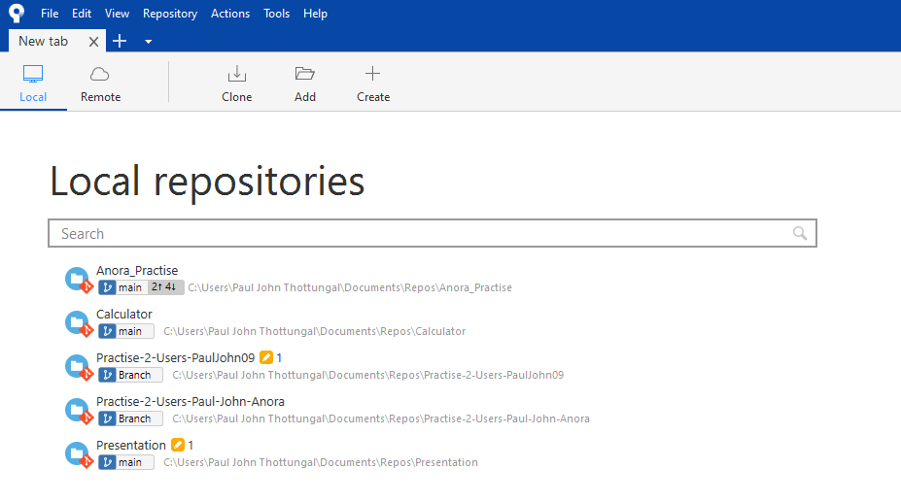
How to Clone a GitHub Repo
Step 1 :

Slide 10
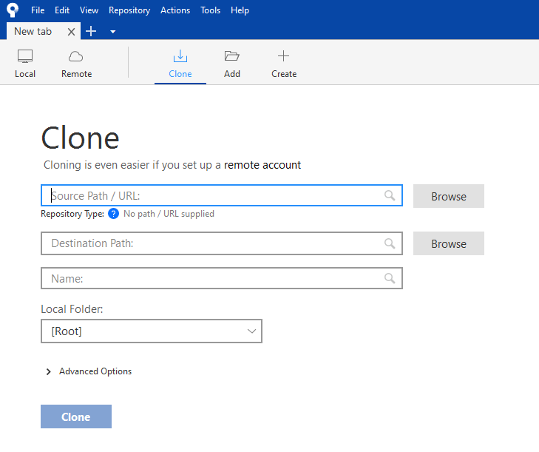
How to Clone a GitHub Repo
Step 2 :
Copy and paste your GitHub Repo Link here
Giver your Path for your local Repo in your computer

Slide 11
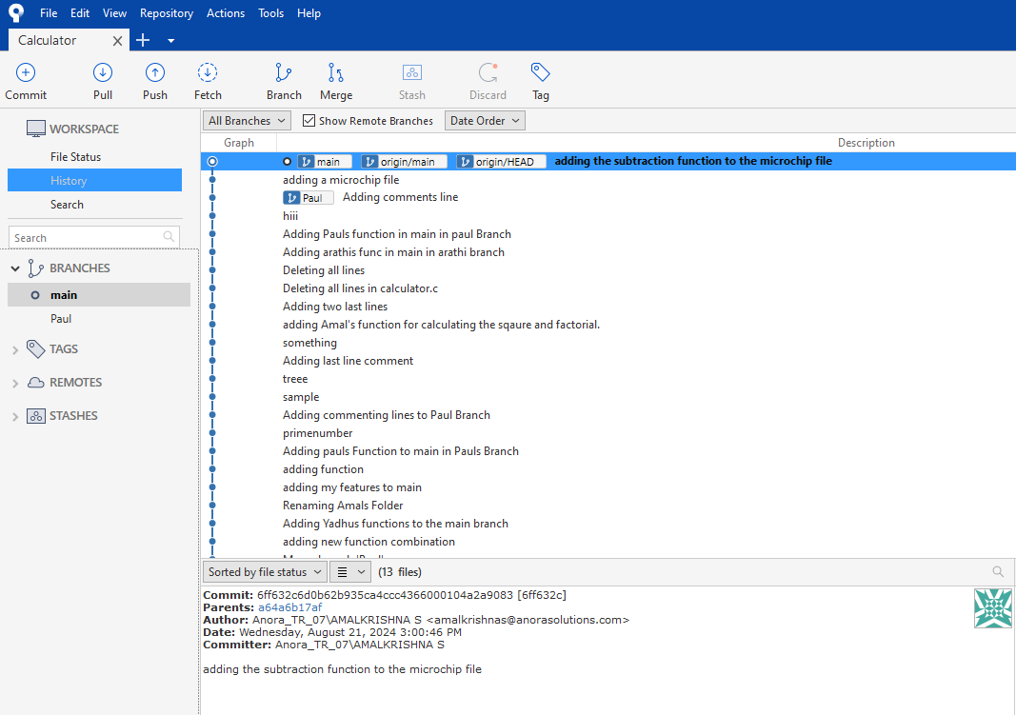
How to Clone a GitHub Repo
Step 3 :

Slide 12
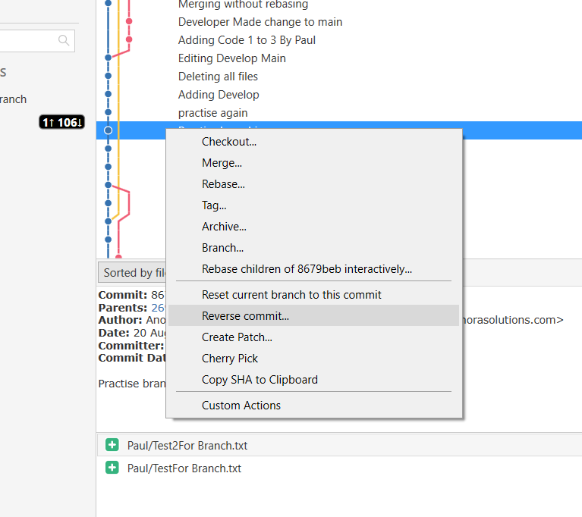
Revert
Creates a commit, undoing the changes done in one or more commits.
Usage
git command: git revert <commit_hash1>...<commit_hashn> (the commits to be undone)
source tree: Right click on the commit to revert, click on “Reverse commit...”

Slide 13
“Reset” is a similar command but it remove the commit to be undone from the history of commits in that repository.
Usage: git reset <commit_hash> (of the commit to which we have reset the repo)
Revert is more preferred than reset as it creates a new commit and the older version is also visible in the commit history.

Slide 14
Thank you

