Slide 1
Analyzing Presidential Speeches with Artifical Neural Networks
Raymond Willey

Slide 2
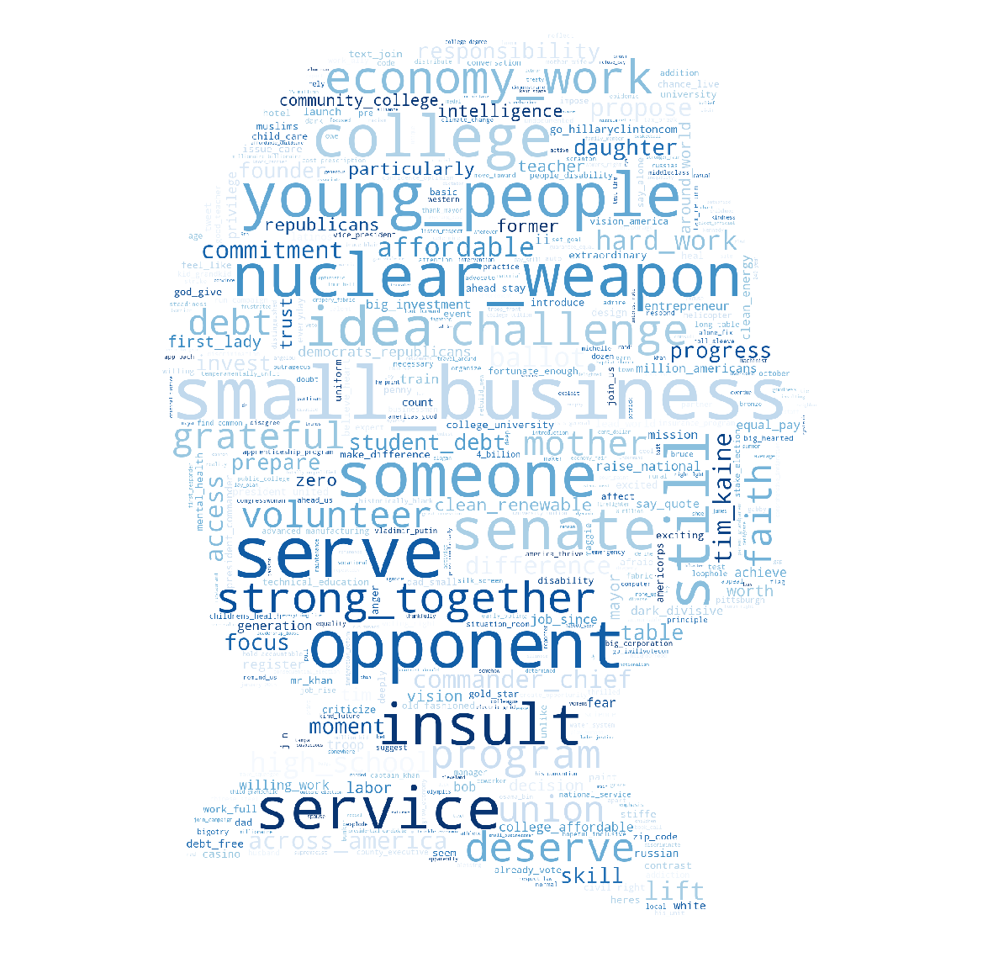
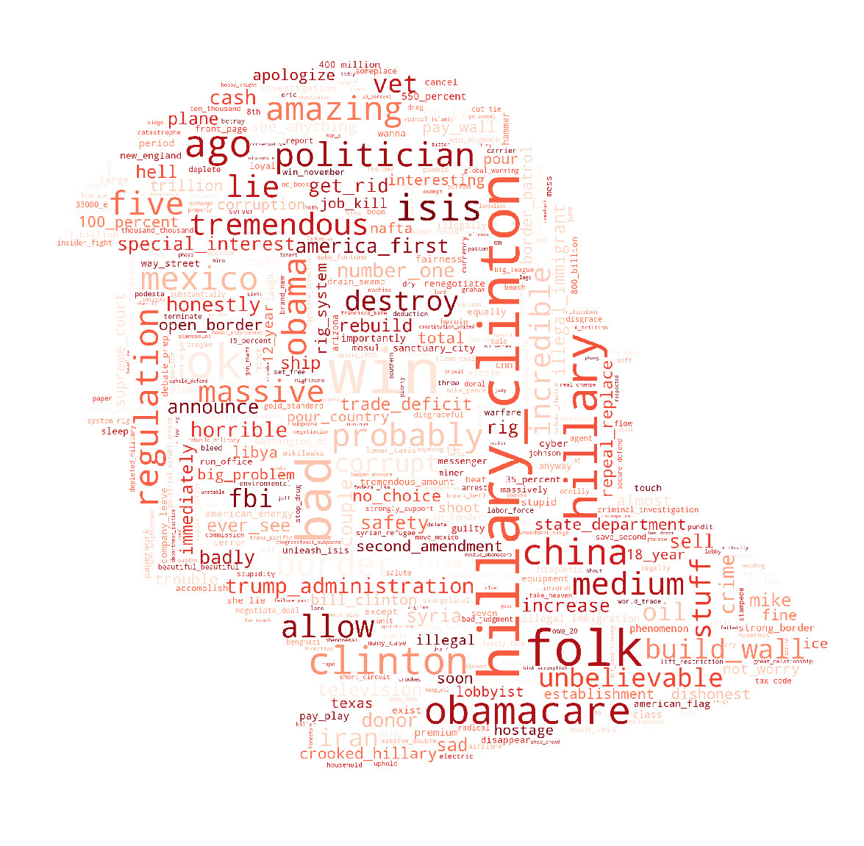
Most Frequently Used Words

Slide 3
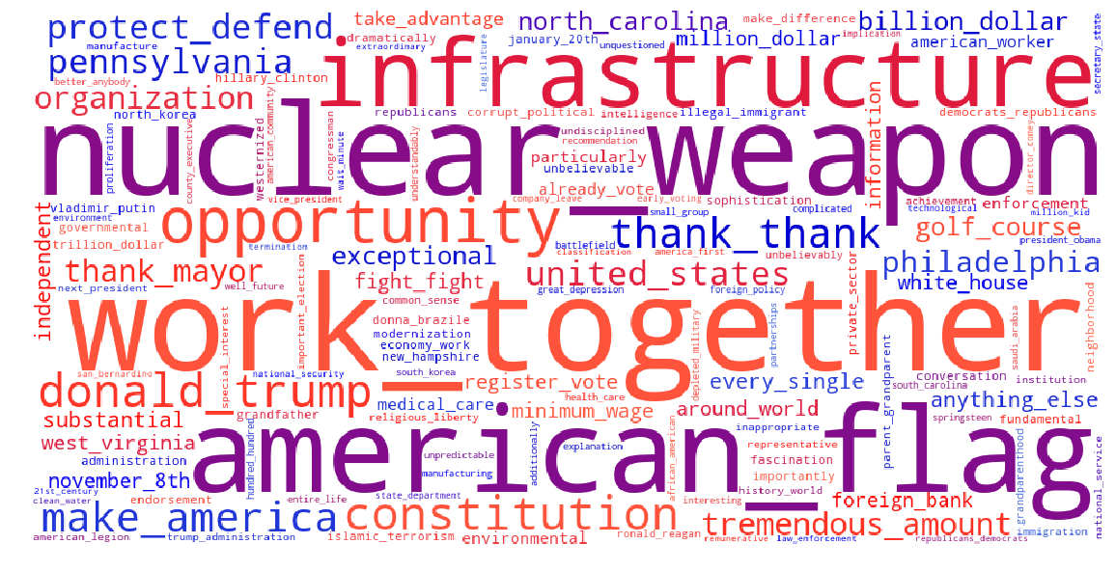
Themes within Errors

Slide 4
Who said it?
But there are common sense things that your government could do that would give Americans more opportunities to succeed. Why don't we do it? Because powerful special interests and the tendency to put ideology ahead of political progress has led to gridlock in Congress. And how can you not be frustrated, and even angry, when you see nothing getting done? And a lot of people feel no one is on their side and no one has their back and that is not how it's supposed to be in America.

Slide 5
Who said it?
And we're gonna use all of that money to invest in the infrastructure and we could even say the environmental infrastructure of our country. And remember this, remember this. When it comes to environment because I receive many environmental awards, you know, people don't wanna talk about that, that's OK. But we need absolutely crystal clear and clean water.

Slide 6
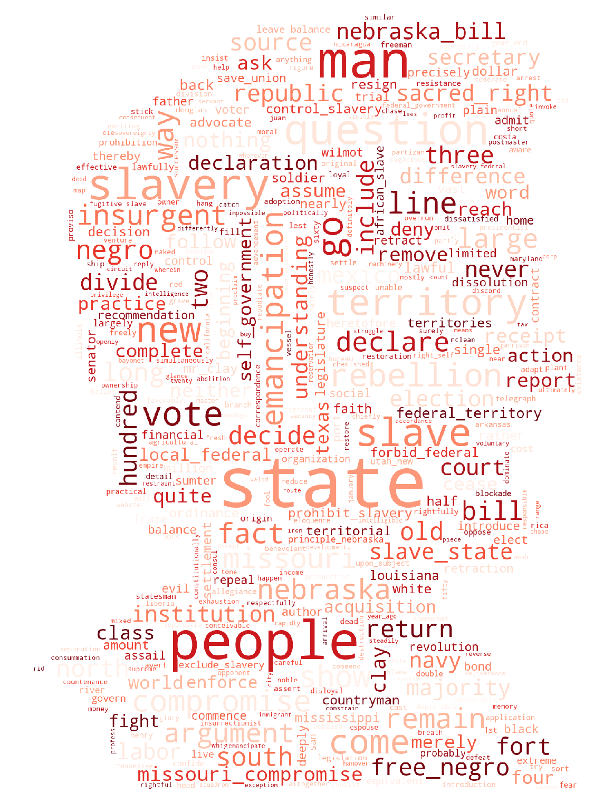
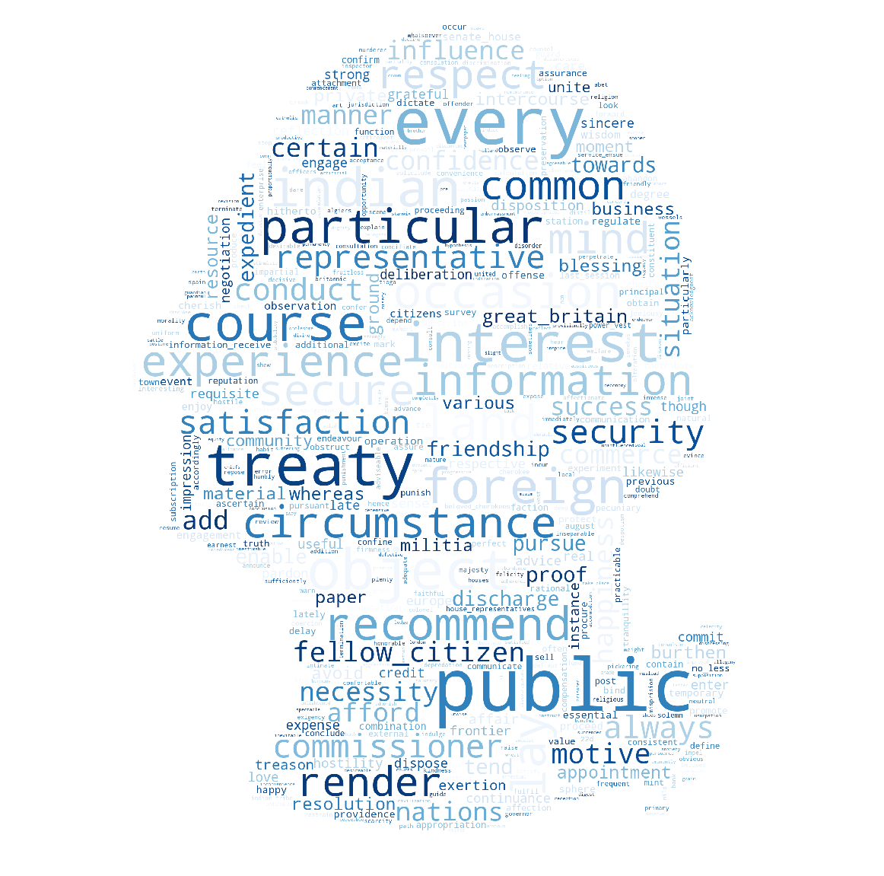
Most Frequently Used Words

Slide 7
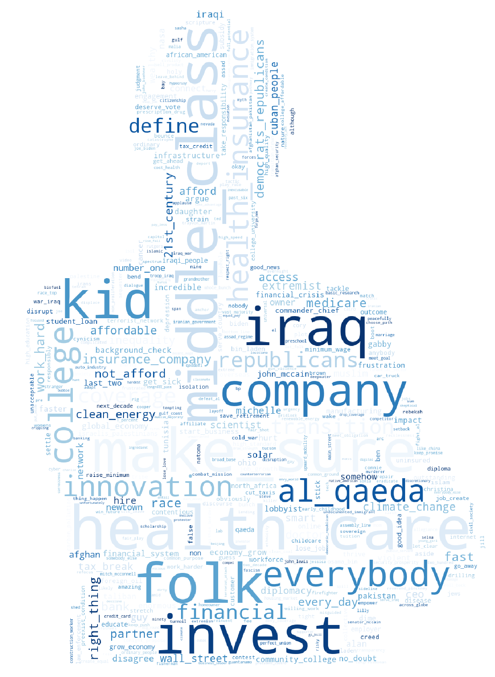
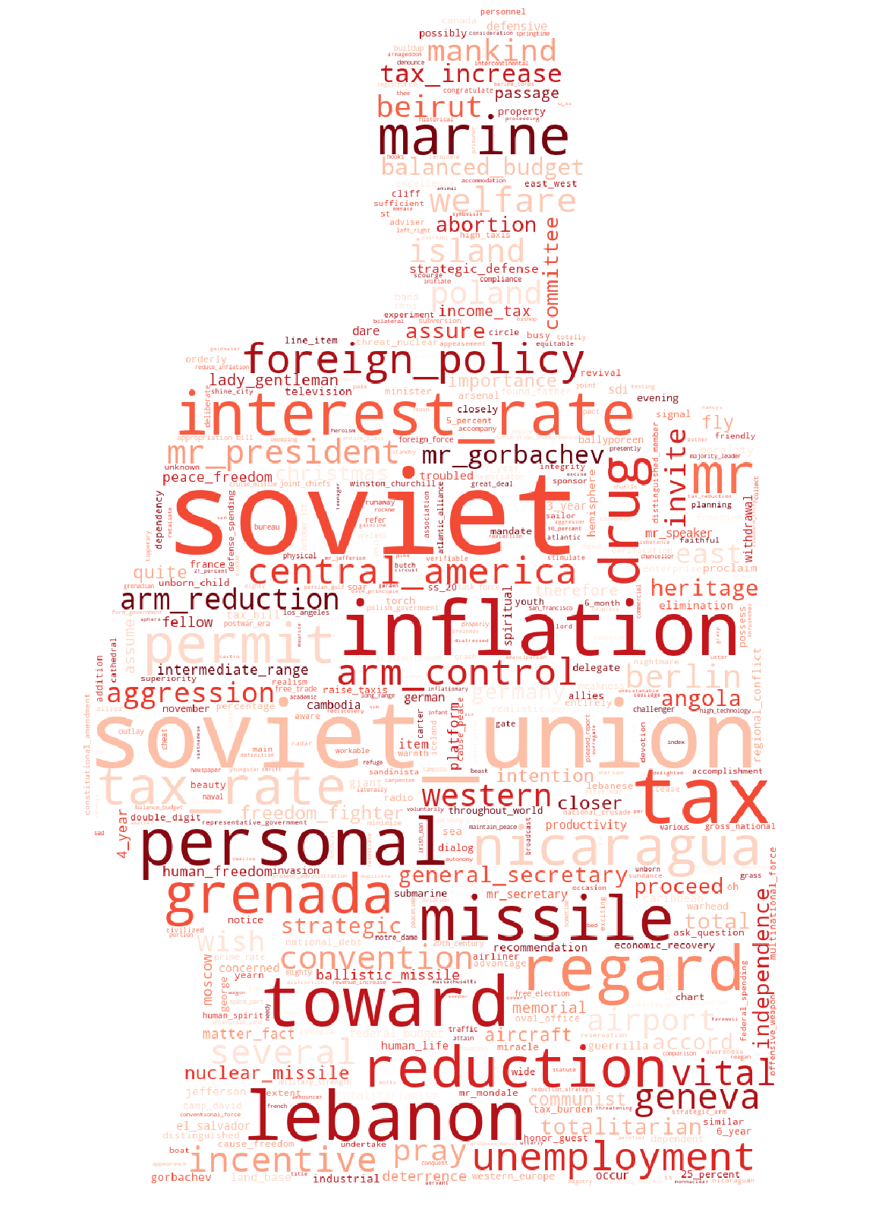
Most Frequently Used Words

