Slide 1

SMART INDIA HACKATHON 2026
THE KAIZEN FLOW
Problem Statement ID – 26135
Problem Statement Title – Difficulties in tracking employment outcomes, skill gaps, and the impact of skilling initiatives.
Theme – Miscellaneous
PS Category – Software
Team ID –
Team Name – Team KAIZEN

Slide 2
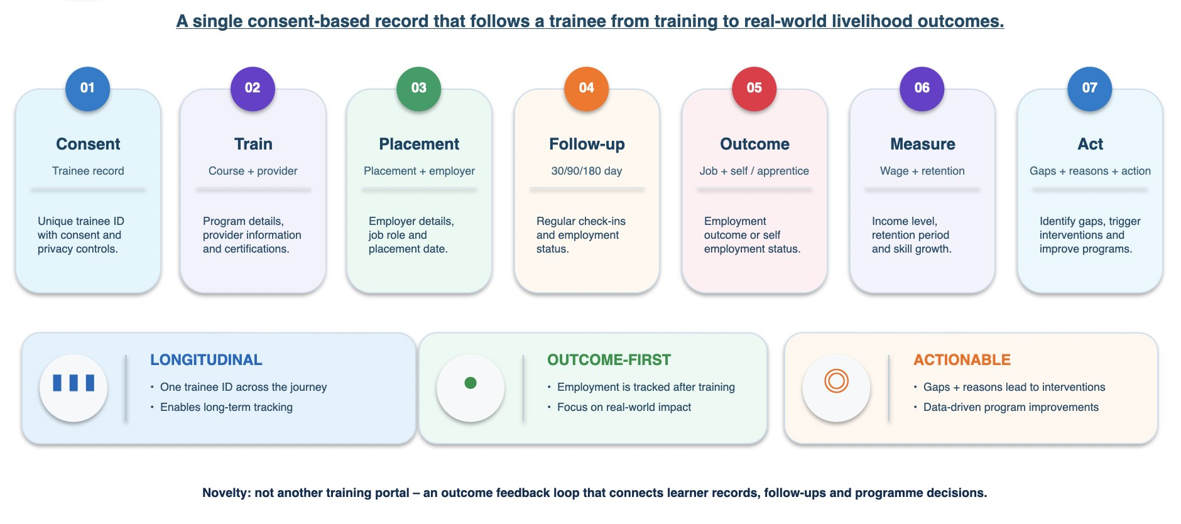
THE KAIZEN FLOW
LONGITUDINAL SKILLING OUTCOME INTELLIGENCE
Team KAIZEN

Slide 3
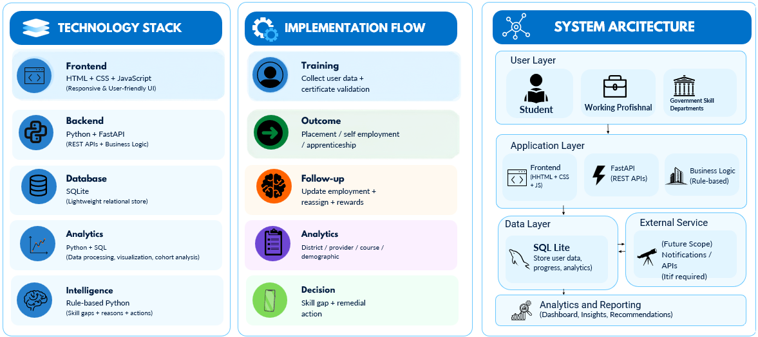
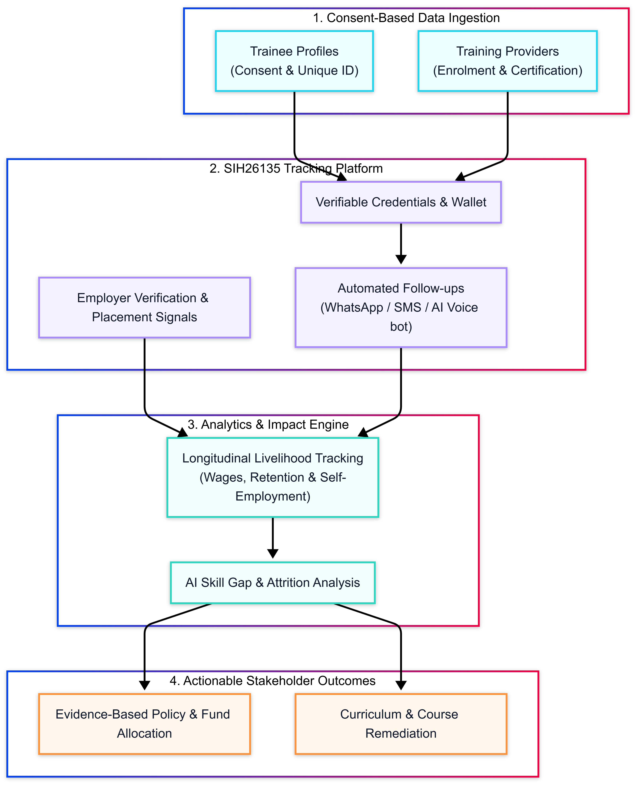
Team KAIZEN
TECHNICAL APPROACH
@SIH Idea submission- Template
3

Slide 4
FEASIBILITY AND VIABILITY
Team KAIZEN
Simple architecture • manageable rollout • measurable outcomes
✓
!
→
FEASIBILITY
KEY CHALLENGES
MITIGATION STRATEGY
FastAPI + SQLite + HTML/CSS/JS: lightweight and easy to deploy.
One longitudinal trainee record links training → placement → employment.
Rule-based analytics and skill-gap logic avoid heavy ML dependency.
Works with synthetic/imported data now; APIs allow future integrations.
Fragmented records and inconsistent trainee identifiers.
Phone/location changes can break follow-up continuity.
Low response rates and incomplete employment updates.
Consent, privacy and employer-data reliability.
Use a unique trainee ID + validation/normalisation checks.
Keep follow-up status separate from phone/location changes.
Pending queue + assisted follow-up + structured outcome forms.
Consent log, minimum necessary data and employer validation score.
VIABLE
Prototype-first today → modular government integration tomorrow

Slide 5
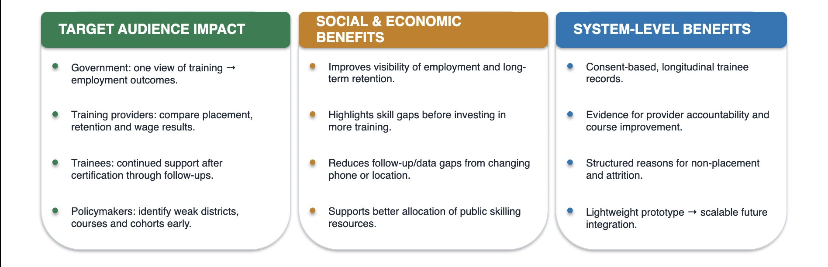
IMPACT AND BENEFITS
Team KAIZEN
FROM DATA COLLECTION → PROGRAMME ACTION
1
TRAINEE
2
PROVIDER
Follow-up creates a persistent outcome record
Outcome-linked accountability
Employment, self-employment, apprenticeship and retention remain visible after training.
Compare completion, placement and retention across providers and courses.
3
POLICY TEAM
4
PROGRAMME
Evidence for resource allocation
Targeted remedial action
District and demographic patterns expose where interventions are needed.
Skill gaps and non-placement / attrition reasons point to course or industry-linkage changes.
Better outcome data → better accountability → better interventions → better livelihood outcomes
Social impact • economic efficiency • transparent programme monitoring

Slide 6
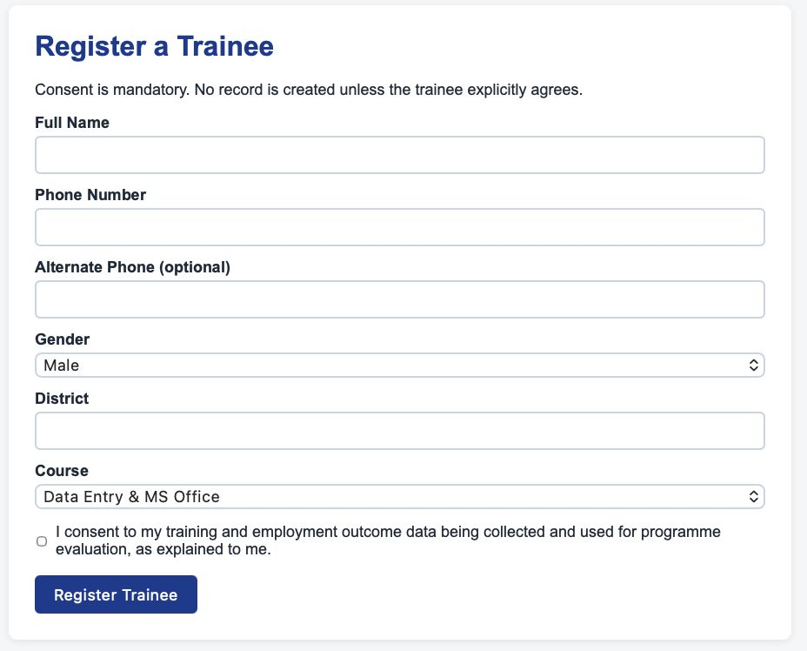
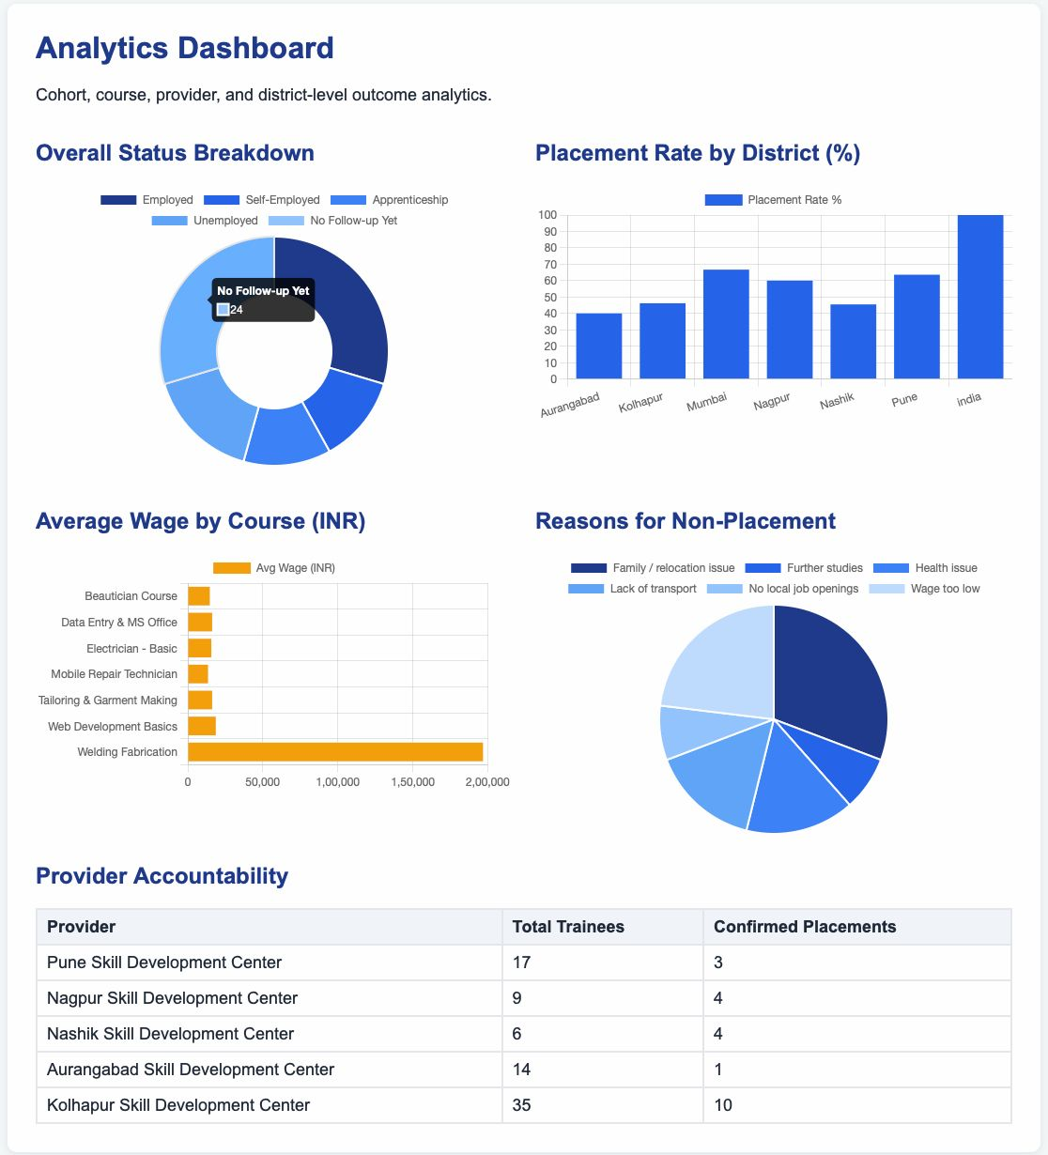
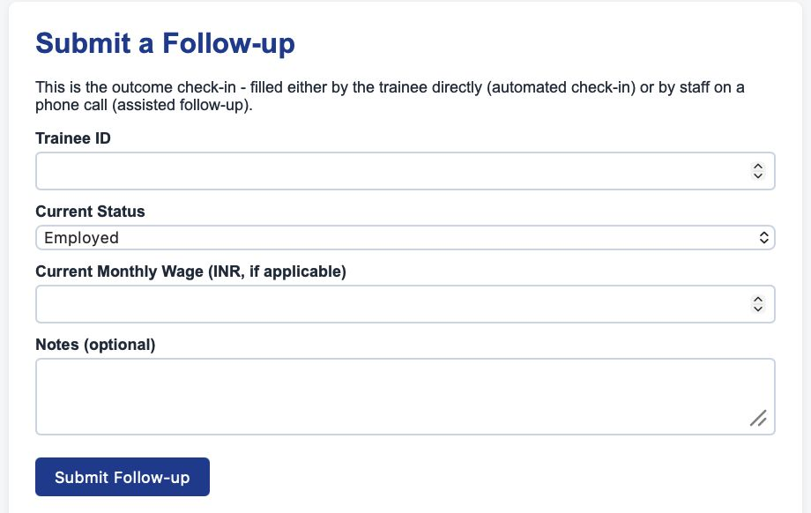
RESEARCH AND REFERENCES
Team KAIZEN
REFERENCE PROTOTYPE
REFERENCE LINKS
Mahaswayam – Government of Maharashtra
https://www.mahaswayam.gov.in
Mahaswayam – Skill Gap Study Report
https://www.mahaswayam.gov.in/skillgapstudy
Skill India Digital Hub (SIDH)
https://www.skillindiadigital.gov.in
National Career Service (NCS)
https://www.ncs.gov.in
National Career Service – Job Search
https://www.ncs.gov.in/job-seeker/pages/search.aspx
@SIH Idea submission- Template
6

