Slide 1

Hear me if you can! (Audio Steganography)
CS 753: Course Project
Mithilesh Vaidya, 17D070011
Rishabh Dahale, 17D070008
Samyak Shah, 18D070062

Slide 2


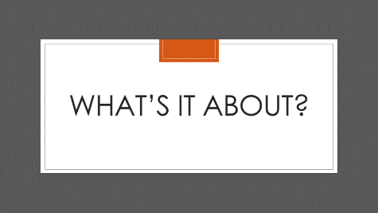

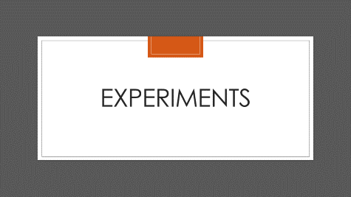
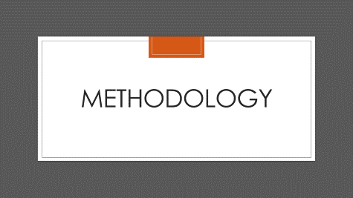

Slide 3
What’s IT About?

Slide 4
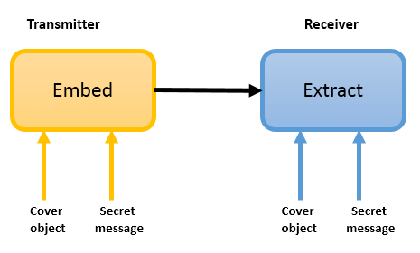
What is Audio Steganography?
It is a technique for concealing the existence of information by embedding it within non-secret audio, called the carrier audio signal.
Unlike cryptography which just conceals the secret message, steganography conceals the presence of the secret itself!
Picture Credits – Alaa Jabbar Almaliki

Slide 5
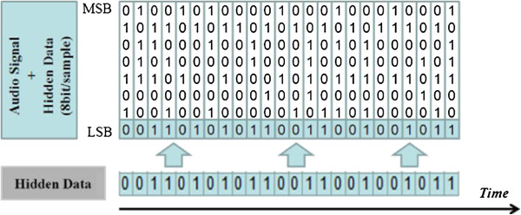
Why ASR for Audio Steganography?
Traditional approaches for audio steganography include hiding info in LSB, echo hiding, spread spectrum, etc.
Limitations: Time domain techniques have high hiding capacity but low imperceptibility while transform domain techniques have better imperceptibility but poor hiding capacity.
LSB Coding
Picture Credits – Fatiha Djebbar

Slide 6
Evaluation metrics

Slide 7

PESQ- Perceptual Evaluation of Speech Quality
PESQ analyses specific parameters of the audio, including time warping, variable delays, transcoding and noise.
The PESQ Algorithm predicts the subjective opinion scores of degraded audio samples. Score ranges from -0.5 to 4.5 or 0 to 5.0 (higher the better)
Measuring the character-per-second can be an important metric to understand the hiding capacity of a model.
PESQ Score- 1.11 (Very Poor)
PESQ Score- 4.33 (Excellent)
Audio Credits - Spearline

Slide 8
METHODOLOGY

Slide 9
The Algorithm Information is encrypted by adding small perturbations (d) to the carrier audio
Input: Audio signal (X) and text to encrypt (T)
Choose a threshold t.
Clip the value of perturbation d between –t and t.
Add perturbation signal to Audio Signal X and decode using CTC. Keep updating d till you get
T = CTCdecode(ASRmodel(X+d)
d Is updated by backpropagating on Loss(Predicted-Text, T) after each iteration.
Once we get the target text as the output, we run the algorithm again with a reduced threshold (using gamma decay)

Slide 10
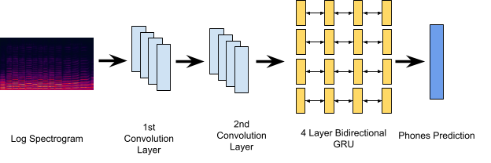
The ASR Model The ASR model we used is a simple CNN-RNN model (see figure below). The input to the model are log spectrograms and the outputs are phones We trained the model from scratch using the TIMIT dataset. TIMIT dataset is a collection of high-quality recordings of 630 individual speakers with 8 different American English accents. Each recording is up to 10 phonetically rich sentences. Using the above model and dataset we were able to achieve a PER (Phone Error Rate of 19.7%.

Slide 11
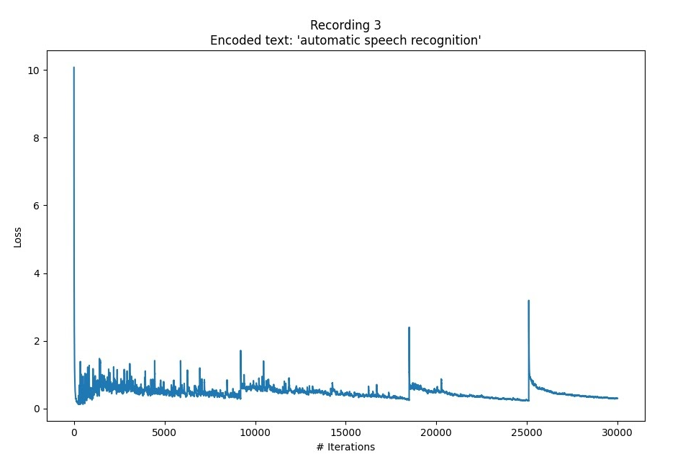
Text Encryption Information is encrypted by adding small perturbations (d) to the carrier audio
We ran the algorithm for 30,000 iterations to get the target audio. The plot on the right is for an audio signal for ‘Now I am become death, the destroyer of worlds’.
The initial audio file had notable noise in the background hence the distortions in the output audio caused due to the algorithm are almost imperceptible.
This audio and text pair was not present in the training set and the model was successfully able to encrypt the text in the audio.
Loss v/s no. of iterations
The spikes are caused due to lowering of the threshold after the model predicts the target text.

Slide 12
EXPERIMENTS

Slide 13
Does initial noise affect the output?
Sr. No. | Source | Actual Text in the Audio | Encoded Text
1. | TIMIT | She had your dark suit in greasy wash water all year | Far below expectations
2. | TIMIT | Swing your arm as high as you can | Clean your oily rag like that
3. | Internet | Now I am become death, the destroyer of the world | Automatic Speech Recognition
Observations:
For the first two recordings the input audio has no noise. As a result the small perturbation caused due to the algorithm becomes perceptible.
For the third recording, the input audio has significant noise in the background. As a result the difference between the original audio and the encoded audio is imperceptible!

Slide 14
Does initial noise affect the output?
Sr. No. | Source | Input Audio | Encoded Audio
1. | TIMIT
2. | TIMIT
3. | Internet
Observations:
For the first two recordings the input audio has no noise. As a result the small perturbation caused due to the algorithm becomes perceptible.
For the third recording, the input audio has significant noise in the background. As a result the difference between the original audio and the encoded audio is imperceptible!

Slide 15
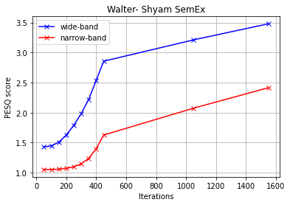
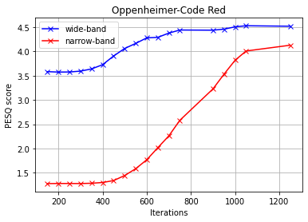
How is PESQ score affected by no. of iterations?
Recording | I am not in danger Skylar; I am the danger
Duration (in s) | 11
Encoding Text | Shyam, how is your semester exchange?
Final PESQ WB (NB) | 3.5 (2.4)
Recording | Now I am become death, the destroyer of worlds
Duration (in s) | 4
Encoding Text | Code Red
Final PESQ WB (NB) | 4.5 (4.1)
Sentence to Phone Conversion – http://www.speech.cs.cmu.edu/cgi-bin/cmudict

Slide 16
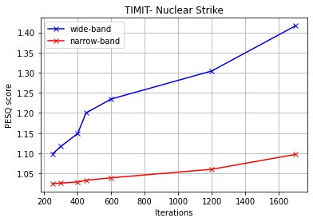
How is PESQ score affected by no. of iterations?
Recording | Shaving cream is a popular item on halloween
Duration (in s) | 3
Encoding Text | Nuclear strike authorized
Final PESQ WB (NB) | 1.42 (1.10)
Observations:
For all the cases we observed PESQ increased as number of iterations increased.
We plotted both the Wide Band (WB) PESQ and the Narrow Band (NB) PESQ; the WB PESQ was always higher than the NB PESQ. It is not known whether our main reference paper used WB or NB for calculating its PESQ values.
For all the examples- please refer to the code repo or report

Slide 17
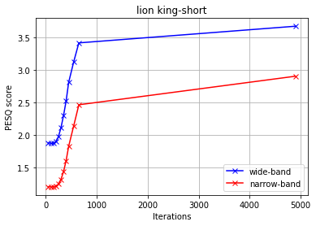
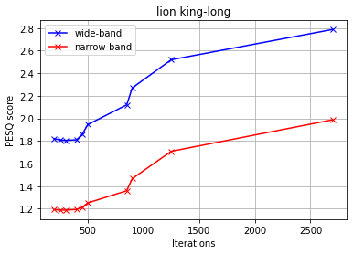
How is PESQ score affected by the type of encoding text?
Recording | To change the future you gotta put the past behind you, way behind. Look kid, bad things happen but you cannot do anything about it. Right? WRONG! When the world turns its back on you, you turn your back on the world and only embrace what's next and turn the what into so what
Duration (in s) | 19
Encoding Text for Short | That’s my spot
Final PESQ WB (NB) for short | 3.70 (2.90)
Encoding Text for long | In winter that seat is close enough to the radiator so it's warm yet not so close that he sweats. In summer it’s directly in the path of cross breeze. It faces the television at an angle that isn’t direct so he can still talk to everybody yet not so wide that the picture looks distorted
Final PESQ WB (NB) for long | 2.80 (2.00)

Slide 18
How is PESQ score affected by the type of encoding text?
Observations:
The longer texts are more difficult to encode due to the high number of phones compared to the shorter texts.
That’s why as one would expect, the final PESQ score for the shorter texts is higher than the PESQ score for the longer texts.
A keen listener may be able to identify the presence of a secret if the PESQ score is low!

Slide 19
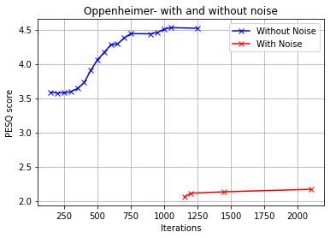
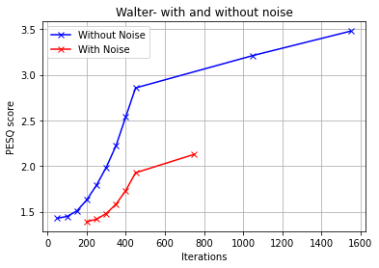
What’s the effect of Gaussian Noise?
Observations:
For a fixed input audio and encoded text, when we plotted the WB PESQ v/s iterations graph for with and without noise, we found that the PESQ score for the case with noise is lower than the case without the noise.
For all the examples- please refer to the code repo or report

Slide 20
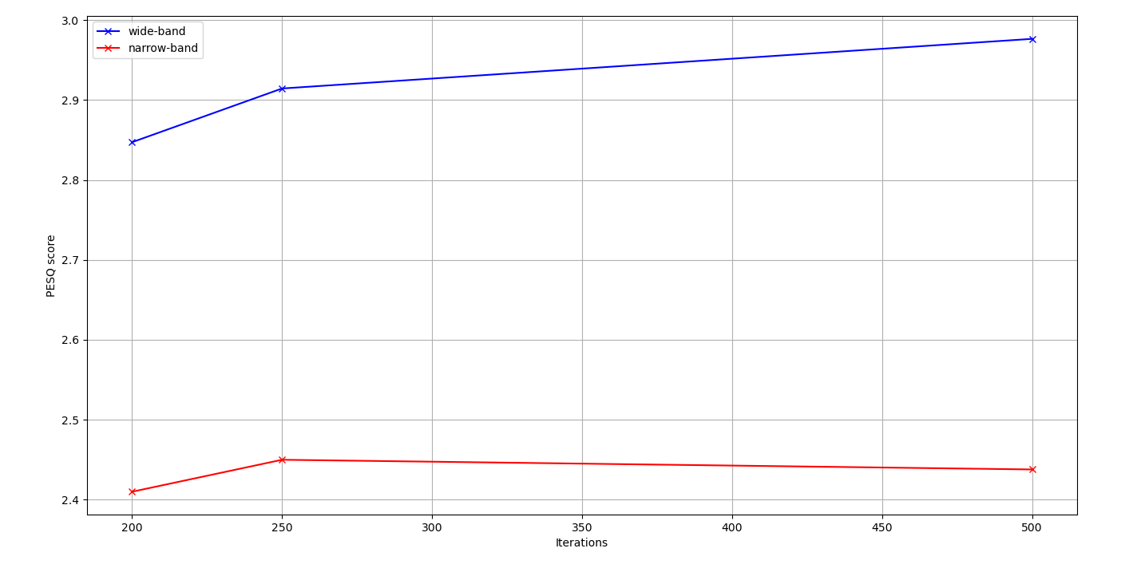
Does perturbation in log spectrogram directly, create a difference?
Observations:
At the same value of iteration no., the PESQ here is lower than the previous cases. This is because the phase information is lost during this test and GriffinLim can only approximate the phase value.
Due to lost information, PESQ is lower when we use log spectrograms.

Slide 21
References & Sources

Slide 22
References and Sources
Kong, Yehao, and Jiliang Zhang. ”Adversarial audio: A new information hiding method and backdoor for dnn-based speech recognition models.”arXiv preprint arXiv:1904.03829 (2019).
Kui Ren, Tianhang Zheng, Zhan Qin, Xue Liu, Adversarial Attacks and Defenses in Deep Learning, Engineering, Volume 6, Issue 3, 2020 (referred very little)

Slide 23
Work Distribution
All the work and ideas were discussed in the group before implementation. Since, the work was very collaborative it is difficult to categorize who did what. But below is a rough work distribution
Mithilesh Vaidya: Ideation, Experiment Design, Model Training, Experimenting with PESQ scores, Report
Rishabh Dahale: Ideation, Data Pre-processing, Model Training, Experimenting with Gaussian Noise, Report
Samyak Shah: Ideation, Experimenting with Audios, Visualising the data, Presentation Design, Report

