Slide 1
Prediction Model to identify potential customers for a banking institution
Submitted in the partial fulfillment for the award of the degree of
BACHELOR OF ENGINEERING
IN
Cloud Computing
Submitted by:
Tanu Aneja 20BCS4177
Rohit Kumar 20BCS4155
Anubhav Jain 20BCS4181
Hardik 20BCS4123
Under the Supervision of:
Professor Ranjan Walia
Department of AIT-CSE
DISCOVER . LEARN . EMPOWER

Slide 2
Outline
Introduction to Project
Problem Formulation
Objectives of the work
Methodology used
Results and Outputs
Conclusion
Future Scope
References

Slide 3
Introduction to Project
With the startling rise over the last few decades of media and technology which increases the amount of information we have at our fingertips (cell phones, television, Internet, etc.), humans are now more connected than ever. One result of this is that marketing campaigns are growing evermore pervasive in our daily lives. This glut of advertising has forced businesses to compete for the attention of a population that has an ever growing amount of distractions. Thus raising the question: How can businesses successfully advertise their products in the most efficient way possible with the highest possible rate of success? We will answer this question in the context of banks advertising fixed term deposit products to their customers. Using data collected from a previous bank marketing campaign, a number of features centered around the clients, the campaign itself, and general market conditions will be explored. Based on this data, machine learning models will predict which clients will subscribe and what banks can do to increase the rate of subscription.

Slide 4
Problem Formulation
In today's world, we're constantly bombarded with ads from all directions—on our phones, TVs, and the internet. This makes it tough for businesses, especially banks, to grab people's attention and convince them to sign up for things like fixed term deposits.
So, the big question is: How can banks advertise these products in a way that actually works, given all the distractions people face?
To figure this out, we're going to look at data from past bank ads and see what factors make people more likely to sign up. We'll look at things like who the clients are, how the campaigns were run, and what the market was like at the time.
Our goal is to use this data to build computer models that can predict who's most likely to sign up for fixed term deposits. Then, we'll use those predictions to come up with ideas to help banks get more people to sign up.

Slide 5
Objectives of the Work
A marketing campaign run by Banco de Portugal is examined. The campaign’s aim was to increase customers’ subscription rates to fixed-term deposit products, such as CDs. Using knowledge from the course, a number of machine learning algorithms are implemented to answer the question: How can banks successfully market these products in the most efficient way possible and with the highest possible rate of success?
We will answer this question in the context of banks advertising fixed term deposit products to their customers. Using data collected from a previous bank marketing campaign, a number of features centered around the clients, the campaign itself, and general market conditions will be explored. Based on this data, machine learning models will predict which clients will subscribe and what banks can do to increase the rate of subscription.

Slide 6
Methodology used
A. Programming in Python Python provides a number of packages and libraries for the convenience of the programmer. The whole project is coded using Python 3. Packages/libraries used are numpy for array manipulation, pandas for dataframe operations, and matplotlib and seaborn for visualization. The sklearn libraries were also critical in providing packages for machine learning algorithms, tasks, and by giving the user the control to set important attributes of those algorithms as they wished. The dataset is stored in a dataframe and is intensively queried and manipulated using facilities provided by the Python 3 environment. Other data structures such as arrays, lists, and dictionaries are used as needed[1].

Slide 7
B. Data cleaning and exploratory analysis The dataset was provided by the U. C. Irvine Machine Learning Repository and contained information on 41,188 clients across 20 different features, both categorial (marital status, job type, education, etc.) and numeric (age, number of days since previous contact, etc.). The target variable is a binary “Yes” (client subscribed) or “No” (client did not subscribe). The first step is to load the dataset into a dataframe for easy manipulation and exploration using the pandas package. The ‘duration’ feature was dropped due to the risk of data leakage. This feature measures the length of the phone call between the bank’s marketing representative and the customer. Since this time cannot be known until after the call has ended (when the outcome for that customer is already known), including it in a predictive model would not provide realistic results. The next step was to explore and clean the categorical variables such as ‘job type,’ ‘marital status,’ ‘education,’ etc. Plots for each were produced that looked at their relative frequency as well as normalized relative frequency. In Python, these graphs are created using the seaborn package.

Slide 8
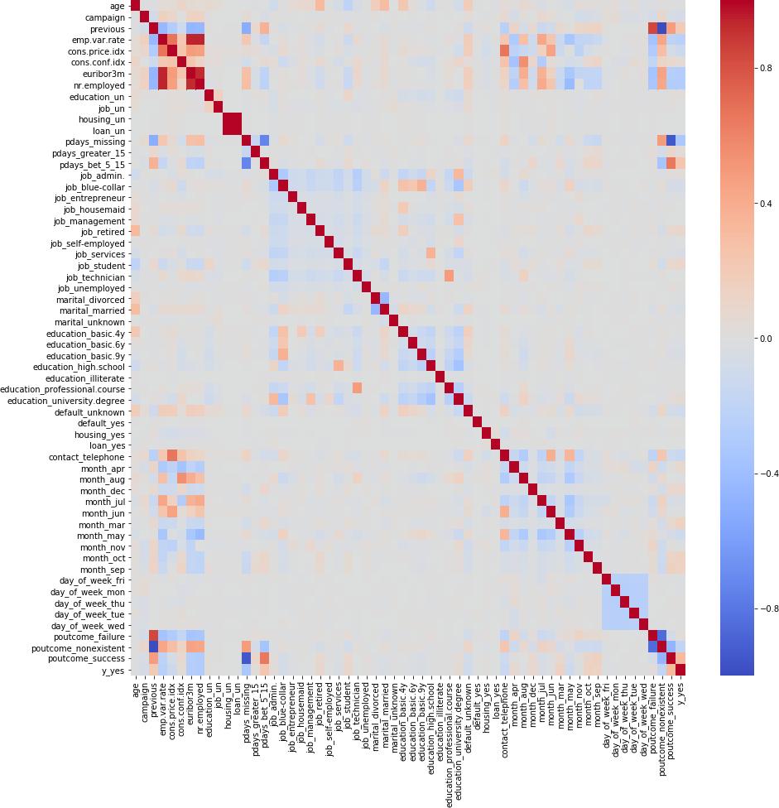
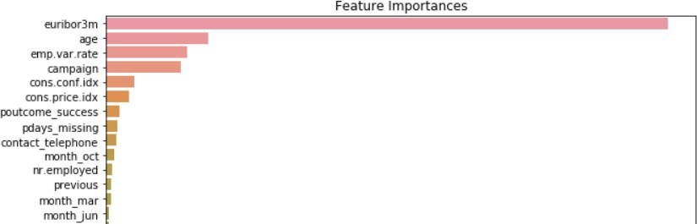
Results and Outputs
Fig. 1. Spearman correlation heatmap of rankings for each variable
Fig. 2. Most important Features based on the AdaBoost model

Slide 9
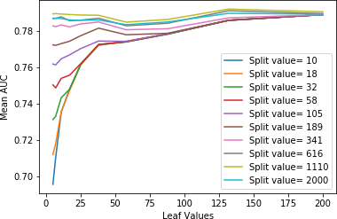
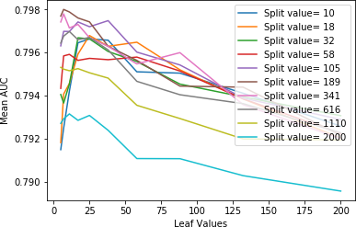
Hyper-parameter tuning for Random Forest Classifier
Hyper-parameter tuning for Decision Trees

Slide 10
From the above results, the best out of sample model performance was obtained for the AdaBoost Classifier with nestimators = 1000. On the test data, the best AUC score achieved was 0.8036. The importance of the features (in terms of how greatly they affected the coefficients) was also plotted. This provides valuable insight toward understanding which features contribute the most toward the models’ performance. From the feature importance plot, it can be inferred that Europe’s Libor rate, age of the applicant, employment variation rate, campaign, consumer confidence index, consumer price index, mode of contact (= telephone), and number of employees are some of the most important features in predicting the outcome. The below graph was created using the seaborn package and the function plotfeatureimportances.

Slide 11
Conclusion
From this project, we learned how banks can improve their marketing campaigns by focusing their efforts on certain prime-grade clients and also how they can recognize market conditions which are favorable to increase client subscription for the fixed-term products they are offering. All of this was possible by implementing data science and machine learning methods in Python. Tools such as dataframes, arrays, for loops, etc. were all critical for the success of this project. A large number of other tools and techniques from the Python for Data Science course were used and these were invaluable for making our analyses and predictions. This project demonstrated how powerful Python can be for data science applications

Slide 12
Future Scope
Data Analytics and AI: With the increasing volume of data generated by digital transactions, social media interactions, and other sources, banks will continue to leverage advanced analytics techniques and artificial intelligence (AI) to extract actionable insights. Predictive analytics, machine learning models, and natural language processing (NLP) algorithms will play a crucial role in understanding customer preferences, detecting patterns, and optimizing marketing strategies.
Personalization: Banks will increasingly focus on delivering personalized experiences to their customers. By analyzing transactional data, browsing behavior, and demographic information, banks can tailor their marketing messages, product recommendations, and service offerings to individual needs and preferences. Personalization not only enhances customer satisfaction but also improves conversion rates and customer loyalty.

Slide 13
References
[1] Foster Provost and Tom Fawcett, Data Science for Business. O’Reilly Media, 2013.
[2] https://ababankmarketing.com/insights/network-effect-strong-ever/

