Slide 1
Dissimilar Nodes Improves Graph Active Learning
Xiaxuan Gao, Zhicheng Ren, Yuxin Wu, Yifu Yuan

Slide 2
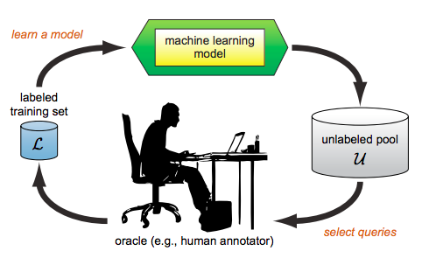
Introduction
What is active learning?
Notes:
So What is active learning? The active learning is the subset of ML in which a learning algorithm can query a user interactively to label data with the desired output. As shown in the graph, in active learning, a machine learning model may begin with a small number of instances in the labeled training set L. Then the model will learn from the labeled data, and then leverage its new knowledge to choose which instances to query next from the unlabeled data pool. The human annotator will label those queries. Those labeled instances are simply added to the labeled set and the model will then proceeds in s standard supervised way.

Slide 3
Motivation & Challenge
Motivation
Current supervised graph embedding algorithms require a large number of labels in the training data, which is costly to obtain.
E.g. chemistry and health care
Active Learning is a promising strategy to tackle this challenge.
Challenge
Active Learning has been proven effective on i.i.d data such as NLP and CV.
However, developing an active graph embedding protocol is more challenging, since it requires to consider the graph structure with dense connections between different instances.
Notes:
Our project is trying to apply active learning methods on GNN. The motivation for our project is that
Current supervised graph embedding algorithm require a large number of labels in the training data, which is costly to obtain e.g. chemistry and health care
Active learning is a promising strategy to tackle this challenge
Although active learning has been proven effective on independent identically distributed data such as NLP and Computer vision, developing an active graph embedding protocol is more challenging, since it requires to consider the graph structure with dense connections between different instances. So it is worth studying on how to apply active learning on graph embedding.

Slide 4
Background
General Active Learning Methods
Heterogeneity-based: select as diverse nodes as possible
Performance-based: select the nodes with the most performance gain
Representativeness-based: select the most representative nodes in the graph
Existing Work
AGE (Active Graph Embedding)
Three query selecting function
Centrality: Global Representativeness-based
Density: Local Representativeness-based
Information Entropy: Heterogeneity-based
Notes:
Here is some background knowledge about our project.
Here are some general active learning methods.
Heterogeneity-based methods which aim to select as diverse nodes as possible
Performance-based methods which aim to select the odes with the most performance gain
Representativeness-based methods which select the most representative nodes in the graph
Our project is based on the existing work (Active learning for Graph embedding). The paper proposes a framework called AGE (active graph embedding), in which it designed a generative active learning query strategy. It mainly contains three query functions:
First is centrality and the second is density.
The two are both representative measures. Centrality aims to find a node which is representative for the entire graph, for example, those with the most in-degrees, while density measures how representative one node is within its own class,
Entropy which is one example of heterogeneity based methods. The larger the entropy of a candidate node is, the more uncertain current model is regarding to that node. We tend to choose that node. . Our project tries to invent new query functions and improve the overall performance.

Slide 5
Key Idea: Dissimilar Nodes
Traditional active learning query functions for graphs focus on new nodes only, i.e., how to select the most valuable nodes to get queried within a budget.
However, few attention has been put on the nodes which have already been labeled.
Our motivation is that, if a new node sample are dissimilar to all the nodes which have already been labeled, it is likely to contain additional information that could boost the training process of active learning.
Absolute heterogeneity
(Consider new nodes only)
Relative heterogeneity
(Consider existing labels)

Slide 6
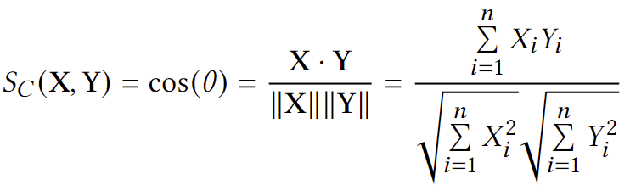
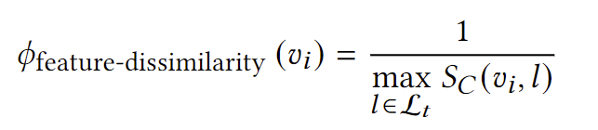
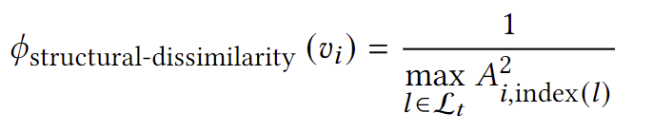
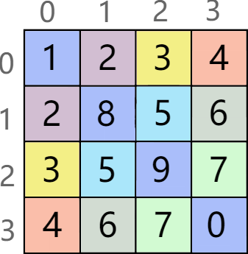
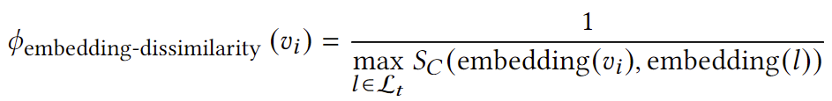
Methodology: Three ways to evaluate dissimilarity
Feature Dissimilarity Score
Structural Dissimilarity Score
Embedding Dissimilarity Score

Slide 7
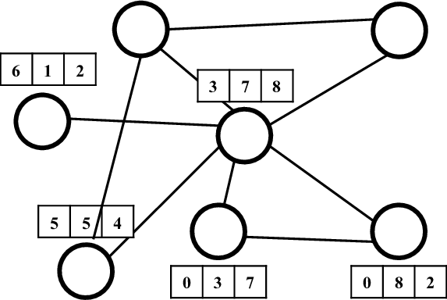
Methodology: Three ways to evaluate dissimilarity
L

Slide 8
Training Process
If the labeling budget B is not reached, the AL Query Strategy module starts selecting the best candidate in the unlabeled nodes set (U), query it with the oracle, and add into the labelled nodes set (L) before another epoch of GCN training begins.
Otherwise, we have reached the budget. The training is carried normally until GCN converges.

Slide 9
Experimental Setting
Task: Node Classification
Datasets: Cora, Citeseer, Pubmed
Backbone (base model): GCN
Baseline: AGE-GCN

Slide 10
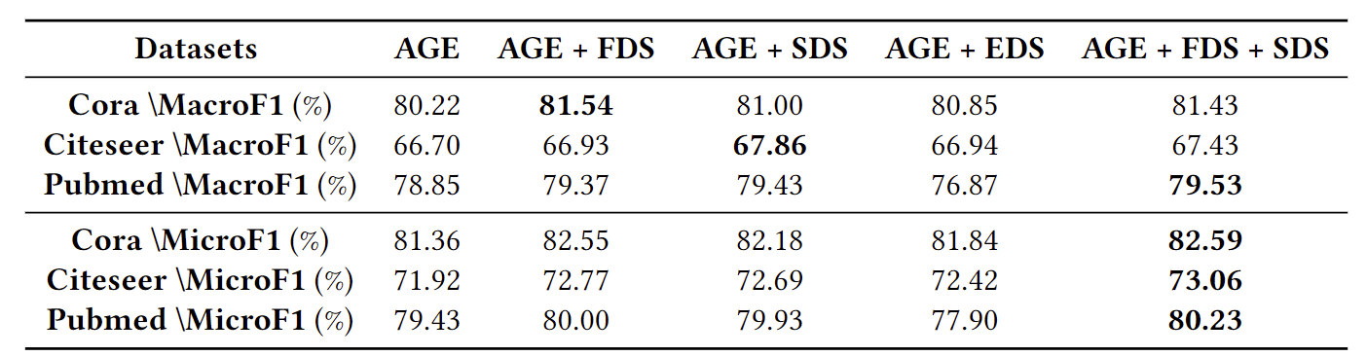
Results

Slide 11
Backbone Comparison
Replace the vanilla GCN backbone with other well-known graph neural networks.
Graph Attention Network (GAT)
Operates on graph-structured data, leveraging masked self-attention layers
Simplifying Graph Convolutional Network (SGC)
A compact model which reduces excess complexity of GCN
Simple and Deep Graph Convolutional Network (GCNII)
An extension of vanilla GCN with initial residual and identity mapping

Slide 12


Backbone Comparison cont.
Experiments are conducted in original AGE setting
Apply the same scores, macro and micro F1
Apply the same metrics, entropy, density and centrality
Test on Cora and Citeseer datasets.

Slide 13
Backbone Comparison cont.
SGC resembles the performance of vanilla GCN
GAT and GCNII not so well
We reason that:
As the training set size is very limited, attention based and deep convolutional models are not able to deliver quality node embeddings.
On the other hand, compact and shallow models are more suitable in AGE paradigm.

Slide 14
Conclusion
We propose a new metric, dissimilarity, in order to improve the effectiveness of existing active learning protocols for graphs.
Our experimental result shows that a combination of FDS and SDS will improve the performance of active learning protocols for graph when they are added to existing active learning scores.
We also provide an high level explanation about why those scores work. Then, we do some ablation study by replacing the GCN module with other similar GNN models, including GAT, SGC, and GCNII. We observe that GCN is still the best candidate.

Slide 15
Future Work
One possible future direction is to improve on the EDS. Our current EDS is inefficient since the model might not be well trained at the beginning. And our future work is to overcome this bottleneck.
Another possible future direction is to develop an efficient performance-based active learning algorithm. Currently we are not using any performance-based active learning algorithm since existing algorithms usually require a lot of training time.

Slide 16
References
[1] Yuexin Wu, Yichong Xu, Aarti Singh, Yiming Yang, and Artur Dubrawski. Active learning for graph neural networks via node feature propagation. CoRR, abs/1910.07567, 2019.
[2] Shengding Hu, Zheng Xiong, Meng Qu, Xingdi Yuan, Marc-Alexandre Côté, Zhiyuan Liu, and Jian Tang. Graph policy network for transferable active learning on graphs. CoRR, abs/2006.13463, 2020.
[3] Thomas N. Kipf and Max Welling. Semi-supervised classification with graph convolutional networks. In International Conference on Learning Representations (ICLR) , 2017.
[4] Petar Veliˇ ckovi ́c, Guillem Cucurull, Arantxa Casanova, Adriana Romero, Pietro Liò, and Yoshua Bengio. Graph attention networks, 2017.
[5] Hongyun Cai, Vincent Wenchen Zheng, and Kevin Chen-Chuan Chang. Active learning for graph embedding. CoRR, abs/1705.05085, 2017.
[6] Petar Veliˇckovi ́c, Guillem Cucurull, Arantxa Casanova, Adriana Romero, Pietro Liò, and Yoshua Bengio. Graph Attention Networks.
International Conference on Learning Representations, 2018. accepted as poster.
[7] Felix Wu, Amauri Souza, Tianyi Zhang, Christopher Fifty, Tao Yu, and Kilian Weinberger. Simplifying graph convolutional networks. In Proceedings of the 36th International Conference on Machine Learning , pages 6861–6871. PMLR, 2019.
[8] Zhewei Wei Ming Chen, Bolin Ding Zengfeng Huang, and Yaliang Li. Simple and deep graph convolutional networks. 2020.

