Slide 1


Adversarial Attacks on Knowledge Graph Embeddings
Yikai Zhu
2022/05/31

Slide 2

Agenda
01
Background
02
Related Work
03
Proposed Method
04
Experiment

Slide 3

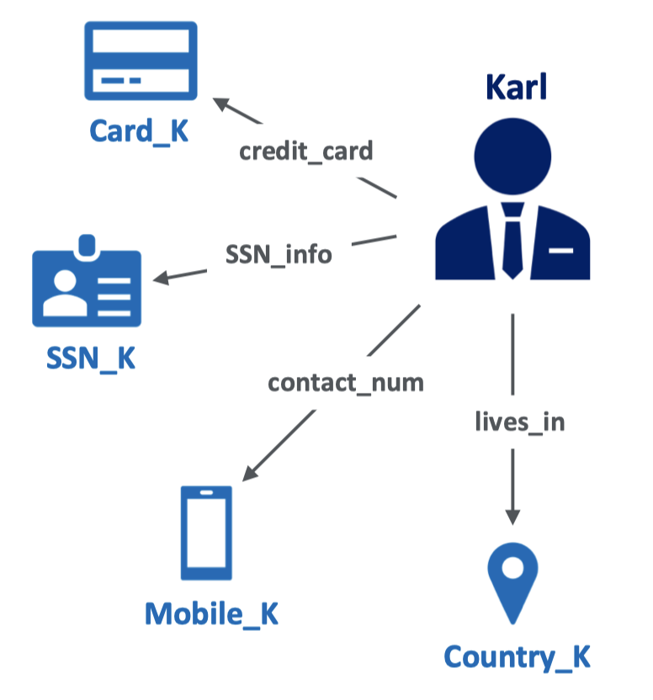
01
Background:Knowledge Graph
Structured representation of facts
Encoded in (head, relation, tail) triples
head | relation | tail
Karl | credit_card | Card_K
Karl | SSN_info | SSN_K
Karl | contact_num | Mobile_K
Karl | lives_in | Country_K
Notes:
(20s)Knowledge graph is a graph structured representation of real world facts.
These facts are encoded in the form of head relation tail triples.

Slide 4
01
Background:Knowledge Graph
Structured representation of facts
Encoded in (head, relation, tail) triples
head | relation | tail
Karl | credit_card | Card_K
Karl | SSN_info | SSN_K
Karl | contact_num | Mobile_K
Karl | lives_in | Country_K
Notes:
Knowledge graph is a graph structured representation of the factual knowledge about real world facts.
These facts are encoded in the form of subject relation object triples.
For example, we can represent the fact that Karl lives in country_K as shown here.

Slide 5
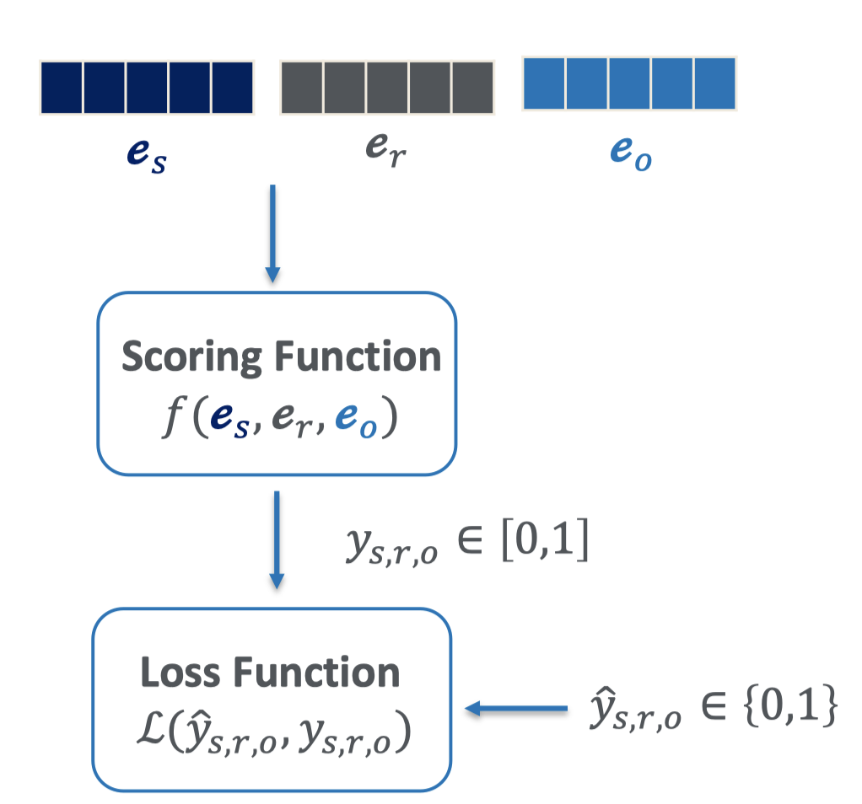


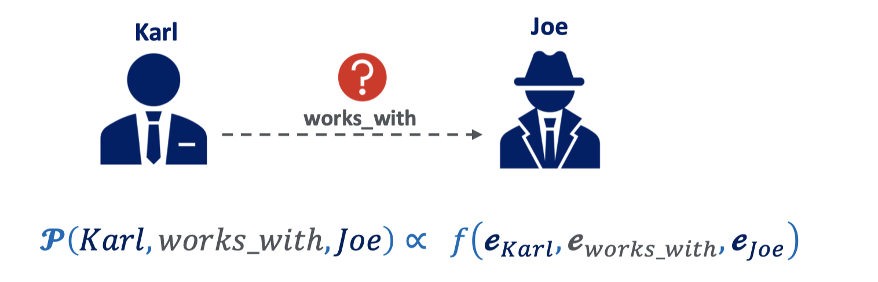
01
Background:Knowledge Graph Embedding
Notes:
Knowledge graph plays an important role in many real-world applications. However, Knowledge Graph cannot be fed directly to Machine Learning system
That’s why we need Knowledge graph embedding models to map entities and relations to continuous vector spaces.
The embedding are updated to make sure positive triples have higher scores than negative triples so we can use the embedding model infer missing facts.

Slide 6
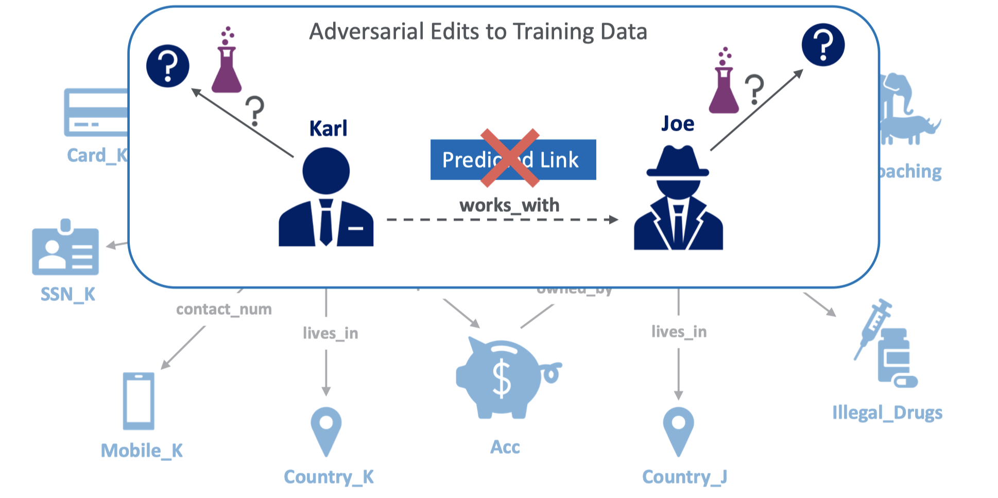
01
Background: Attacks On KGE
Notes:
many knowledge graphs are built upon unreliable data sources
we need to investigate the robustness of knowledge graph embeddings by designing adversarial attacks.
In this project, we mainly investigate adversarial additions, that is, we try to degrade the scores of the target triples by adding some incorrect facts.

Slide 7
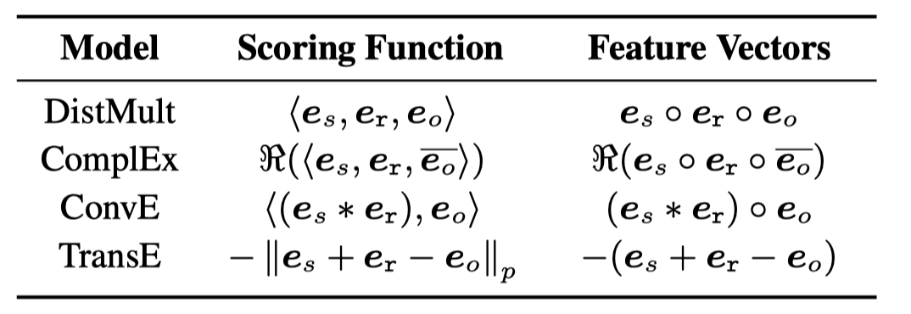
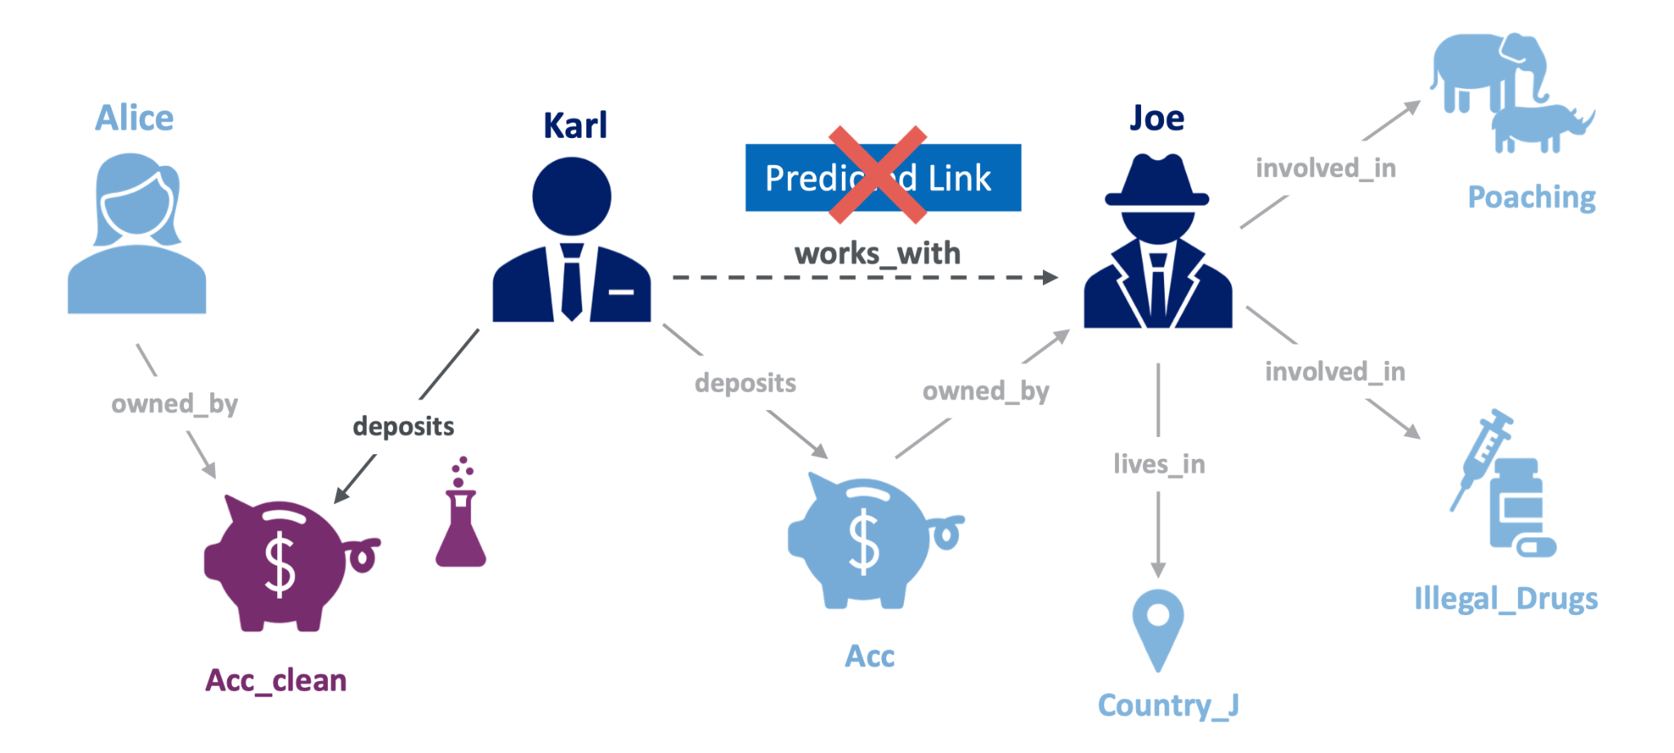
02
Related Work:Instance Attribution Method
Identify the most influential triple
add a dissimilar entity
Notes:
In the related work part, I will introduce state-of-art adversarial attack methods.
Instance attribution method is the state-of-art adversarial attack on deleting and this method can also be used as an adversarial addition method.
The main idea is that First they identify the most influential triple In the training data.
They using similarity between triple features. The feature function for TransE is just h+r-t.
Then they add the entity with the least cos similarity. For example, if we find (karl deposits in Acc) is the most influential triple in the training set, While Acc_clean is the entity which has least cos similarity with Acc among all entities, we can just add (Karl deposits in Acc_clean)

Slide 8


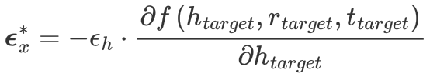
02
Related Work:Direct Attack
Key idea: shift head embedding to minimize the score of target triple
Sample candidate triples with the same head
Pick one using the attack function
Why using this attack function?
Why just attack entity?
Notes:
Another attack method is named direct attack, which is not a good name.
They try to minimize the score of target triple by shifting entity embedding.
To minimize the score of target triples, we can find the optimal shift direction of head
sample some candidate triples with the same head
pick one using this attack function.
All previous works generate one noise triple for each target triple for fair comparison
However, their paper doesn’t explain these two questions:
Why using this attacking function
Why just attack entity?

Slide 9
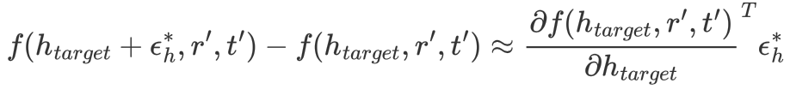

03
Proposed Method: Central_Diff
Taylor series:
Optimization:
Notes:
To answer these questions, I propose the math explanation for “direct attack”:
Using taylor series, if we set the \lambda_2 and \lambda_3 to 1, the attacker function is the approximation of the dot product of expected vector and the gradient of score function.
Now if we optimize the score function of this candidate triple, head embedding will move towards gradient
If we maximize this, we can make sure that if we optimize the score function, head embedding will move towards the expected direction.
With this mathematics explanation, we can further optimize it by using central difference since it is a better approximation of forward difference.

Slide 10

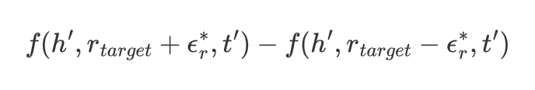
03
Proposed Method: Direct_Relation
Direct claim relations are more stable than entities
A relation involves more facts than a entity
This assumption may not hold!
Attack Relation:
Notes:
The paper claims that the relations are more stable than entities since one relation type involves more facts than a entity
However, this assumption may not hold! Since attack on relations might have a large influence on global structure.
Therefore, I try to use the same method to attack relation. Fix the relation and sample candidate triples, and use this attack function to pick one for every target triple

Slide 11

03
Proposed Method: Least_Confidence
Can we attack the global pattern?
Random sample triples
Pick k triples with lowest scores
Main idea: add contradiction to the model
Notes:
All the methods talked before focus on attacking the local pattern. Can we attack the global pattern?
A most naive way to attack global pattern is to add triples which have the lowest score.
We randomly sample some triples and pick k triples which the original model with give them the lowest scores.

Slide 12
04
Experiment: Set-up
Train KGE model with clean dataset
Generate perturbations and add them to train set
Training a new KGE model
Number of perturbations is fixed
Target triple set is the test-set
Embedding dim is set to 200

Slide 13
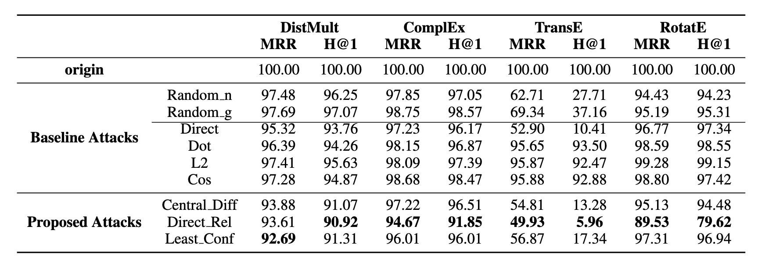

04
Experiment: FB15k-237
Notes:
Let’s see the result of Fb15k-237
Attack on relation outperform the other models in FB15k-237, which means that the relation in FB15k-237 is more sensitive
The central diff and direct almost have the same performance. This is because First, in the generation step we would randomly sample candidates, which introduces uncertainty.
In addition, we can see that the gradient based method is especially successful on TransE. This is because the score function of TransE. The gradient of head is not related to each other. If we focus on attacking the entity, TransE is more sensitive.
Another problem is that these methods don’t actually drop the performance much. The best model can drop the performance by 10 percent.

Slide 14
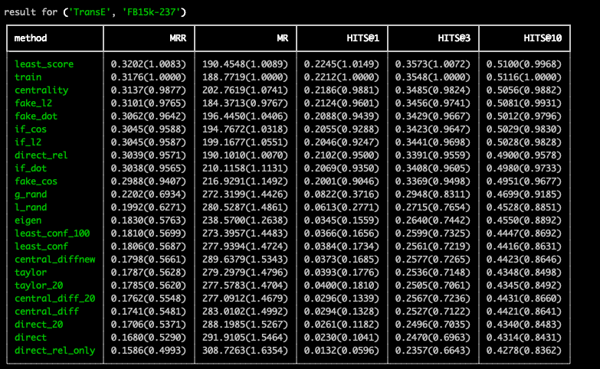
04
Experiment: FB15k-237
Notes:
Let’s see the result of Fb15k-237
Attack on relation outperform the other models in FB15k-237, which means that the relation in FB15k-237 is more sensitive
The central diff and direct almost have the same performance. This is because First, in the generation step we would randomly sample candidates, which introduces uncertainty.
In addition, we can see that the gradient based method is especially successful on TransE. This is because the score function of TransE. The gradient of head is not related to each other. If we focus on attacking the entity, TransE is more sensitive.
Another problem is that these methods don’t actually drop the performance much. The best model can drop the performance by 10 percent.

Slide 15
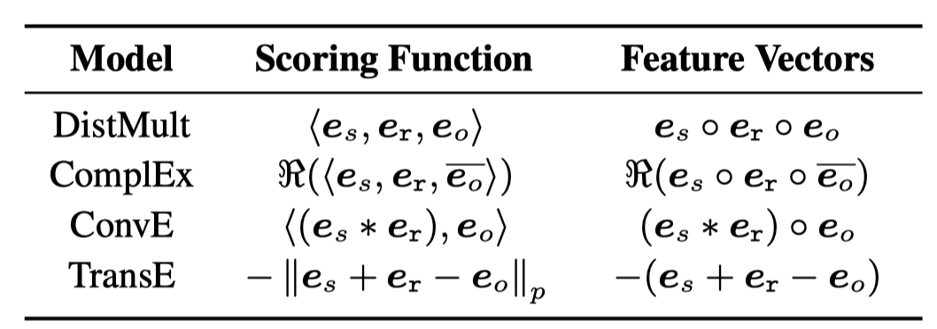
04
Experiment: FB15k-237
Notes:
Let’s see the result of Fb15k-237
Attack on relation outperform the other models in FB15k-237, which means that the relation in FB15k-237 is more sensitive
The central diff and direct almost have the same performance. This is because First, in the generation process we would randomly sample candidates, which introduces uncertainty.
In addition, we can see that the gradient based method is especially successful on TransE. This is because the score function of TransE. The gradient of head is not related to each other. If we focus on attacking the entity, TransE is more sensitive.

Slide 16
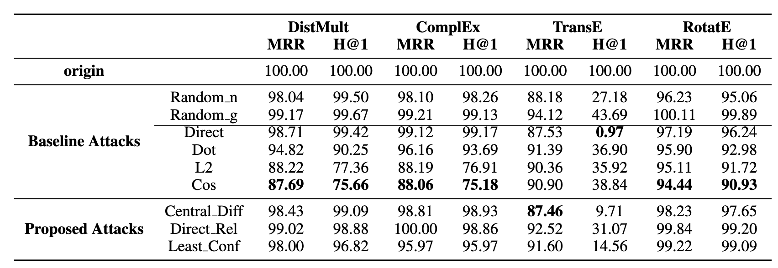
04
Experiment: WN18RR
Notes:
For WN18RR, we find that instance attribution method has the best performance.
A problem is that these methods don’t actually drop the performance much. The best model can drop the performance by 10 percent.

Slide 17
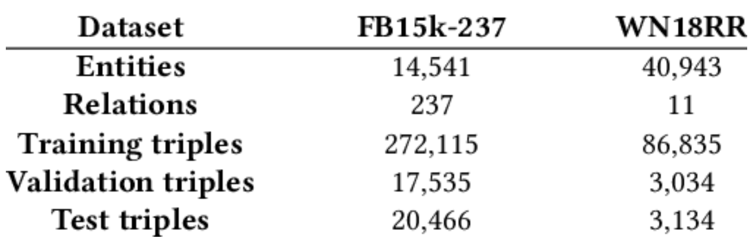
04
Experiment: WN18RR
WordNet is sparse
small shifting won’t change the meaning
reasoning process is easily affected
FreeBase is dense
Notes:
Actually the structure of WordNet is very different from FreeBase
WordNet is more sparse than FreeBase
For the gradient based attack, if we can shift the embedding of an node, in the dense Freebase the model might get confused because the shifted embedding has a different meaning; For sparse wordnet the model won’t get confused since the shifted embedding is still close to the original cluster.
Another problem is that these methods don’t actually drop the performance much. The best model can drop the performance by 10 percent.
I think this is because the existing methods just focus on attacking local patterns of the graph.
Now most methods focus on just one hop of the target triple.
Like, can we attack the graph structure to change the eigenvalue of the whole graph? I believe this is the direction of the future work.

Slide 18
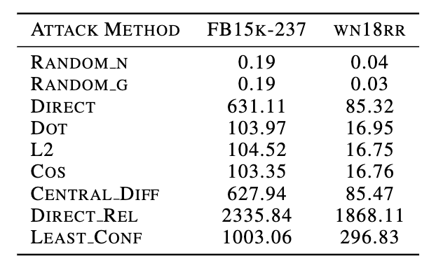
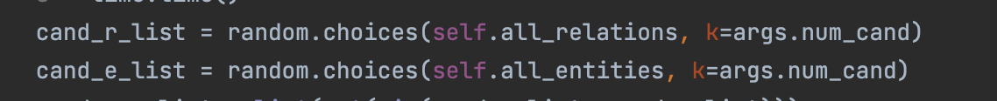
04
Experiment: Time cost(seconds)
Notes:
In addition, this the time cost of each method. All the methods are efficient and we can get the output in about 30 minutes.

Slide 19


THANK YOU
END

