Slide 1


AED: Synthesizing Network Updates that Satisfy Management Objectives
Anubhavnidhi “Archie” Abhashkumar*, Aaron Gember Jacobson#,
and Aditya Akella*
*University of Wisconsin-Madison, # Colgate University

Slide 2




Network Configurations
Policies
Configuration Example
interface GigabitEthernet0/1
ip address 1.0.1.1 255.255.0.0
ip ospf cost 1
router ospf 10
network 3.0.1.2 0.0.255.255 area 0
Y → Z
D
C
Y
Z
OSPF
1
OSPF
1
OSPF
1
OSPF
Z
E
B
Notes:
Vast networks use control planes that run multiple protocols to satisfy network policies
Protocols compute route that implement policies
Flow adheres the policy

Slide 3
Configurations are Complex
interface GigabitEthernet0/1
ip address 1.0.1.1 255.255.0.0
ip ospf cost 1
!
interface GigabitEthernet0/2
ip address 10.11.11.1 255.255.0.0
!
router bgp 300
neighbor 2.2.2.2 route-map COMM out
!
route-map COMM permit 10
set community 1:1 additive
set local-preference 150
!
router ospf 10
network 3.0.1.2 0.0.255.255 area 0
Multiple routing protocols
BGP
OSPF
…
Multiple routing metrics
ospf cost
local preference
…
Multiple filters
Community
…

Slide 4


Configuration Synthesis
Policies
Correct configurations
Synthesizer
Configs
Notes:
Synthesizing safe configs from scratch has issues
Repair after verification requires manual intervention

Slide 5
Configuration Synthesis
Policies
Correct configurations
Synthesizer
Configs
Surveyed 54 network operators
2/3rd synthesize from template
1/3rd synthesize from high-level specifications
Not all changes are automated
2/3rd operators still need manual intervention to make changes
Notes:
Synthesizing safe configs from scratch has issues
Repair after verification requires manual intervention

Slide 6
Operators have Different Management Objectives
Other than correctness, operators care about multiple factors while updating network
We term these factors as management objectives
Different management objectives create different network updates
Notes:
What is high-level problem I am solving – high level pblm statement

Slide 7
Features Used
Policy
U can reach Z
U
Z
E
D
C
BGP
BGP
OSPF
OSPF
BGP
Factor 1: Features Used
Not ideal when objective is
Avoid redistribution (known to cause routing loops)
Case 1: Enable redistribution on D
Adds single line on one router D
Enables redistribution
Notes:
You can repair policies in multiple ways

Slide 8
Update Size/Scope
Policy
U can reach Z
U
Z
E
D
C
BGP
BGP
OSPF
OSPF
BGP
Factor 2: Update Size/Scope
Not ideal when objective is
Minimize devices changed or config changes
Case 2: BGP peering between C and D for Z
Adds statements on both routers C and D
Adds BGP peering

Slide 9
Configuration Structure
4.*.*.*
Policy
4.*.*.*
can reach D
E
D
C
OSPF
OSPF
OSPF
OSPF
Factor 3: Configuration Structure
1 router D
2 interface Ethernet0/1
3 ip access-group ACL1 in
4 access-list ACL1 deny ip any 4.*.*.*
5 access-list ACL1 permit ip any 7.*.*.*
1 router C
2 interface Ethernet0/1
3 ip access-group ACL1 in
4 access-list ACL1 deny ip any 4.*.*.*
5 access-list ACL1 permit ip any 7. *.*.*
Different management objectives create different network updates
Not ideal for objective
Maintain similarity between D and C
Notes:
Synthesizing safe configs from scratch has issues
Repair after verification requires manual intervention

Slide 10
Multiple Synthesis/Update Tools
Tools | Config Structure | Update Size/Scope | Features Used
Zeppelin (Sigmetrics’18) | × | × | Partial
Synet (CAV’17) | × | × | ×
Propane (SIGCOMM’16) | × | × | ×
Netcomplete (NSDI’18) | Partial | × | Partial
CPR (SOSP’17) | × | ✔ | ×
Propane/AT (PLDI’17) | Partial | Partial | Partial
AED | ✔ | ✔ | ✔
Goal: A synthesis tool to compute correct config updates while accommodating diverse management objectives

Slide 11
Insight on Modeling Networks
Insight 1: Network can be modeled as an Abstract Syntax Tree
Network
Router1
Router2
………..
Route Filter1
……
Routing Process1
Packet Filter1
……
……
Rule1
……
Adjacency
Origination
Rule1
……
Match
Action1
…
Router2
…
Prefix1
Prefix2
…
…

Slide 12
Insight on Modeling Networks
1 RouterB​
2 router bgp
3 network 7.*.*.*​
4 neighbor RouterA route-map rmap in​
5 route-map rmap permit 10​
7 set local-preference 20​
8 match ip address prefix-list b_rfil​
9 access-list b_rfil deny 1.*.*.*​​
Network
RouterB
…
b_rfil filter
BGP Process1
Rule1
Rule2
Adjacency
Origination
lp: 20
Match: 1.*.*.*
Action1:
deny
RouterA
7.*.*.*
Model captures syntactic structure of network configurations
Notes:
Synthesizing safe configs from scratch has issues
Repair after verification requires manual intervention

Slide 13
Insight on Updating Networks
1 RouterB​
2 router bgp
3 network 7.*.*.*​
4 neighbor RouterA route-map rmap in​
5 route-map rmap permit 10​
7 set local-preference 20​
8 match ip address prefix-list b_rfil​
9 access-list b_rfil deny 1.*.*.*​​​
Network
RouterB
…
b_rfil filter
BGP Process1
Rule1
Rule2
Adjacency
Origination
lp: 20
Match: 1.*.*.*
Action1:
deny
RouterA
7.*.*.*
Insight 2: Network updates can be modeled as syntax tree addition and removal
Notes:
Synthesizing safe configs from scratch has issues
Repair after verification requires manual intervention

Slide 14




AED
Encode network config and policies as SMT constraints
Encode objectives as soft constraints
AED encodes all possible updates
AED generates policy-compliant updates
Maximally satisfy management objectives
Configs
Policies
Management objective
Encode as SMT constraints
Encode as soft constraints
Encode configuration updates
Z3 MaxSMT solver
Configs
Notes:
AED is built on top of minesweeper. Minesweeper encoded the network as SMT constraints
Specify what SMT is

Slide 15
Encode Configuration
AED models syntactic structure of configurations
if match(BGP_{A→B}.prefix, 1.*.*.*)
filter_{B→A}.allow = false
...
else
filter_{B→A}.lp = 20
5 route-map rmap permit 10​
7 set local-preference 20​
8 match ip address prefix-list b_rfil​
9 access-list b_rfil deny 1.*.*.*​​
Notes:
Replicating variables and considering them all as a single network model creates variable explosion and makes SMT complex
We have 2 performance improvement techniques
Integer variables create a larger search space compared to Boolean variables

Slide 16
Encode Configuration Updates
AED models syntactic structure of configurations
AED uses delta variables to model config changes
Name of delta variables map to nodes in syntax tree
if match(BGP_{A→B}.prefix, 1.*.*.*)
filter_{B→A}.allow = false
...
else
filter_{B→A}.lp = 20
∧
5 route-map rmap permit 10​
7 set local-preference 20​
8 match ip address prefix-list b_rfil​
9 access-list b_rfil deny 1.*.*.*​​
¬rm_B_rFilA_1 then
∨ B_rFilA_1_allow
Run Z3 solver to compute updates on delta variables
+ B_rFilA_2_lp
Notes:
Replicating variables and considering them all as a single network model creates variable explosion and makes SMT complex
We have 2 performance improvement techniques
Integer variables create a larger search space compared to Boolean variables

Slide 17
Encode Management Objective
Specify what parts of configurations may (or) may not change
Network
Objective 3:
Maintain filter template for Router A and B
RouterB
RouterA
Objective 2:
Minimize changes to Router B
Objective 1:
Don’t change Router B
b_rfil filter
BGP Process1
a_rfil filter
…
Rule1
Rule2
Adjacency
Origination
Rule1
Rule2
lp: 100
Match: 1.*.*.*
Action1:
deny
RouterA
7.*.*.*
…
…
Notes:
Replicating variables and considering them all as a single network model creates variable explosion and makes SMT complex
We have 2 performance improvement techniques
Integer variables create a larger search space compared to Boolean variables

Slide 18
Objective Language
Specify three main restrictions on subtrees
Restriction | Meaning
NOMODIFY | Avoid changes
ELIMINATE | Eliminate subtrees
EQUATE | Make subtrees consistent
Notes:
Replicating variables and considering them all as a single network model creates variable explosion and makes SMT complex
We have 2 performance improvement techniques
Integer variables create a larger search space compared to Boolean variables

Slide 19
Objective Language
Network
RouterB
RouterC
b_rfil filter
….
….
Rule1
Subtree selection – Xpath
<restriction> //<subtree>
E.g. NOMODIFY //Router[name=‘‘B’’]
Delta variables associated with these nodes added as soft constraints
Z3 solver minimizes violation of soft constraints
Notes:
Replicating variables and considering them all as a single network model creates variable explosion and makes SMT complex
We have 2 performance improvement techniques
Integer variables create a larger search space compared to Boolean variables

Slide 20
AED
Configs
Policies
Management objective
Encode as SMT constraints
Encode as soft constraints
Encode configuration updates
Z3 MaxSMT solver
Configs
Notes:
AED is built on top of minesweeper. Minesweeper encoded the network as SMT constraints
Specify what SMT is

Slide 21
Evaluation
Networks used
Real networks: 24 datacenters
Synthetic networks: 10 networks from internet topology zoo
Evaluation
Meeting different management objective
AED synthesis performance
Notes:
Come back to motivation

Slide 22
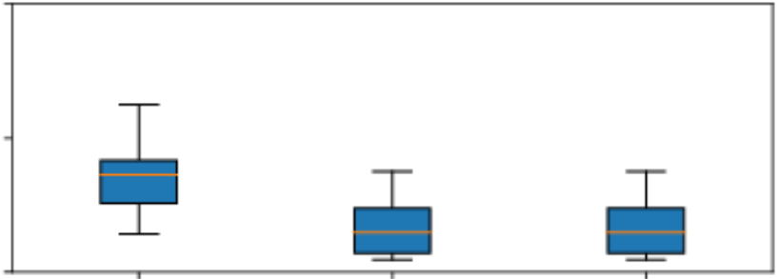
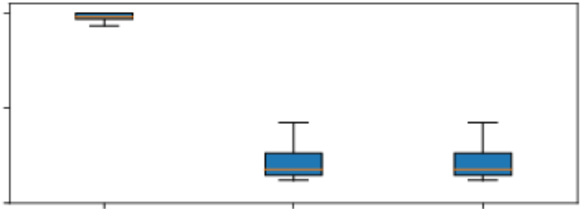
Evaluation: Update Scope - Minimize Devices Changed
Manual had the most changes in real networks
Netcomplete had the most changes in synthetic networks
AED and CPR had similar results
100
100
% devices changed
% devices changed
50
50
0
0
Manual
CPR
AED
Netcomplete
CPR
AED
Real networks
Synthetic networks
Notes:
Reduce to 3 policy

Slide 23
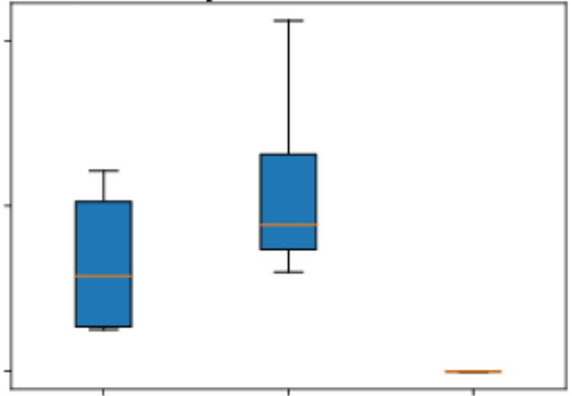
Evaluation: AED vs. CPR
CPR added more ACLs than AED
CPR violated most templates
40
% violating devices
20
0
AED supports many management objectives
AED
Netcomplete
CPR
Features used: Minimize ACLs added
Config structure: Templates violated
Notes:
Reduce to 3 policy

Slide 24
Evaluation: AED Performance
AED is comparable to CPR
CPR has limited management objective support
AED significantly outperforms Netcomplete

Slide 25
AED Summary
AED - synthesis tool to compute correct config updates while accommodating diverse management objectives
Encodes network, policy, updates and management objective as SMT constraints
Objective language to specify management objectives
AED covers multiple management objectives without losing too much performance

