Slide 1
PROJECT PRESENTATION
DataShield &
Privacy Flow Tracker
DS
A Chrome extension that warns about sensitive data and makes outgoing data flows visible.
SENSITIVE DATA
FLOW VISIBILITY
MANIFEST V3
JAVASCRIPT
CLIENT-SIDE
Overview • Features • Architecture • Testing

Slide 2
01 • INTRODUCTION
Project Overview
What is DataShield?
Where it works
Core principle
A Chrome Manifest V3 extension for detecting sensitive data entry and tracking privacy-safe metadata about outgoing flows.
Runs in the browser, observes supported page interactions and network APIs, and presents recent flow events in its popup.
Record categories and routing metadata—not raw form values or request bodies.
Goal: help users notice sensitive information before submission and understand where it may be sent.
02

Slide 3
02 • MOTIVATION
Problem Statement
Forms can contain payment, identity, contact, or credential data.
THE VISIBILITY GAP
Users may not notice when sensitive values go to an unexpected destination.
Sensitive input
↓
Unclear destination
↓
Potential exposure
Third-party scripts and APIs can send data through multiple browser networking mechanisms.
Browser interfaces offer limited at-a-glance visibility into these flows.
Warning + flow view
03

Slide 4
03 • SCOPE
Project Objectives
Detect
Warn
Observe
Identify sensitive-data patterns in inputs and outbound payloads.
Highlight sensitive input and confirm potentially risky form submissions.
Track supported fetch, XHR, sendBeacon, and WebSocket activity.
Control
Review
Support trusted/blocked domains and detector settings.
Display recent events and export metadata as JSON or CSV.
04

Slide 5
04 • CAPABILITIES
Key Features
Inline detection
Submission confirmation
Network flow monitoring
Highlights inputs when sensitive patterns are detected.
Shows the destination and lets users cancel or proceed.
Observes fetch, XMLHttpRequest, sendBeacon, and WebSocket sends.
Domain classification
Local history controls
Custom patterns
Labels destinations as first-party or third-party.
Retention choices, clear history, and JSON/CSV export.
User-defined regular expressions extend detection.
05

Slide 6
05 • DETECTION ENGINE
Sensitive Data Detection
Payment cards
Email addresses
Candidate digit sequences checked with the Luhn algorithm.
Pattern matching for common email formats.
Phone numbers
US SSNs
Pattern matching for common phone formats.
Recognizes the 123-45-6789 style pattern.
API keys / tokens
Custom regex
Looks for labels such as api_key, access_token, secret_key, and bearer.
User-configured regular expressions add new data patterns.
Pattern-based detection can produce false positives and may miss formats it does not recognize.
06

Slide 7
06 • WORKFLOW
How DataShield Works
1
2
3
4
5
User types
or submits
Content script
checks patterns
Page hook
observes network
Background
applies rules
Local log +
popup view
Flow records store domains, channel, detected categories, severity, timestamp, and blocked status.
07

Slide 8
07 • COMPONENTS
System Architecture
Browser page
content.js
page_hook.js
Inputs, forms, network activity
Detects patterns and handles warnings
Observes supported network APIs
background.js
popup.html / popup.js
chrome.storage.local
Applies domain rules and stores metadata
Settings, recent flows, history and exports
Local settings and bounded event history
Technology: HTML, CSS, JavaScript, Chrome Manifest V3, and browser local storage.
08

Slide 9
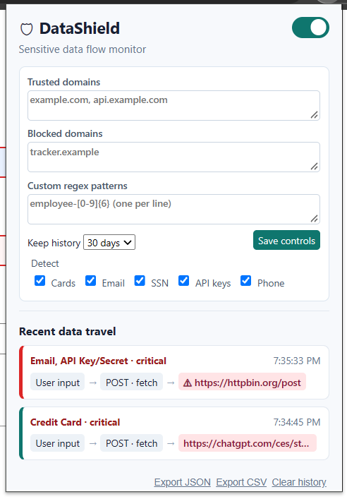
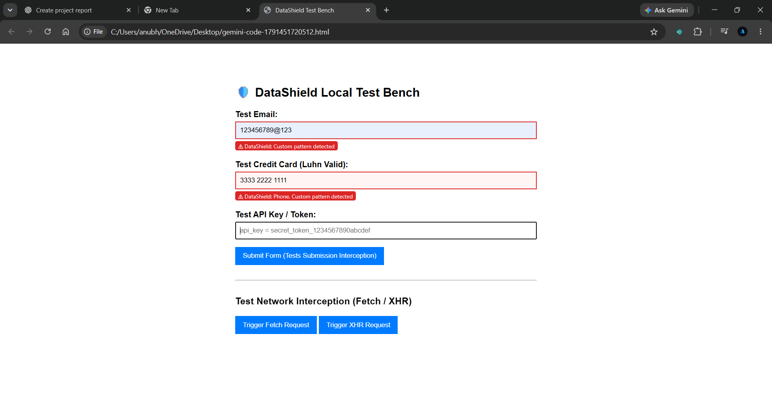
08 • SCREENSHOTS
DataShield in Action
Local test bench
Extension popup and recent data travel
Screenshots supplied with the project; test values are illustrative.
09

Slide 10
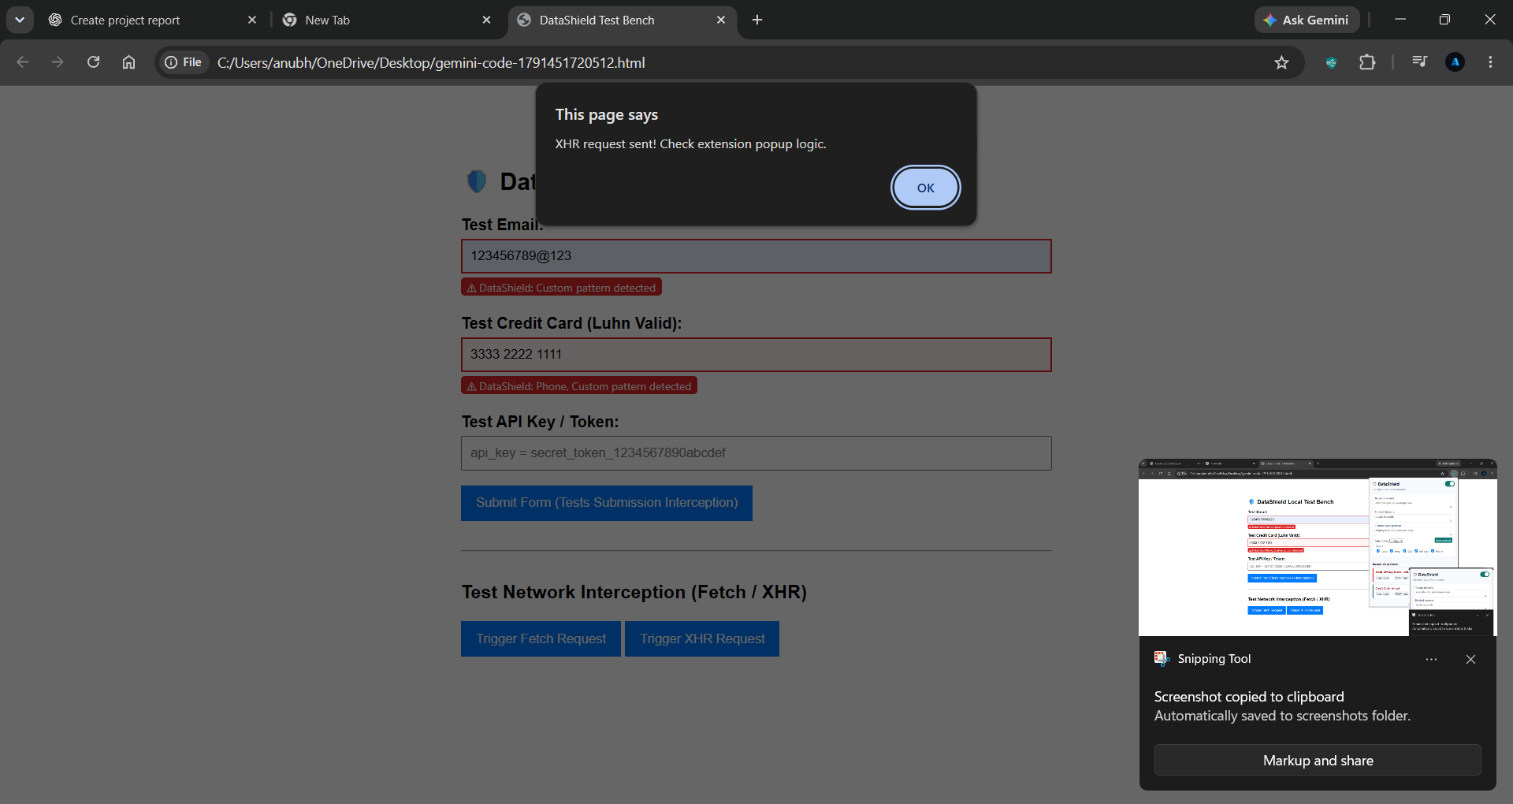
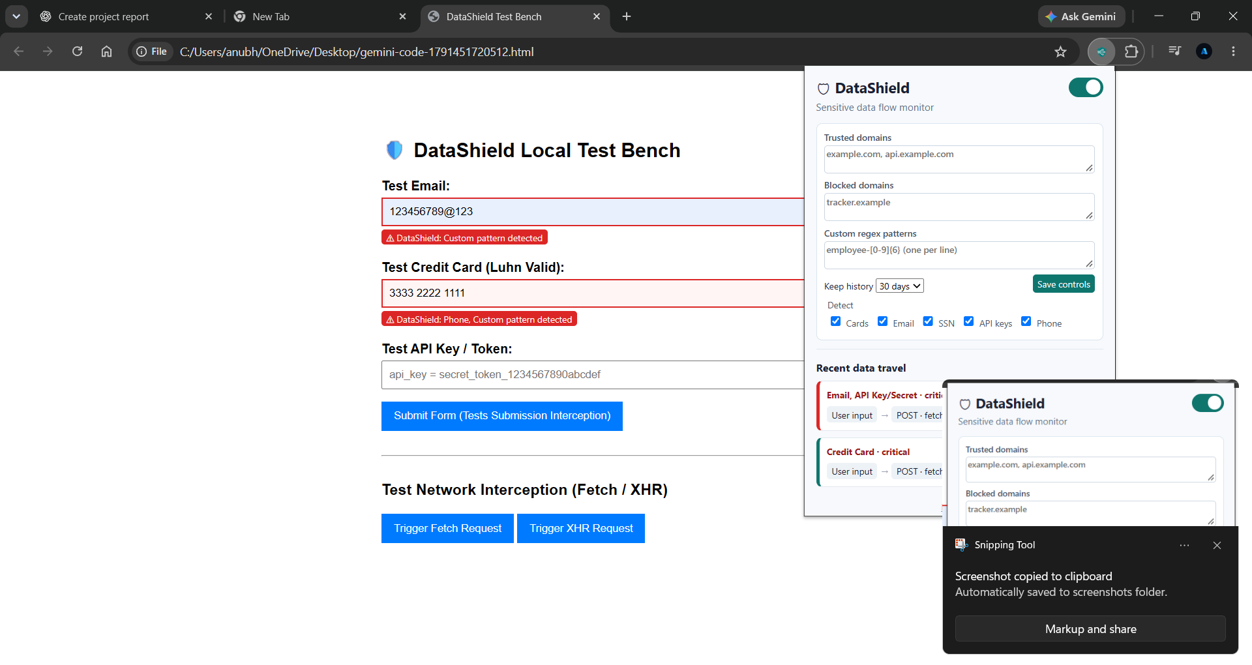
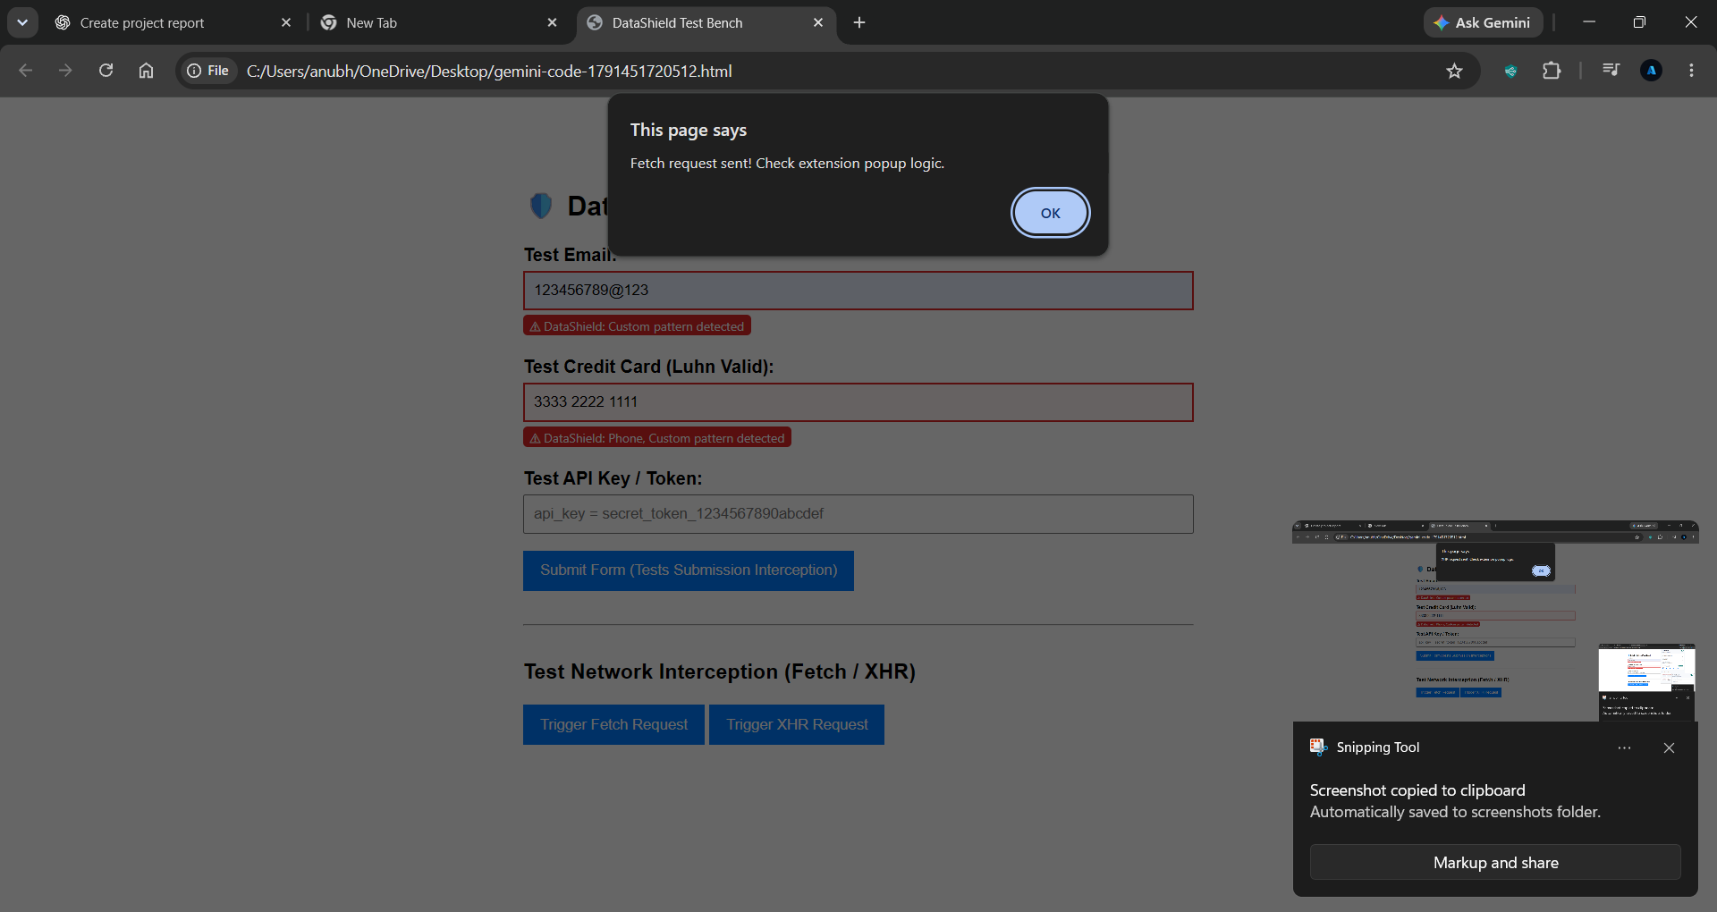
09 • DEMONSTRATION
Testing Form & Network Interception
The test bench triggers sample fetch and XHR requests; alerts confirm that test requests were initiated.
10

Slide 11
10 • DATA HANDLING
Controls & Privacy
Trusted domains
Blocked domains
Detector settings
Configure hostnames that are treated as trusted destinations.
Configured destinations can trigger blocking on supported paths.
Toggle cards, email, SSN, API keys, and phone checks.
The design states that raw form values and request bodies are not stored.
Settings and recent flow entries are stored locally in chrome.storage.local.
Users can choose retention, export metadata, and clear history.
Blocking coverage is limited to observed paths; this is not a universal firewall.
11

Slide 12
11 • QUALITY CHECKS
Testing & Validation
Detector unit tests
Manual test bench
What testing shows
Node.js assertions cover Luhn-valid/invalid card numbers and email, SSN, and API-key patterns.
Sample inputs demonstrate detection highlights; buttons trigger fetch and XHR requests.
Core detection cases and demonstration flows are covered; tests are not exhaustive integration tests.
Recommended next step: test across real sites, browser versions, edge-case formats, and allowed/blocked destinations.
12

Slide 13
12 • IMPROVEMENTS
Limitations & Future Scope
Current limitations
Future enhancements
Pattern matching is heuristic; formats vary, and not every outbound channel or payload can be guaranteed to be observed.
Broaden test coverage, improve configurable rules, add richer explanations, and refine destination policies.
Add more regression and browser integration tests.
Provide clearer reasons for each detected pattern and severity.
Improve handling of complex forms and nested payloads.
Document permission scope and privacy behavior for users.
13

Slide 14
13 • SUMMARY
Conclusion
DataShield adds a practical layer of awareness around sensitive data in browser workflows.
Detect
Warn
Observe
Empower
Recognizes selected sensitive-data patterns.
Highlights risky inputs and form destinations.
Makes supported outgoing flows easier to inspect.
Keeps controls and metadata history in the user's hands.
Thank you • Questions?
DataShield & Privacy Flow Tracker
14

