Slide 1
Campus Recruitment Process System
Course : Object Oriented Programming and Design
Instructor : Naveen Prakash
Team Members :
Dharmendar Kumar(MT20110)
Anubhav Ruhela(MT20083)

Slide 2
What we are doing ?
We are building a System for the Campus Recruitment. It involves everything from identifying, attracting, screening, shortlisting, interviewing, selecting, hiring and onboarding employees. Our model will work for all the types of colleges or institutions and various parameters are also being taken care of.
There are 5 sub-modules in our system. These are Company Profile, College Profile, Student Profile, Recruitment Drive and Placement Records.

Slide 3
Cartesian Decomposition
Cartesian Decomposition reveals structure of a model. It decompose the whole into its parts and depicts the relationship between those parts.
We have “Campus Recruitment Process System” at our node which is further subdivided into 5 modules which are subcategorized further.
So our Cartesian Decomposition looks like :

Slide 4
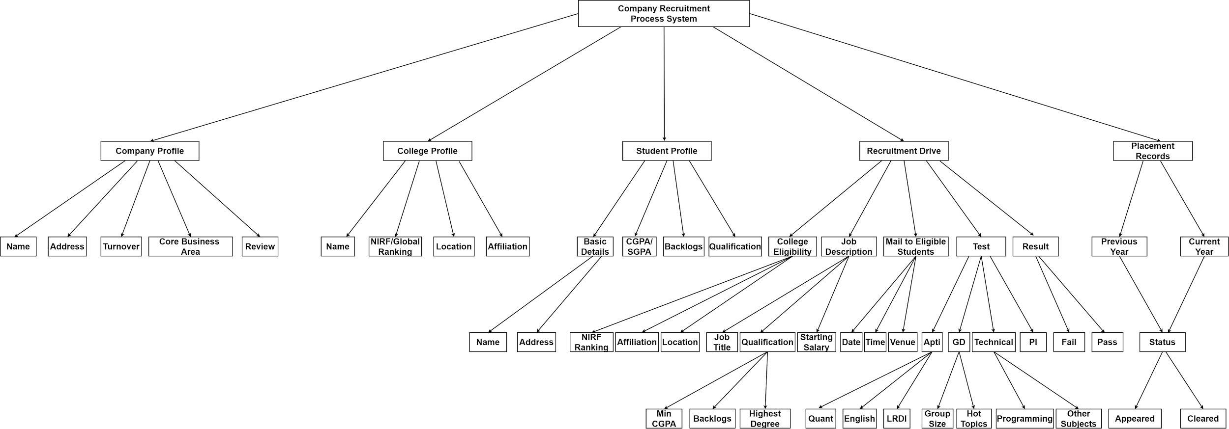
Fig : Cartesian Decomposition

Slide 5
Modular structure
Modularity is the process of decomposing a problem(program) into a set of modules so as to reduce the overall complexity of the problem.
Basically it is another representation of Cartesian Decomposition.
So our Modular Structure looks like :

Slide 6
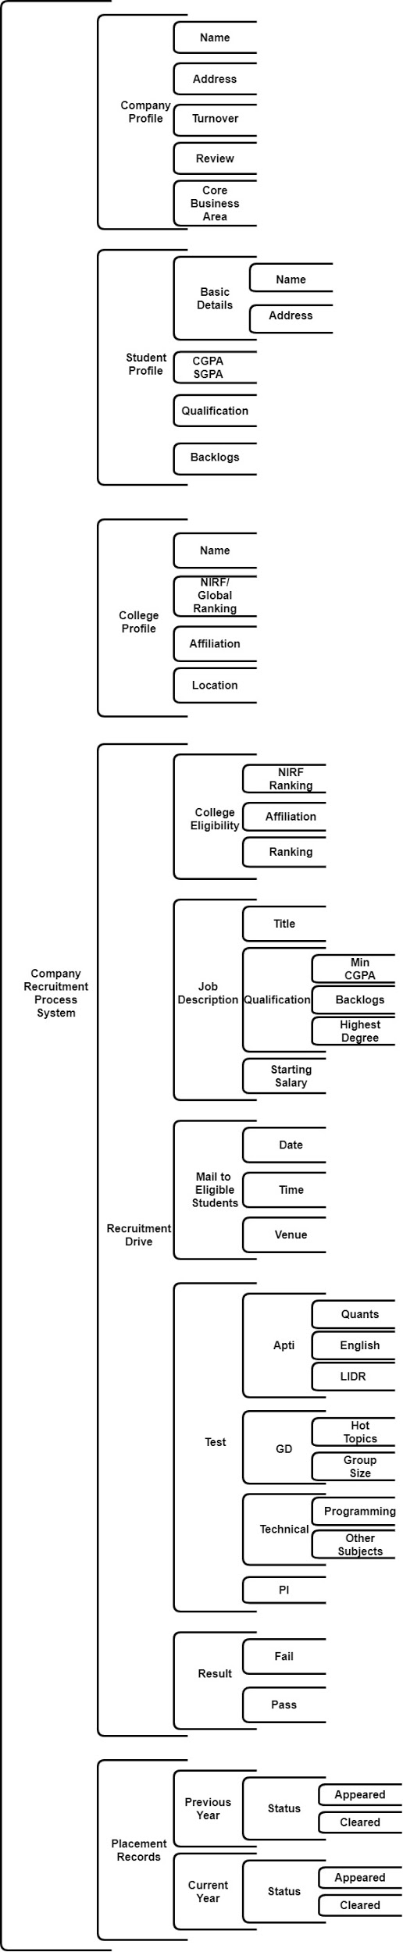
Fig : Modular Structure

Slide 7
Submodule Explanation

Slide 8
1. company profile
Company profile will provide potential information to know about the company. The importance of a company profile is that it gives an idea about all its relevant information like location, turnover, core-business area, reviews, etc.

Slide 9
2. College Profile
The college profile will provide all the essential information about the college. The importance of a college profile is that it gives a general idea about all its relevant information like rankings, affiliation and location.

Slide 10
3. Student profile
The student profile will display the student information like name, address, cgpa, backlogs and latest qualification.

Slide 11
4. Recruitment drive
This is main sub module of our system. It basically checks College Eligibility, Description of Job, Mail details to the student, showing results and updating results in the Records database.

Slide 12
5. Placement records
We will be storing all the previous and current year records for future reference i.e. status of the students(Appearing/Clearing) is stored here.

Slide 13
Functionalities
We have implemented everything that we have mentioned in our Cartesian Decomposition and Modular Structures.
In upcoming slides, there are list of features that we were able to implement :

Slide 14
T&P HEAD Login

Slide 15
Updating COLLEGE record

Slide 16
Updating company record

Slide 17
Student login

Slide 18
Student register

Slide 19
CHecking COLLEGE eligibility

Slide 20
Checking eligibility based on cgpa/backlog

Slide 21
Taking interested companies list

Slide 22
Adding and showing test details

Slide 23
Sending mails to eligible students

Slide 24
Updating placement records

Slide 25
COde Flow
Basically we have made a console-based Campus Recruitment System which runs these major modules :
T&P Head Login
Student Login
Student Register

Slide 26
T&P Head Login
First we match admin credentials with our database.
Admin have these tasks :
Admin can add College details to college database.
Admin can add Company details to company database and add test details of that company in company test details database.
Exit.

Slide 27
Student Login
Firstly login credentials will be verified using Students Database.
Student then enters his/her college name which is again matched with College Database.
Our code takes care of the constraints of backlog and CGPA, matching it with both the Student and Company Database to check the eligibility.
An eligible list is then displayed on the console which represents all those companies for which that student is eligible to sit.
Then we ask student for his/her interested companies and display final company list.
Company list is then matched with Job Description Database, all the job related details, date, time, venue, job description, starting salary, role etc. are then mailed to the eligible students.
Storing placement records year-wise in Records Database.
In all the functionalities mentioned above, proper messages are also displayed for unmatched values.

Slide 28
Student register
Unregistered students can also register themselves by giving their details.
These details will be added to the Student Database.
Note : Any college student can apply for the recruitment process if that college is present in the college database.

Slide 29
Contribution of member :
50 - 50 participation in coding and creating the presentation.
We have done this project on Google Colab.
In Colab file we have done approximately 20-25 functionalities in our Python code.
In these Python functionalities we both contributed 50 - 50% i.e. 10-12 functions done by each person.
Finally, we have created presentation together on Google Slides.
Also we have done our work over Whatsapp calls, Google Meet and Discord.

Slide 30
Thank You !

