Slide 1
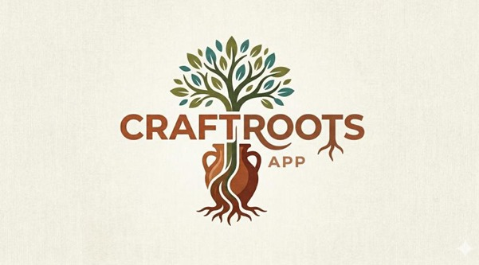
Where travellers meet makers.
Reviving Channapatna, one hand-made
souvenir at a time.
CAUSE 2026 · THE FUTURE IS LOCAL
Anubhav Singh Chahar || Prisha Sharma || Prashant Lohar
Channapatna wooden toys · 200 years of tradition
Notes:
P1 (warm, slow): Picture this. You're a traveller in Bangalore. You want something real — not another tourist trap. Sixty kilometres away is Channapatna, a town that's been hand-making wooden toys for 200 years. But thousands of tourists drive past it every weekend and don't even know. We're going to change that. We're CraftRoots.

Slide 2
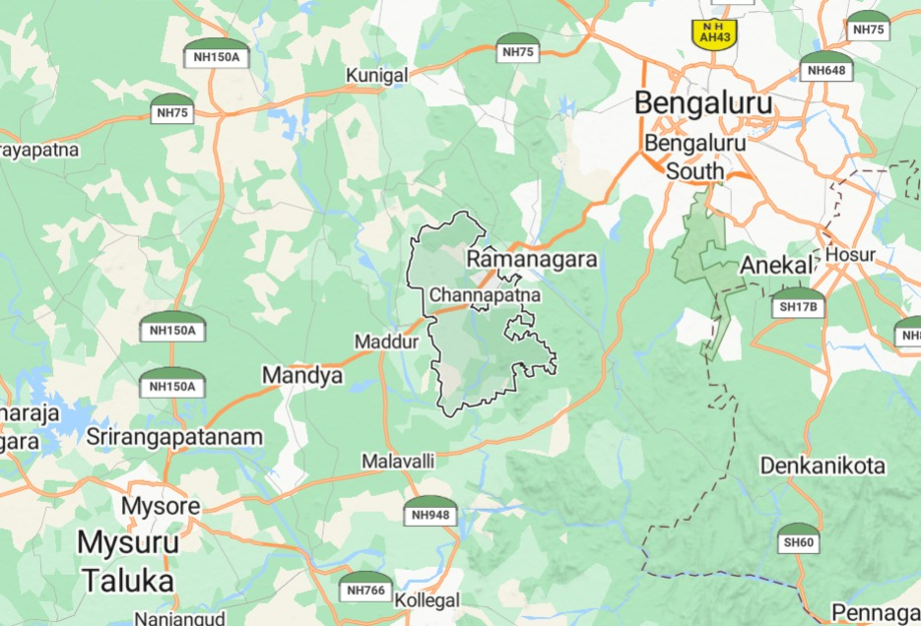
01 — THE PLACE
A craft town the highway forgot.
200+ years
of GI-tagged lacquerware tradition
60 km
from Bengaluru — weekend-trip distance
BUT
The new Bengaluru–Mysuru expressway
bypasses Channapatna entirely.
Pit-stop traffic has collapsed. Artisans are losing their customers overnight.
Bengaluru → Mysuru corridor · Channapatna sits between
CRAFTROOTS
02 / 09
Notes:
P1: Channapatna sits between Bengaluru and Mysuru — a 200-year-old craft town with a GI tag for its lacquerware. Perfect weekend distance from the city. But here's the problem: the new expressway now goes straight to Mysuru. Travellers don't stop here anymore. An entire generation of artisans is watching their market disappear.

Slide 3
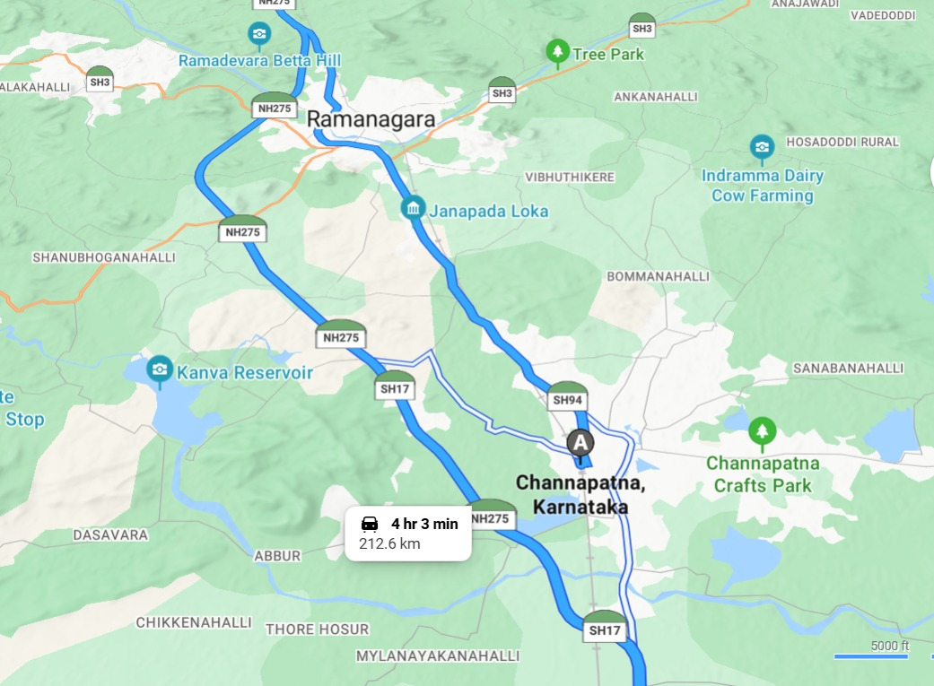
02 — HOW WE NARROWED DOWN
Five whys to the real problem.
We started with a symptom. We ended with a cause.
SYMPTOM
Artisans in Channapatna are earning less.
→
Fewer customers are buying directly from them.
WHY 1
Why fewer customers?
→
Tourists aren't stopping in Channapatna anymore.
WHY 2
Why aren't tourists stopping?
→
The new Bengaluru–Mysuru expressway bypasses the town.
WHY 3
Why does that matter so much?
→
Artisans relied almost entirely on walk-in trade.
ROOT CAUSE
Why only walk-in trade?
→
They have no way to reach travellers before the trip.
CRAFTROOTS
03 / 09
Notes:
P1: We didn't start at the answer. We started at the symptom — artisans earning less. Then we kept asking why. Each why took us deeper. Until we hit the real problem: artisans have no way to reach travellers BEFORE the trip. Everything they built depended on walk-ins. The highway broke that. Solving the root cause means giving them a digital channel to travellers — before the journey even begins.

Slide 4
03 — WHAT WE HEARD
We surveyed 120 travellers.
The demand is there. The access isn't.
71%
rate interest in learning a local craft
72%
say they're likely to use a platform like CraftRoots
4 or 5 out of 5
4 or 5 out of 5
58%
willing to pay ₹700+ per experience
92%
of artisans open to hosting workshops
13% willing to pay ₹1,500+
"yes" or "maybe"
CRAFTROOTS
04 / 09
Notes:
P2: We didn't stop at conversations. We ran a proper survey. 120 people. 71% are genuinely interested in learning a local craft. 72% would actually use a platform like ours. 58% are willing to pay seven hundred rupees or more. And on the artisan side — 92% are open to hosting. The market is there. It's been there. Nobody's built the bridge.

Slide 5
04 — THE QUESTION
“
How might we enable travellers
to discover, trust, and participate
in authentic artisan experiences?
Three verbs. One mission.
CRAFTROOTS
05 / 09
Notes:
P2 (pause, slow): So we asked — how might we enable travellers to discover, trust, and participate in authentic artisan experiences? Discover. Trust. Participate. Those three words shaped everything we built.

Slide 6
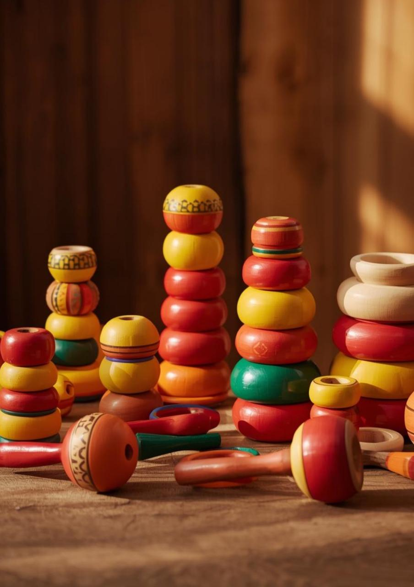
05 — OUR ANSWER
CraftRoots.
A booking platform for hands-on craft experiences.
Discover
Verified artisan workshops near you.
Trust
Reviews, photos, GI-tag verification.
Participate
Learn. Make. Take it home.
CRAFTROOTS
06 / 09
Notes:
P1: This is CraftRoots. A platform where a traveller discovers a verified artisan workshop, trusts it through reviews, photos, and a GI-tag stamp, and participates — learns, makes, takes it home.

Slide 7
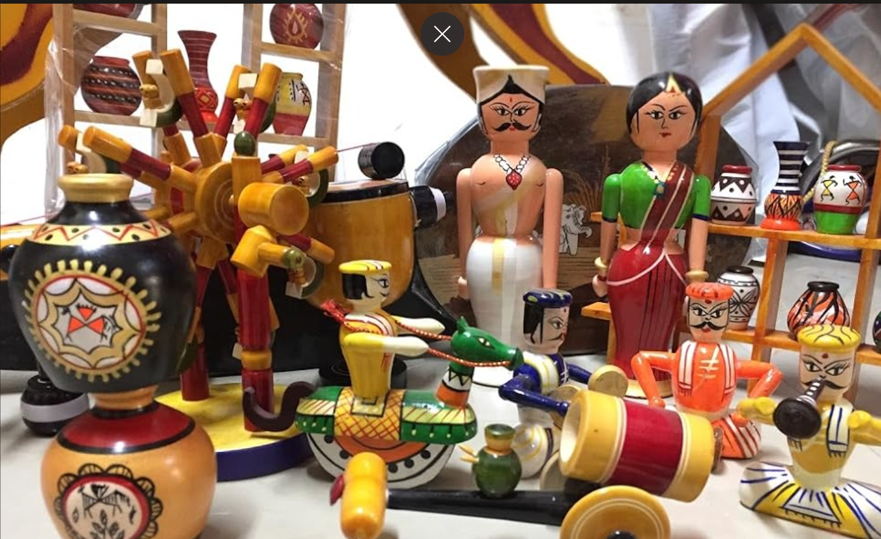
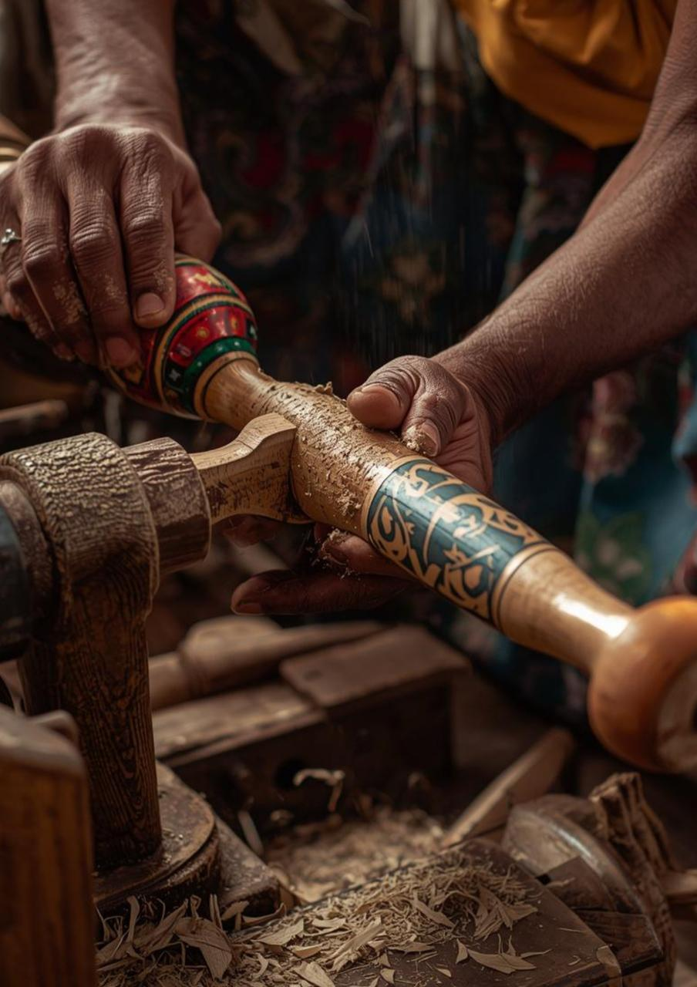
06 — HOW IT WORKS
Emilia's journey.
1
2
3
4
DISCOVER
BOOK
MAKE
KEEP
Browse verified experiences near her.
Pick a date. Pay securely.
Meet Ramesh. Shape a toy.
Take it home. Rate the host.
Every booking = direct income for an artisan. Every review = more trust for the next traveller.
CRAFTROOTS
07 / 09
Notes:
P1: Emilia's journey, in four steps. She discovers verified experiences. She books in a few taps. She spends an afternoon with Ramesh, shaping a toy with her own hands. She takes it home and rates the host. That review helps the next traveller trust the next artisan.

Slide 8
07 — SUCCESS METRICS
How we'll know it's working.
Four categories. Measured from day one of the pilot.
ADOPTION
PARTICIPATION
50–100
30–40%
70–80%
5–10
bookings / month by month 3
repeat-user rate
booking-to-attendance rate
travellers per session
INCOME IMPACT
SATISFACTION
2–3×
₹500–1,000
4.0+
80%
artisan earnings per session
per traveller, direct
average star rating
report "meaningful"
CRAFTROOTS
08 / 09
Notes:
P2: We're not building this on vibes. Four success categories, measured from day one. Adoption — fifty to a hundred bookings a month, with thirty to forty percent coming back. Participation — seventy-to-eighty percent show up, five to ten per session. Income impact — two to three times what the artisan makes today, five hundred to a thousand rupees per traveller, direct. Satisfaction — four-plus stars, eighty percent calling it meaningful. This is how we'll know it's working.

Slide 9
We start with Channapatna.
Every craft cluster in India is next.
OUR PILOT
Team
Tools
Test
Scale
2–3 builders
+ artisan partners
Figma, no-code MVP,
social discovery
5–10 sessions,
5–10 travellers each
Channapatna →
other craft clusters
Care. Collaborate. Create.
CRAFTROOTS
09 / 09
Notes:
P1 (land it): We start with Channapatna — one town, one craft, one proof. But India has sixty-four lakh artisans. Every craft cluster is a CraftRoots waiting to happen. P2: We're not just building a platform. We're building back what a highway took away. Thank you.

