Slide 1

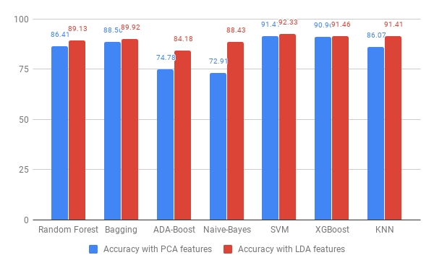
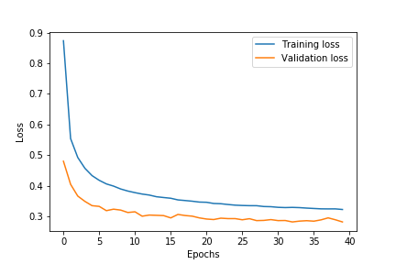

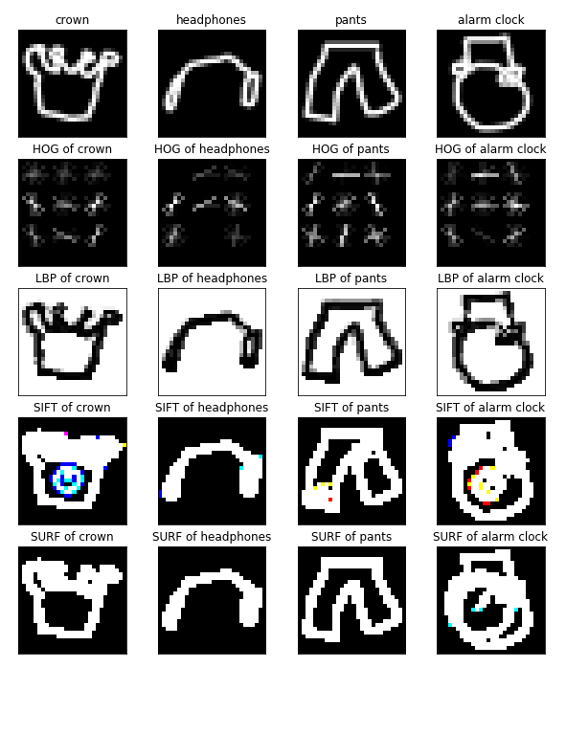
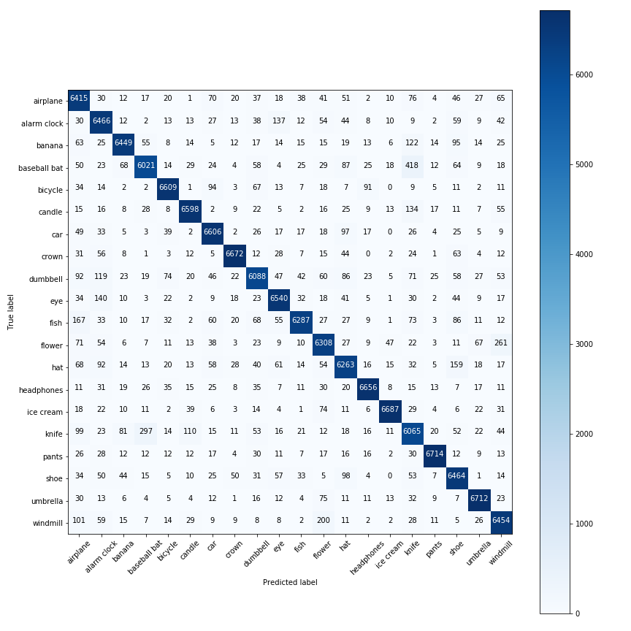
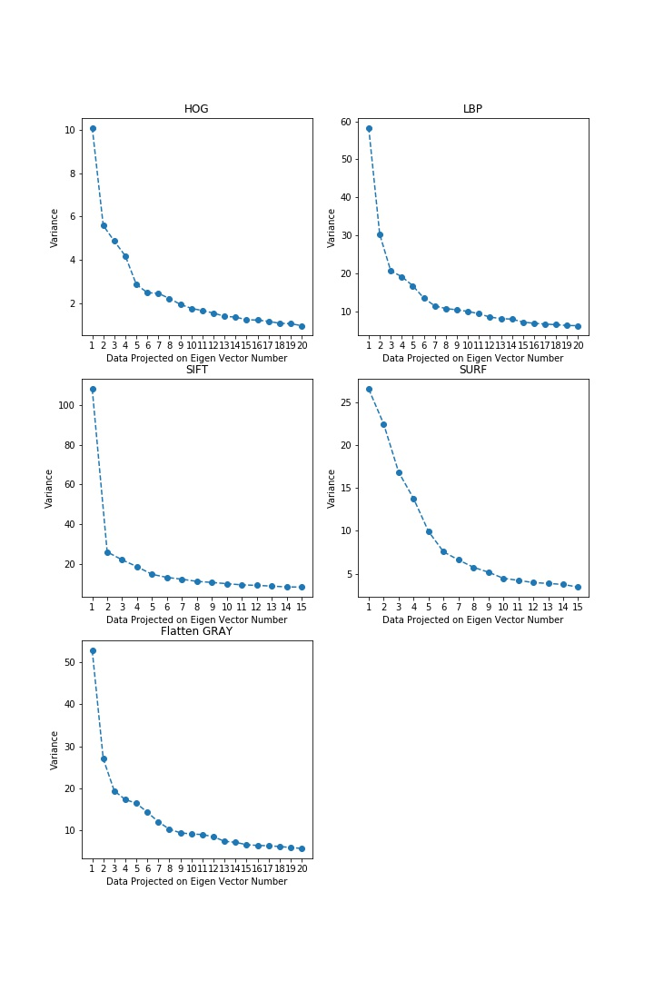
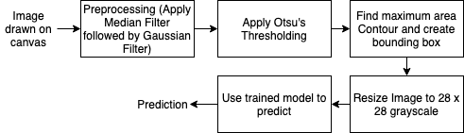
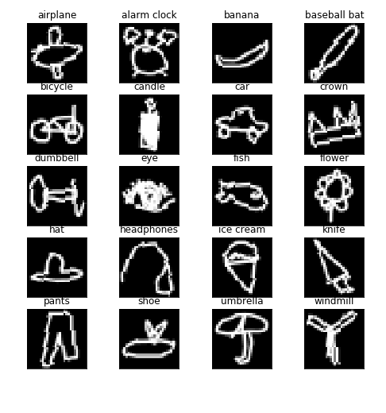
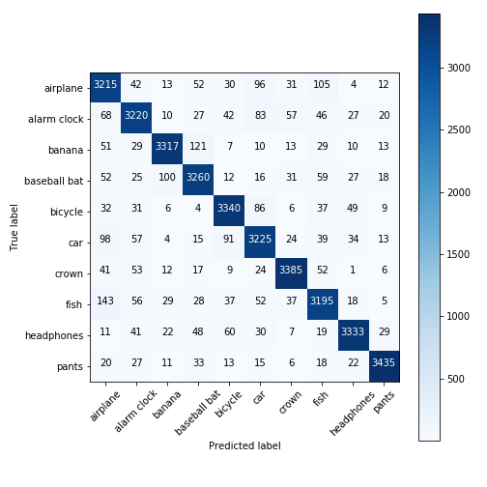

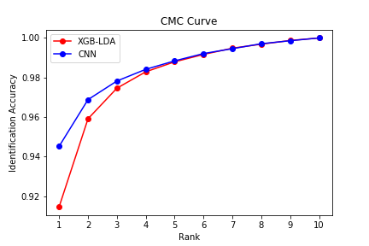
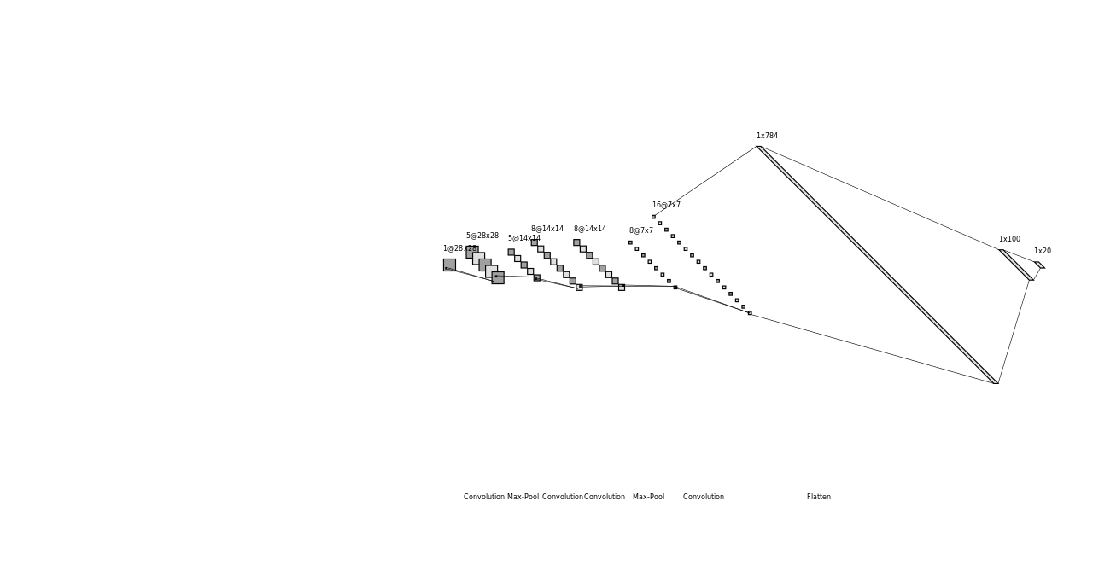
Quick Draw Doodle Recognition
Anubhav Shrimal (MT18033), Vrutti Patel (MT18020)
Advisor: Dr. Mayank Vatsa
Computer Vision (CSE 544)
Abstract
Proposed Algorithm
Results
In Quick Draw the AI system tries to classify the hand-drawn doodle into a predetermined category which is quite similar to pictionary. By this project we are trying to achieve the same using different feature extraction techniques and applying various classifiers such as Naive Bayes, Random Forest, SVM, XGBoost, Bagging, ADA-boost, KNN and CNN and compare their performance on different evaluation metric such as MAP@3.
We have followed a conventional computer vision pipeline to train our model. Fig. 3 shows the training pipeline followed.
Use Case of the Problem
Fig 3. Training Pipeline
It is a challenge in Computer Vision & Machine Learning to handle noisy data and dataset with many different representations of the same class. The Quick Draw Doodle Recognition challenge is a good example of these issues because different users may draw the same object differently or the doodles could be incomplete which is similar to noisy data.
This application can be used as a fast prototyping tool for designers or artists by suggesting them the accurate templates on the basis of the rough doodles made by them.
It can be extended by replacing the doodles with doodles of alphabets and then convert the hand-written text into digital text format.
Feature Extraction: Extract texture information from HOG & LBP, Spatial information from SIFT & SURF (Fig. 2) and pixel information from grayscale image.
Preprocessing: Feature normalization by Min-Max and Z-score to bring features on a similar scale.
Dimensionality Reduction: PCA or LDA was applied to project the features with max separation. In PCA number of components were selected by plotting the variance over projected data (Fig. 4).
Classification: Different classifiers were trained and tested with different parameters and feature combinations.
Prediction and Evaluation Metrics: Metrics such as accuracy, MAP@3, CMC curve was found to compare the performance of classifiers.
For Production time the following pipeline was used where contours were used to find the object.
Fig 10. Accuracy over different models on PCA and LDA reduced data
Fig 11. CNN Training Validation Loss
 | Accuracy | MAP@3
XGBoost (PCA features) | 90.96 | 93.81
XGBoost (LDA features) | 91.46 | 94.19
CNN | 94.52 | 96.01
Fig 2. Feature Visualization
Literature Review
Fig 9. CM for CNN with 20 classes
Past work has been done on free hand sketch recognition [1],[5] where the authors have used KNN and SVM based approaches. In the recent times, Deep Neural Network based approaches have been applied using CNN and ResNet architectures [3] and also incorporating LSTM for pen strokes.
Interpretation of Results
In Dimensionality reduction technique LDA performs better than PCA as it is able to separate data on the basis of classes.
Texture based features gave good classification accuracy as compared to other features.
XGBoost shows best performance as compared to all the other non-deep learning models as the dataset includes images of multiple classes over which XGboost is able to learn better because of boosting technique.
CNN (architecture Fig. 5) gives the best performance with a MAP@3 of 96.01%. This is because the kernels are able to learn different feature representations which help the model to differentiate between the classes well.
Dataset Description
The Quick Draw dataset is a collection of millions of doodle drawings of 300+ categories. The drawings draw by the players were captured as 28 x 28 grayscale images in .npy format with respect to each category.
The complete dataset is huge (~73GB) and so we have used only a subset of the complete data (20 categories).
The dataset is split in training and test set with 80-20 ratio, the training set is further split into train and validation with 70-30 ratio.
Fig 1. shows a doodle image of each class in our sampled dataset.
Fig 5. Production Pipeline
Fig 4. Variance of PCA projected data
Evaluation Metrics
Conclusion
Confusion Matrices were plotted for best performing classifiers.
Mean Average Precision (MAP@3) score were found for classifiers to find performance in top 3 predictions.
CMC Curve was plotted to find the identification accuracy at different ranks.
Accuracy of different classifiers was used to compare the performance using PCA and LDA.
We performed in depth analysis of different feature extractors and classifiers and found HOG, LBP and SIFT features to be best useful for classification and XGBoost classifier was able to learn the best in non deep learning models whereas CNN based architecture is able to give best accuracy.
Fig 1. Dataset Visualization
Baselines
As we are working on a small subset of data due to resource limitations there were no previous baselines to compare.
We have shown an in-depth analysis with various feature extraction techniques and classifiers to compare and contrast their performances.
References
Lu, W., & Tran, E. (2017). Free-hand Sketch Recognition Classification.
M. Eitz, J. Hays, and M. Alexa. How do humans sketch objects? ACM Trans. Graph. (Proc. SIGGRAPH), 31(4):44:1– 44:10, 2012.
K. He, X. Zhang, S. Ren, and J. Sun. Deep residual learning for image recognition. IEEE Conference on Computer Vision and Pattern Recognition, 2016.
Kim, J., Kim, B. S., & Savarese, S. (2012). Comparing image classification methods: K-nearest-neighbor and support-vector machines. Ann Arbor, 1001, 48109-2122.
Ha, D., & Eck, D. (2017). A neural representation of sketch drawings. arXiv preprint arXiv:1704.03477.
Fig 7. CM for XGBoost
Fig 8. CM for CNN
Fig 6. CMC Curve
Fig 5. CNN Architecture
Notes:
highlight details about team members,
project title and problem statement, literature review, dataset description, the existing baseline for the problem/dataset, proposed algorithm, results, interpretation of results, conclusion, and reference.

