Slide 1
SALES PERFORMANCE
An Executive Business Review
Answering the questions that matter most — market performance, customer value, product mix, and revenue trends — through Tableau-driven analysis.
₹986.64M
Total Revenue (FY 2017–2020)
14
Markets Analyzed Nationwide
20+
Customer Accounts Tracked

Slide 2
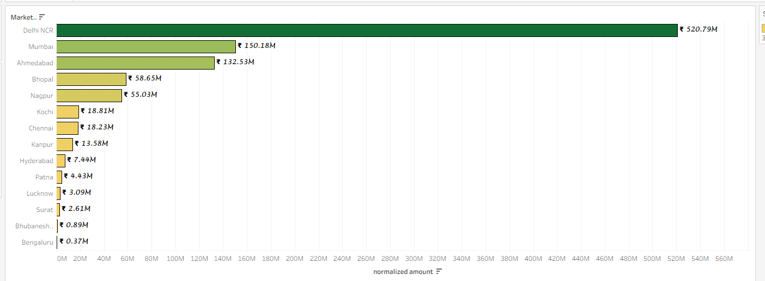
Market Revenue Performance
BUSINESS QUESTION Which markets generate the highest revenue for the business?
Revenue by Market (normalized amount)
WHY THIS MATTERS
Leadership needs to know where revenue is actually being generated so budget, staffing, and inventory follow demand rather than assumption.
ANSWER FROM THE DASHBOARD
Revenue is heavily concentrated in a handful of metro markets, led by Delhi NCR, with a long tail of smaller markets contributing marginally.
KEY BUSINESS INSIGHTS
Delhi NCR alone generates ₹520.79M — over half of total company revenue.
Mumbai (₹150.18M) and Ahmedabad (₹132.53M) form a clear second tier.
The bottom 8 markets combined contribute less than Ahmedabad alone.
Revenue drops off sharply after the top 5 markets, signaling a long-tail distribution.
DECISIONS THIS SUPPORTS
Prioritize marketing and inventory investment toward Delhi NCR, Mumbai, and Ahmedabad.
Evaluate underperforming markets (Bengaluru, Bhubaneshwar) for restructuring or exit.
Set market-specific revenue targets instead of a flat national target.
WHY THIS VISUALIZATION
A sorted horizontal bar chart makes ranking and scale differences across 14 markets instantly readable at a glance.

Slide 3
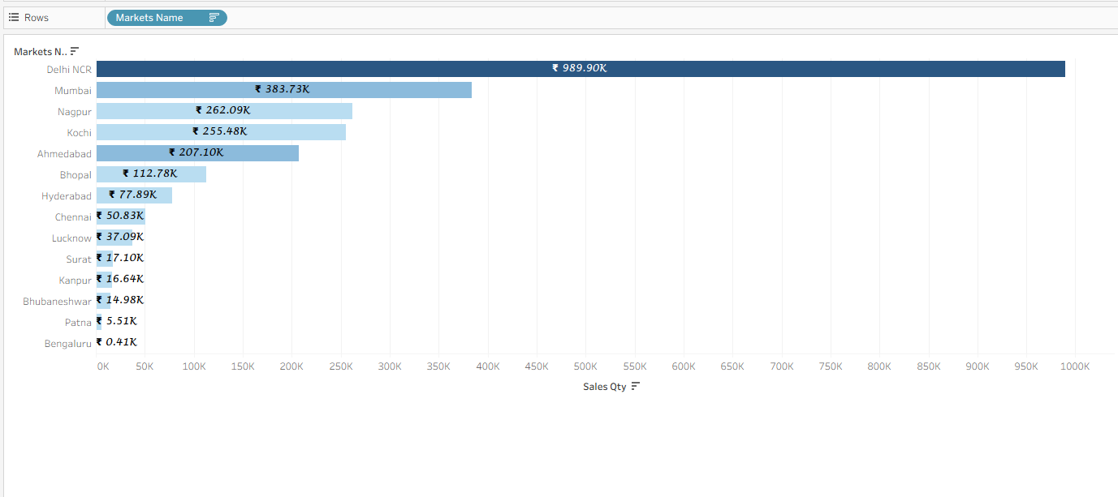
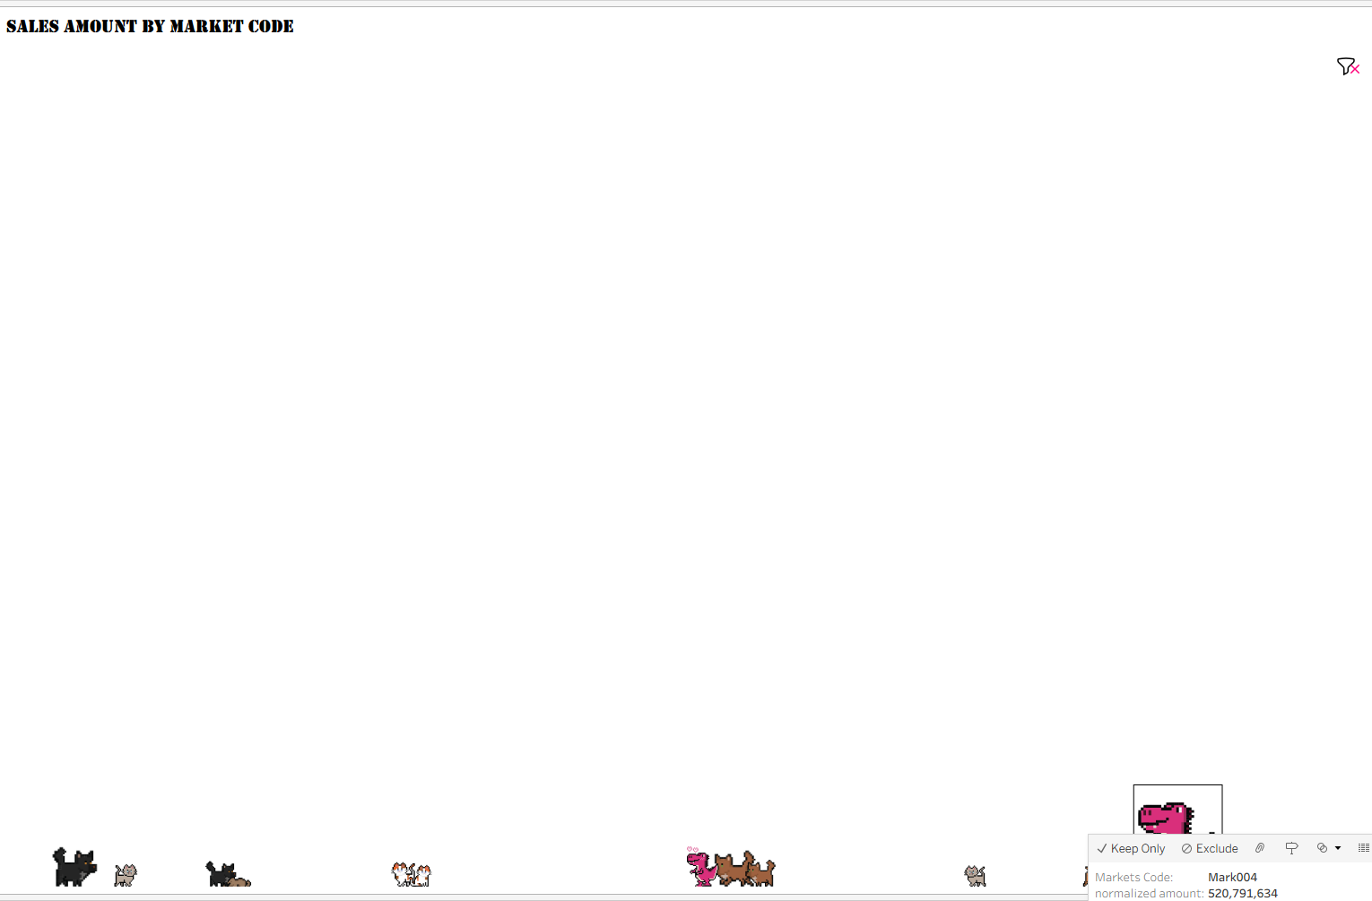
Market Sales Volume
BUSINESS QUESTION How much product is actually moving through each market — and how healthy is that momentum?
Sales Quantity by Market
Sales Amount by Market Code (Pictogram)
WHY THIS MATTERS
Revenue alone doesn't reveal operational load. Sales Directors need to see unit volume to plan logistics, stock, and delivery capacity per market.
ANSWER FROM THE DASHBOARD
Delhi NCR again leads by a wide margin in units moved, confirming it is both the highest-revenue and highest-volume market — a genuine growth engine.
KEY BUSINESS INSIGHTS
Delhi NCR moves ~989.9K units — more than 2.5x Mumbai, the next largest market.
Nagpur and Kochi post similar volumes (~255–262K) despite very different revenue tiers.
Volume ranking mostly mirrors revenue ranking, with a few notable exceptions (Nagpur outranks Ahmedabad in volume).
The pictogram view reinforces scale intuitively for non-technical stakeholders.
DECISIONS THIS SUPPORTS
Align warehousing and distribution capacity with Delhi NCR's outsized volume.
Investigate why Nagpur under-indexes on revenue relative to its volume — possible pricing or mix issue.
Use volume data to negotiate better logistics contracts in top markets.
WHY THIS VISUALIZATION
A bar chart quantifies exact volume for analysis, while the pictogram translates the same data into an intuitive, stakeholder-friendly visual.

Slide 4
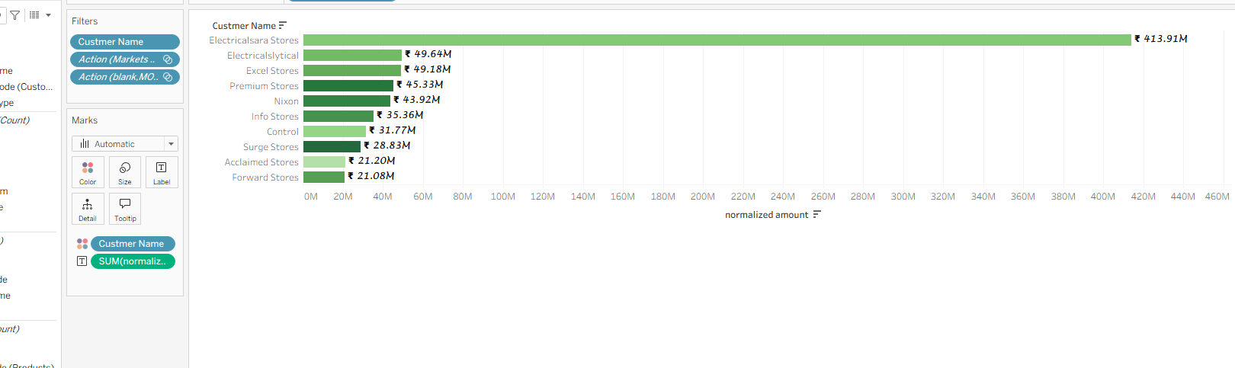
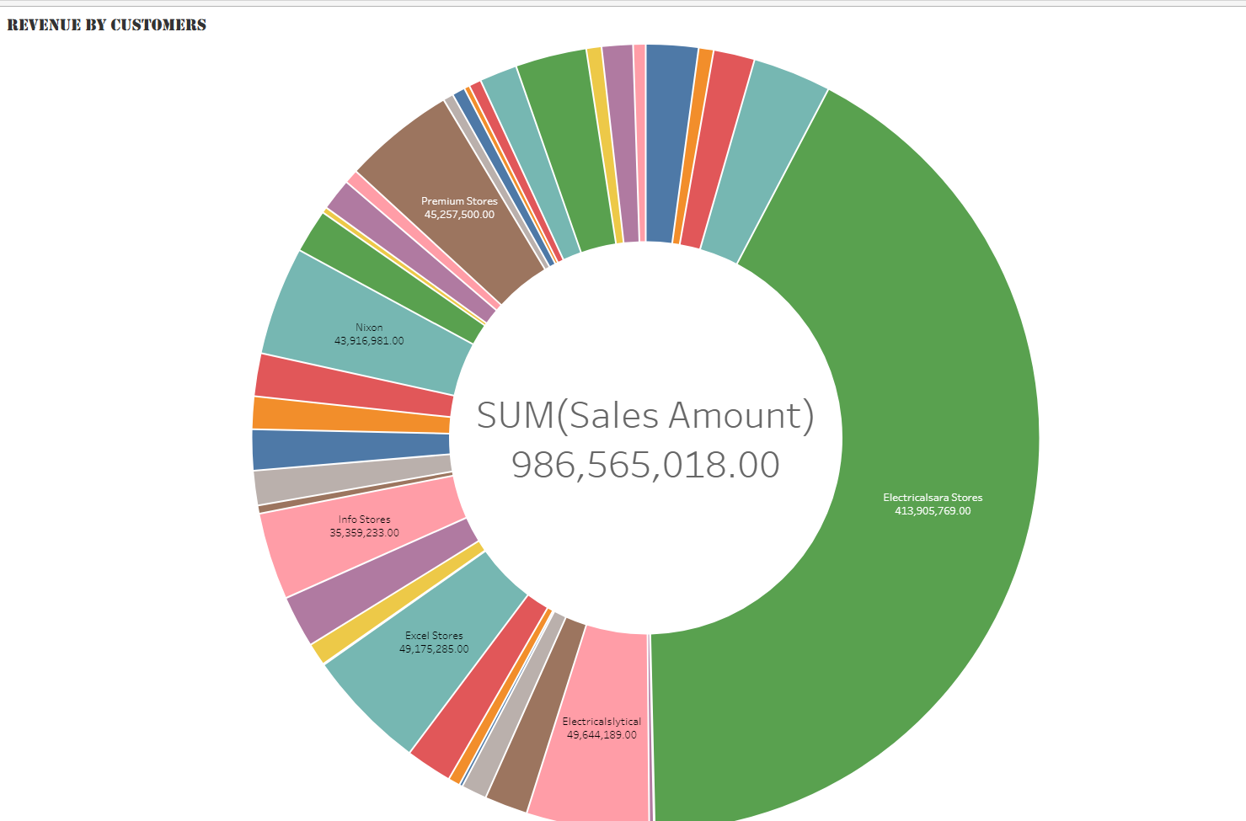
Customer Value Concentration
BUSINESS QUESTION Who are our highest-value customers, and how concentrated is our revenue among them?
Top Customers by Revenue
Revenue Share by Customer (Donut)
WHY THIS MATTERS
Account management and retention strategy depend on knowing which customers the business cannot afford to lose.
ANSWER FROM THE DASHBOARD
One account, Electricalsara Stores, dominates the customer base — a concentration risk as much as a commercial success story.
KEY BUSINESS INSIGHTS
Electricalsara Stores contributes ₹413.91M — roughly 42% of total company revenue.
The next 9 top customers combined contribute less than Electricalsara Stores alone.
Revenue is heavily skewed toward a single strategic account, per the donut's dominant slice.
A broad base of smaller accounts (Info Stores, Control, Surge Stores, etc.) rounds out the remainder.
DECISIONS THIS SUPPORTS
Assign senior account management and retention incentives to Electricalsara Stores.
Build a diversification plan to reduce dependency risk on one customer.
Develop tiered account strategies for the next 5–10 high-potential customers.
WHY THIS VISUALIZATION
The bar chart ranks customers precisely; the donut shows, in one glance, just how disproportionate that top customer's share of revenue really is.

Slide 5
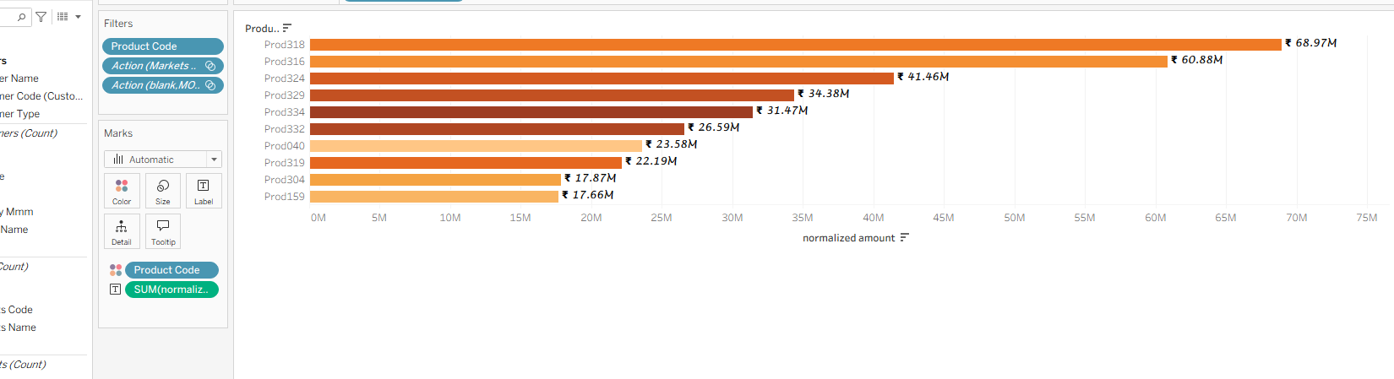
Product Revenue Contribution
BUSINESS QUESTION Which products contribute the most to overall sales revenue?
Top Products by Revenue (normalized amount)
WHY THIS MATTERS
Product and merchandising teams need to know which SKUs are true revenue drivers to guide production, pricing, and promotion decisions.
ANSWER FROM THE DASHBOARD
Revenue is led by a small cluster of products, with Prod318 and Prod316 clearly outperforming the rest of the catalog.
KEY BUSINESS INSIGHTS
Prod318 (₹68.97M) and Prod316 (₹60.88M) are the two clear top performers.
The top 3 products generate roughly ₹151M — a substantial share of total revenue.
Performance tapers off gradually rather than dropping off a cliff, suggesting a healthy long tail.
The bottom products shown (Prod304, Prod159) still each exceed ₹17M — a respectable floor.
DECISIONS THIS SUPPORTS
Prioritize production capacity and marketing spend on Prod318 and Prod316.
Use top-performer insights to inform new product development and bundling strategy.
Monitor lower-tier products for potential rationalization or repositioning.
WHY THIS VISUALIZATION
A ranked horizontal bar chart is ideal for comparing product-level revenue contribution across many SKUs at once.

Slide 6
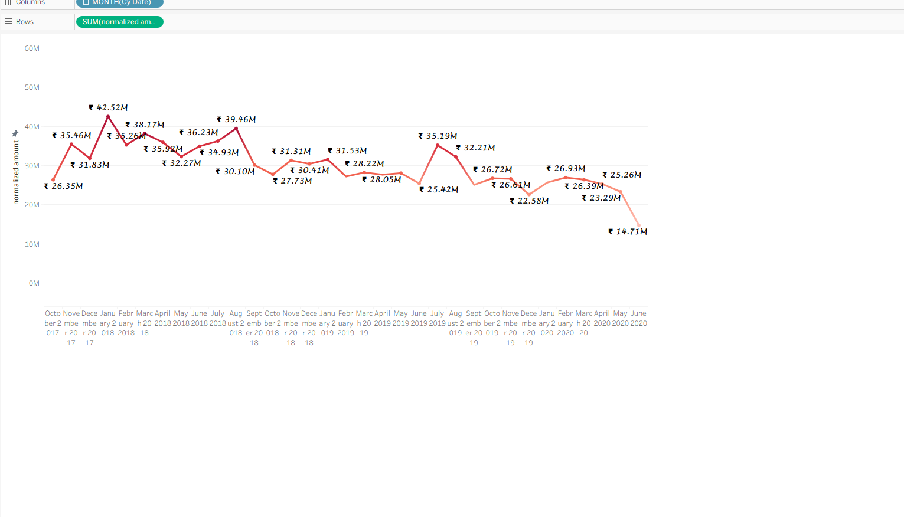
Revenue Trends Over Time
BUSINESS QUESTION How has revenue trended month over month, and is growth sustainable?
WHY THIS MATTERS
Executives need to distinguish seasonal fluctuation from structural decline to forecast accurately and react to real risk in time.
ANSWER FROM THE DASHBOARD
Revenue peaked early (₹42.52M) and has trended in a volatile, gradually softening pattern since, with a sharp recent drop to ₹14.71M.
Monthly Normalized Revenue, Oct 2017 – Present
KEY BUSINESS INSIGHTS
An early peak of ₹42.52M was followed by a multi-month pull-back to the ₹30M range.
A secondary rebound reached ₹39.46M before fluctuating between ₹25–35M for an extended stretch.
The most recent data point (₹14.71M) is the lowest on the entire timeline — a red flag worth investigating.
The overall pattern shows recurring peaks and troughs, consistent with seasonal demand cycles.
DECISIONS THIS SUPPORTS
Investigate the cause of the latest sharp decline before it repeats next cycle.
Use historical seasonality to time promotions and stock builds ahead of peak months.
Build rolling revenue forecasts rather than relying on single-month snapshots.
WHY THIS VISUALIZATION
A time-series line chart is the standard, most intuitive way to reveal trend, seasonality, and inflection points across many periods.

Slide 7
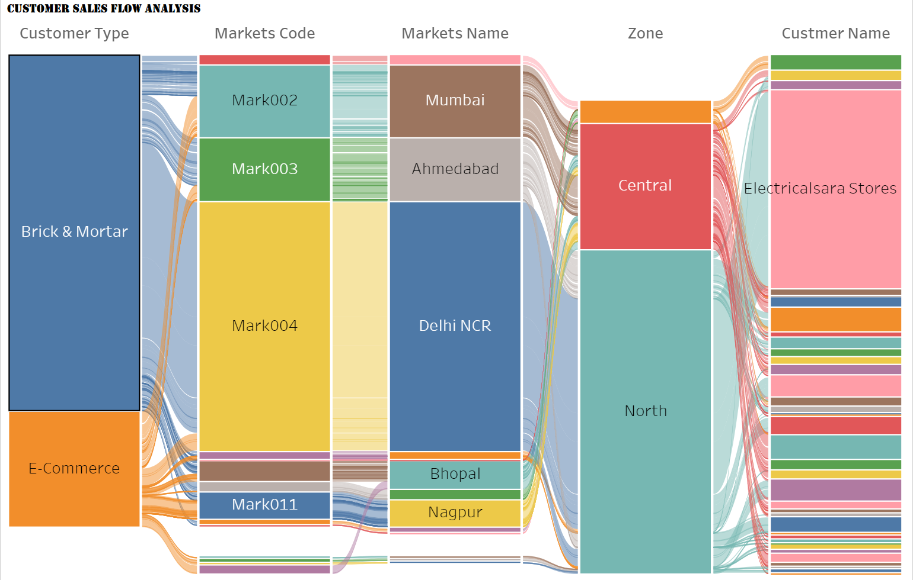
Customer Sales Flow Analysis
BUSINESS QUESTION How does revenue flow from customer type, through markets, down to individual accounts?
WHY THIS MATTERS
Understanding the full path of revenue — from channel type down to the individual store — helps leadership see where structural strength or fragility lies.
ANSWER FROM THE DASHBOARD
Both Brick & Mortar and E-Commerce channels funnel heavily through Mark004 (Delhi NCR) and the North/Central zones before concentrating in a few large customer accounts.
Sankey: Customer Type → Market Code → Market → Zone → Customer
KEY BUSINESS INSIGHTS
Brick & Mortar is a larger contributor than E-Commerce, but both flow through the same top markets.
Mark004 (Delhi NCR) is the dominant hub connecting both channel types to downstream customers.
North and Central zones capture the overwhelming majority of flow volume.
Electricalsara Stores emerges as the single largest end destination of value, regardless of channel or zone.
DECISIONS THIS SUPPORTS
Strengthen both channel strategies around the Delhi NCR hub rather than treating channels in isolation.
Use zone-level flow data to plan regional distribution and staffing investment.
Protect the Electricalsara Stores relationship — it sits at the convergence of nearly every upstream flow.
WHY THIS VISUALIZATION
A Sankey diagram is uniquely suited to showing multi-stage flow and relative proportions across several linked dimensions at once.

Slide 8
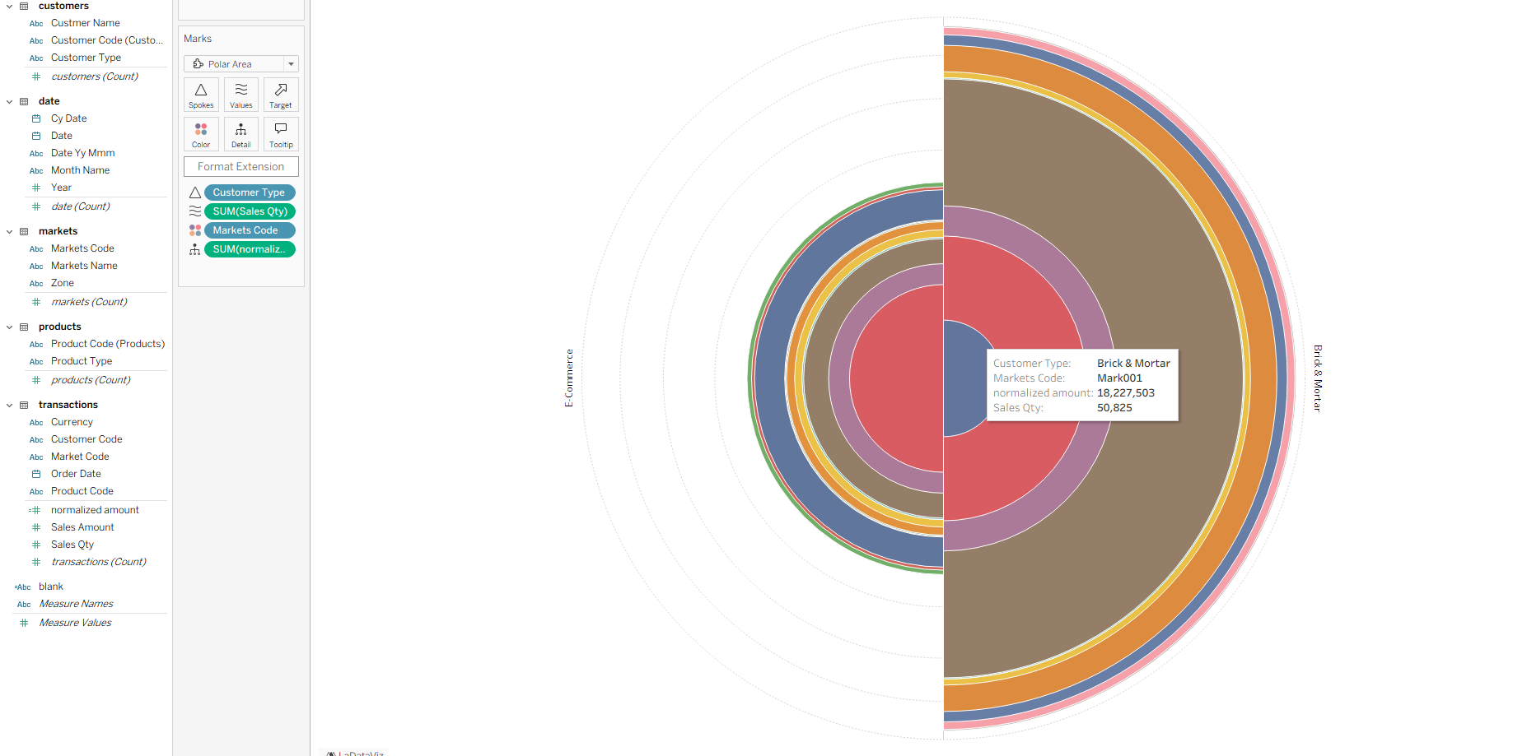
Sales Volume by Channel & Market
BUSINESS QUESTION How does sales volume break down by customer channel type and market?
WHY THIS MATTERS
Operations and channel leaders need to know whether physical retail or e-commerce drives volume, and in which markets each channel is strongest.
ANSWER FROM THE DASHBOARD
Brick & Mortar and E-Commerce both contribute meaningful volume across the same core markets, with individual market rings (e.g. Mark001) each representing tens of thousands of units.
Polar Area: Sales Quantity by Customer Type & Market
KEY BUSINESS INSIGHTS
Both customer types show comparably structured volume rings, indicating balanced channel maturity.
Individual markets like Mark001 alone move over 50,000 units within a single channel.
The layered ring structure makes it easy to compare a market's share within each channel side-by-side.
No single market completely dominates volume within either channel — distribution is broader here than in revenue.
DECISIONS THIS SUPPORTS
Continue investing in both Brick & Mortar and E-Commerce rather than favoring one channel exclusively.
Use market-level volume rings to right-size fulfilment resources per channel.
Track this view quarterly to catch any early channel-shift signals.
WHY THIS VISUALIZATION
A polar area chart compares nested category volumes (market within channel) more compactly than an equivalent set of bar charts.

Slide 9
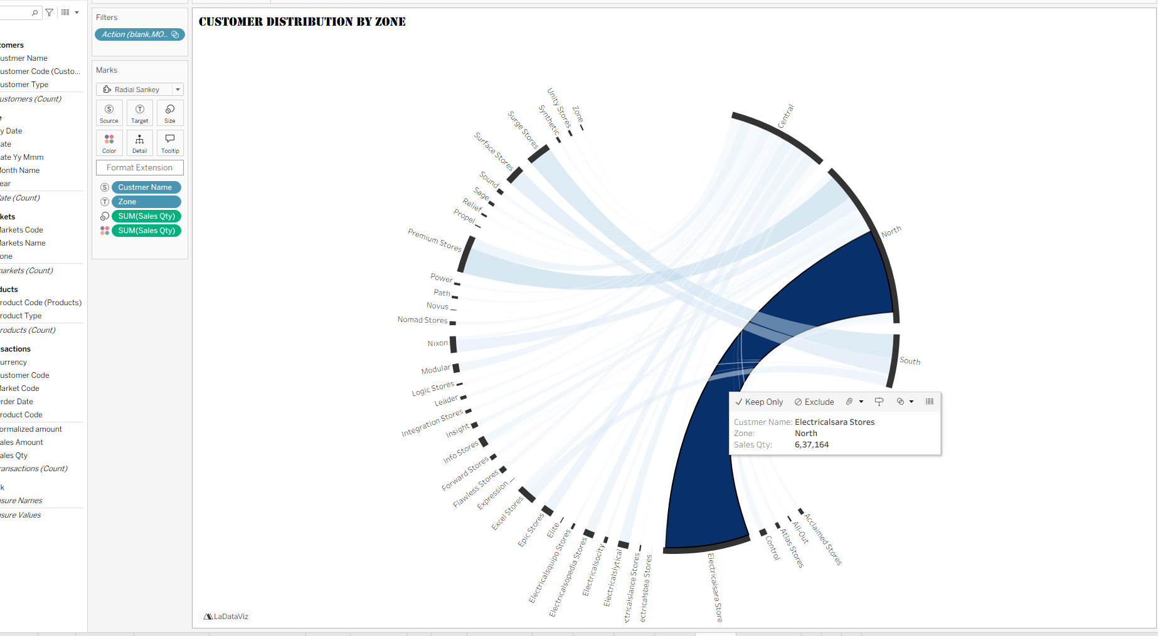
Customer Distribution by Zone
BUSINESS QUESTION How are our customer accounts geographically distributed across zones?
WHY THIS MATTERS
Regional and territory managers need to see which zones carry the greatest concentration of active customer accounts to plan coverage and support.
ANSWER FROM THE DASHBOARD
The North zone holds the largest concentration of customer flow, led decisively by Electricalsara Stores, followed by Central; South carries comparatively little share.
Radial Sankey: Customer Accounts → Zone
KEY BUSINESS INSIGHTS
Electricalsara Stores alone routes 6,37,164 units of sales quantity into the North zone.
North and Central together account for the vast majority of all customer-zone flow.
South zone shows a visibly thin flow band, marking it as an underdeveloped territory.
Dozens of smaller-named accounts (Surge, Sound, Sage, Relief Stores, etc.) feed into the same two dominant zones.
DECISIONS THIS SUPPORTS
Expand territory coverage and account acquisition efforts in the South zone.
Assign additional support resources to North given its outsized customer concentration.
Use zone-level account density to guide regional sales team sizing.
WHY THIS VISUALIZATION
A radial Sankey elegantly condenses dozens of individual customer-to-zone flows into one compact, comparably-scaled view.

Slide 10
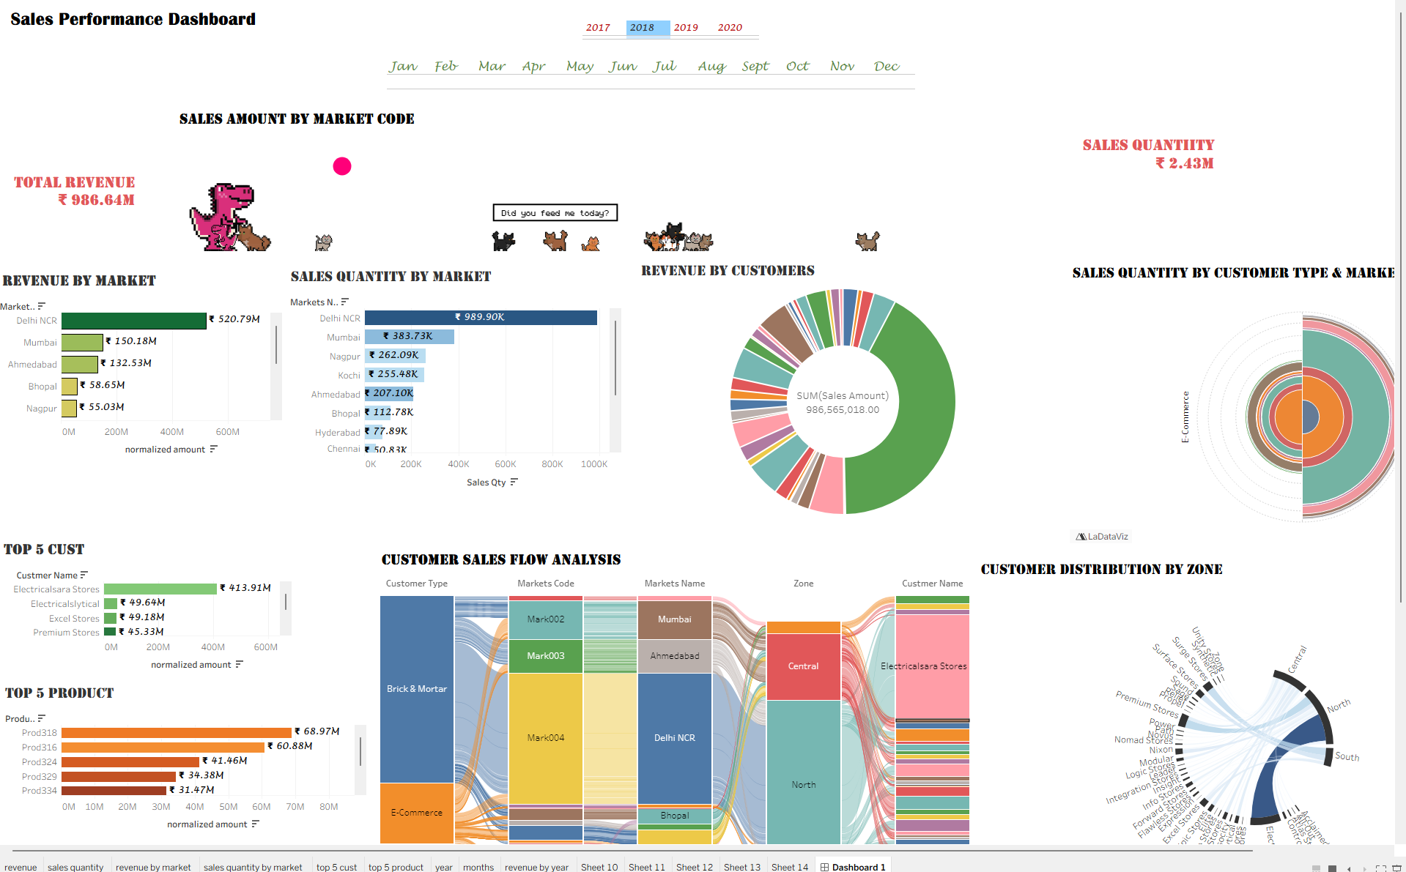
The Complete Executive View
Every business question answered above comes together in a single, unified Sales Performance Dashboard.
This dashboard unifies market revenue, sales volume, customer concentration, product performance, revenue trends, and channel/zone flow into one executive-ready view — enabling leadership to move from question to insight to decision without leaving a single screen.

