Slide 1





VENDOR PERFORMANCE ANALYSIS
An End-to-End Data Analytics Pipeline — SQL ETL, Feature Engineering, EDA & Statistical Inference
Python
SQLite
Pandas / Seaborn
ETL Pipeline
SciPy Stats
Prepared by: Data Analyst | 126 Vendors • 10,692 Vendor–Brand Records • $451.6M in Tracked Sales
Notes:
Title slide. Introduce the project as a full data analytics pipeline — not just an EDA notebook. Emphasize scale: 126 vendors, ~10.7K records, $451M+ in sales tracked end to end from raw CSVs to statistical inference.

Slide 2

Business Problem & Dataset Overview
The Business Problem
Dataset Overview
A multi-vendor liquor distribution business tracks purchases, sales, freight and invoices across separate systems.
Without a unified view, management cannot see which vendors are profitable, which products sit as dead stock, or where pricing is misaligned with cost.
This project consolidates 4 raw data sources into one analytical model to answer: Which vendors and brands drive profit — and which drain it?
4
10,692
Raw SQLite Tables
Vendor–Brand Records
purchases · purchase_prices · sales · vendor_invoice
consolidated via CTE-based SQL joins
126
10,663
Unique Vendors
Unique Brand Items
spanning national & regional suppliers
individual product-level detail
Why It Matters: Every 1% improvement in profit margin across $451.6M in tracked sales represents roughly $4.5M in recovered margin.
Vendor Performance Analysis
2
Notes:
Frame the business problem before any technical detail. Dataset numbers are pulled directly from the consolidated vendor_sales_summary table (10,692 rows, 126 vendors, 10,663 brand items).

Slide 3




End-to-End Pipeline Architecture
CSV Source Files
Raw purchase, sales & invoice extracts
SQLite Database
Ingested via chunked pandas.to_sql()
SQL (CTEs & Joins)
Purchases + Prices + Sales + Freight merged
Python ETL Pipeline
Cleaning, type-casting, deduplication
Logging Layer
Every stage timestamped & audit-logged
Feature Engineering
GrossProfit, Margin, StockTurnover, Ratio
Exploratory Data Analysis
Distributions, correlation, Pareto, rankings
Statistical Analysis
95% confidence intervals, hypothesis testing
Business Insights
Vendor risk, pricing & inventory decisions
Vendor Performance Analysis
3
Notes:
This is the anchor slide of the deck. Walk through each stage in order — raw CSVs land in SQLite, get merged with CTE-based SQL, pass through a logged Python ETL, get feature-engineered, then flow into EDA and statistical testing to produce business insights.

Slide 4
Data Engineering: Ingestion & Logging
ingestiondb.py
How the Pipeline Runs
engine = create_engine("sqlite:///inventory.db")
def ingest_db(df, table_name, engine, mode):
df.to_sql(name=table_name, con=engine,
if_exists=mode, index=False)
def load_raw_data():
for file in os.listdir():
if file.endswith(".csv"):
table_name = os.path.splitext(file)[0]
for chunk in pd.read_csv(file,
chunksize=10000):
ingest_db(chunk, table_name, engine,
"replace" if first_chunk else "append")
total_rows += len(chunk)
logging.info(f"{table_name} imported | "
f"Rows: {total_rows:,}")
Chunked Ingestion
CSVs load in 10,000-row chunks — memory-safe for large files, first chunk replaces the table, later chunks append.
Modular Design
ingest_db() is a single reusable function, imported into downstream scripts (get_vendor_summarry.py) rather than duplicated.
Full Audit Logging
logging module timestamps every stage to ingestion_db.log — start, per-file row counts, and total runtime in minutes.
Reproducible ETL
SQLAlchemy engine + if_exists mode make re-runs idempotent — safe to re-ingest without duplicating data.
Vendor Performance Analysis
4
Notes:
Show the actual ingestion function. Emphasize chunked loading (10K rows), modular reusable functions, and that every run is logged with timestamps and row counts for auditability.

Slide 5

Data Cleaning & Feature Engineering
Raw Data Issues
Cleaning Applied
Engineered Metrics
Volume stored as text/object dtype
Null values in freight & sales fields
Leading/trailing spaces in VendorName & Description
No standard profitability metric across tables
Volume cast to float64 for numeric ops
fillna(0) applied across the summary table
VendorName / Description stripped of whitespace
Consolidated into one vendor_sales_summary table
GrossProfit = Sales − Purchases
ProfitMargin = GrossProfit / Sales × 100
StockTurnover = Sales Qty / Purchase Qty
SalesToPurchaseRatio = Sales$ / Purchase$
Vendor Performance Analysis
5
Notes:
Show the transformation flow left to right: raw data problems, the cleaning steps applied, and the four business metrics engineered on top of the cleaned data — these four metrics drive every insight later in the deck.

Slide 6
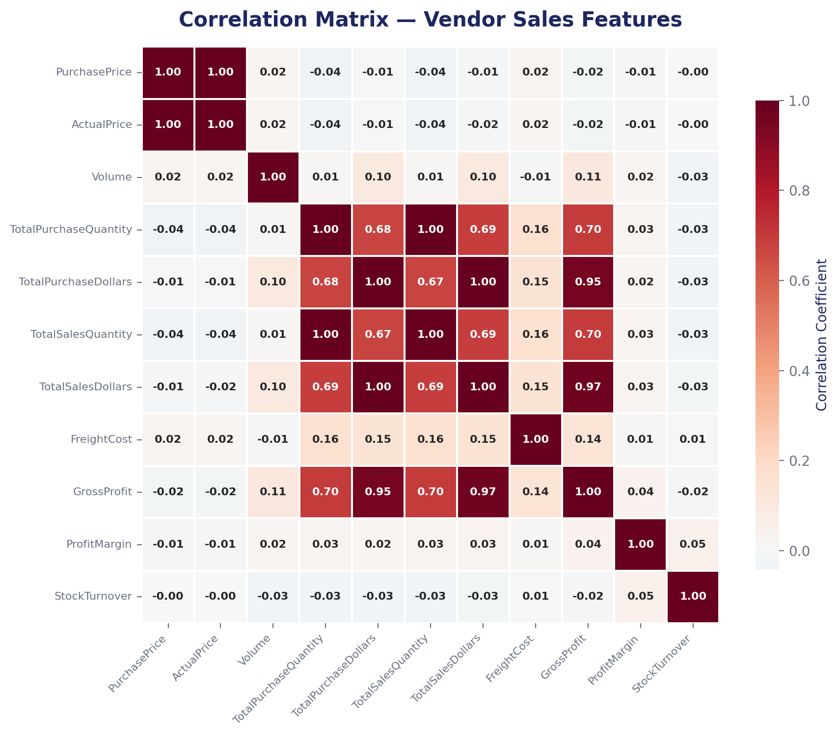
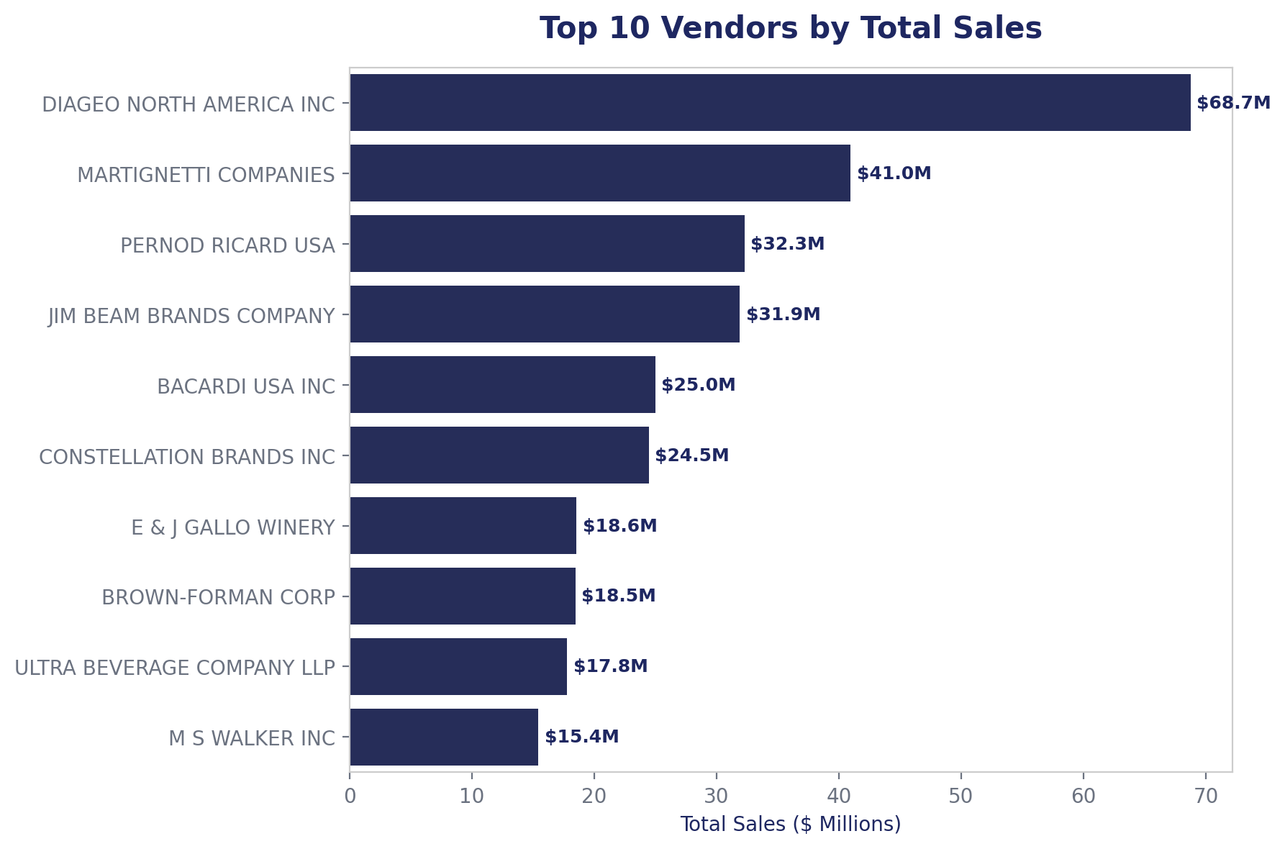
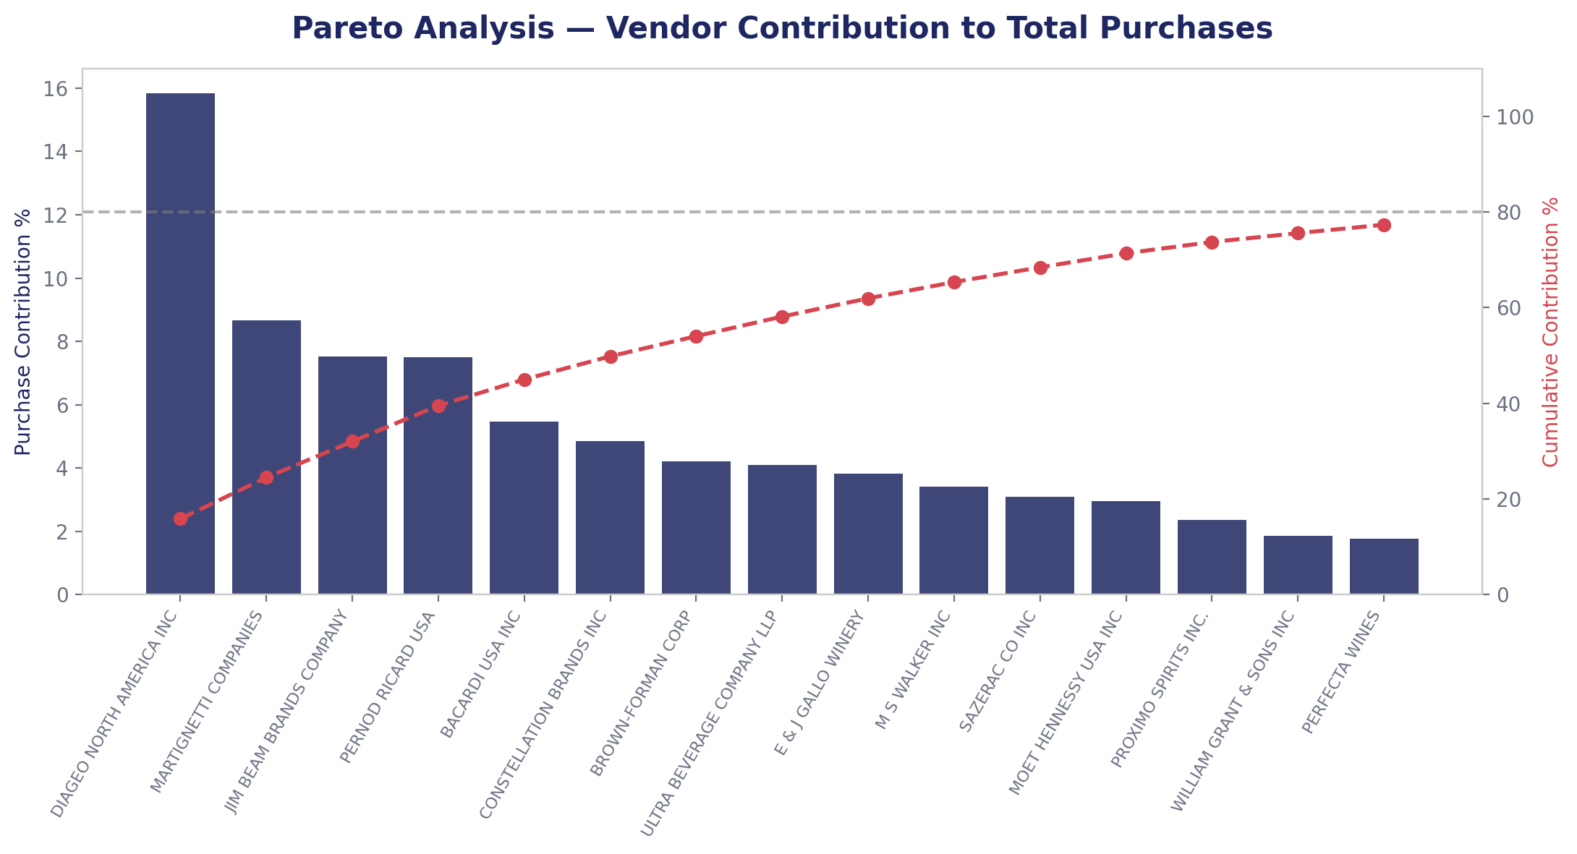
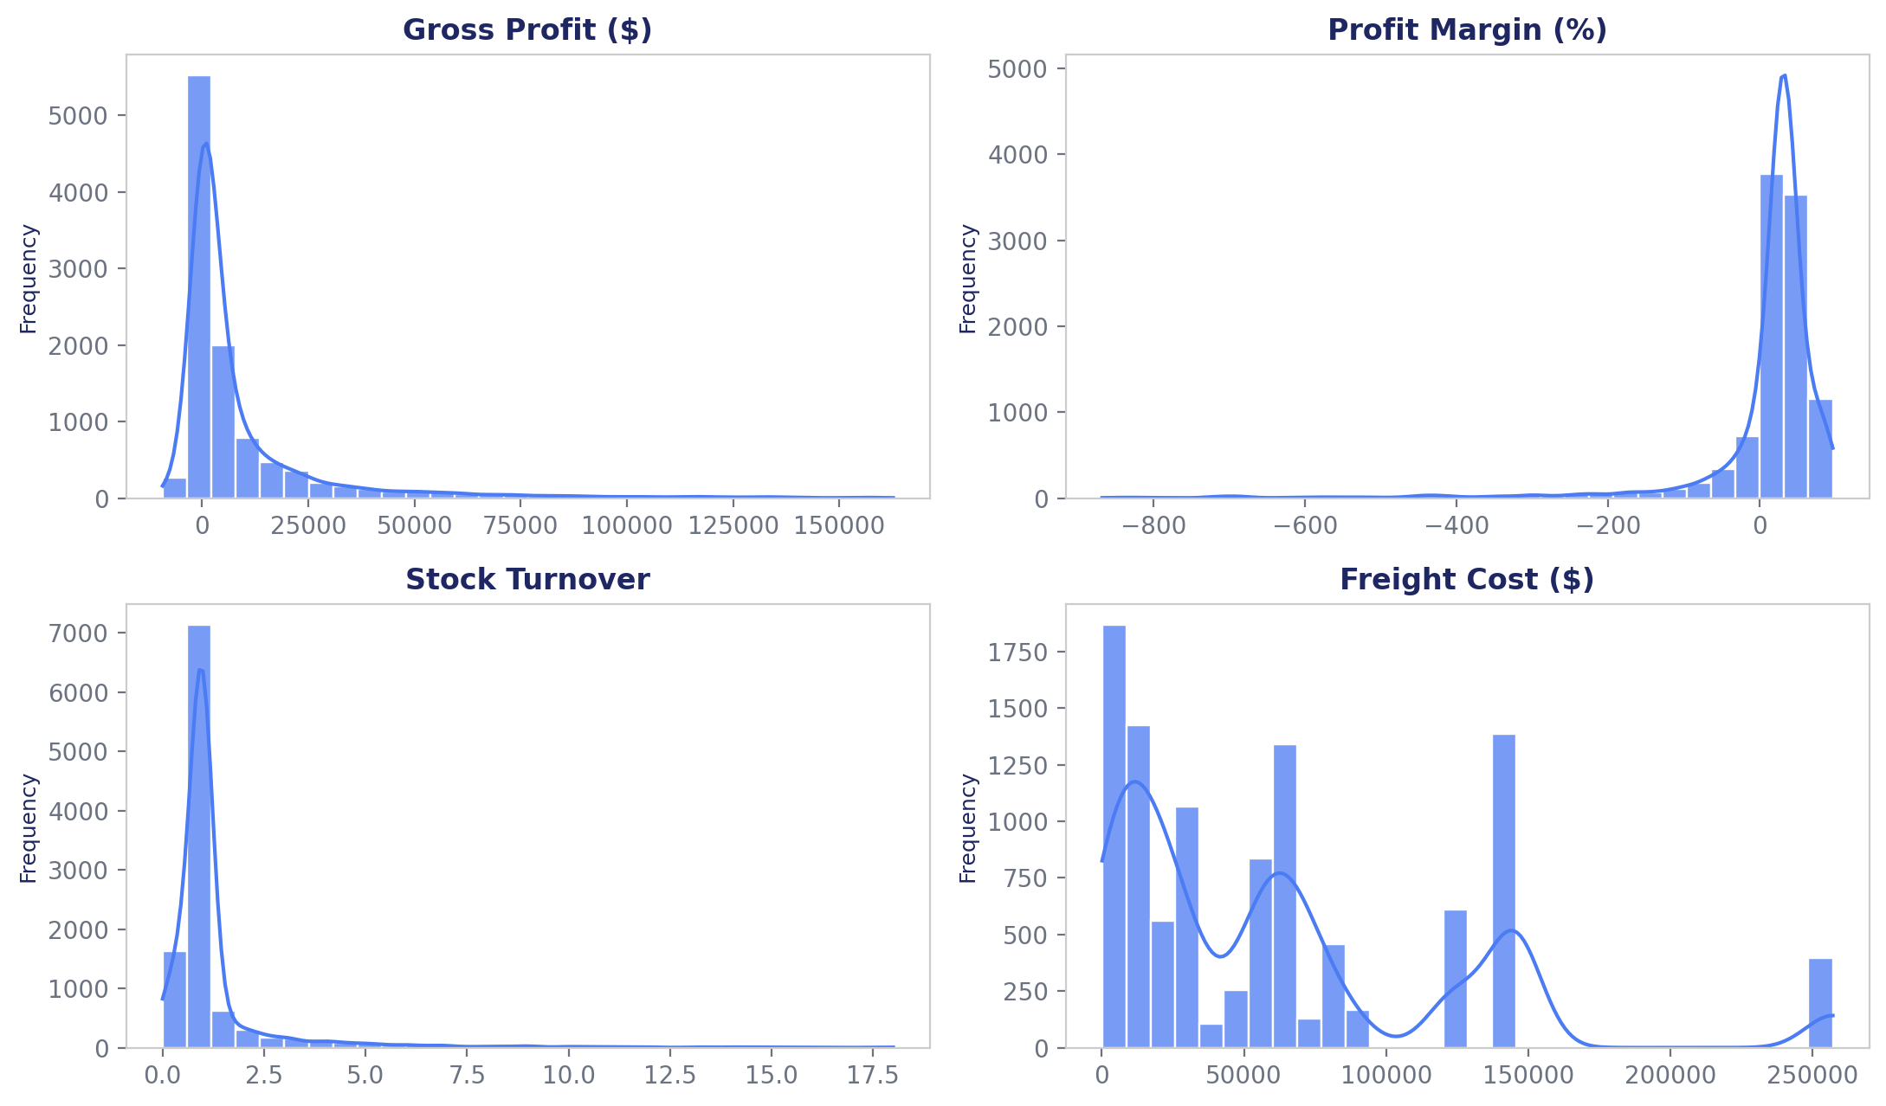
Exploratory Data Analysis
Correlations: Purchase $ and Sales $ move together; margin is largely independent of volume.
Diageo North America leads all vendors at $68.7M in tracked sales.
~15 vendors already account for the bulk of purchase spend (80/20 pattern).
Profit margin and stock turnover are both heavily right-skewed with a long loss-making tail.
Vendor Performance Analysis
6
Notes:
Four real charts generated directly from the vendor_sales_summary table: correlation heatmap, top-10 vendors by sales, Pareto vendor concentration, and metric distributions. Walk through the caption under each.

Slide 7
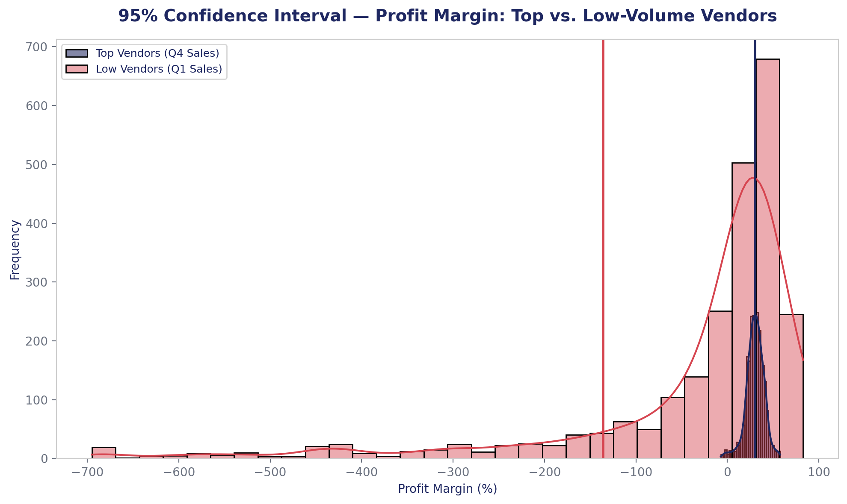
Statistical Analysis: Confidence Intervals
Top-Quartile Vendors
30.0%
95% CI: 29.5% – 30.5% (n = 2,629)
Tight, stable margins — high-volume vendors price consistently and predictably.
Bottom-Quartile Vendors
-136.0%
95% CI: -169.4% – -102.5% (n = 2,630)
Wide, deeply negative interval — low-volume vendors show erratic, often loss-making pricing.
Method: Vendors split into top vs. bottom sales quartiles; mean profit margin and its 95% confidence interval computed for each group using Student's t-distribution (scipy.stats). The non-overlapping intervals indicate the margin gap between high- and low-volume vendors is statistically meaningful, not noise.
Vendor Performance Analysis
7
Notes:
Confidence interval test comparing profit margin between top-quartile and bottom-quartile vendors by sales volume. Intervals don't overlap — top vendors cluster tightly around 30% margin, while low-volume vendors have a wide, negative-mean interval. Keep the business read front and center, not the formula.

Slide 8



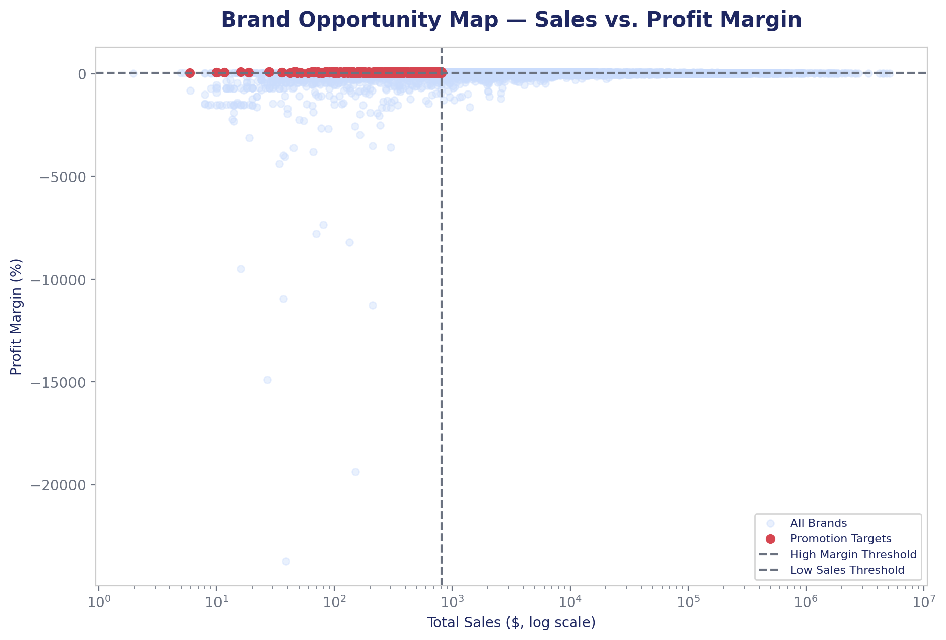
Business Insights
$451.6M
$129.7M
30.8%
Total Sales Tracked
Total Gross Profit
Median Profit Margin
178 SKUs
19.9%
65.0%
Zero-Sale (Dead) Inventory
Line Items Sold at a Loss
Sales Held by Top 10 Vendors
520 brands
sit in the low-sales / high-margin quadrant — strong candidates for promotional investment to unlock volume without sacrificing margin.
Vendor Performance Analysis
8
Notes:
All KPI numbers computed directly from the vendor_sales_summary table. 65% vendor concentration is a risk signal; 178 dead SKUs and 19.9% loss-making line items are the clearest cost-reduction opportunities; the 520 brands in the opportunity-map quadrant are the clearest growth opportunity.

Slide 9


Recommendations
Clear Dead Inventory
Fix Loss-Making Pricing
Reduce Vendor Concentration Risk
178 SKUs (1.7% of items) have zero sales, tying up $282K in purchase value. Liquidate or discontinue to free working capital.
19.9% of line items (2,127 SKUs) sell below cost, a combined $4.35M drag on gross profit. Prioritize repricing the largest offenders first.
Top 10 vendors supply 65% of purchases and sales. Diversify sourcing or negotiate resilience clauses to limit single-vendor disruption risk.
Promote High-Margin, Low-Volume Brands
Negotiate with Pareto-Priority Vendors
Stand Up Ongoing Monitoring
520 brands combine strong margin with weak sales volume — the highest-ROI segment for targeted marketing spend.
~15 vendors drive 80% of purchase spend — consolidate negotiating leverage and freight terms with this group first.
Automate this pipeline (ingestion → SQL → EDA → CI testing) into a recurring dashboard to catch margin erosion and dead stock earlier.
Vendor Performance Analysis
9
Notes:
Six concrete, data-backed actions, each tied directly back to a number introduced on the insights slide. Frame this as what management should do this quarter, ranked roughly by ease of execution.

Slide 10



Project Summary
Skills Demonstrated
Business Impact & What's Next
End-to-end ETL design: chunked ingestion, SQLAlchemy, modular Python
Advanced SQL: CTEs, multi-table joins, aggregations at scale
Data cleaning & feature engineering for business KPIs
EDA storytelling with Pandas, Seaborn & Matplotlib
Inferential statistics: confidence intervals with SciPy
Production hygiene: logging, error handling, reproducibility
Turned 4 disconnected raw tables into a single model surfacing $4.35M in loss-making sales, $282K in dead stock, and a 520-brand growth opportunity.
Automate this pipeline into a scheduled, refreshing dashboard
Extend the T-test / CI framework to formal hypothesis tests across vendor cohorts
Add demand forecasting to flag future dead stock before it accumulates
Deploy as an interactive Power BI / Streamlit report for stakeholders
github.com/your-username/vendor-performance-analysis • Thank you — questions welcome
Vendor Performance Analysis
10
Notes:
Close by reframing this as a demonstration of full-stack data analyst skills — ETL, SQL, stats, storytelling — not just a notebook of charts. Update the GitHub link before presenting.

