Slide 1

SEMINAR PRESENTATION
CAFNet: A Hybrid CNN–ViT Framework with
Cross-Attention Fusion for Robust Brain Tumor Classification
Guided by
Ms. Sreeja S
Asst. Professor
Cyber Security
Presented by
Anubind C Biju
S7 CY
Roll no 17
Department of Cyber Security

Slide 2
Agenda
Introduction
Problem Statement
1
2
Existing Research
Base Paper
3
4
Research Gap
Proposed Direction
5
6
Applications
Conclusion
7
8
2

Slide 3
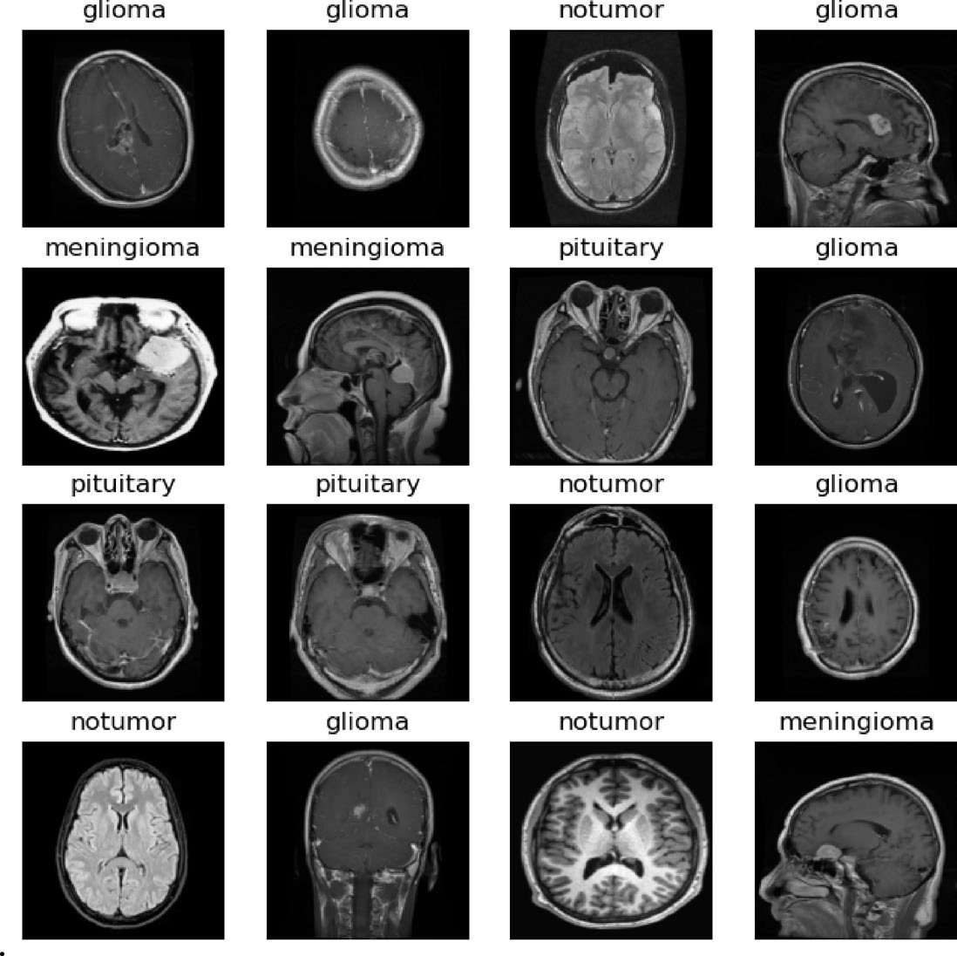
Introduction
Background
Brain tumor classification from MRI is essential for early diagnosis and treatment planning.
Traditional ML methods (SVM, Decision Tree, Naïve Bayes) rely on hand-crafted features (texture, shape, intensity).
CNNs learn hierarchical spatial features automatically but struggle to capture global context across an image.
Vision Transformers (ViT) model long-range relationships via self-attention, but have weak inductive bias and need large datasets.
This motivates a hybrid CNN–ViT approach: CAFNet, with a Cross-Attention Fusion (CAF) module.
Sample MRI scans across the 4 tumor classes
3

Slide 4
Problem Statement
Conventional ML and standalone deep learning models fail to jointly capture local fine-grained tumor texture and global contextual relationships in brain MRI scans, limiting classification accuracy and robustness across tumor types.
Local vs. Global
Data Scarcity
Fusion Gap
CNNs capture local texture but miss long-range spatial dependencies.
Small medical datasets cause both CNNs and ViTs to overfit or underperform.
No effective attention-driven mechanism to combine CNN and ViT features.
4

Slide 5
Existing Research
Comparison of prior CNN / ViT hybrid approaches
Study | Methodology | Advantages | Limitations
CNN–RNN hybrid (Bharati et al.) [3] | CNN extracts spatial features; RNN models sequential MRI slice information | Captures inter-slice dependence across 3D volumes | Lacks explicit global spatial awareness within a single slice
Capsule Networks (Afshar et al.) [2] | CapsNets preserve spatial hierarchies unlike CNNs | Robust to orientation variation; works with fewer samples | High computational complexity
5

Slide 6
Existing Research (contd.)
Comparison of prior CNN / ViT hybrid approaches
Study | Methodology | Advantages | Limitations
EFFResNet-ViT (Hussain et al.) [4] | Combines ResNet convolutional features with ViT global attention | Improved accuracy & interpretability on medical images | Symmetric/static fusion; no query-driven cross-attention
CNN Transfer Learning (Yadav et al.) [5] | Fine-tuned pretrained CNNs (ResNet, VGG) for multi-class brain tumor MRI | Strong accuracy using pretrained knowledge | Captures only local spatial info; no global contextual modelling
6

Slide 7
Base Paper — Architecture & Workflow
CAFNet: hybrid CNN–ViT with Cross-Attention Fusion
CNN Encoder
(local features)
Tumor Class:
Glioma / Meningioma /
Pituitary / No Tumor
Brain MRI
Input
Cross-Attention
Fusion (CAF)
Classifier
ViT Encoder
(global features)
Figure: CNN provides local texture (Key/Value); ViT provides global context (Query); CAF fuses both before classification.
7

Slide 8
Base Paper — Preprocessing & Augmentation
Images rescaled to [0,1] (divide by 255).
Random rotation ±20°.
Random zoom ±20%.
Horizontal flip with 50% probability.
Validation/test sets: rescaled only — no augmentation, to preserve unbiased evaluation.
Split: 80% train / 10% validation / 10% test, stratified.
Why augment?
Simulates real-world variance in scan orientation and scale, reducing overfitting on a moderate-sized dataset (5,712 train / 1,311 test images).
8

Slide 9
Base Paper — Layered System View
Data Layer — MRI scans (glioma, meningioma, pituitary, no tumor)
Feature Layer — CNN local features ∥ ViT global features
Fusion Layer — Cross-Attention Fusion (Q = ViT, K/V = CNN)
Model Layer — Fused representation → dense classifier
Output Layer — Predicted tumor class (Test Acc. 96.41%)
9

Slide 10
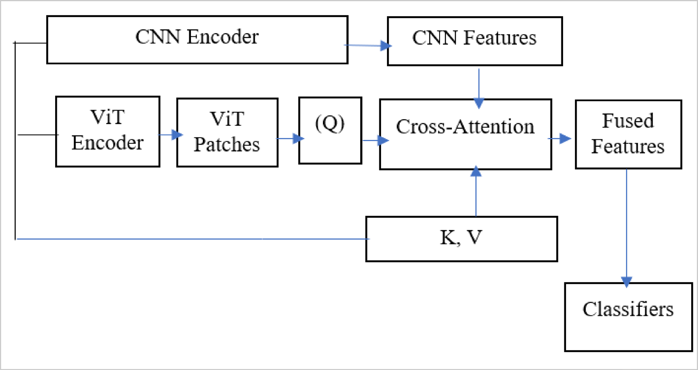
Base Paper — Cross-Attention Fusion (CAF)
The core novelty: how CNN and ViT features are fused
Fig. 23 (from base paper) — CNN Encoder produces Key/Value; ViT Encoder produces the Query; Cross-Attention fuses them into the final feature representation.
Q (query) comes from ViT — “which local regions matter for my global understanding?” K, V (key/value) come from the CNN — the fine-grained local detail being queried.
10

Slide 11
Base Paper — Dataset & Results
Dataset
Kaggle Brain Tumor MRI dataset
4 classes: glioma, meningioma, pituitary, no tumor
Train: 5,712 images Test: 1,311 images
Grayscale, stratified 80/10/10 split
Task
Multiclass classification of tumor type from an MRI scan.
11

Slide 12
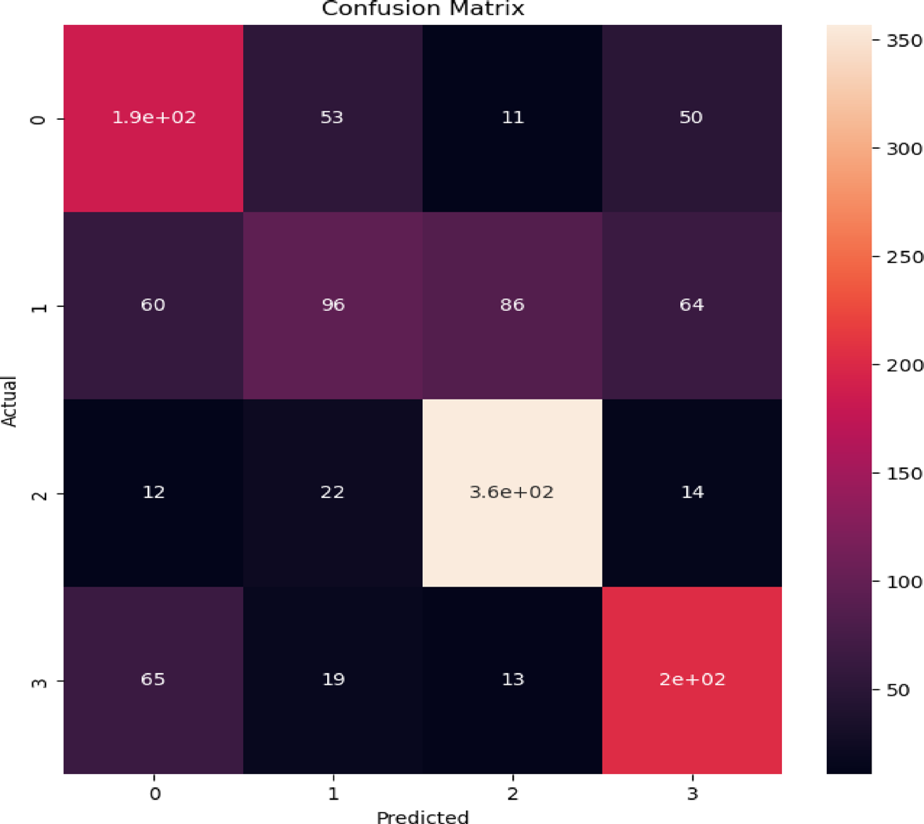
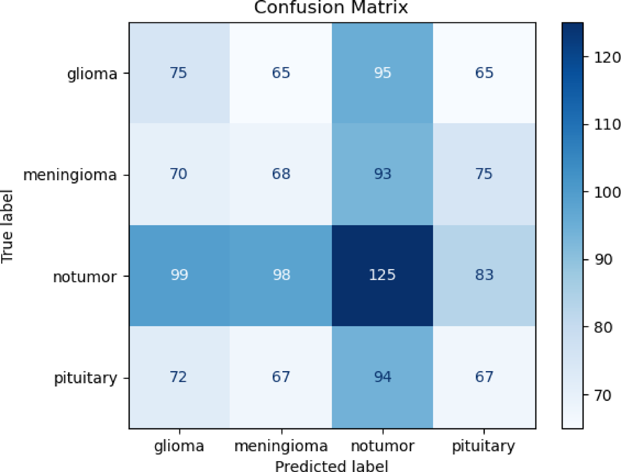
Base Paper — Confusion Matrix: ViT vs. CAFNet
Fig. 21 — ViT (Test Acc. 87.34%)
Fig. 26 — CAFNet (Test Acc. 96.41%)
12

Slide 13
Research Gap
What the base paper and wider literature do not fully address
1
Generalizability across scanners, institutions and imaging protocols not established.
4
No privacy-preserving or federated training setup for multi-institutional data.
2
No interpretability analysis (e.g. Grad-CAM, SHAP) of CAFNet's predictions.
5
Higher computational cost; overfitting risk with limited training data.
3
Evaluated on a single public dataset only.
6
No lightweight/real-time deployment variant for clinical workflows.
13

Slide 14
Proposed Direction
Possible extensions to explore further — not a completed project
Explainability
Multi-institutional Validation
Apply Grad-CAM / SHAP to visualize which fused (local + global) features drive each CAFNet prediction.
Extend evaluation to larger, multi-site MRI datasets to test generalizability.
Privacy-Preserving Training
Lightweight Deployment
Explore federated learning and encrypted inference for clinical deployment.
Investigate compressed/distilled CAFNet variants for real-time clinical workflows.
14

Slide 15
Applications
Clinical Diagnosis
Treatment Planning
Assisting radiologists with faster, consistent MRI-based tumor screening.
Supporting early-stage detection to guide treatment strategy.
Multi-organ Extension
Secure Clinical AI
Same CNN–ViT fusion approach generalizable to other imaging tasks (breast, skin).
Encrypted inference pipelines for privacy-preserving deployment in hospitals.
15

Slide 16
Conclusion
CAFNet fuses CNN's local texture features with ViT's global context via a Cross-Attention Fusion mechanism.
Achieves 96.41% test accuracy, outperforming classical ML (82.99%), plain CNN (75.90%) and standalone ViT (87.34%).
Ablation study confirms the fusion mechanism itself — not just combining two branches — drives the largest accuracy gain.
Validated via 5-fold cross-validation (96.08% ± 0.47%) and out-of-domain testing (95.60%).
Key open gaps: interpretability, multi-institutional generalization, and privacy-preserving deployment.
16

Slide 17
References
[1] Jayaraman, G., Meganathan, S., Mohideen Shah, S. S., Anuradha, M., Sundararajan, R. K., & Rajakumar, R. “A hybrid CNN–ViT framework with cross-attention fusion and data augmentation for robust brain tumor classification.” Scientific Reports, 15:45769 (2025).
[2] Afshar, P., Mohammadi, A., & Plataniotis, K. N. “Brain tumor type classification via capsule networks.” IEEE ICIP (2018).
[3] Bharati, S., Podder, P., & Mondal, S. “Hybrid CNN-RNN model for brain tumor classification from MRI images.” Pattern Recognit. Lett., 145 (2021).
[4] Hussain, T. et al. “EFFResNet-ViT: A fusion-based convolutional and vision transformer model for explainable medical image classification.” IEEE Access, 13 (2025).
[5] Yadav, A. C., Shah, K., Purohit, A., & Kolekar, M. H. “Computer-aided diagnosis for multi-class classification of brain tumors using CNN features via transfer-learning.” Multimedia Tools and Applications, 84(31) (2025).
17

Slide 18
THANK YOU
Questions?

