Slide 1
Databricks
Activity Based Segmentation

Slide 2
Problem Statements
Currently Customer Segmentation is done based on SCI , EBBS Source segment – Retail, Business Banking, Corporate and Sub Segment based on Product Category.
For Individual Customer segment broadly categorized into Personal Banking, Premium Banking, Priority Banking.
Hence proposed solution will look for customer activity based segmentation.

Slide 3
Dataset
 | CustomerID | CustomerDOB | CustGender | CustLocation | CustAccountBalance | TransactionDate | TransactionTime | TransactionAmounts
T1 | C5841053 | 10/1/1994 | F | JAMSHEDPUR | 17819.05 | 2/8/2016 | 143207 | 25
T2 | C2142763 | 4/4/1957 | M | JHAJJAR | 2270.69 | 2/8/2016 | 141858 | 27999
T3 | C4417068 | 26/11/96 | F | MUMBAI | 17874.44 | 2/8/2016 | 142712 | 459
T4 | C5342380 | 14/9/73 | F | MUMBAI | 866503.21 | 2/8/2016 | 142714 | 2060
T5 | C9031234 | 24/3/88 | F | NAVI MUMBAI | 6714.43 | 2/8/2016 | 181156 | 1762.5
T6 | C1536588 | 8/10/1972 | F | ITANAGAR | 53609.2 | 2/8/2016 | 173940 | 676
T7 | C7126560 | 26/1/92 | F | MUMBAI | 973.46 | 2/8/2016 | 173806 | 566
T8 | C1220223 | 27/1/82 | M | MUMBAI | 95075.54 | 2/8/2016 | 170537 | 148
T9 | C8536061 | 19/4/88 | F | GURGAON | 14906.96 | 2/8/2016 | 192825 | 833
T10 | C6638934 | 22/6/84 | M | MUMBAI | 4279.22 | 2/8/2016 | 192446 | 289.11

Slide 4
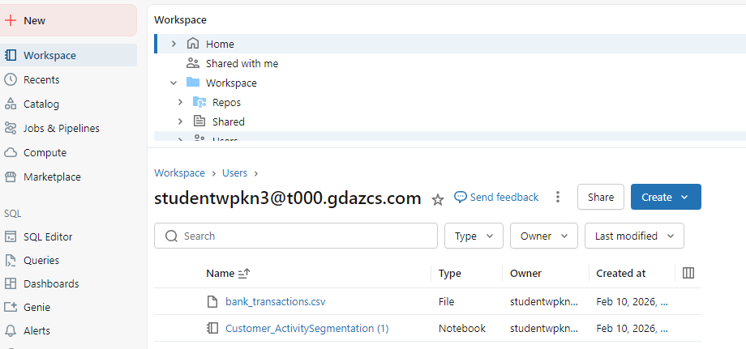

Slide 5
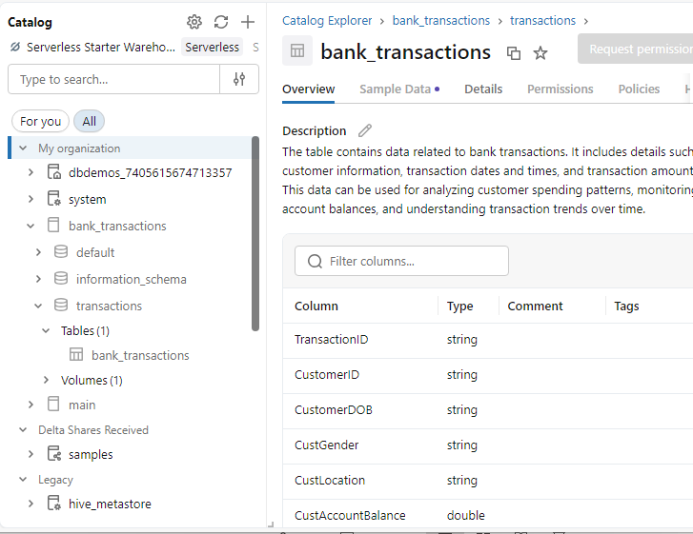

Slide 6
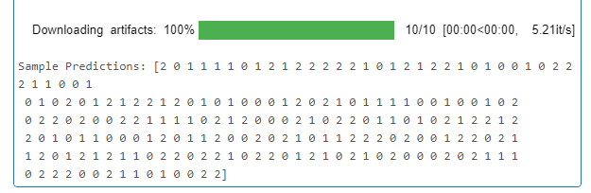
Outcome

