Slide 1
HTE-1
Assignment is available on onderwijsonline
2 assignments
linear regression
prediction of heating demand of a house
neural networks
prediction of drive failures
Notes:
Due to availability of teachers, and changing ordering of topics it is not the case that HTE1 is all in first term and HTE2 is all in second term.

Slide 2
General assignment structure
Matlab programming
Implementation of basic algorithm
Apply the algorithm to a given data set
Make choices to create a model (regularization, learning rate, model complexity)
Report
Description what you did in Matlab
Justify your choices
Evaluate your results
Discussion of the questions

Slide 3
General coding practice
use clear variable names
Preferably full words, not abbreviations
NO single letters (except for indexing)
use comments to clarify the code
use of sub-functions can help to keep the structure of the code clear
Notes:
If you have problems with your code ask questions!

Slide 4
Assignments are individual
Discussion on how to implement things is fine, but…
Make your own implementation
Write the code and comments yourself from scratch
Changing variable names is not enough
For NN part use the provided code, but start with a blank script and only use necessary parts
Make your own analysis of the results
Draw your own conclusions
Notes:
In case you use inspiration of a piece of code you found somewhere, give a reference to this as well! Make sure you understand what you use, and show this in the report.

Slide 5
Report
Keep it concise
Discussion of your implementation
What did you do?
Why did you do it?
Look critically at your results
What results do you have?
What do they mean?
Are the results what you expected?
Can you explain (un)expected results?
Is your argumentation complete and logical?
Do the results/graphs/numbers support your argumentation?
Did you cover all questions in the assignment?
Refer to the sources you have used, use proper citations
Write in your own words.
DO NOT copy text from any source!
Notes:
Page limit: 4 pages

Slide 6
Handing in assignments
deadline, April 5th, 23:59:59 CEST
Hand in through the application HANDin zip-file containing:
separate folder for the 2 parts
Matlab code and provided data
Word or pdf document with your results and discussion
examiners: Marijn Jongerden and Dixon Devasia
In case of problems with the HANDin notify the teacher before the deadline
When everything fails, do not panic, mail your solution before the deadline to marijn.jongerden@han.nl

Slide 7
Grading exam
2 assignments
linear regression (40%)
prediction of heating demand of a house
neural networks (60%)
prediction of drive failures
Both assignments graded on:
Knowledge and understanding:
show the theoretical knowledge and understanding of the relevant machine learning principles
Applying knowledge and understanding:
Correct practical implementation and correct methods used in finding the best model
Making Judgement:
Correct analysis of result
Correct and complete reasoning
Supporting results are clear
All aspects are graded 1-10, and have equal weight.

Slide 8
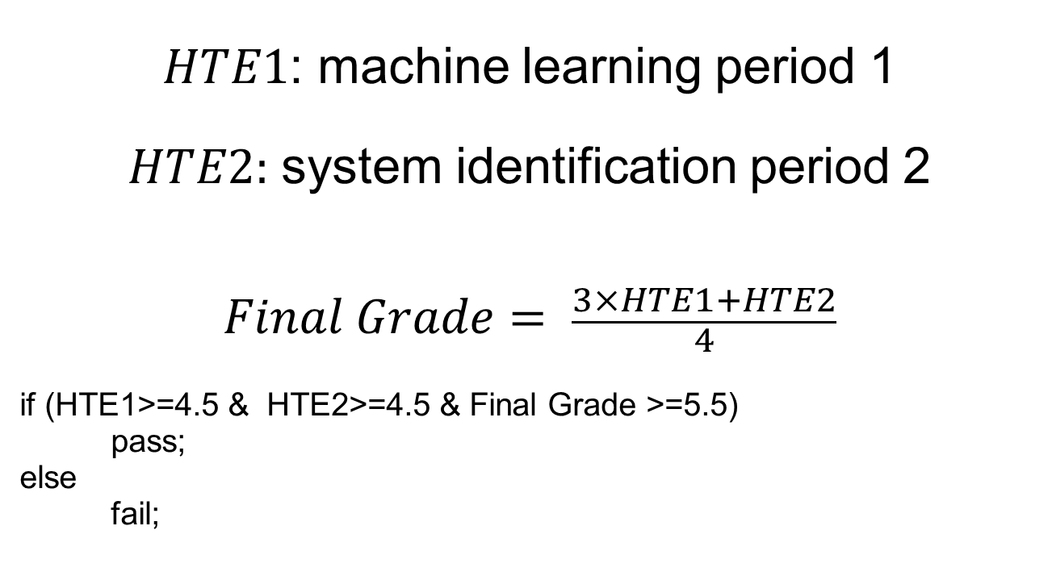
grading for the course
$HTE1$: machine learning period 1
$HTE2:$ system identification period 2
$$Final Grade= \frac{3×HTE1+HTE2}{4}$$
if (HTE1>=4.5 & HTE2>=4.5 & Final Grade >=5.5)
pass;
else
fail;

