Slide 1
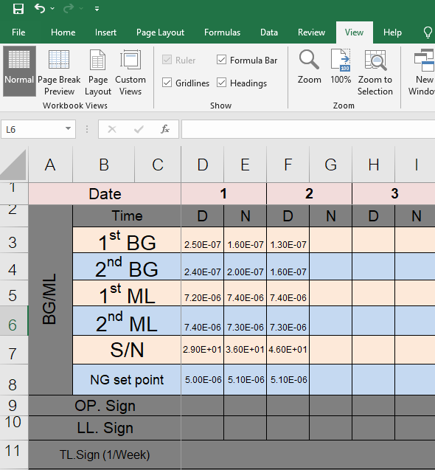
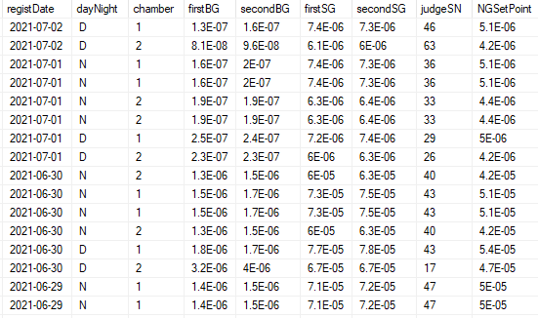
Operation manual Auto Recording software
P1
[Helium leak test machine (WGR) ]
Understand Outline
Chamber 1
dB
Trigger recording time
8:00 AM and 20:00PM every day
Chamber 2
Make sure software
running all time.
Understand Condition
Calibration time is 23:00 PM yesterday - 08:00 AM today => Shift = Day (D)
Calibration time is 11:00 AM today - 20:00 PM today => Shift = Night (N)
Using latest only. One day has 2 times.
Feature
Transfer data from DB to Excel file which using form designed
in c:\radiator\master\Calibratehelium.xlsx (depend on setting)
2. File is created on section-name if system has more one section-code
3. Provide Function re-update on datetime by individual.
Collaborate Lab

Slide 2
Operation manual Auto Recording software
P2
Understand Flow Chart
Individual section
8:02 AM,20:02PM
Service
Software 2
ST
ST
Service
Software 1
8:00 AM,20:00PM
read
insert
copy
read
Master File (Excel)
Raw Data
Normal Data
write
Need
Setup directory
A
: Run all time on BPK. Server.
OUTPUT
Excel Files
Need
Setup directory
B
: Run all time on each individual
or on demand.
ST
: Schedule Trigger
Collaborate Lab

Slide 3
Operation manual Auto Recording software
P3
Understand Folder structure
C:\Radiator\master\Calibratehelium.xlsx
Fixed folder
File Master
C:\Radiator\Assy1\Calibratehelium_1_June’21.xlsx
Year
Month
Chamber no.
Filename
Section name
Auto Record folder
Collaborate Lab

Slide 4
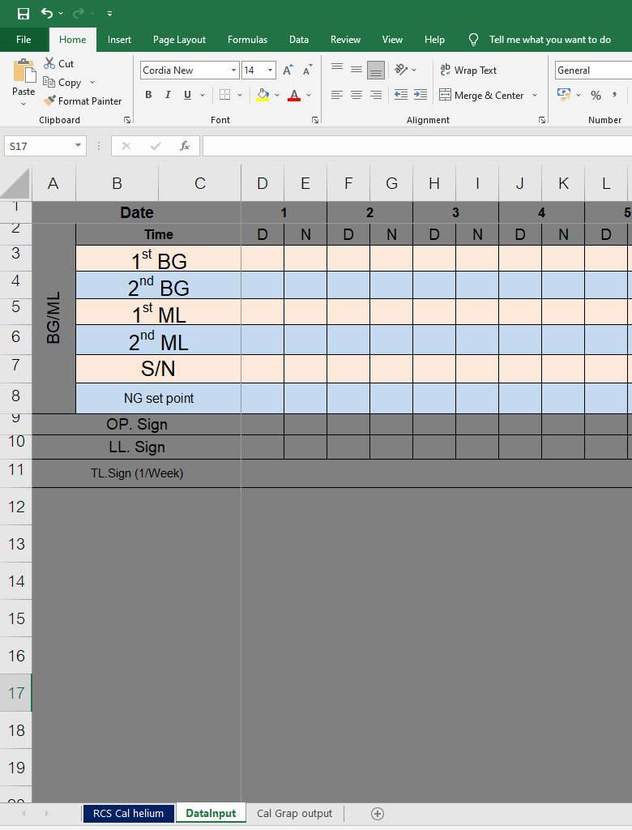
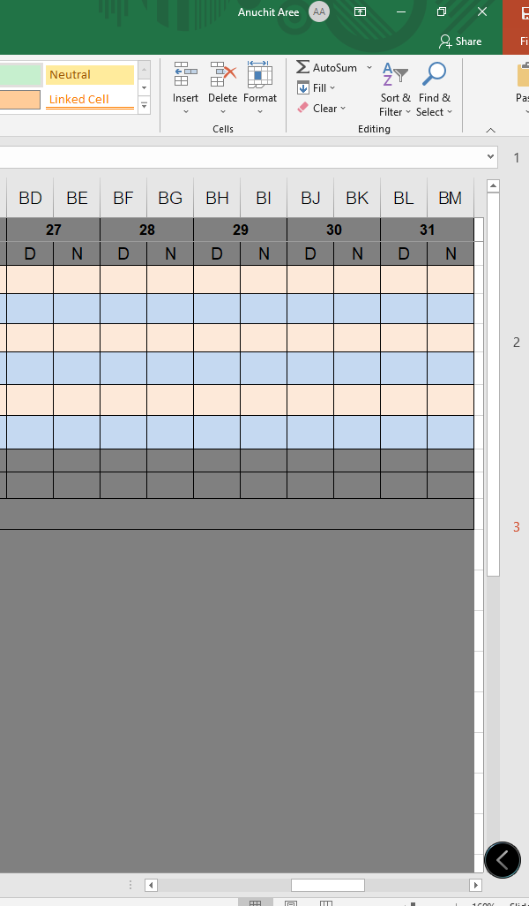
Operation manual Auto Recording software
P4
Understand File Master
Auto filling.
Do NOT touch this area.
Do NOT change sheet name
Collaborate Lab

Slide 5
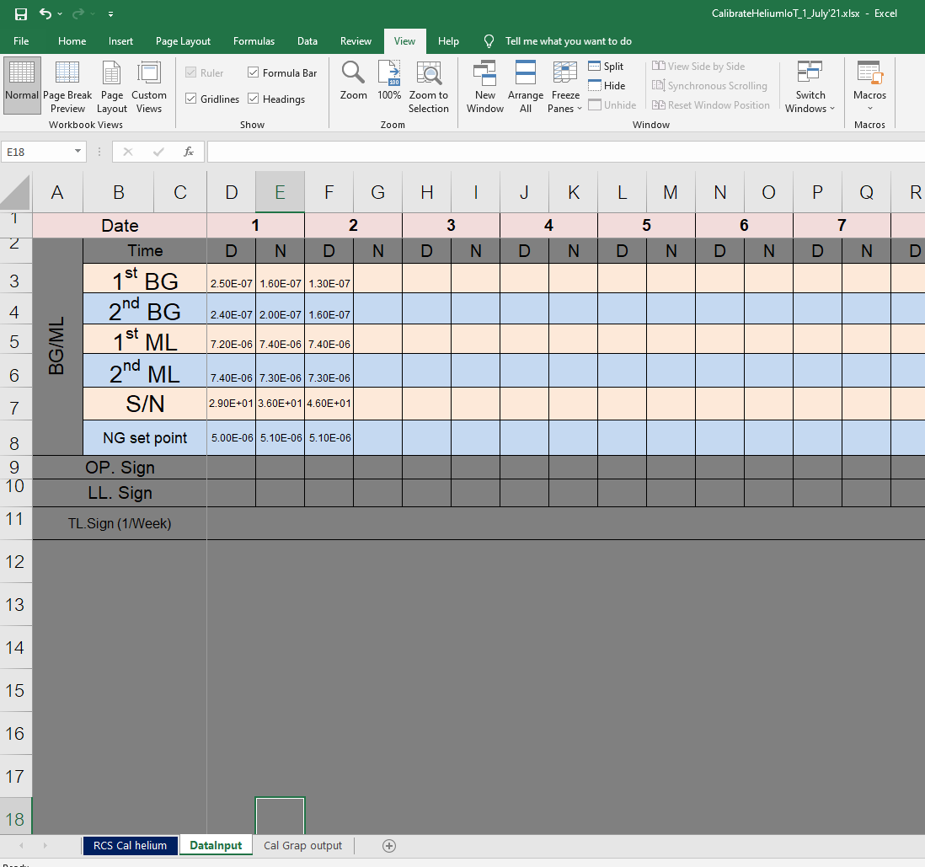
Operation manual Auto Recording software
P5
Understand File recorded
Recorded data : data is transferred 2 Chamber
On Day-shift and Night-shift twice.
File name
Collaborate Lab

Slide 6

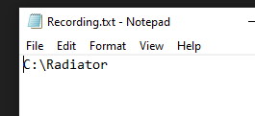

Operation manual Auto Recording software
P6
Understand Service software
Run file Service.exe
Program create file C:\KPi\Login\Connection.dat
You should select connection type
Network 3G/4G/5G :4G,Local
Network Local : Local,4G
And Program create file C:\KPi\AutoRecord\Recording.txt
You make sure subdirectory to keep file. You can change by yourselves.
Such as “D:\RadiatorAssy” instead. And SAVE File.
If you edit file, you should restart this program again to create new folder.
Collaborate Lab

Slide 7
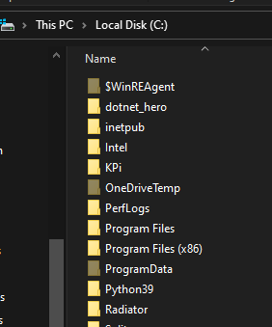
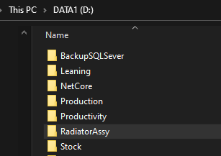
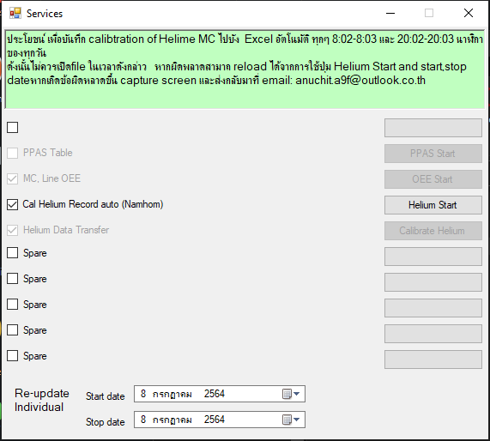
Operation manual Auto Recording software
P7
Understand Service software
In the case:
Don’t edit data
In the case:
Change to D:\RadiatorAssy
Bring Calibratehelium.xlsx file to place at “Master” folder
of “Radiator” folder or “RadiatorAssy” folder.
2. Run file Service.exe again. (In the case : RadiatorAssy)
Trial save transfer data by individua.
Step I: select start & stop date
Step II: push Helium start
Step III: Excel file and section-name folder
is created at Radiator directory . It has 2 files.
If these files lost. It created after trigger running.
But data is NOT full, should update by self.
Collaborate Lab

Slide 8
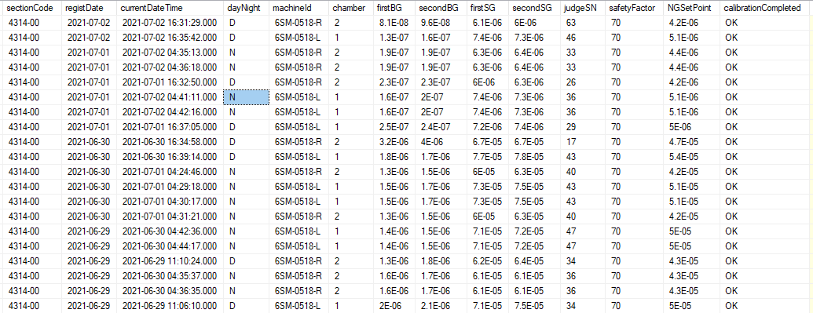
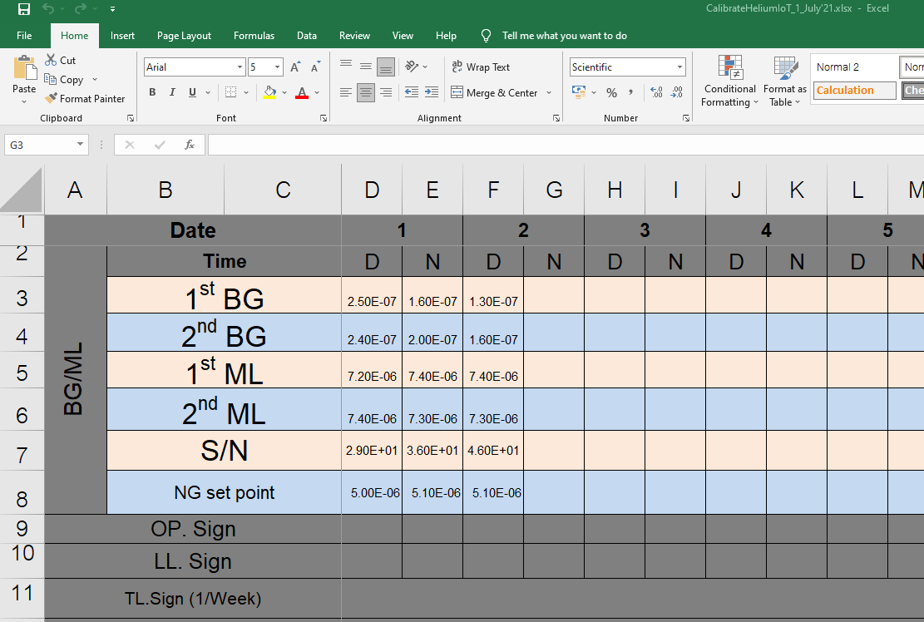
Operation manual Auto Recording software
P8
Understand Service software
Data in database.
After data was transferred.
END
Collaborate Lab

Slide 9
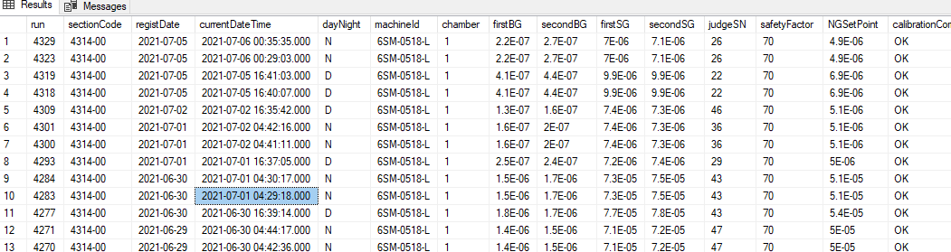
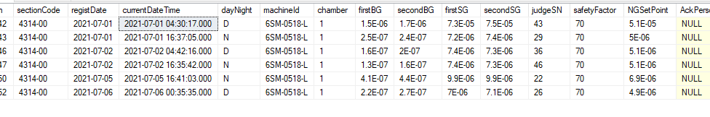
Condition
Calibration time is 23:00 PM yesterday - 08:00 AM today => Shift = Day (D)
Calibration time is 11:00 AM today - 20:00 PM today => Shift = Night (N)
Appendix
WGR].[dbo].[RD_HL_CalibrationTable] (Before)
2021-07-06 D
2021-07-05 N
2021-07-02 N
2021-07-02 D
2021-07-01 N
2021-07-01 D
WGR].[dbo].[RD_HL_Calibration] (After)

