Slide 1
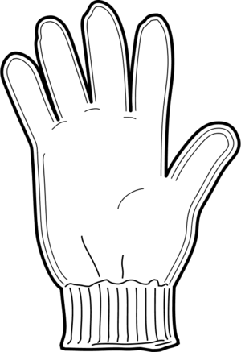
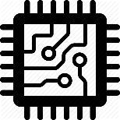
SMART NAVIGATION GLOVES
Team SAK
J Anudeep
G Kowshik
Ch Vineeth
Shriram K Vasudevan

Slide 2
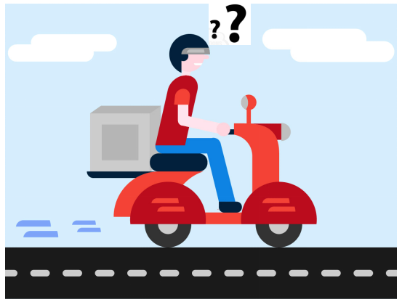
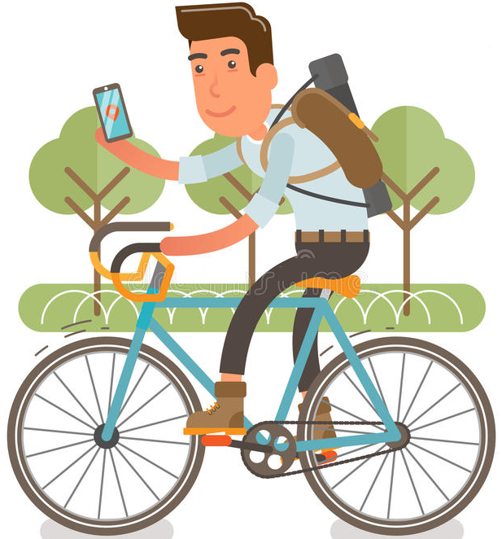
Why ????
Lack of traffic safety due to mobile usage while driving and 1.3 million accidents have been reported due to mobile usage while driving.
Reference: https://www.deccanchronicle.com/nation/current-affairs/180517/chennai-road-mishap-deaths-high-among-teens-using-mobiles.html
Navigation checks while driving pose great difficulty to most of the riders and impose traffic congestion.
Delay in dropping time of auto rickshaw customers is due to frequent navigation checks when they go to a new destination.
Most of the delivery services complain that delay in service is due to the frequent navigation checks by delivery agents when sent to a new location.
?
Difficulty in navigation for common people
Confused food delivery personnel

Slide 3
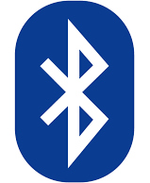
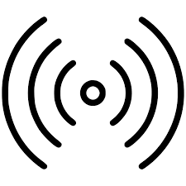
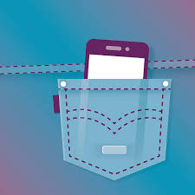
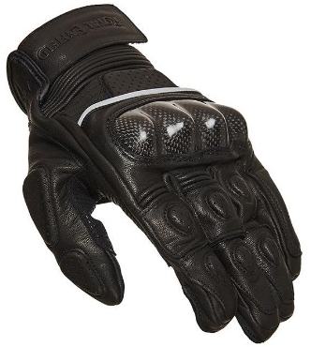
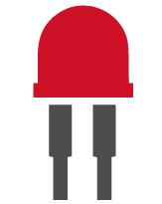
Solution:
Bluetooth paired riding Gloves
Indication of direction
through LED's
Mobile in the pocket
The solution is to design wearable gloves that are capable of navigating the route, by glowing the respective LED according to the direction.
The distance of the turn to be taken can be indicated by the glowing rate of the LED.
As the communication between the gloves and the mobile is through Bluetooth, navigation is hands-free from mobile.

Slide 4
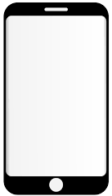
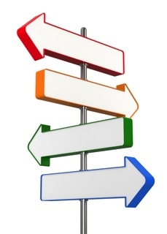
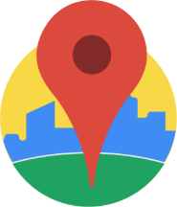
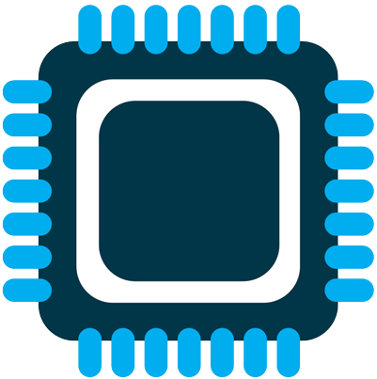
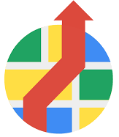
Product Design:
Android Application
Microcontroller in glove
Indication of direction
The Android app uses Google directions API, places API, Geolocation API in order to navigate the user to the destination.
Information about the direction and distance from the upcoming turn is sent to microcontroller in the gloves through Bluetooth.
The microcontroller processes the data and indicates the user through appropriate LED indication.

Slide 5
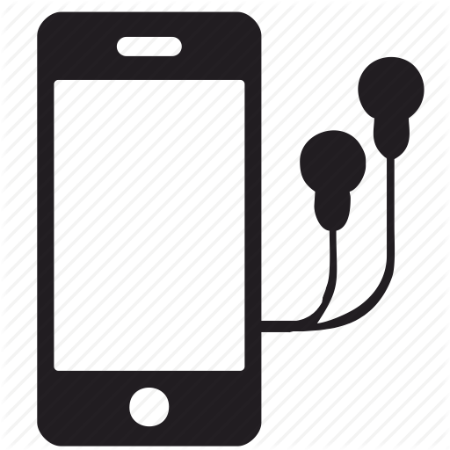
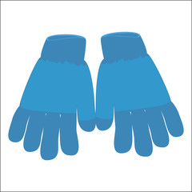
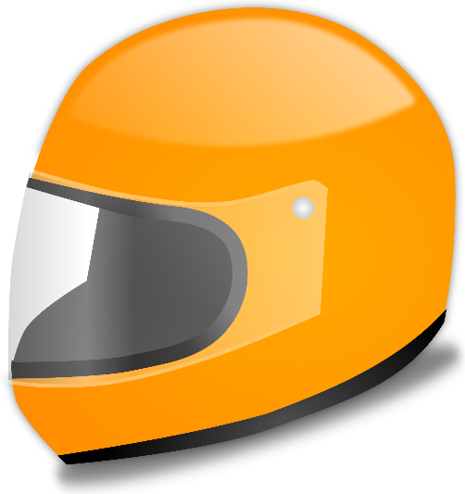
Uniqueness of the product:
Listening to the Navigation through Ear Phones
Listening to the Navigation through Bluetooth Ear Phones in Helmet
Indication of Navigation route through Bluetooth
Existing Market
Our Innovation

Slide 6
Demo Video Links:
1.) Demonstration of Internal working of our App: https://youtu.be/r28m-mP7H6A
2.) Demo with the prototype: https://youtu.be/OlccFptsWcQ

Slide 7
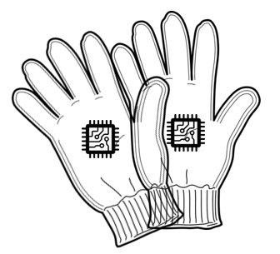
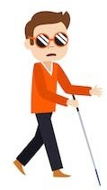
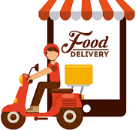
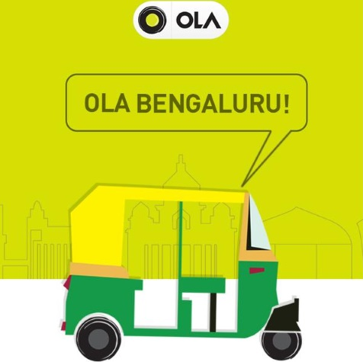
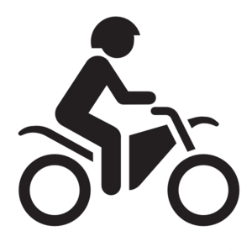
Applications:
Visually Challenged
Food Delivery Persons
Cab Drivers
Common Public
Food Delivery Persons

Slide 8
Applications:
Visually challenged : Generally blind people need public assistance in travelling from one place to another place. So our product navigates the blind people just by vibrations without any visual assistance.
Food Delivery: Food delivery services can implement our product with their delivery personnel to decrease the delay in delivery time.
Cab Services: Our product can be used not only for two-wheelers but also for other vehicles like auto rickshaw’s, cars which extends the market to cab services.
Common Public: Our product can also render its service to the common public riders, to help them navigate in new locations. It can help them in daily travel by reducing the frequent google maps check while driving.

Slide 9

Financials:
According to the survey held by “Statista”, the market of the food delivery services is expected to be 6.1 billion British pounds which require a faster food delivery. To reduce the delay in service due to navigation checks, our product can be used by each delivery person.
Reference: https://www.statista.com/statistics/690783/food-delivery-market-size-by-channel-united-kingdom-uk/
Our product is useful to every motorcycle rider. According to the statistics available on “Statista”, in the year 2017/18 alone 20,192,672 two-wheelers are purchased which is an indication that our product has a huge market value even from the perspective of common people.
Reference: https://www.statista.com/statistics/318023/two-wheeler-sales-in-india/
According to EMBARQ publication, In tier I & II cities alone 80,000 auto-rickshaws run everyday. The dropping time of their customers greatly reduces by using our glove without any traffic rule violation and traffic congestion.
Reference: https://wricitieshub.org/charts-graphs/market-size-auto-rickshaws-indian-cities
The selling price of the complete product is estimated to be 3000 INR. In the Indian market, we expect a sale of 1,00,000 pieces by the end of the first year.

Slide 10

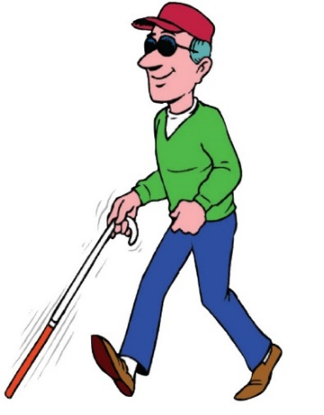
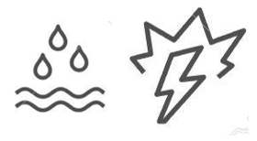
Future Enhancements
An Indication to the users will be given not only by the vibrations in the glove but also by various other UIs (user interface) like LEDs, OLED display, etc.,
For visually challenged people, a voice search feature will be provided in order to select various options in the Android app.
For safety and reliability purpose the glove need to be made as shock and water proof.
Voice assistance for
visually challenged
Assistance systems for Visually Challenged
Shock & Water Proof

Slide 11
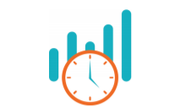
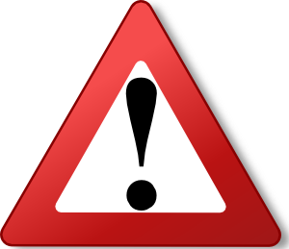
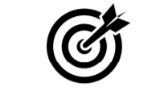
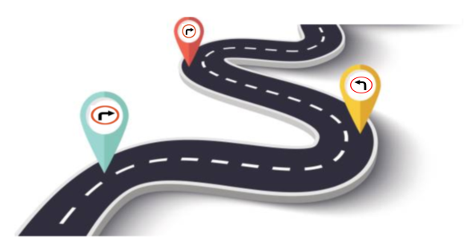
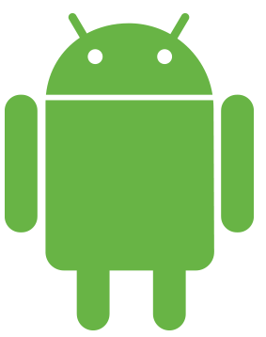

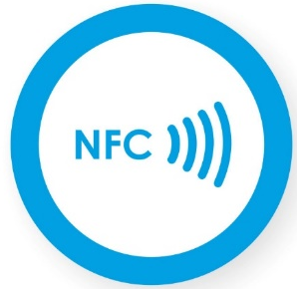
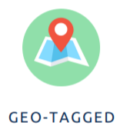
We Provide..!!
REAL-TIME
ACCURACY
NAVIGATION
SEPERATION ALERT
GEOTAG
MOBILE APP
CUSTOMER SAFETY
NFC for easier payments

Slide 12


