Slide 1
TEAM- 4Blood
Blood Management
Santhosh Mohan (35)
Fathima James (58)
Prasanna Muppidi (33)
Anudeep Pandiri (40)

Slide 2
Technologies used
Android studio
Firebase
Java & XML
Google play services (REST APIs)

Slide 3
Features
Welcome page – login with social login and register an account
Home page – user can search the blood donors based on the blood group and city.
Blood donors list – Name, address, phone no, blood group & navigation
Navigation bar – includes the functionalities such as Hospitals, blood banks, blood drive, share on FB.
Profile page – user can view and edit the profile page.

Slide 4
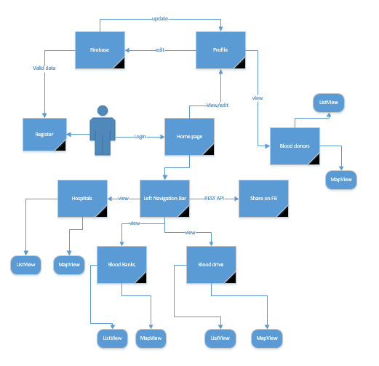
Operational Architecture

Slide 5
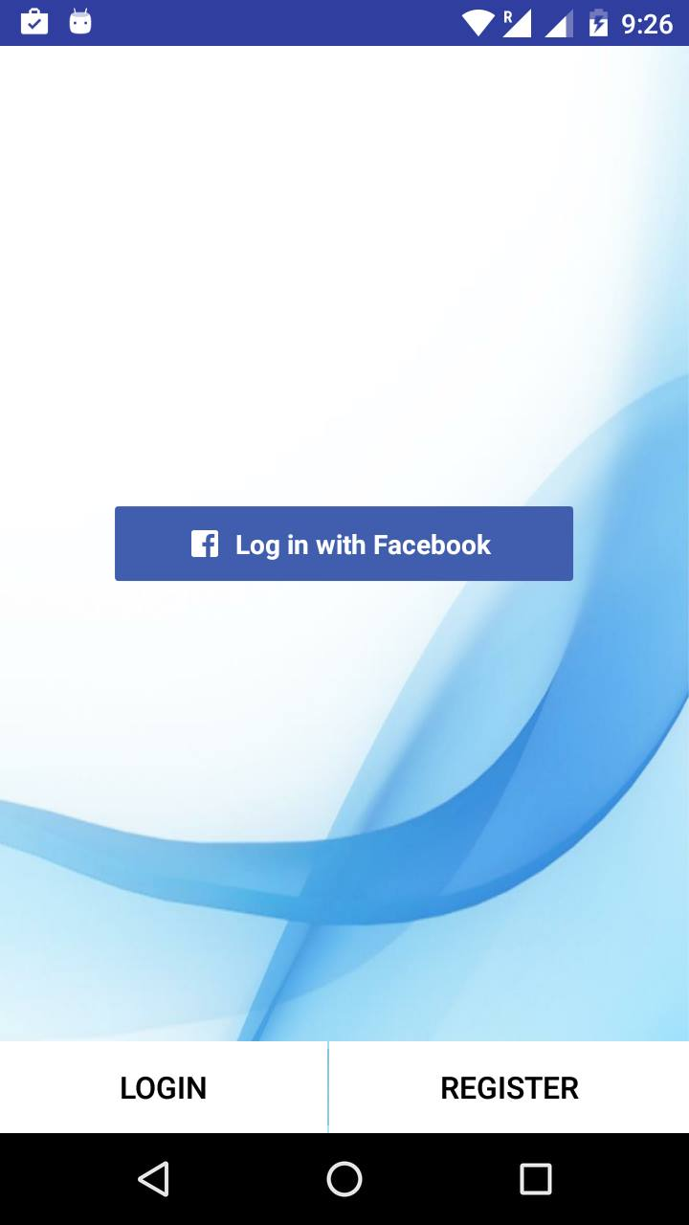
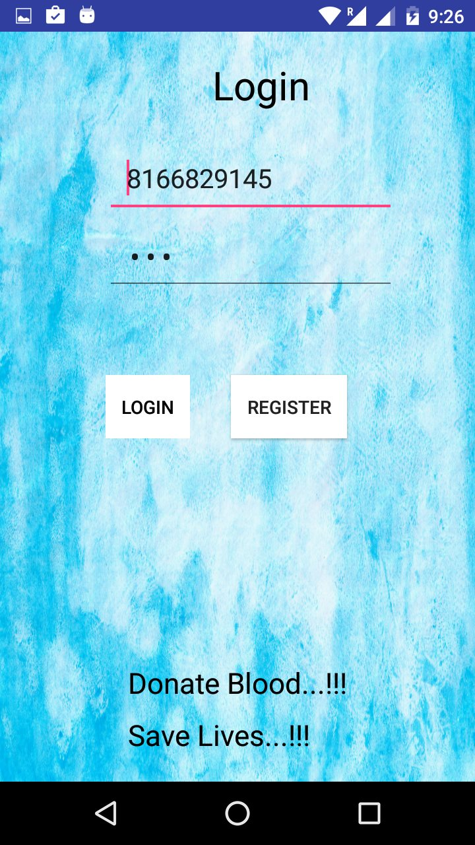
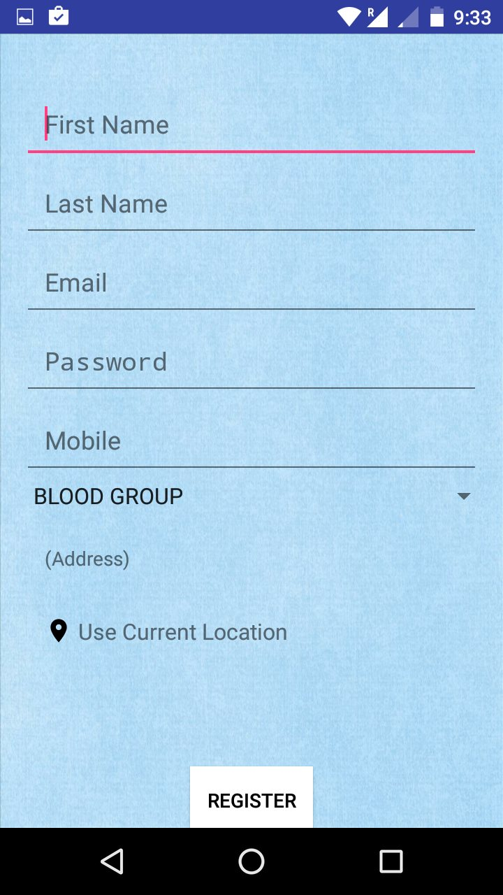
Screenshots

Slide 6
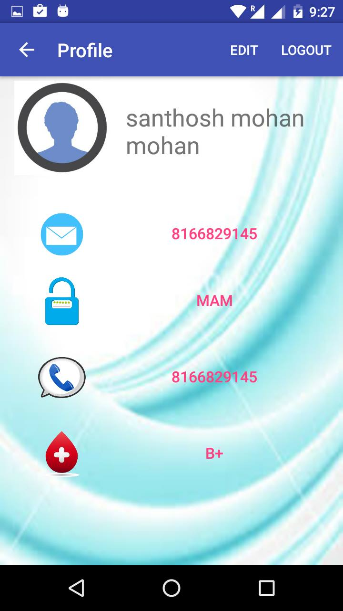
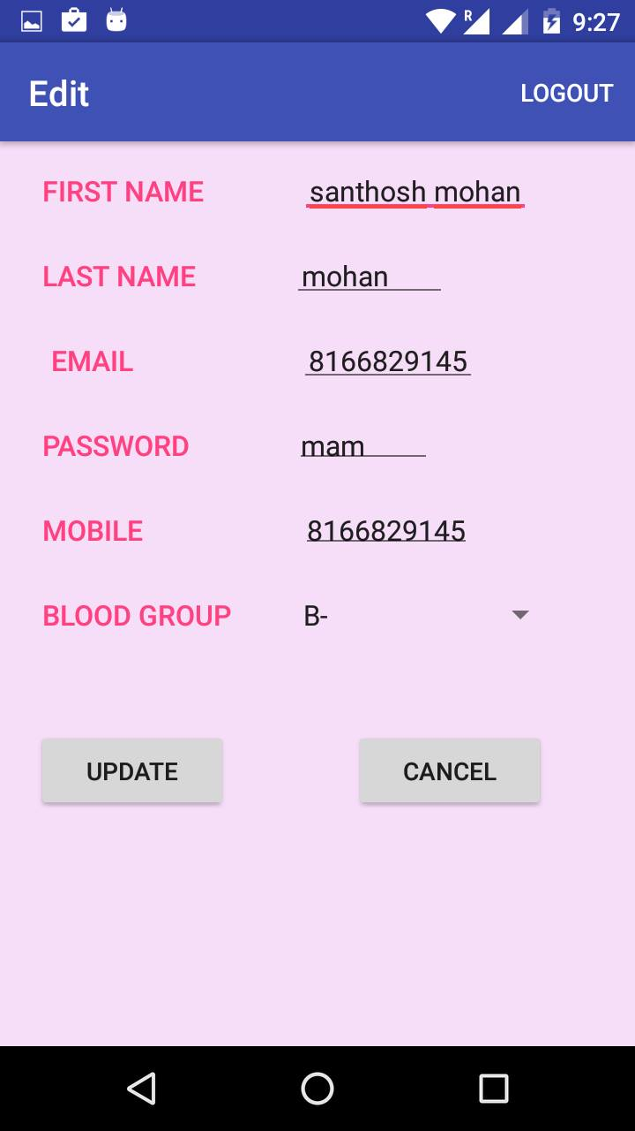
Screenshots Profile

Slide 7
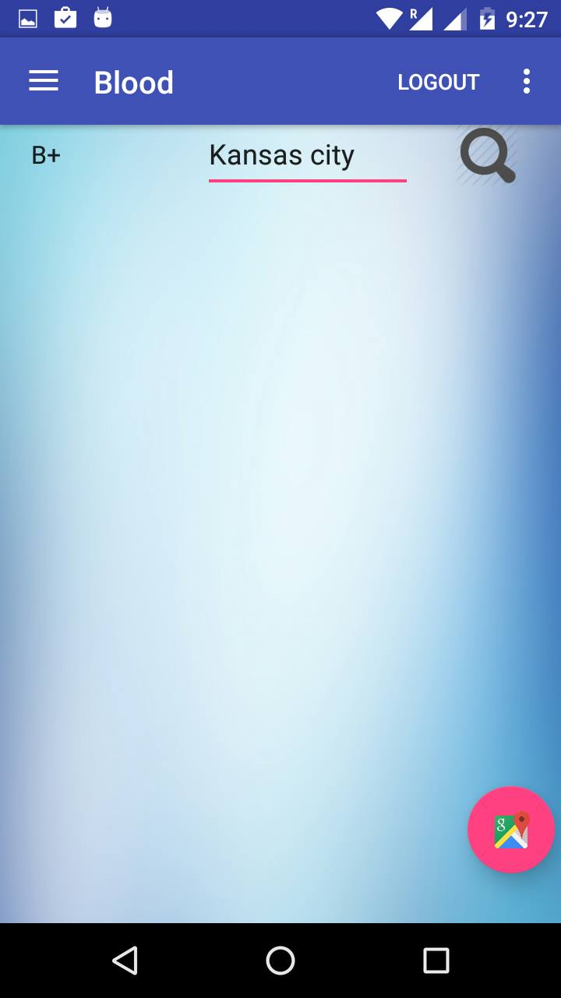
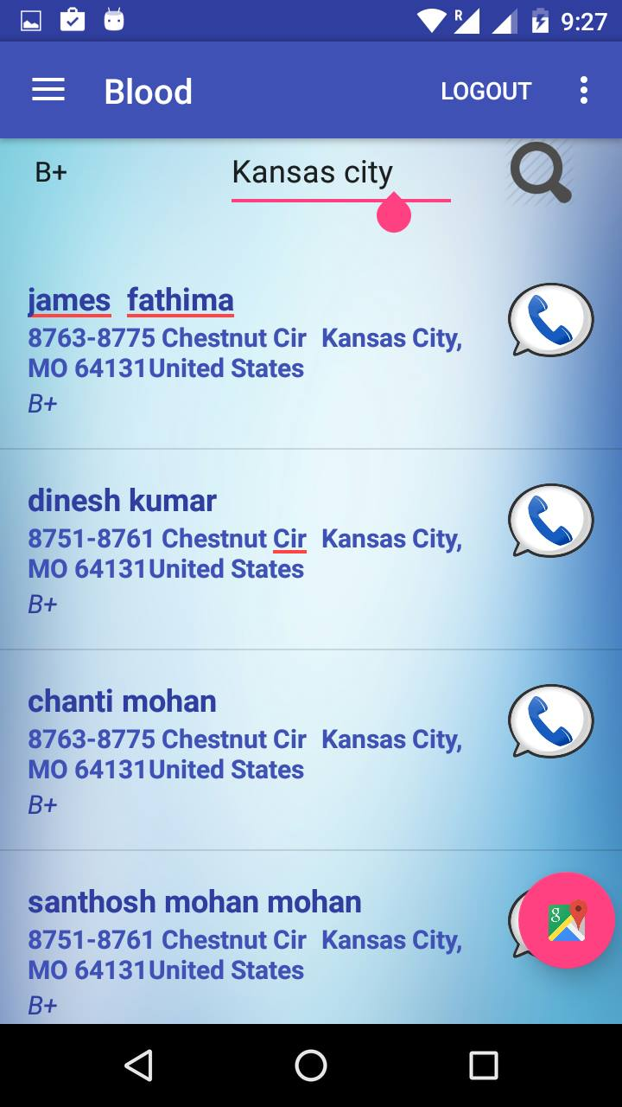
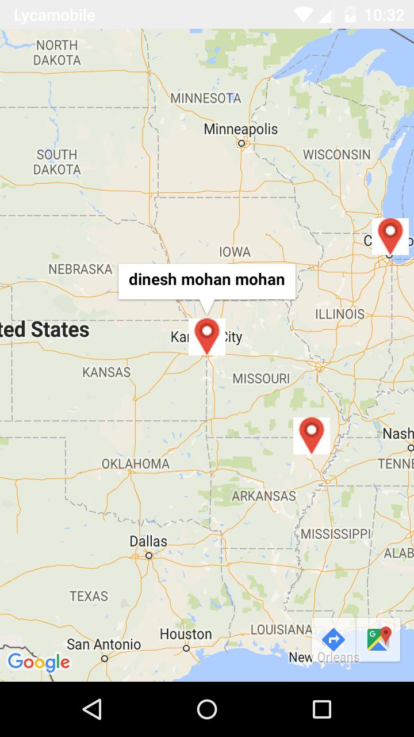
Screenshots Searching donors

Slide 8
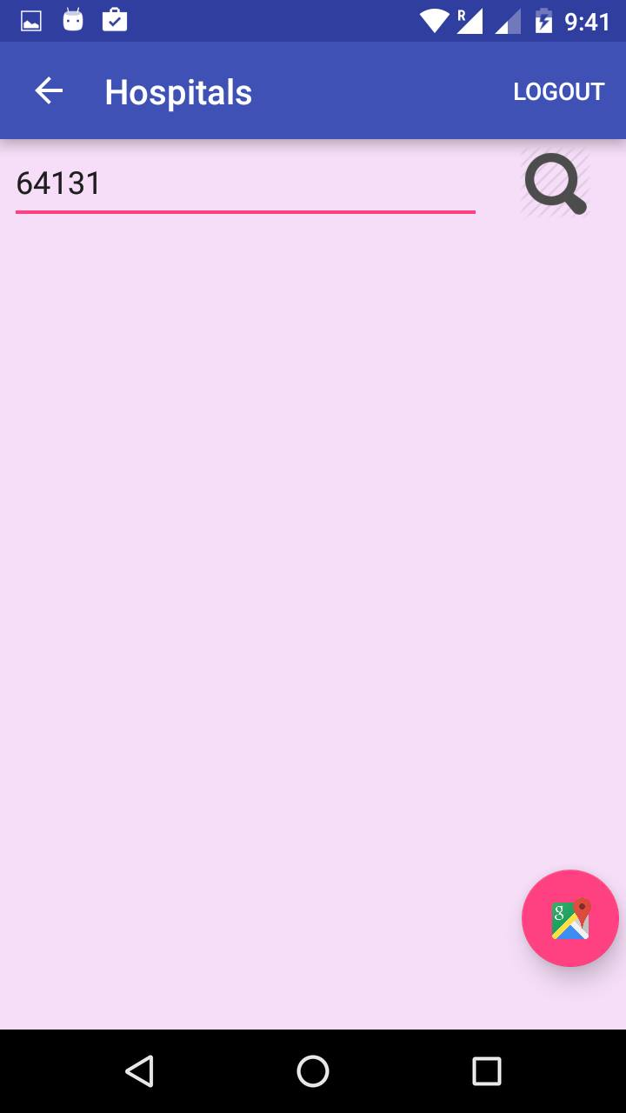
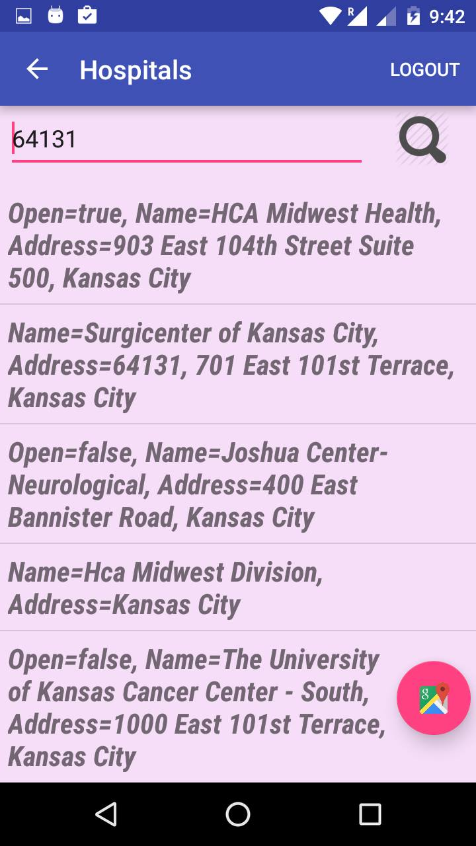
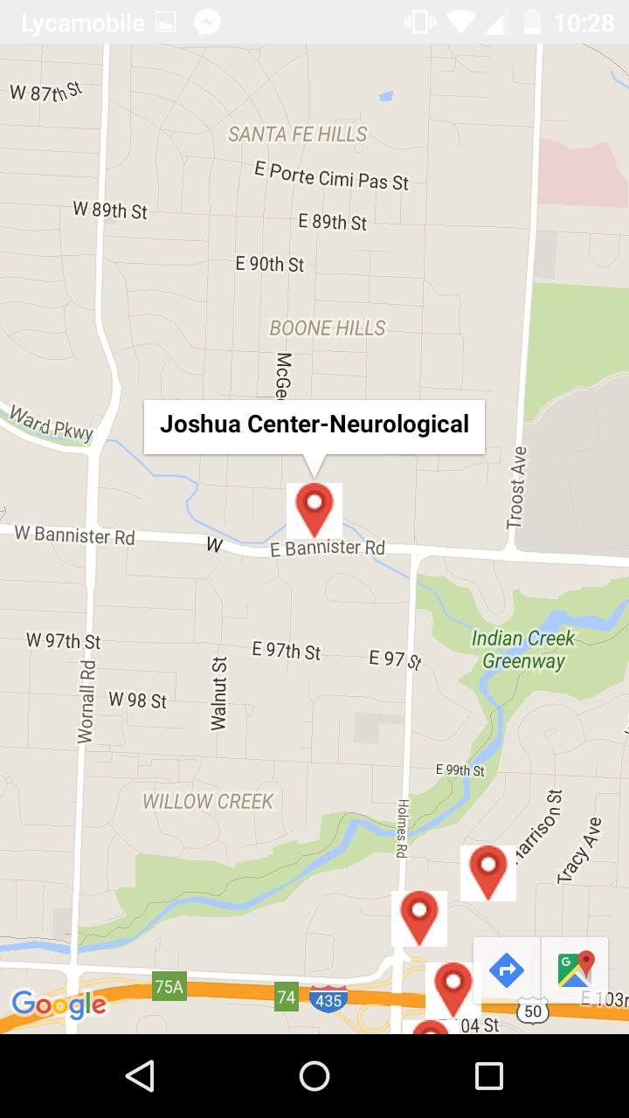
Screenshots Searching hospitals

Slide 9
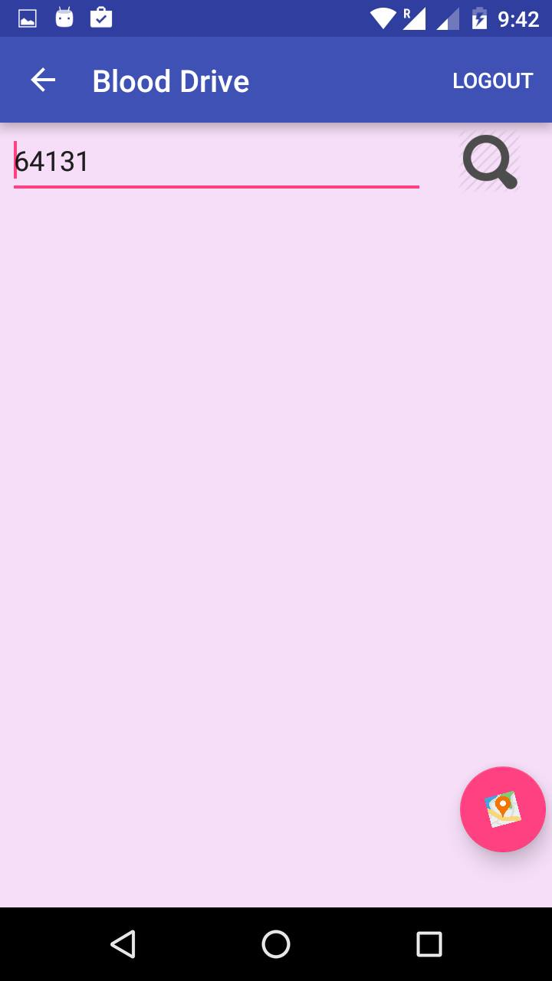
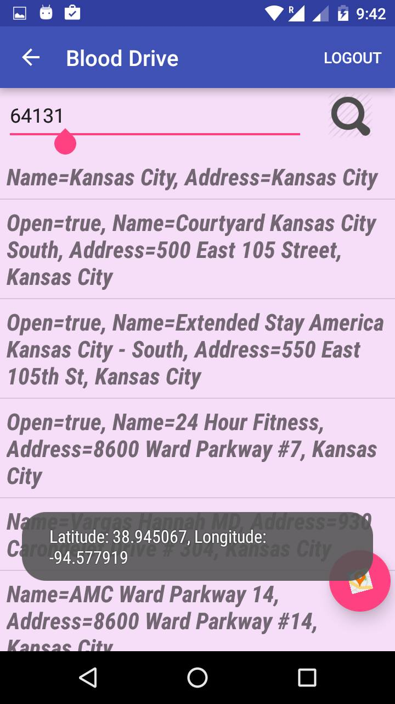
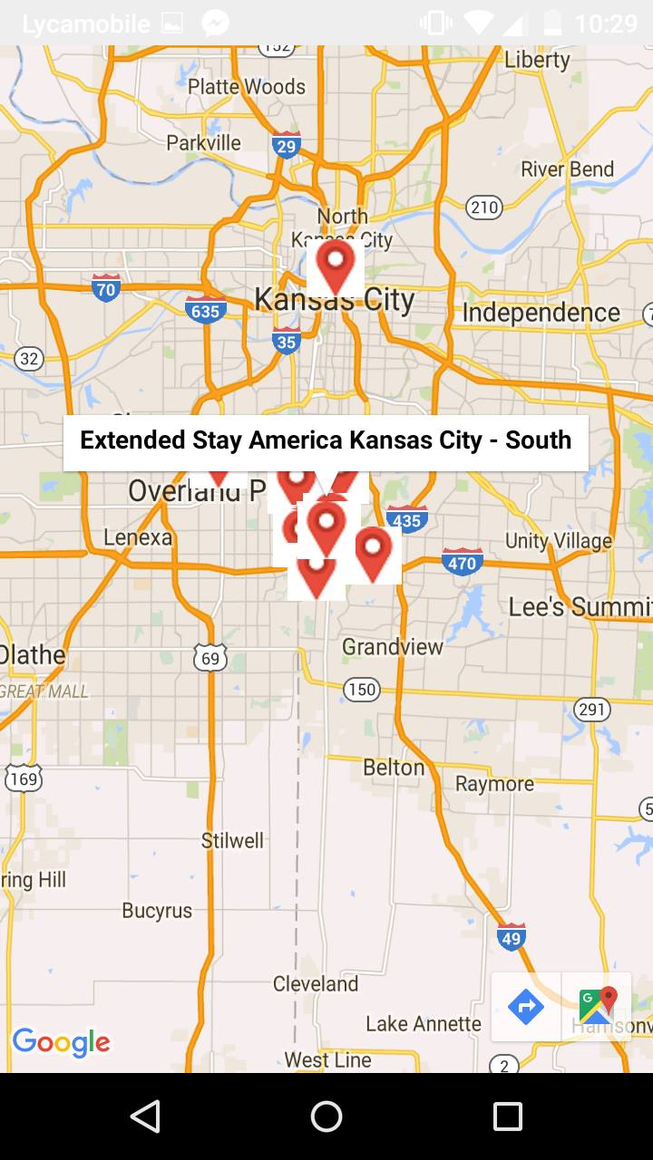
Screenshots Searching blood drives

Slide 10
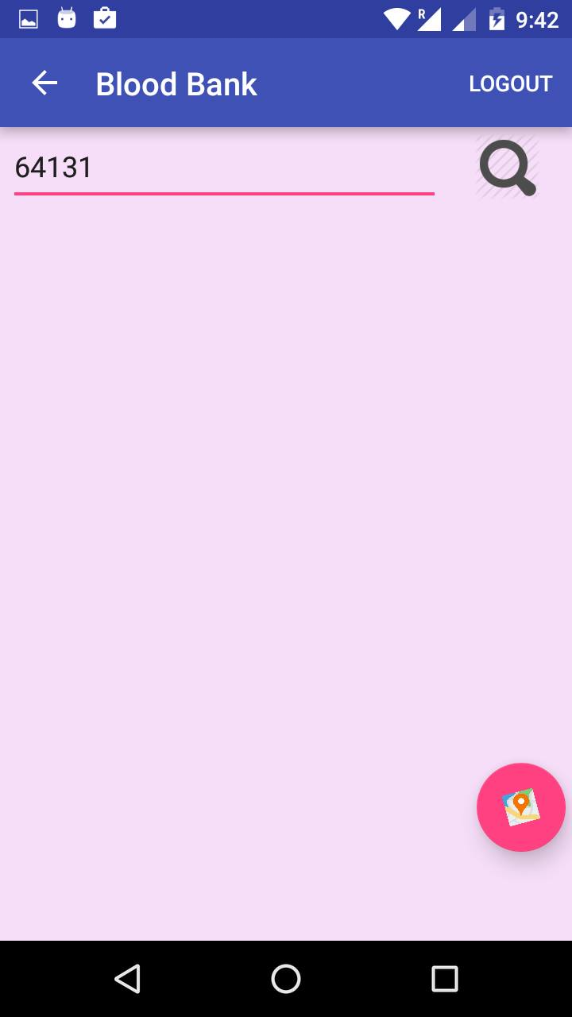
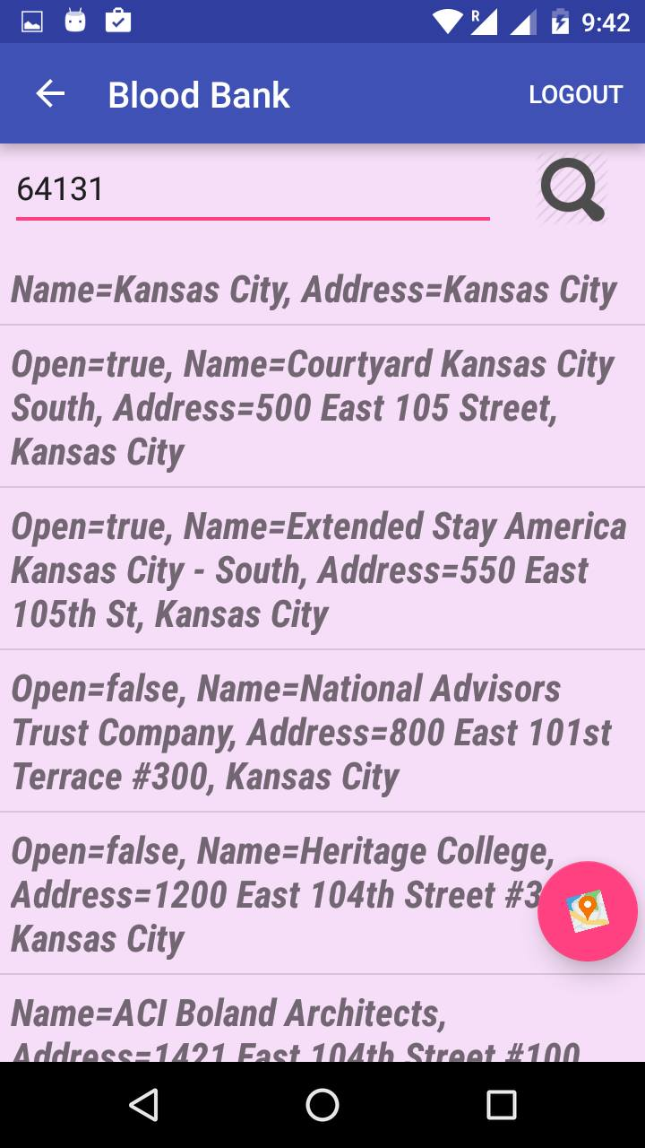
Screenshots Searching blood banks

Slide 11
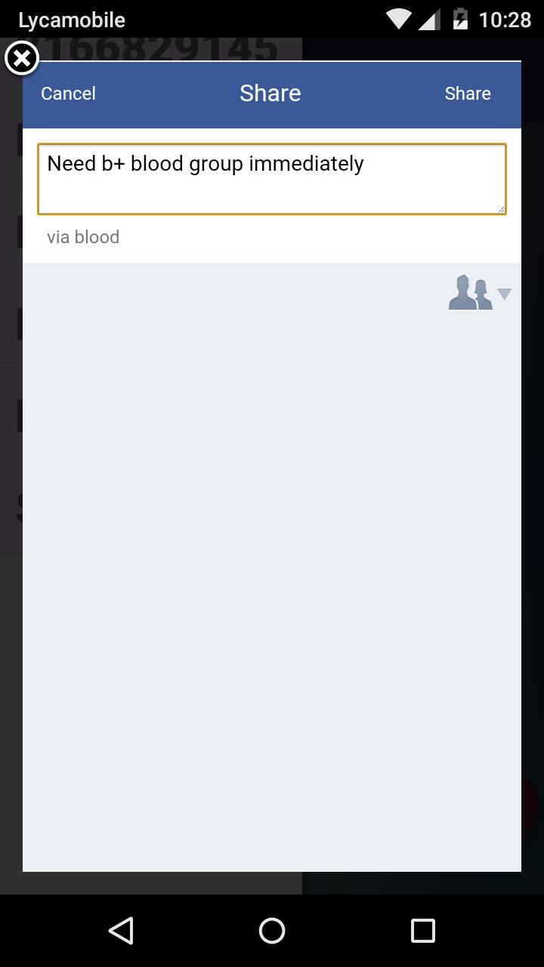
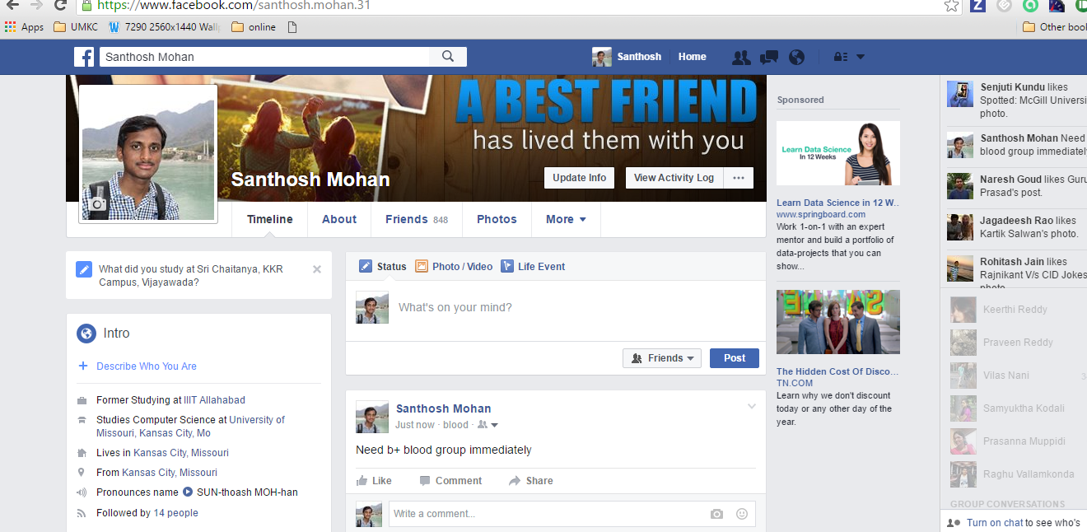

Share on FB

Slide 12


