Slide 1

Sales & Demand Forecasting System
DATA SCIENCE Project Review-2
Date& Time
Team Members Jawwad 2420030075 Pushpak 2420030107 Anudeep 2420030148
 | Under the Guidance of Assistant Professor, Department of Computer Science and Engineering, KLH CSE Bowrampet Campus

Slide 2
Problem Statement
The Problem
Retailers largely rely on manual spreadsheets or single-model tools that ignore data quality issues, seasonality, and anomalies, producing unreliable demand predictions.
There is no unified, end-to-end system that cleans data, detects anomalies, forecasts demand with multiple models, and explains results to non-technical stakeholders.
Real-World Relevance
Inaccurate demand forecasts directly cause overstocking (tied-up capital, waste) or stockouts (lost sales, poor customer experience) — a problem every retail and e-commerce business faces.
Reliable forecasting drives inventory planning, staffing, and promotional decisions across industries, making this a widely applicable, high-impact problem.
Motivation for Selecting the Problem
Working with real Walmart retail sales data lets us validate forecasting techniques against genuine business patterns rather than synthetic data.
We wanted to build a complete, practical pipeline — from raw messy data to an interactive decision-support dashboard — rather than a narrow, model-only exercise.

Slide 3
Objectives
Build an end-to-end sales & demand forecasting system that ingests raw CSV/Excel sales data and produces accurate, actionable forecasts.
Design a data cleaning and quality-scoring pipeline that detects missing values, duplicate records (via RapidFuzz), and invalid entries, and reports a measurable data quality score.
Implement anomaly detection to flag unusual sales spikes or drops before they distort model training.
Develop and compare ARIMA and Prophet forecasting models on real retail data (Walmart Sales Dataset), evaluating each with MAE, RMSE, and MAPE.
Automatically select the better-performing model per series and surface the reasoning behind that choice.
Build an interactive Streamlit dashboard presenting sales trends, data quality scores, detected anomalies, forecast results, and business insights in a clear, non-technical way.
Expected outcome: a working prototype validated on held-out sales data, with forecast error (MAPE) low enough to support real inventory planning decisions.

Slide 4
Literature Survey
Authors | Title of the Paper | Methodology | Inferences | Limitation/Future work
Taylor & Letham [1] | Forecasting at Scale (Prophet), The American Statistician, 2018 | Additive regression model combining trend, weekly/yearly seasonality, and holiday effects; designed for automatic fitting with minimal manual tuning | Performs well on business time series with strong seasonality and holiday effects; robust to missing data and outliers | Less effective on series with complex short-term autocorrelation; not as precise as ARIMA for tightly coupled dependencies
Box & Jenkins [2] | Time Series Analysis: Forecasting and Control (ARIMA methodology), classic reference | Autoregressive Integrated Moving Average modeling using differencing, ACF/PACF analysis, and maximum likelihood estimation | Strong performance on stationary, well-behaved series with clear autocorrelation patterns; well-established statistical foundation | Requires manual (p,d,q) parameter tuning; struggles with multiple seasonalities and irregular holiday effects common in retail data
Comparative Studies [3] | Benchmarking studies comparing ARIMA vs Prophet for retail/demand forecasting | Evaluate ARIMA, Prophet, and sometimes ML models on real retail sales datasets using MAE, RMSE, and MAPE | Prophet often outperforms ARIMA on series with strong seasonality and holidays; ARIMA can outperform on short, stable series — no single model wins universally | Most studies stop at model comparison and don't address upstream data quality, anomaly detection, or deployment as an interactive decision-support tool

Slide 5
Existing System & Gap Identification
Off-the-shelf forecasting notebooks apply ARIMA or Prophet individually, with no systematic side-by-side comparison or automatic model selection.
Public retail forecasting projects rarely include a real data-quality or duplicate-detection step, so results can look accurate on paper while trained on flawed data.
Anomaly detection, when present, is usually a separate, disconnected script rather than integrated into the forecasting workflow.
Most academic implementations stop at a Jupyter notebook, with no interactive dashboard business users can actually use to explore insights.
No existing open solution connects data cleaning, quality scoring, anomaly detection, dual-model forecasting, and an interactive dashboard into a single closed-loop system — this is the gap our project closes.

Slide 6
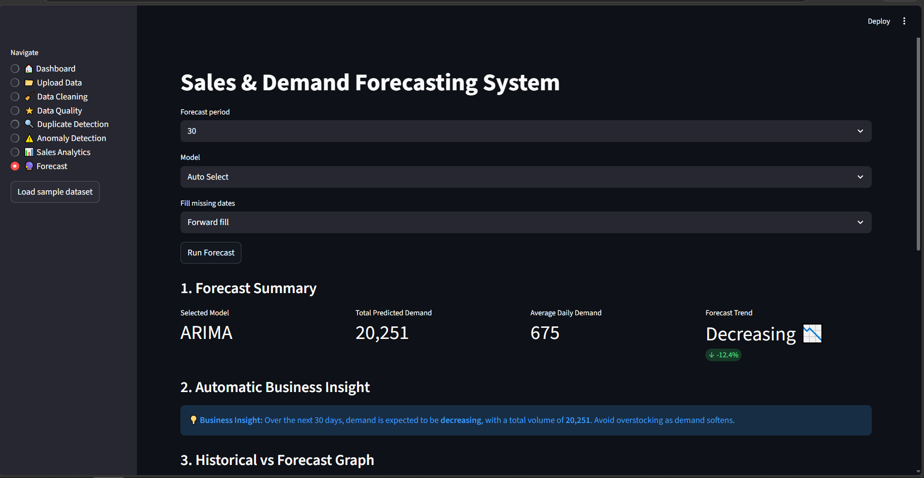
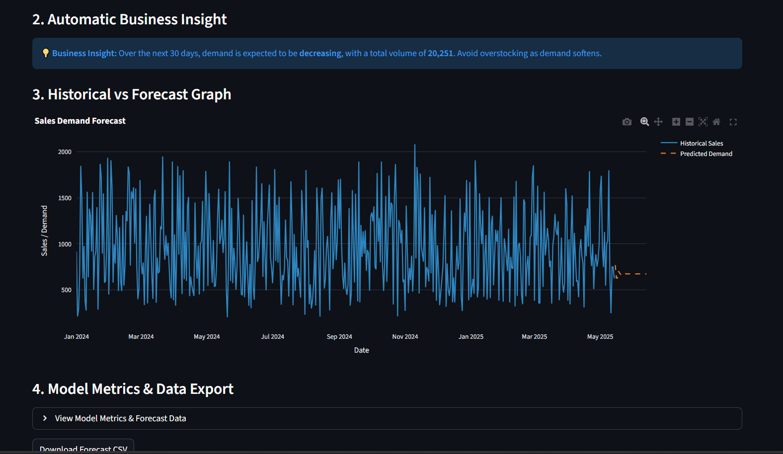
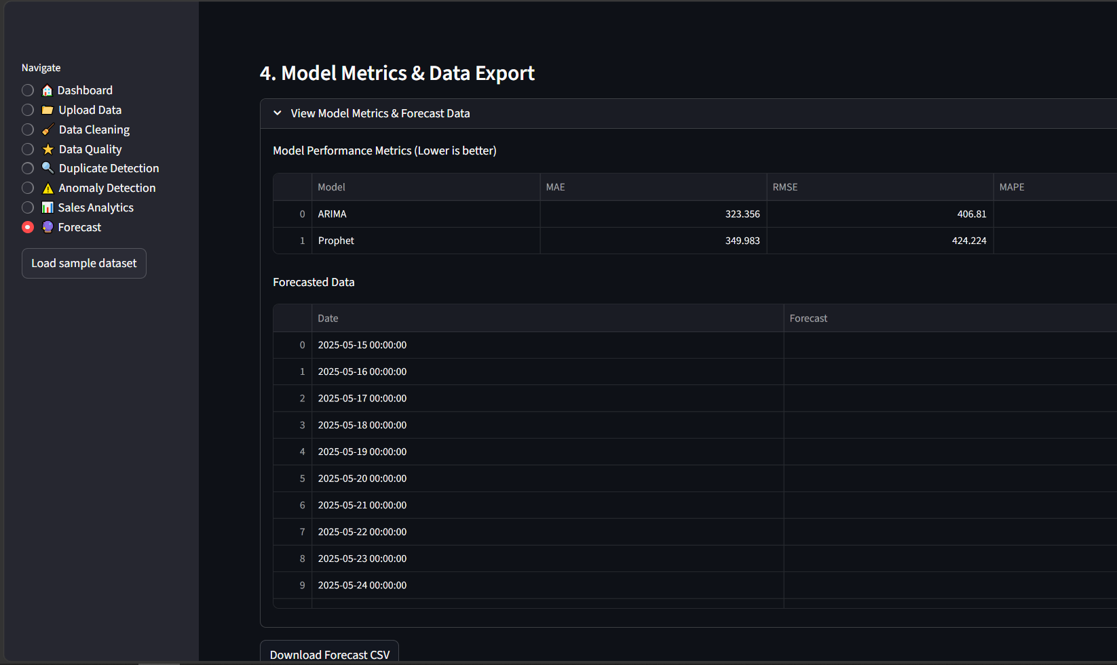
Output

