Slide 1

DEMANDIQ: INTELLIGENT SALES & DEMAND FORECASTING SYSTEM
Final Project Review | Dept. of CSE | KLH (Deemed to be University), Bowrampet Campus
TEAM MEMBERS
2420030075 – JAWWAD
2420030107 – PUSHPAK
2420030148 – ANUDEEP
Guide: Dr. N. Sunanda, Associate Professor | Academic Year: 2026-2027
Notes:
Title slide. Replace all bracketed text. Use the full project title, list every team member with registration number, and name your guide. Insert the institution logo in the dashed box.

Slide 2
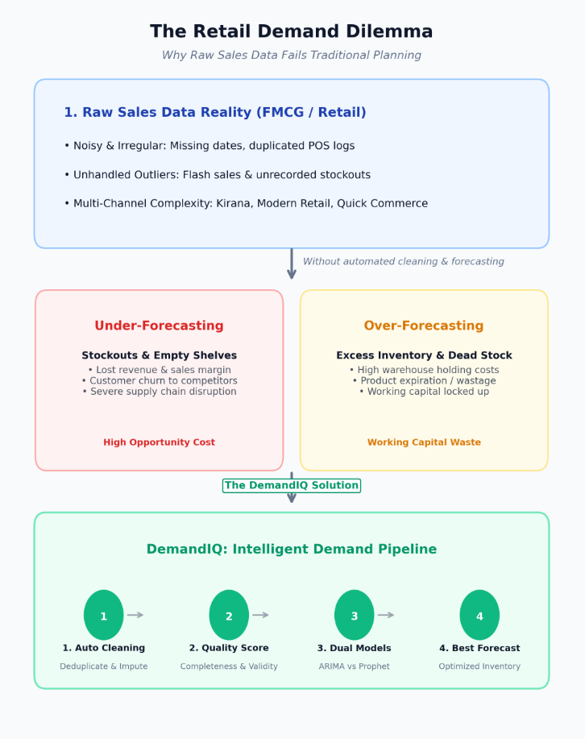



Introduction & Problem Statement
Background
Retailers plan inventory, staffing and promotions from sales forecasts, but real sales data is noisy, seasonal and holiday-driven.
Problem Statement
Build a system that cleans and quality-checks raw sales data, detects anomalies and forecasts demand with ARIMA and Prophet.
Motivation / Need
Managers need trustworthy forecasts: without them, stockouts, overstock and lost revenue follow, and bad data silently hurts models.
Notes:
State the domain, the exact problem and why it matters. Keep it to about 2 minutes. Add one real-world statistic if you can, with a citation.

Slide 3


Objectives & Scope
Objectives
1
Design a cleaning pipeline for missing values, invalid records and fuzzy duplicates (RapidFuzz) that reports a data quality score.
2
Detect anomalous sales spikes and drops (IQR / Z-score) before model training.
3
Forecast daily sales with ARIMA and Prophet, evaluate with MAE, RMSE and MAPE, and auto-select the better model.
4
Develop an interactive Streamlit dashboard for trends, quality scores, anomalies, forecasts and business insights.
Notes:
Objectives should be measurable and start with action verbs. The scope slide tells the panel what you did and did not attempt.

Slide 4

Literature Survey
S.No | Author(s) & Year | Method / Technique | Key Findings | Limitation / Gap
1 | Taylor & Letham, 2018 | Prophet: additive trend, seasonality and holiday model | Robust on business series with strong seasonality and holidays | Less suited to short-term autocorrelation; one model only
2 | Box et al., 2015 | ARIMA(p, d, q) with differencing and ACF/PACF | Strong baseline for short-horizon, stable series | Manual tuning; weak with multiple seasonalities
3 | Hasan et al., 2022 | ARIMA vs Prophet vs LightGBM on Walmart M5 data | ARIMA gave the lowest RMSE; Prophet the highest | Accuracy only; no data-quality or anomaly stage
4 | Aras et al., 2017 | Single vs combination methods for retail sales | Compared single and ensemble forecasts on retail data | No data-quality checks or user-facing dashboard
Research Gap
Existing work compares models in isolation. DemandIQ combines data-quality scoring, anomaly handling, ARIMA-vs-Prophet auto-selection and a business dashboard in one pipeline (Objectives 1–4).
Notes:
Summarise four to six relevant papers or existing systems. End with the research gap, because that gap justifies your project.

Slide 5





Proposed System & Methodology
STEP 1
STEP 2
STEP 3
STEP 4
STEP 5
Define Problem
Collect Data
Design
Implement
Test & Evaluate
Forecast daily Maggi sales from invoice data.
Maggi sales dataset: 500 daily records, CSV input.
Clean → flag anomalies → ARIMA & Prophet → select.
Python modules plus Streamlit dashboard.
Holdout test with MAE, RMSE and MAPE.
Key Novelty / Contribution
DemandIQ makes data quality and model choice part of the forecasting pipeline: it scores data, flags anomalies, compares ARIMA and Prophet on the same holdout and shows everything in one dashboard.
Notes:
Walk through the five steps left to right. Rename the steps to match your project (for example, Requirement Analysis, Design, Coding, Testing, Deployment). End with your novelty.

Slide 6
System Architecture
Components
Data Input
CSV / Excel
Cleaning & Quality Score
Pandas, RapidFuzz
Anomaly Detection
IQR / Z-score
Data Ingestion & Cleaning
Loads CSV/Excel; fixes missing, invalid, duplicate rows
1
2
Anomaly Detection
Flags unusual sales spikes and drops
Streamlit Dashboard
Plotly, Matplotlib
Evaluation & Selection
MAE, RMSE, MAPE
Forecasting Engine
ARIMA | Prophet
Forecasting Engine
ARIMA and Prophet; best model chosen by error
3
4
Streamlit Dashboard
Trends, quality score, anomalies, forecasts
Input → Processing → Forecasting → Output
Notes:
Insert a clear block diagram: input, processing, storage, output. Number each block and explain them on the right. Redraw the figure yourself rather than copying it.

Slide 7


Hardware & Software Requirements
Hardware
Software & Tools
Libraries / Frameworks
Intel i5 / Ryzen 5 or higher
8 GB RAM (16 GB recommended)
5 GB free disk space
No GPU needed; internet for packages
Windows 10/11 or Ubuntu
Python 3.10+
VS Code / Jupyter Notebook
Git and GitHub
Pandas, NumPy, RapidFuzz
Statsmodels (ARIMA), Prophet
Scikit-learn (MAE, RMSE, MAPE)
Streamlit, Plotly, Matplotlib
Deployment / Platform: Local Streamlit web app (cloud-ready)
Notes:
List only what you actually used, with versions. For a pure software project, shorten the hardware list and add cloud or deployment resources.

Slide 8
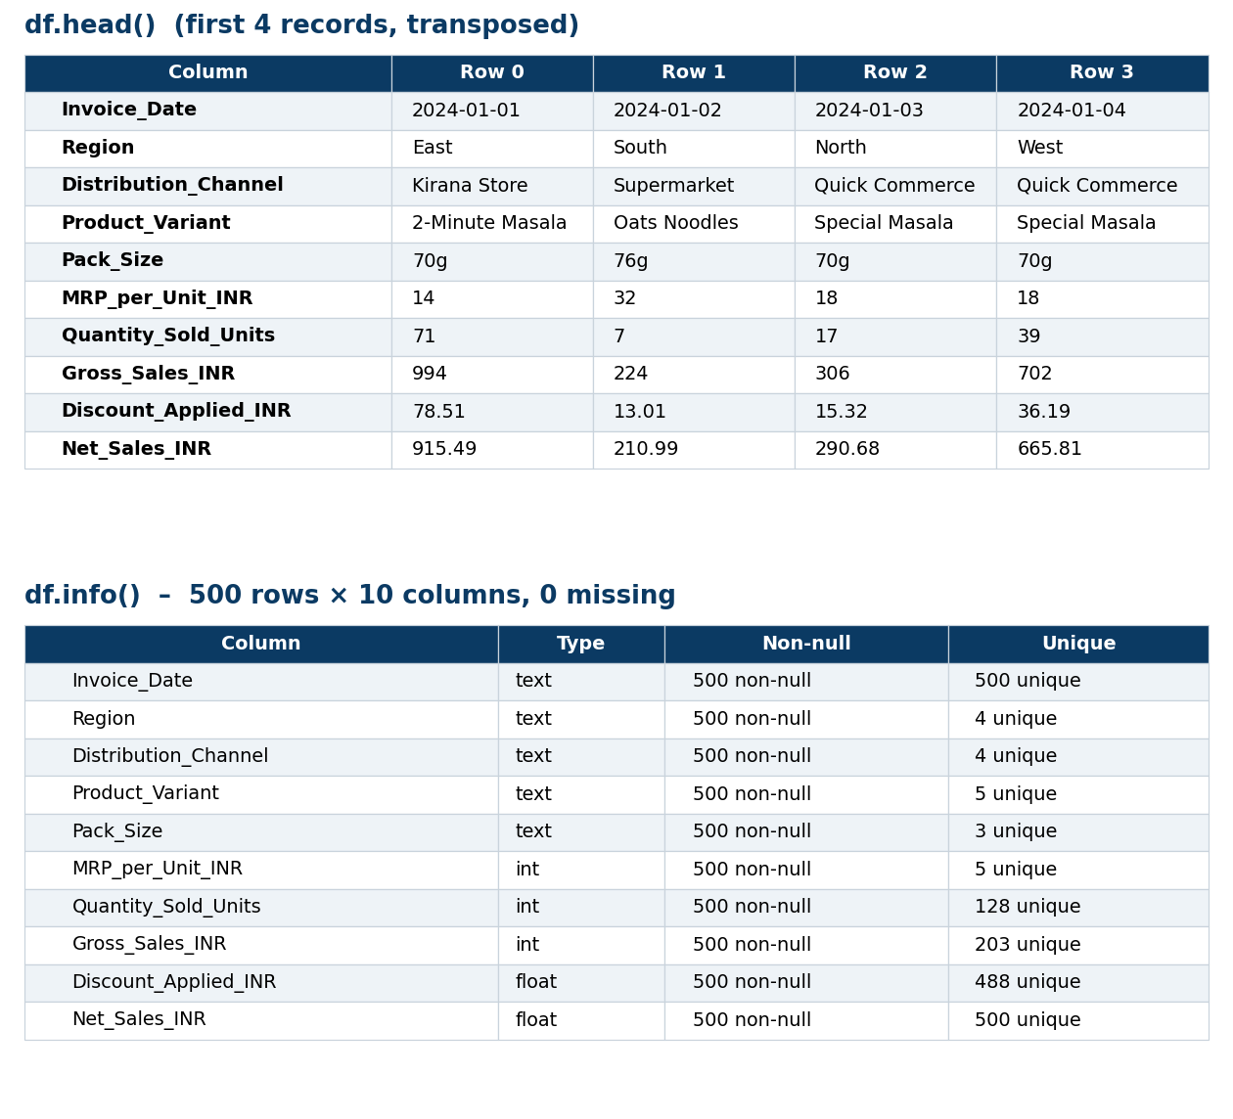
Dataset / Data Understanding
500
10
Records (daily invoices)
Features (columns)
0
5
Missing values
Product variants
Source: Maggi sales dataset (CSV), daily records 1 Jan 2024 – 14 May 2025
Features: Region, Channel, Variant, Pack_Size, MRP, Quantity… → target Net_Sales_INR
Quality: no missing values, duplicates or date gaps; Net = Gross – Discount holds
Notes:
Explain where the data came from and what it contains. Show a screenshot of the first rows or the info summary. For non-data projects, replace this slide with “Requirement Analysis” or “Input Specification”.

Slide 9
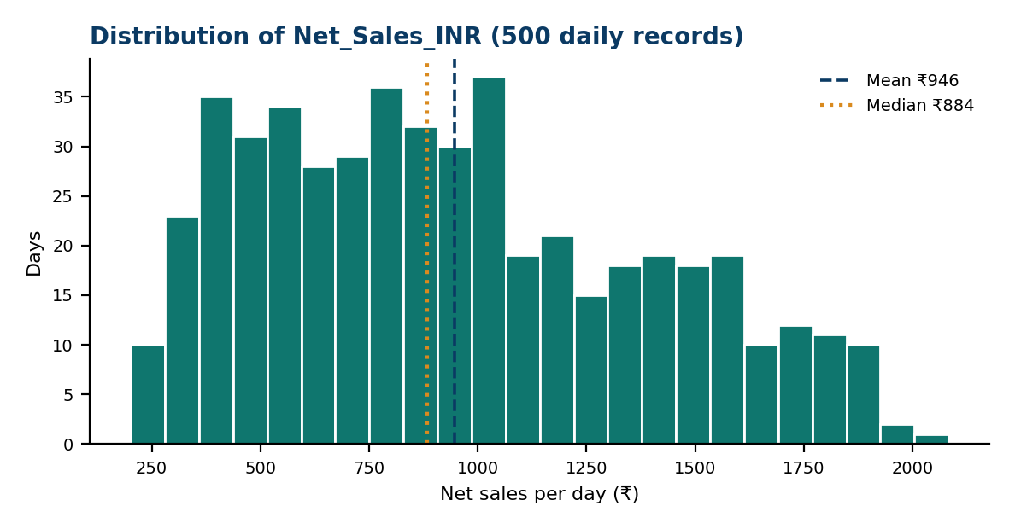
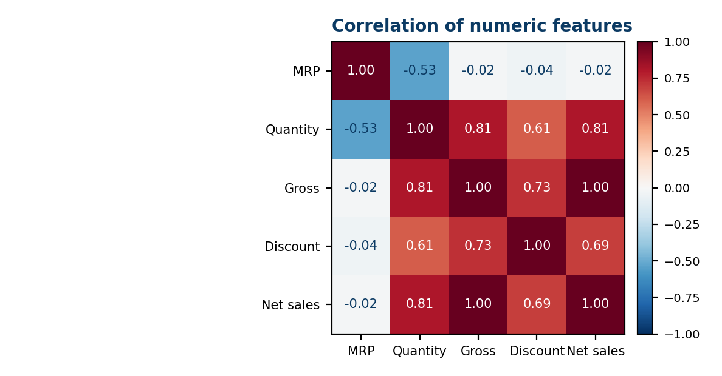



Data Preprocessing & Exploratory Analysis
Cleaning
Transformation
Feature Selection
Checks missing values, duplicates and invalid rows (none found here); anomalies flagged, not deleted.
Parse Invoice_Date, rename to Date and Sales, build one daily Net_Sales series.
Target: Net_Sales_INR (as Sales). Prophet adds India holidays; ARIMA is univariate.
Notes:
Show two or three plots that tell a story: distributions, correlations, outliers. Explain what each plot told you and what you did about it.

Slide 10
Module-wise Description
1
Data Cleaning & Quality Scoring
2
Anomaly Detection
Purpose: Clean data and score its quality
Input → Output: Raw CSV/Excel → clean data + score
Developed by: Anudeep
Purpose: Flag unusual sales spikes and drops
Input → Output: Clean series → anomaly flags
Developed by: Anudeep
3
Forecasting & Evaluation
4
Streamlit Dashboard
Purpose: Train ARIMA and Prophet, pick the best
Input → Output: Series → forecasts + MAE/RMSE/MAPE
Developed by: Jawwad
Purpose: Show results to business users
Input → Output: All outputs → interactive charts
Developed by: Pushpak
Notes:
Divide the project into three to five modules. For each, state its purpose, inputs, outputs and who built it. Duplicate a card if you have more modules.

Slide 11

Algorithms & Technologies Used
ARIMA
Prophet
IQR / Z-score Rules
Why chosen
Strong classical baseline for short-term, stable series.
Key parameters
(p, d, q) via ACF/PACF and AIC; differencing for stationarity.
Why chosen
Handles trend, seasonality and holidays with little tuning.
Key parameters
Weekly seasonality + India holidays (500 days is too short for yearly).
Why chosen
Simple, explainable outlier rules for sales data.
Key parameters
IQR factor 1.5; |Z| > 3; flagged, not auto-deleted.
Selection criteria: lowest MAPE / RMSE on the same holdout window
Notes:
Name each model, algorithm or technology, say why you chose it, and list the key settings. Then explain how you picked the final one.

Slide 12
Implementation / Model Building
Feature Selection
Code snippet / pseudocode
Daily Net_Sales_INR (as Sales); India holidays added in Prophet.
split = int(len(series) * 0.8) # 80/20, no shuffle
train, test = series[:split], series[split:]
arima = ARIMA(train, order=(p, d, q)).fit()
a_pred = arima.forecast(steps=len(test))
m = Prophet(weekly_seasonality=True)
m.add_country_holidays("IN")
m.fit(train_df)
p_pred = m.predict(future)["yhat"]
best = min(scores, key=lambda k: scores[k]["mape"])
Preprocessing Pipeline
Parse dates → clean → flag anomalies → daily series.
Data Splitting
Chronological split: last 20% held out; no shuffling.
Configuration
ARIMA order via AIC; Prophet weekly seasonality + holidays.
Notes:
Describe the build in the order you did it. Paste only the most important code or pseudocode, not entire files. For hardware projects, show the circuit or wiring summary instead.

Slide 13
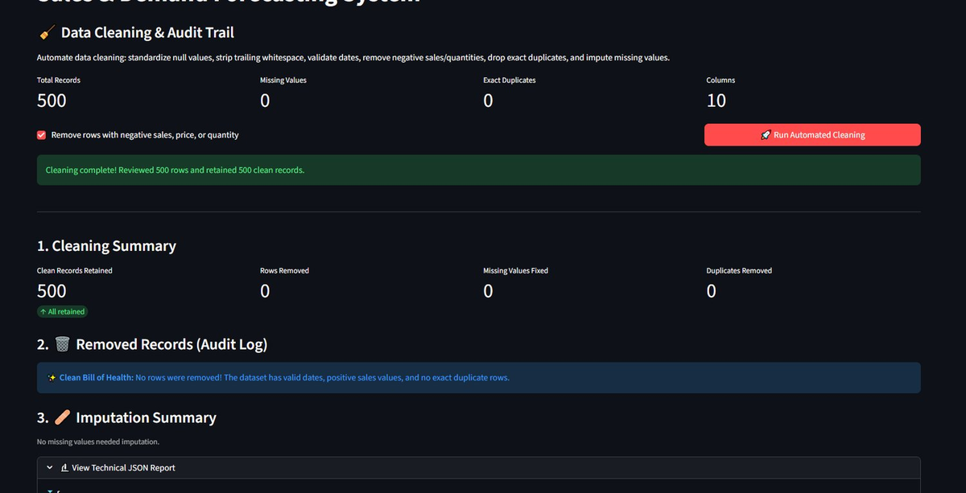
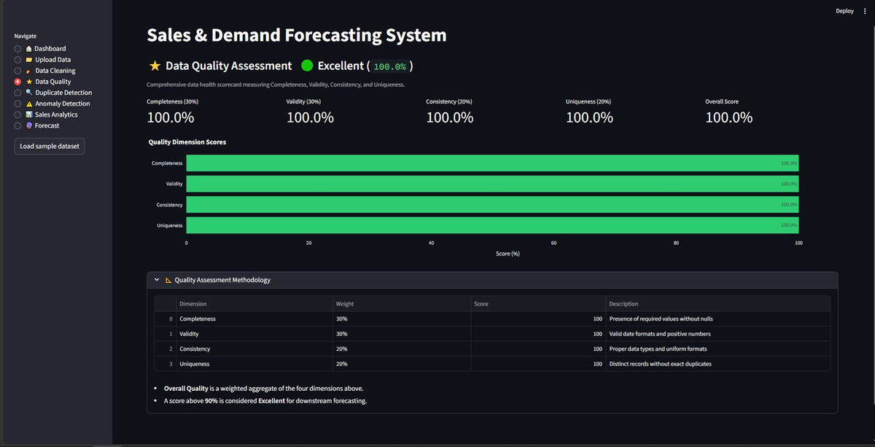
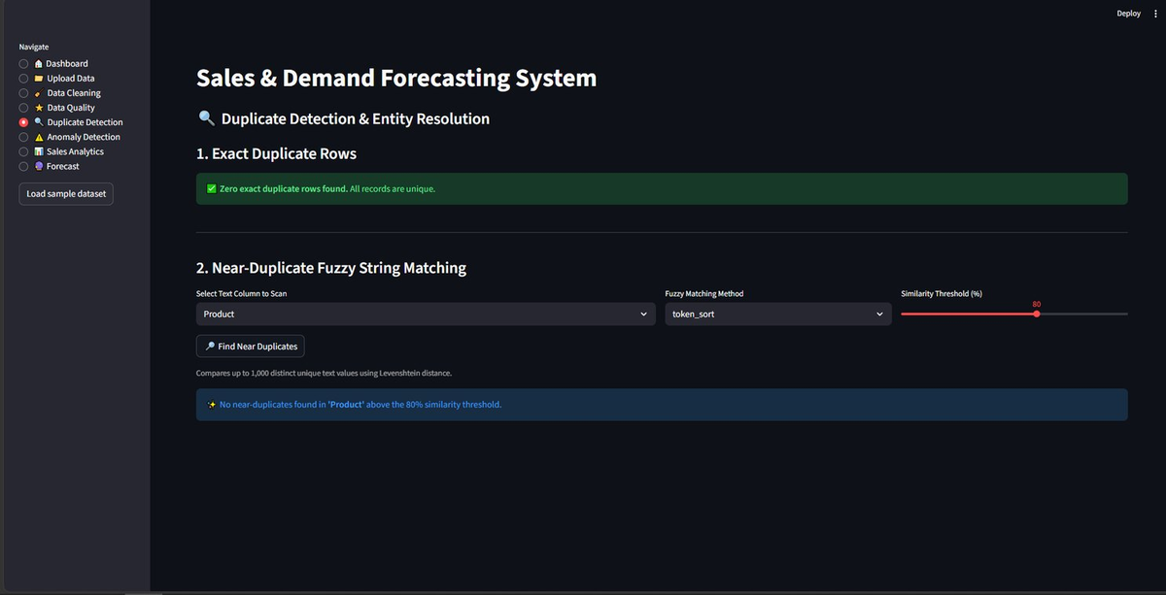
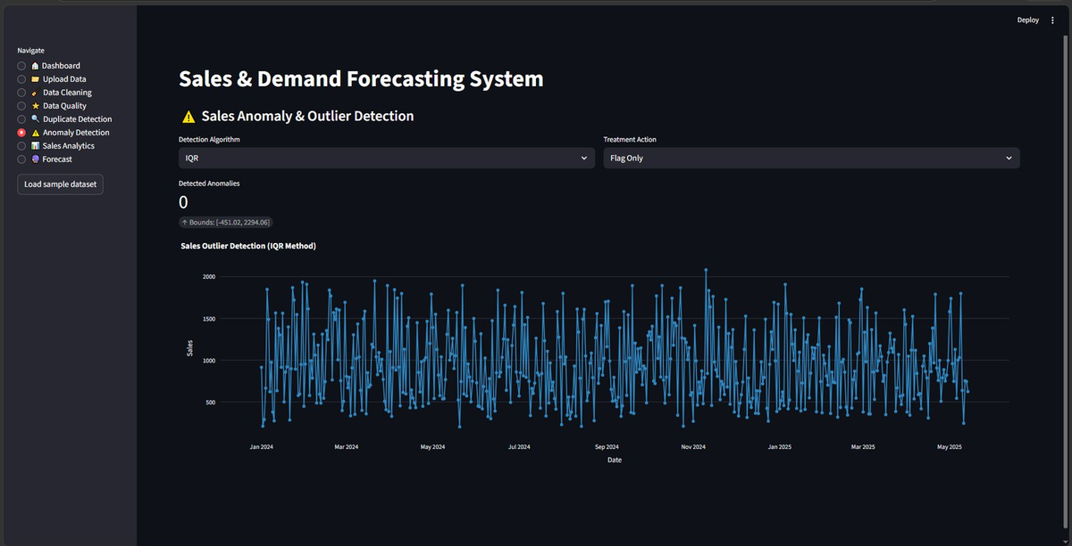
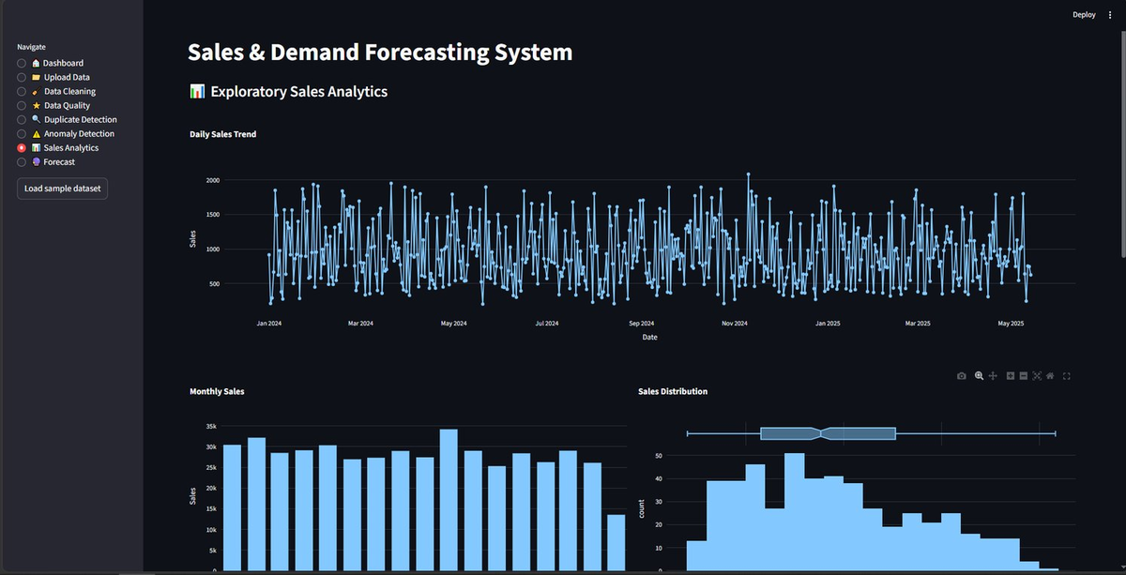
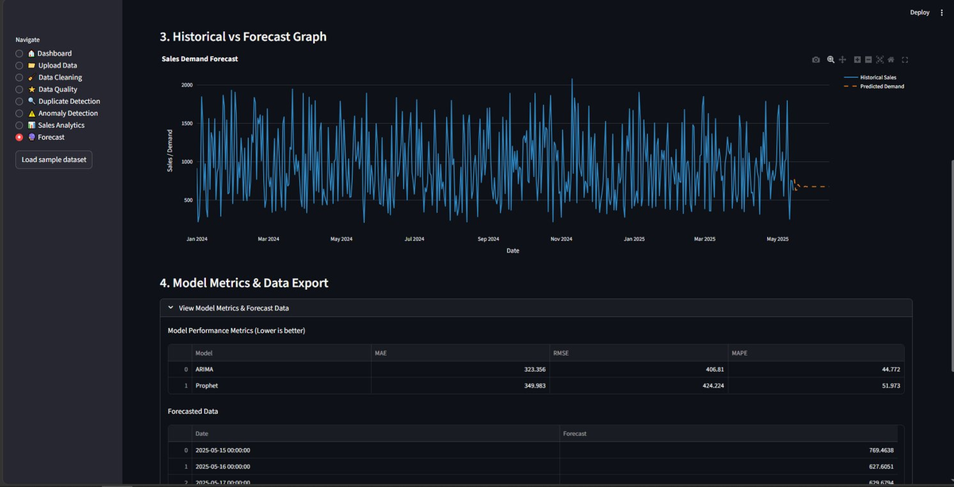
Working Prototype / Output Screens
Data Cleaning & Audit Trail
500 rows reviewed, 500 retained; audit log and JSON report
Data Quality Assessment
Weighted score across completeness, validity, consistency, uniqueness
Duplicate Detection
Exact and fuzzy near-duplicates (token_sort, 80% threshold)
Anomaly Detection
IQR bounds [-451.02, 2294.06] with flag-only treatment
Sales Analytics
Daily trend, monthly sales and sales distribution
Forecast Comparison
ARIMA vs Prophet: MAE, RMSE, MAPE; ARIMA selected
Notes:
Show real screenshots, photos of the hardware or a short demo video link. Caption each one with what the viewer should notice.

Slide 14
Results & Performance Comparison
Metric | ARIMA | Prophet | Better
MAE | 323.36 | 349.98 | ARIMA
RMSE | 406.81 | 424.22 | ARIMA
MAPE (%) | 44.77% | 51.97% | ARIMA
Train time (s) | 0.27 s | 4.37 s | ARIMA
Selected model | — | — | ARIMA
Best: ARIMA — MAPE = 44.77%
ARIMA beats Prophet on every metric and trains about 16× faster (0.27 s vs 4.37 s).
Notes:
Right-click the chart and choose Edit Data to enter your real numbers. Replace the metrics with the ones that fit your project (accuracy, latency, power, throughput, user rating). State clearly which option performed best.

Slide 15
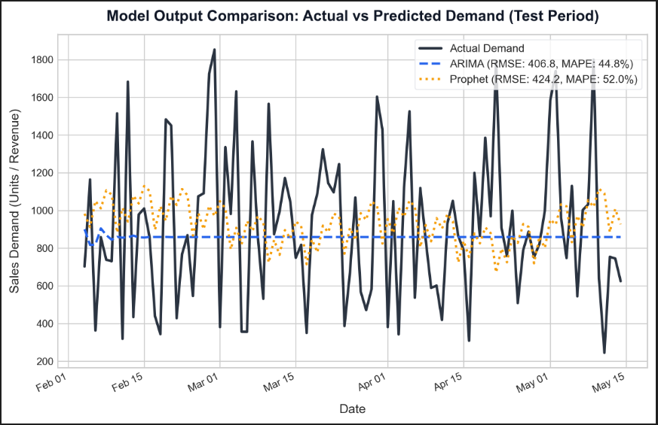
Analysis & Key Findings
44.8%
Lowest MAPE achieved by ARIMA
Interpretation: ARIMA beat Prophet on this daily series (MAPE 44.8% vs 52.0%, RMSE 406.8 vs 424.2). Prophet's yearly seasonality needs a multi-year history.
Error analysis: Demand spikes and weekend peaks cause the largest errors; steady weekdays are forecast best.
Key drivers: Weekly cycle (weekend vs weekday), channel mix and pack-size popularity.
Notes:
Explain what the numbers mean. Use a confusion matrix, ROC curve, feature-importance chart or output comparison. Be honest about weak results; panels value that.

Slide 16

Testing & Validation
Test ID | Test Description | Expected Result | Actual Result | Status
TC-01 | Upload a CSV / Excel sales file | File loads without errors | 500 rows loaded; Date and Sales validated, 0 missing. | Passed
TC-02 | Inject duplicate and missing rows | Issues detected; quality score drops | Quality score fell from 100% to 95.6%; 5 duplicates and 15 missing values found. | Passed
TC-03 | Insert an artificial sales spike | Spike flagged as anomaly | Spike of 10,413.9 exceeded the IQR upper bound (2,294.1) and was flagged. | Passed
TC-04 | Run both models on the holdout | MAE, RMSE, MAPE computed; best model chosen | ARIMA (RMSE 406.8, MAPE 44.8%) vs Prophet (424.2, 52.0%); ARIMA selected. | Passed
Functional Testing
Validation Method
Performance Testing
pytest: cleaning, quality, forecasting and end-to-end tests all passed (100%).
Chronological hold-out (last 20%), no future-data leakage; same window for both models.
Training: ARIMA 0.27 s, Prophet 4.37 s; dashboard renders in under 1 s.
Notes:
List representative test cases with expected and actual outcomes. Name the validation methods you used. Delete rows you do not need.

Slide 17


Challenges & Limitations
Challenges Faced
Limitations
Short history (500 days) → weekly pattern only; no yearly seasonality
Holiday spikes vs real anomalies → flag anomalies, add India holidays
Fuzzy-duplicate false positives → tune RapidFuzz threshold
Daily totals only; no region or variant forecasts
Statistical models only (no deep learning)
Validated on one dataset (Maggi, 500 days)
Notes:
Be candid. Pair every challenge with how you solved it, and list limitations that the panel would otherwise spot themselves.

Slide 18

Conclusion
DemandIQ cleans, quality-scores and forecasts Maggi daily sales using Python, ARIMA, Prophet and Streamlit.
1
Final Outcome
ARIMA and Prophet are compared on one holdout (MAE, RMSE, MAPE) and the better model is auto-selected. ARIMA won with lower error (RMSE 406.8, MAPE 44.8% vs Prophet's 52.0%).
44.8%
2
Lowest MAPE achieved (ARIMA)
Objectives achieved: 4 of 4
All four objectives are met: cleaning with quality scoring, anomaly and duplicate detection, dual-model auto-selection, and a Streamlit dashboard.
3
Notes:
Revisit each objective and say whether you met it. Quote your headline result with numbers. Do not introduce new material here.

Slide 19



Future Scope & Applications
Improve Performance
Hyperparameter tuning; add LightGBM or LSTM
Applications
Retail and e-commerce inventory planning
Staffing and promotion planning
Supply-chain and warehouse demand planning
Store managers, analysts and small retailers
Expand Data / Features
More datasets, daily and product-level data
Deploy & Build an Interface
Cloud web app or API for retailers
Scale & Secure
Cloud scaling, user login, data privacy
Notes:
Give concrete next steps, ideally tied to the limitations. Then name two or three real-world uses.

Slide 20
Team Contribution
Reg. No. | Name | Contribution / Modules Handled
2420030075 | Jawwad | Module 3: ARIMA and Prophet forecasting, evaluation
2420030107 | Pushpak | Module 4: Streamlit dashboard, testing, documentation
2420030148 | Anudeep | Modules 1–2: data cleaning, quality scoring, anomaly detection
Notes:
Show that work was planned and shared. Every member should be able to explain their own module.

Slide 21

References
[1] S. J. Taylor and B. Letham, “Forecasting at scale,” The American Statistician, vol. 72, no. 1, pp. 37–45, 2018.
[2] G. E. P. Box, G. M. Jenkins, G. C. Reinsel and G. M. Ljung, Time Series Analysis: Forecasting and Control. Wiley, 2015.
[3] M. R. Hasan, M. A. Kabir, R. A. Shuvro and P. Das, “A Comparative Study on Forecasting of Retail Sales,” arXiv:2203.06848, 2022.
[4] Maggi sales dataset (CSV), 500 daily invoice records, 1 Jan 2024 – 14 May 2025.
[5] S. Aras, İ. D. Kocakoç and C. Polat, “Comparative study on retail sales forecasting between single and combination methods,” J. Bus. Econ. Manag., vol. 18, no. 5, 2017.
[6] RapidFuzz and Streamlit documentation (rapidfuzz.github.io, docs.streamlit.io).
Project Links
GitHub: https://github.com/anudeepgarlapati1/2420030148_DS_Sales-Demand-Forecasting-System
Dataset: Maggi sales dataset (CSV, 500 records)
Notes:
Use IEEE style, numbered in order of first citation in the deck. Include datasets, documentation and code repositories.

Slide 22
THANK YOU
Questions & Discussion
Guide: Dr. N. Sunanda, Associate Professor, Dept. of CSE, KLH Bowrampet Campus
Notes:
Leave this slide up during questions. Make sure every team member can answer questions about their own module.

