Slide 1

NEIGHBUYR

Slide 2
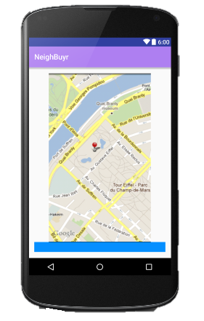
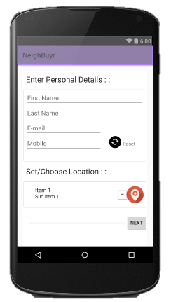
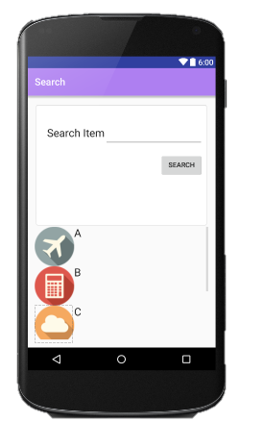
NeighBuyr

Slide 3
OBJECTIVES:
Providing the customer with the closest shop/stall to choose from, in his vicinity.
The customer gets to choose from shops he is familiar with and the shops he can trust.
Providing with services so that the customer gets to select individual items from different shops.
The customer can compare the prices of the items they need between the shops of their likes.
To provide the customer with accumulative bill, so that he/she is free to choose from different shops at the same time.

Slide 4
Product:
NeighBuyr is an android application that provides online shoppers to compare and choose from within items indifferent of the fact which shop they are buying from.
Users looking for a particular item, will have to provide with their details and location using an interactive UI.
And then press search. The search will provide the items from shops in their vicinity and their costs.
The app will also provide ongoing deals, trends and latest offers.
Users will select items in their carts from different shops and checkout to pay a single accumulated bill.

Slide 5
Target Audience:
This app targets audience of all age, specially people who refrain from buying goods online from unknown vendors.
Geographical location : It initially targets audience from big cities where people are too busy to go and buy stuff in the local neighbourhood and hence the name NeighBuyr.
Feasibility : On the basis of needs of an individual and trust of the local shopkeepers the app will provide to all.

Slide 6
THANK YOU

