Slide 1
UMD Baseball Data Analysis
Team O6

Slide 2




Meet our Team
Dhruvin Shah Nilay Somani Shashank Bisht Anudeep Koneru

Slide 3
MISSION STATEMENTS
Load the statistics of matches from Games and Years worksheets.
To identify and generate key features that have a significant impact on game outcomes, enhancing the predictive accuracy for the 2024 season.
To forecast the outcomes of games in the 2024 season using the developed predictive models.
To assess the performance of the predictive models through clear and insightful visualizations.
To predict results of the baseball games for 2024 and evaluate the performance of the model by comparing the model prediction with actual results of games played YTD.

Slide 4
OBJECTIVES
1) Based on the features provided in the dataset, can we assess the trends of overall win, loss, and draw outcomes over the years compared to the win, loss, and draw outcomes in conference games for the UMTerps Baseball Team?
2) Based on the features provided in the dataset, where and when do we observe variations in win-loss-draw percentages by year across home, away, and neutral venues for UMTerps?
3) Based on the features provided in the dataset, where and when have the University of Maryland Terrapins Baseball team demonstrated the highest win percentages at each location?
4) Based on the features provided in the dataset, we analyze the highest win percentages against each opponent?
5) Based on the features provided in the dataset, can we utilize linear regression modeling to predict game results for the 2024 season?
6) Based on the features provided in the dataset, can we utilize Logistic regression modeling to predict game results for the 2024 season?

Slide 5
METHODS
For data visualization we used Numpy, Pandas,Matplotlib, and Seaborn
We used scikit- learn, Logistic regression, Linear regression for building different models.
Data preprocessing methods - For identifying and improving features required for the model performance.

Slide 6
PROCESSING STEPS
- Data Cleaning:
- We conducted thorough data cleaning to ensure data integrity and consistency, removing any inconsistencies or inaccuracies.
- Data Transformation:
- The `df_year` data frame was transformed into multiple columns to enhance analytical capabilities, enabling more granular insights into trends and patterns.
- Feature Engineering:
- We augmented the `df_game` dataframe by adding four new columns strategically designed to improve the accuracy of our regression model. These additions aim to enhance predictive capabilities when testing against real results for the UMTerps Baseball Team in 2024.
- 2024 Data Processing:
- The data for the 2024 season was collected, processed and seamlessly integrated into our analysis pipeline. This step is crucial as it allows us to evaluate the performance of our linear regression model against real-world data, providing a robust validation framework.

Slide 7
ANALYSIS
In the upcoming slides, we will cover in-depth analysis of the generated outputs which are a variety of graphs aligned with our predefined objectives.

Slide 8
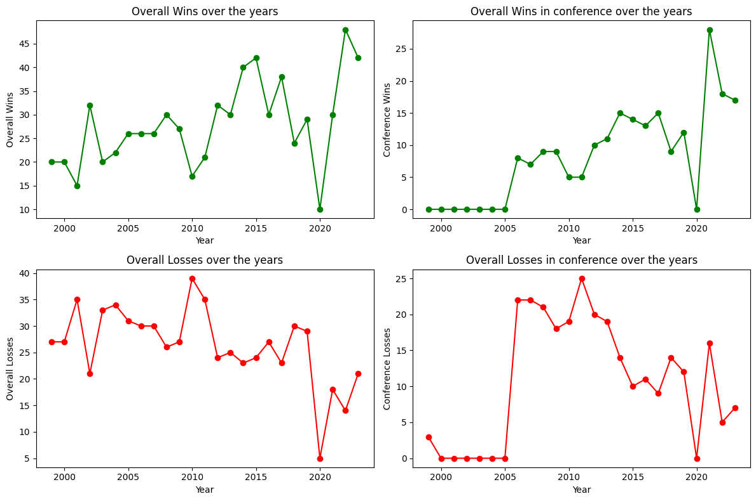
REPORTS
MISSION OBJECTIVE 1
The analysis of overall wins and losses, both across all matches and conference games, reveals noticeable upward trends with significant year-to-year variations. Conversely, losses display a downward trend but exhibit similar fluctuations. The year 2020 stands out with a major dip in all metrics, likely due to reduced game activity amid the COVID-19 pandemic. These trends highlight the dynamic nature of team performance and underscore the need for deeper analysis to understand the factors driving fluctuations. Insights gleaned could inform strategic planning and enhance performance consistency in future seasons.

Slide 9
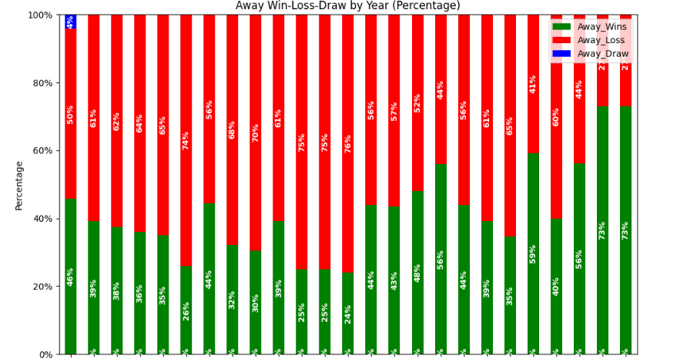
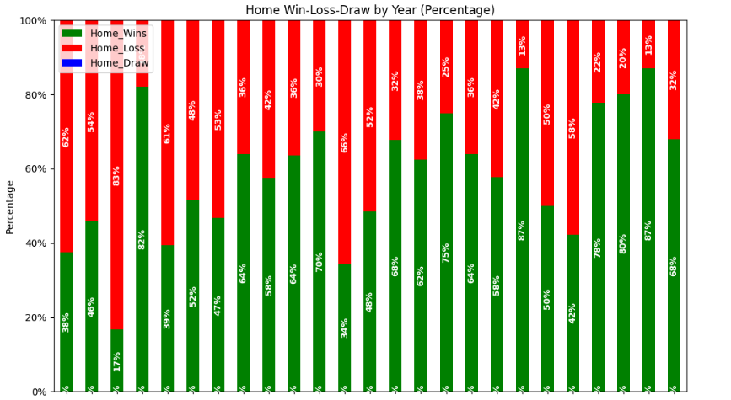
REPORTS
MISSION OBJECTIVE 2
On this slide, we present a 100% stacked column chart visualizing the performance of the UMTerps Baseball Team across different match venues, in alignment with our mission to assess venue-specific factors influencing game outcomes. The graph illustrates a clear distinction in performance between home and away matches. Notably, the data indicates that UMTerps tends to lose more matches when playing away from home, while experiencing a higher frequency of wins in home games. This disparity underscores the significant impact of venue on the team's overall performance. Understanding these venue-specific trends is crucial for our objective of enhancing predictive accuracy for the 2024 season, as it enables us to incorporate venue-related insights into our analysis and strategic planning efforts.

Slide 10
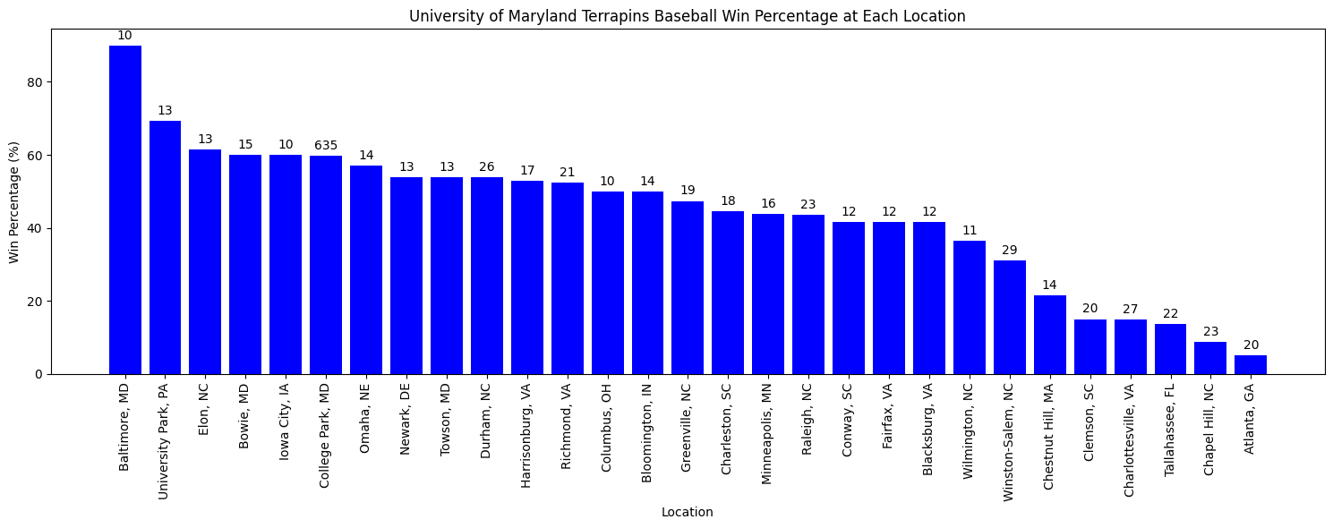
REPORTS
MISSION OBJECTIVE 3
Analysis of match location versus win percentage indicates Baltimore, Maryland, as the venue with the highest win rate for the University of Maryland. Matches against Maryland-based teams show increased success. These findings stress the impact of geography on team performance and inform strategic planning.

Slide 11
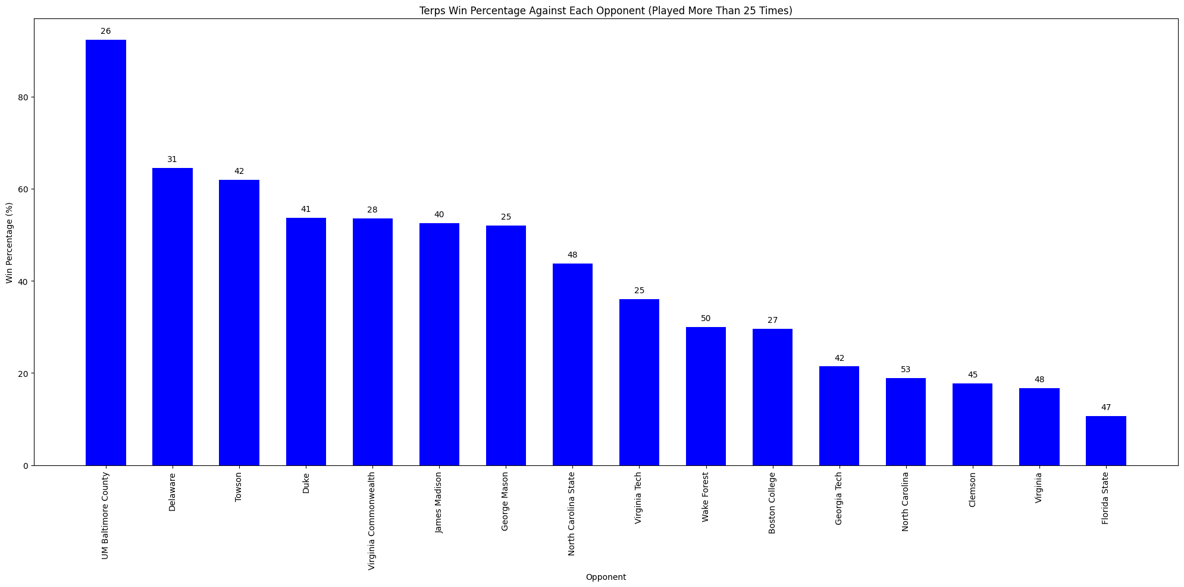
REPORTS
MISSION OBJECTIVE 4
The analysis of win percentage against opponents, considering those faced more than 25 times, reveals a significant trend. Notably, the University of Maryland Terrapins Baseball team has achieved its highest win rate against the University of Maryland, Baltimore County (UMBC), with an impressive 92% win rate. This finding underscores UMD's dominance over UMBC

Slide 12
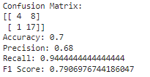
REPORTS
MISSION OBJECTIVE 5
Overall, our linear regression model demonstrates promising performance in predicting game outcomes for the 2024 season. With an accuracy of 0.7 and detailed insights from the confusion matrix, precision, recall, and F-score analysis, we have confidence in the reliability and effectiveness of our model. These results provide valuable insights for strategic decision-making and performance optimization in future seasons.

Slide 13
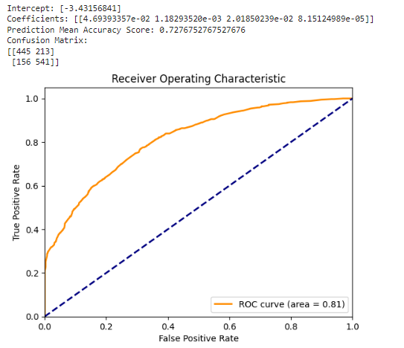
REPORTS
MISSION OBJECTIVE 6
In conclusion, our logistic regression model showcases promising capabilities in forecasting game outcomes for the 2024 season. With a mean accuracy score of 0.72 and an impressive area under the ROC curve of 0.81, coupled with insights from the confusion matrix, precision, recall, and F-score analysis, we have high confidence in the model's reliability and effectiveness. These findings guides us for strategic decision-making and performance optimization in future seasons.

Slide 14
RECOMMENDATIONS
Our baseball team was seen slightly struggling for Away games as compared to Home games. Our team management and support staff can actually focus on areas where we are missing out and form tactics and effective gameplay strategies to improve our Away game results.
Against some of the opponents like Florida State University, our team only won 15% of 47 games played making it a poor result. Hence, while identifying such patterns, team can form designated strategies to improve this record by understanding opponent’s weaknesses and optimize our gameplay accordingly.
For some of the locations like GA and NC, our win track record is below par among all the locations where we have played. As a recommendation, we can try to advertise and pull crowd with UMD support to these locations to increase player encouragement and better motivate them.

Slide 15
FUTURE WORK
While our linear and logistic regression model has shown promising results in predicting game outcomes for the 2024 season, there are avenues for further improvement and exploration.
Future work could focus on implementing more advanced machine learning algorithms such as Random Forest and Support Vector Machines (SVM). These algorithms offer greater complexity and flexibility, potentially enhancing the model's predictive capabilities by capturing more intricate patterns and relationships within the data.
Additionally, fine-tuning model parameters and exploring ensemble techniques could further optimize performance.
We can gather more information regarding past matches to create a more expansive dataset. This will further help us in better predictions and assessments.

