Slide 1
Varsity League Soccer StatPad
Group BUDT 702_Project_0504_11
Abhinandan Gupta
Avi Choudhary
Anudeep Koneru
Shashank Bisht
11 March, 2024

Slide 2
Background
The potential users for the ‘StatPad’ system that we have created are Athletes, Coaches, and Spectators.
We have collected the data from UMD’s ‘ 2022 MEN’s SOCCER CUMULATIVE STATISTICS’
Link: https://umterps.com/sports/mens-soccer/stats/2022
The database include data pertaining to:
Stadiums, Teams, Matches (ex. Timestamp, referees, substitutes),
Match Statistics, Players,
Playing Info (ex. minutes played, goals and assists counts),
and Participation Info (ex. IDs and scores of the 2 teams playing a specific match).

Slide 3
Mission Statement:
To conduct a comprehensive analysis of the performance of the Maryland Men’s Soccer
team across recent seasons, and to derive valuable insights regarding team dynamics
in various match settings. Furthermore, the aim is to assess individual player
performance by examining detailed statistics, contributing to a holistic understanding of
player contributions and their impact on overall team success.
Mission Objectives:
Is there a correlation between goals, assists and fouls with player position?
Analyze the relationship between different match statistics, such as shots on target, fouls, and goals scored, for both home and away teams
What is the win/loss statistics for a team playing Home and Away and How much does attendance affect team performance?
Is there a correlation between the spectator count and FWD player performance? If yes which FWD player performs the best when there are more spectators watching?

Slide 4
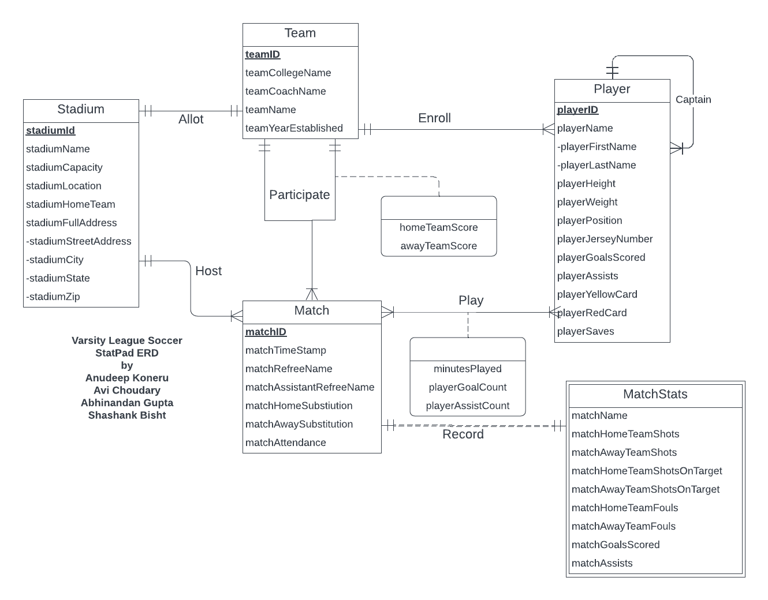
ER
Diagram

Slide 5
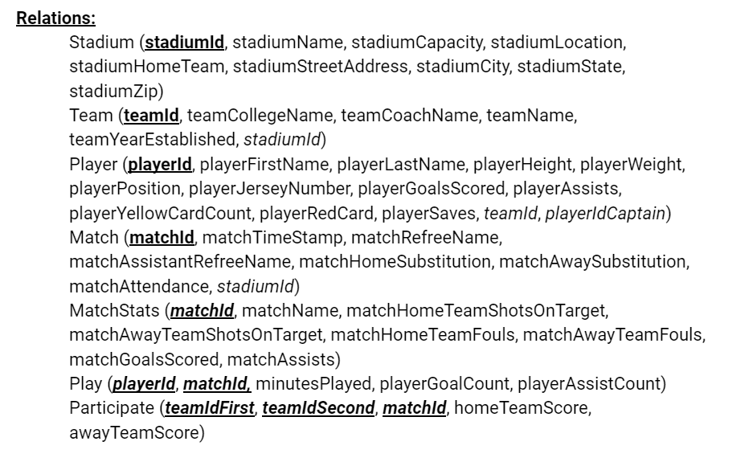
Relational Schema

Slide 6
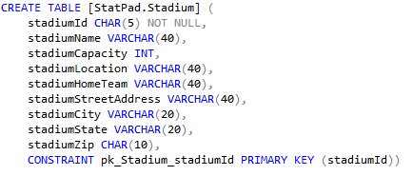
SQL CREATE TABLES
TABLE: Stadium PK: stadiumId

Slide 7
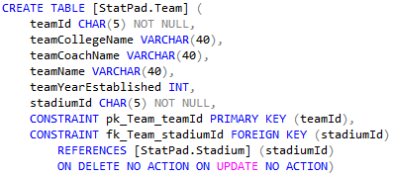
SQL CREATE TABLES
TABLE: Team PK: teamId FK: stadiumId

Slide 8
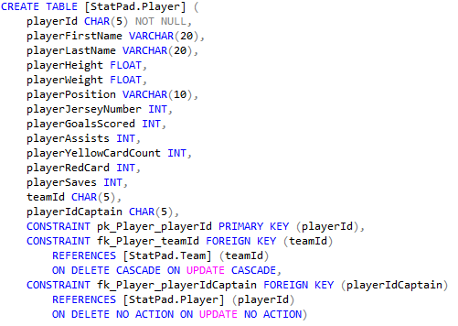
SQL CREATE TABLES
TABLE: Player PK: playerId
FK: teamId, playerIdCaptain

Slide 9
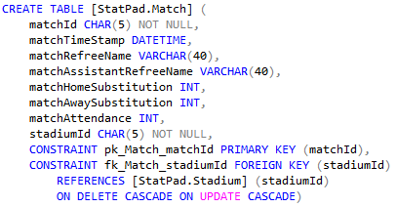
SQL CREATE TABLES
TABLE: Match PK: matchId FK: stadiumId

Slide 10
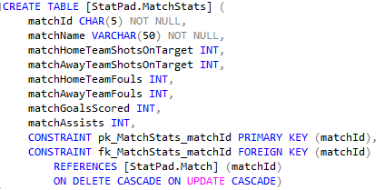
SQL CREATE TABLES
TABLE: MatchStats PK: matchId FK: matchId

Slide 11
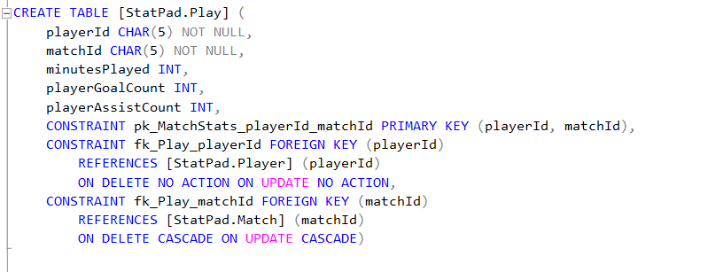
SQL CREATE TABLES
TABLE: Play PK: playerId, matchId FK: playerId, matchId

Slide 12
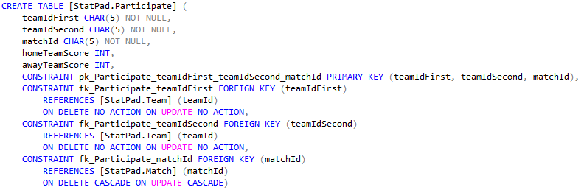
SQL CREATE TABLES
TABLE: Participate PK: teamIdFirst, teamIdSecond, matchId FK: teamIdFirst, teamIdSecond, matchId

Slide 13
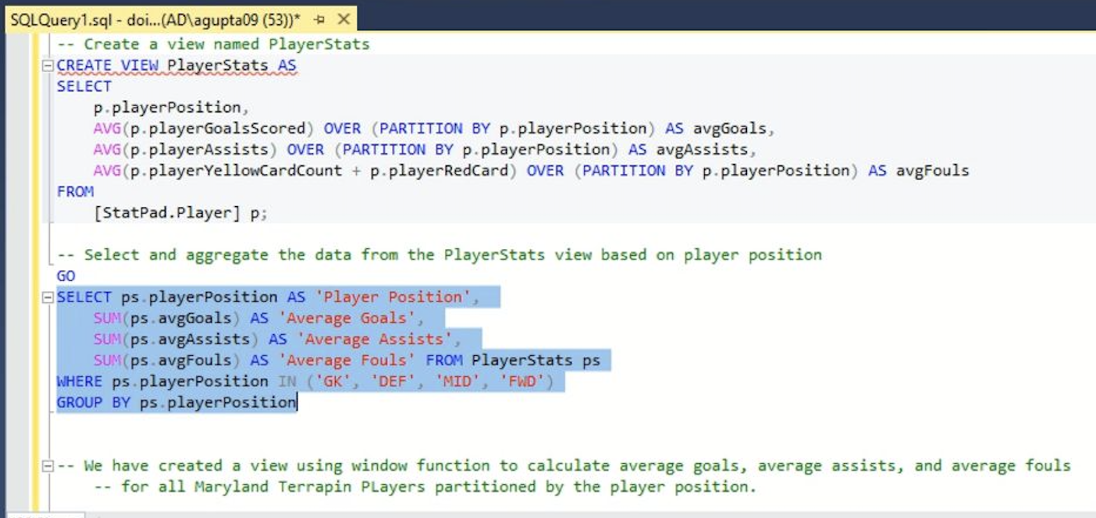
Business Transactions:
1st WH Question:
What is the correlation between goals, assists, and fouls with player position?
SELECT statements for this Question

Slide 14
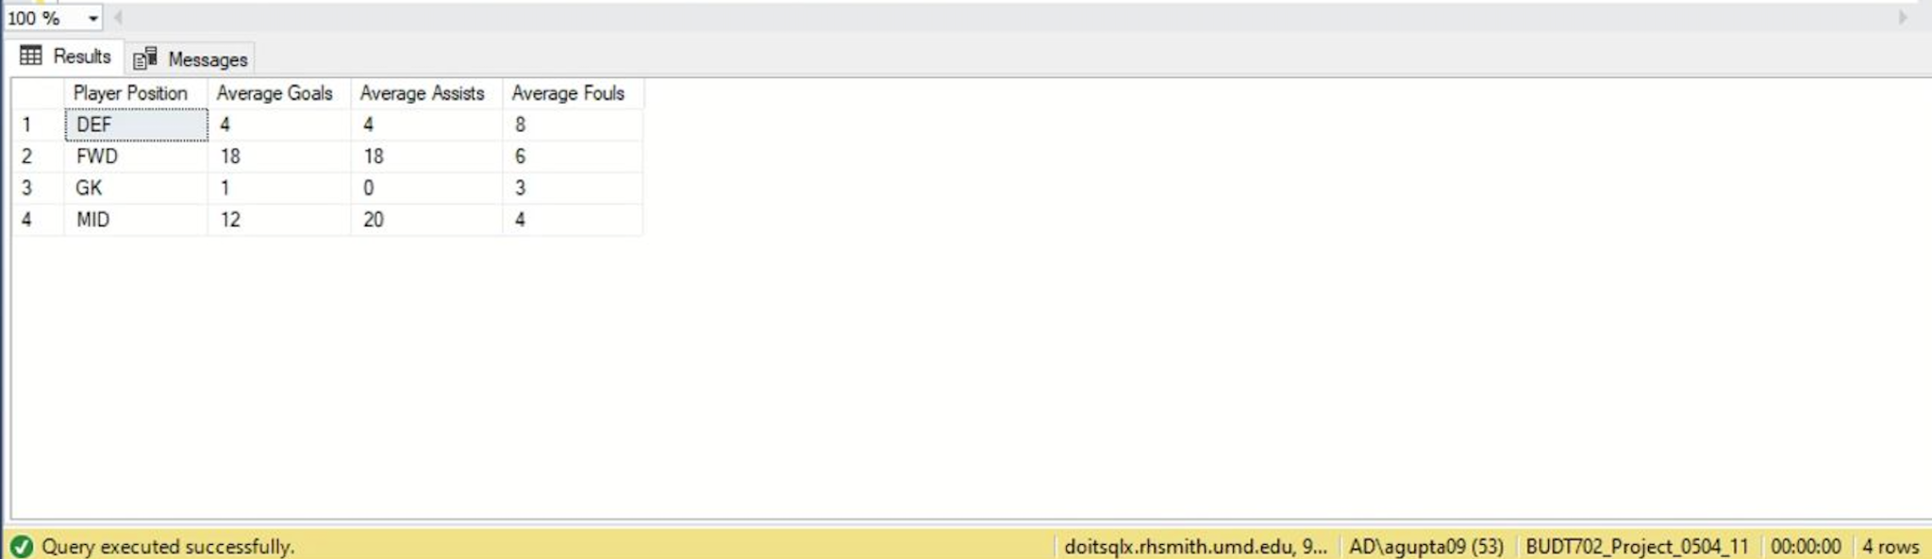
#1: What is the correlation between goals, assists, and fouls with player position?
Result
Observation:
We can see that goals, assists, and fouls are directly correlated to player positions and
that Forwards contribute to most goals, Midfielders contribute to most assists,and most
fouls are committed by the Defenders and Goalkeepers.

Slide 15
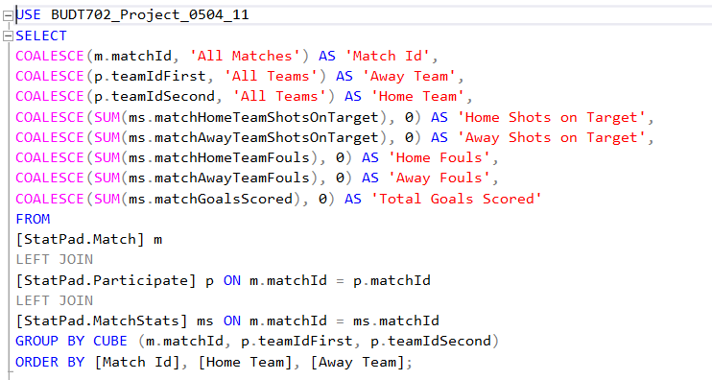
Business Transactions:
2nd WH Question:
How can we analyze the relationship between different match statistics, such as shots on target, fouls, and goals scored, for both home and away teams?
SELECT statements for this Question

Slide 16
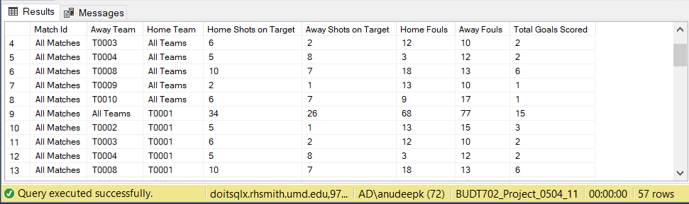
#2: How can we analyze the relationship between different match statistics, such as shots on target, fouls, and goals scored, for both home and away teams?
Result

Slide 17
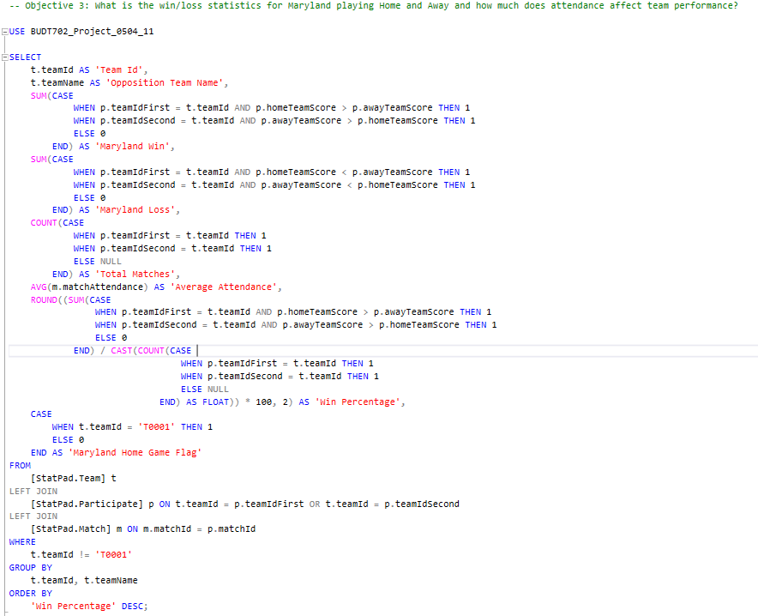
Business Transactions:
3rd Wh- Question:
What is the win/loss statistics for a team playing Home and Away and how much does attendance affect team performance

Slide 18
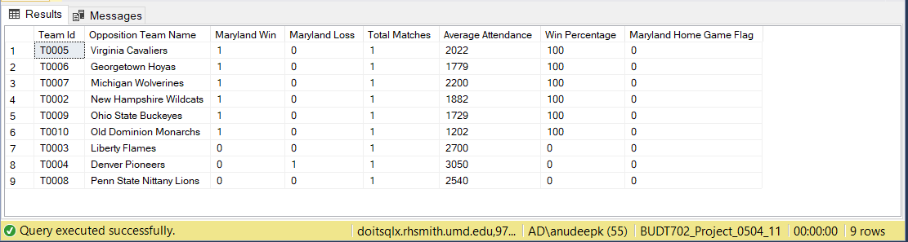
#3: What is the win/loss statistics for a team playing Home and Away and how much does attendance affect team performance
Result
Observation:
We can see that Maryland Terrapins have won all their away games, but during the home games, we have won the matches when average attendance has been between 1000 to 2000, whereas games where the average attendance goes above 2500, we have either drew or lost.
Our assumption is that the extra viewers coming into the games are away fans and that factor plays a part in the game result for Maryland Terrapins

Slide 19
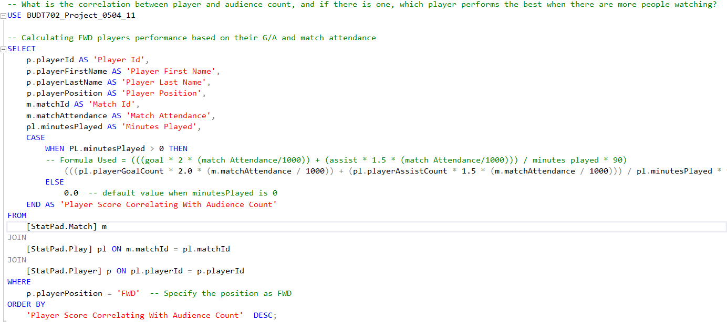
Business Transactions:
4th Wh- Question:
Is there a correlation between player and audience count, and if yes, which forward player performs the best when there are more people watching?

Slide 20
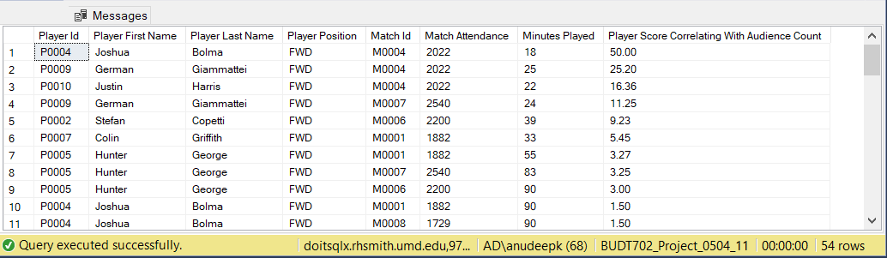
#4: Is there a correlation between player and audience count, and if yes, which player performs the best when there are more people watching?
Result
Observation:
There is a correlation between FWD player performance and match attendance. When the spectator count is above or equal to 2700, the FWDs have less score
Joshua Bolma and George Hunter have 3 non zero 'Player Score Correlating With Audience Count' scores, and Joshua Bolma has the highest score

Slide 21
THANK YOU

