Slide 1

Title : ScholarTrack Pro Smart Attendance Companion
Student Name : P. Anudeep
Student ID : 2520030087
Cluster : 1
Section : 4
Under the Guidance
of
Supervisor Name :

Slide 2
Abstract
Scholar Track is a web-based attendance management system for students.
Provides a centralized dashboard to monitor real-time attendance statistics.
Allows subject-wise attendance tracking and percentage calculation.
Includes an attendance predictor to estimate safe leave and required classes.
Supports custom attendance targets and personalized profiles.
Features a responsive interface with dark/light mode and local data storage.

Slide 3
Existing System
• The traditional attendance system is mostly manual or spreadsheet-based, where records are maintained by teachers.
• Attendance is usually marked by calling student names or using paper registers, which takes more time.
• Calculating attendance percentages is often done manually, which may lead to errors.
• There is no proper prediction system to determine how many classes can be skipped safely.
• Attendance records may be misplaced or difficult to access when stored manually.
• Managing attendance for multiple subjects becomes complex and time-consuming.
• The existing system often lacks a centralized digital platform for students to monitor attendance.

Slide 4
Proposed System
• The proposed system is a web-based Smart Attendance Management System called ScholarTrack Pro Smart Attendance Companion.
• It provides a centralized dashboard to monitor overall attendance statistics.
• Students can add and manage subjects easily within the system.
• An attendance predictor helps students estimate how many classes they can skip or must attend.
• The system supports custom attendance targets based on institutional requirements.
• All attendance data is stored digitally using browser local storage, reducing paperwork.
• It offers a responsive and user-friendly interface with dark/light theme support.
• The system improves accuracy, efficiency, and accessibility of attendance tracking.

Slide 5
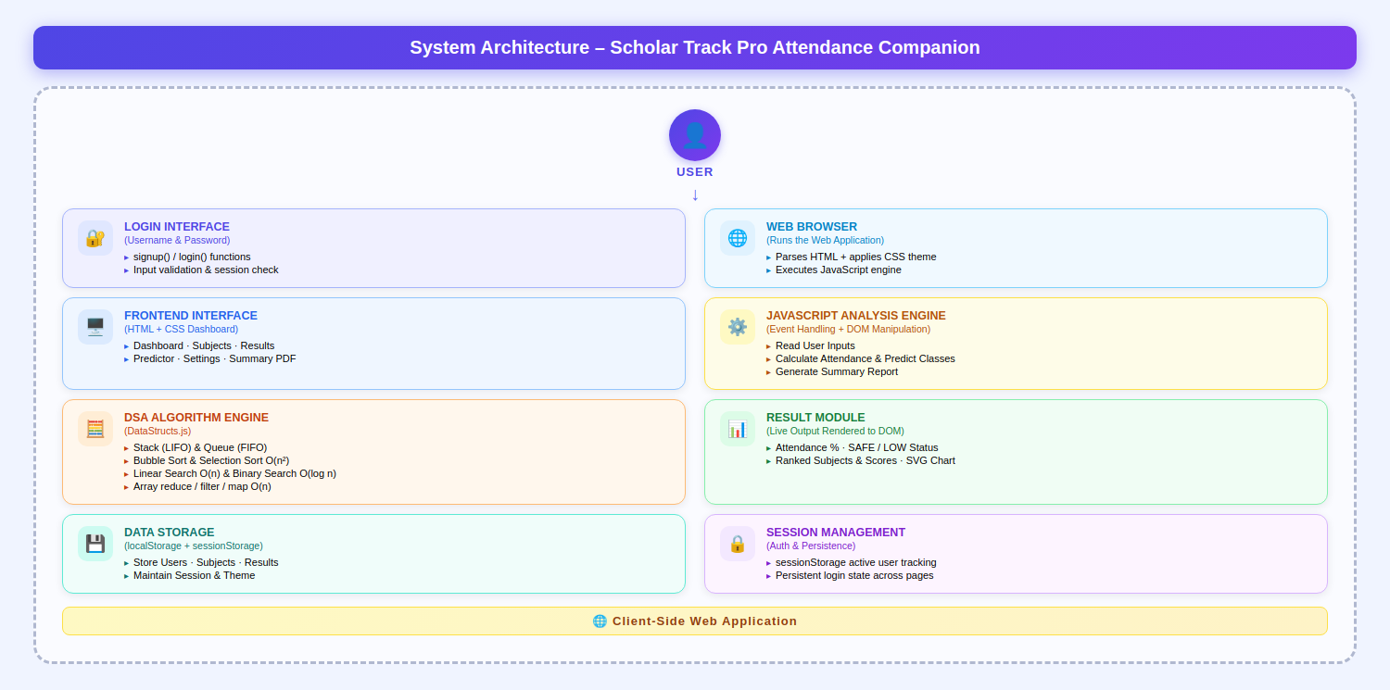
System Architecture

Slide 6
Project Modules
Login / User Profile Module
• Provides access for students to log in and manage their profiles. • Allows users to set personal attendance targets and preferences.
Dashboard Module
• Displays overall attendance statistics and summary. • Shows subject-wise attendance percentage and performance.
Subject Management Module
• Allows users to add, edit, and delete subjects. • Stores subject details like subject name and total classes conducted.
Attendance Tracking Module
• Enables students to mark present or absent for each class. • Automatically updates attendance records and percentages.

Slide 7
Attendance Prediction Module
• Predicts how many classes can be skipped or must be attended. • Helps students maintain required attendance percentage.
Result Management Module
• Displays semester results and subject-wise marks/grades. • Helps students monitor academic performance along with attendance.
Data Storage Module
• Stores attendance and result data using browser local storage. • Ensures quick and persistent access to records.

Slide 8
Objectives
To develop a smart attendance tracking system for students.
To help students monitor attendance percentage in real time.
To provide subject-wise attendance analysis.
To assist students in planning class attendance using prediction tools.
To reduce the risk of attendance shortage before exams.
To create a simple, user-friendly, and responsive web application.

Slide 9
Co’s Attainments - FWD
CO1: Internet Fundamentals, HTML, Intro CSS
Basics of internet and web: HTTP/HTTPS, client-server model, browsers, hosting, domains.
HTML structure and core content tags: document skeleton, headings, paragraphs, links.
Intro CSS: syntax, selectors, typography, colors, and spacing fundamentals (margin, padding, border).
CO2: Forms, Semantic HTML, Advanced CSS Layout
HTML forms: form elements, input types/attributes, and validation basics.
Structured content: semantic tags, tables, media elements, and accessibility attributes.
CSS in depth: advanced selectors, Flexbox, Grid, block layout, media queries, transitions, animations, CSS functions, custom properties, Bootstrap utilities, SCSS basics, and responsive/themed UI design.
CO3: JavaScript Programming Essentials
Core JavaScript: operators, conditions, loops, functions, arrow functions, callbacks.
Data structures and OOP basics: objects, inheritance concepts, arrays and array methods.
Number formats: hexadecimal and scientific literals.

Slide 10
CO4: JavaScript Interactivity and DOM
DOM and event handling: selecting/updating elements and responding to user actions.
Browser storage and async JS: local/session storage, asynchronous programming, and Promises.
CO5: Advanced Web Dev and Deployment
Error handling and ES6 modules.
Dynamic forms and API integration with JavaScript.

Slide 11
Co’s Attainments - DSA
CO1: Algorithm Analysis, Searching, and Basic Sorting
Algorithm analysis foundations: mathematical background, computational model, and running-time calculations.
Searching techniques: Linear Search and Binary Search with analysis.
Sorting introduction with basic methods: Bubble Sort, Insertion Sort, Selection Sort.
CO2: Advanced Sorting Techniques
Divide-and-conquer sorting methods: Merge Sort and Quick Sort.
Comparative understanding of sorting algorithms based on time complexity and use cases.
CO3: Lists and Linked List ADTs
Abstract Data Types (ADTs) and List ADT concepts.
Linked list implementations: singly, doubly, and circular linked lists.
Applications of lists and introduction to Polynomial ADT representation.

Slide 12
CO4: Stacks and Queues
Stack ADT: operations and applications.
Expression-related applications: infix to postfix conversion, arithmetic expression evaluation, balancing symbols.
Queue ADT: operations, Circular Queue, Dequeue (Deque).
Implementing stacks and queues using linked lists.
CO5: Priority Queues, Hashing, and Trees-Related Structures
Priority Queues (Heaps): model, simple implementations, binary heap, and applications.
Hashing: introduction, hash functions, collision handling through Separate Chaining and Open Addressing.
Advanced hashing concepts: Rehashing and Extendible Hashing.

Slide 13
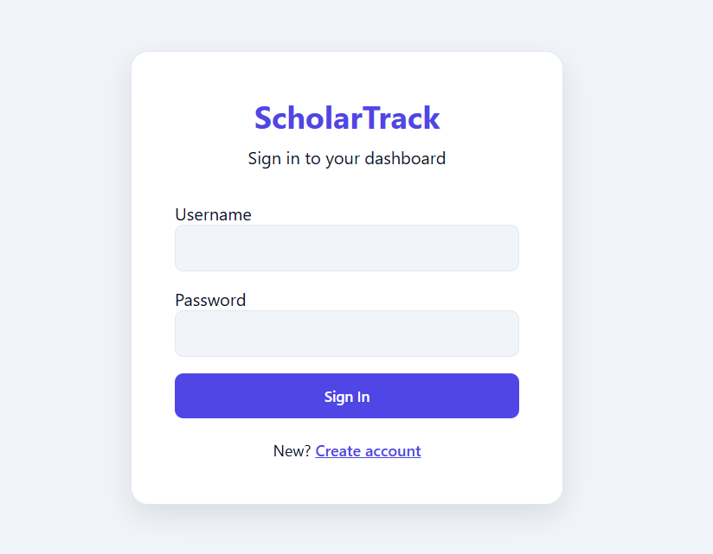
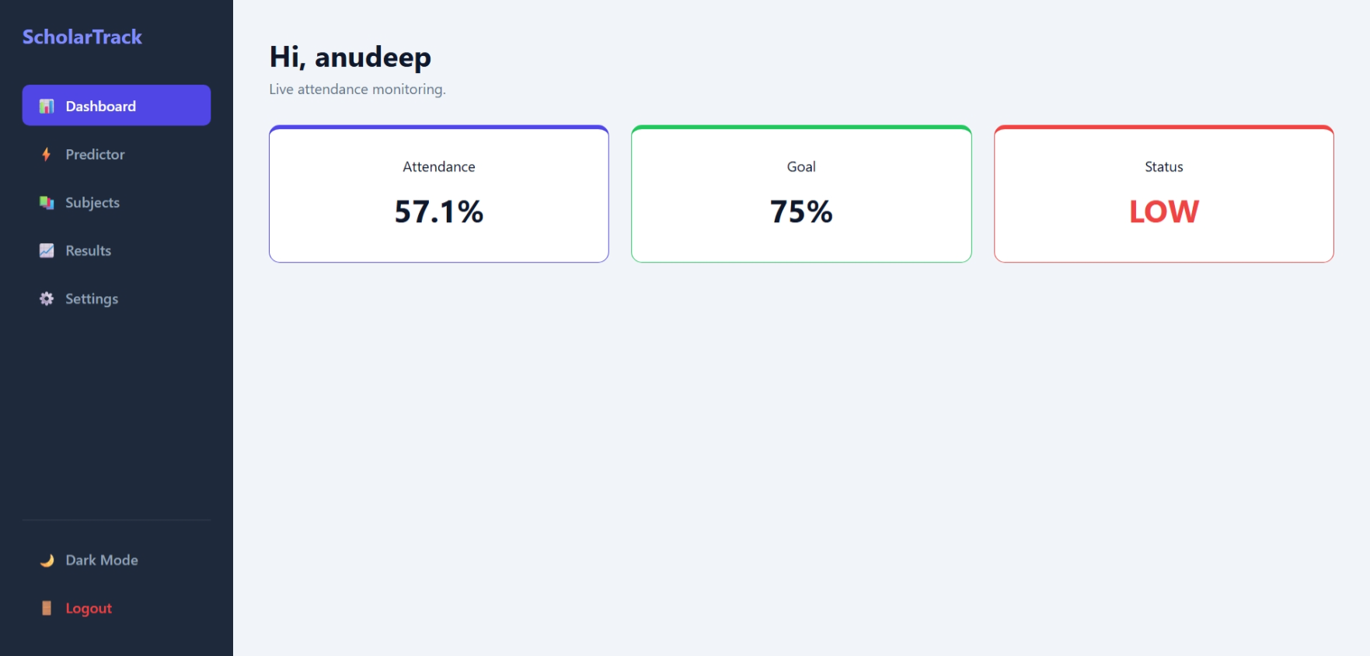
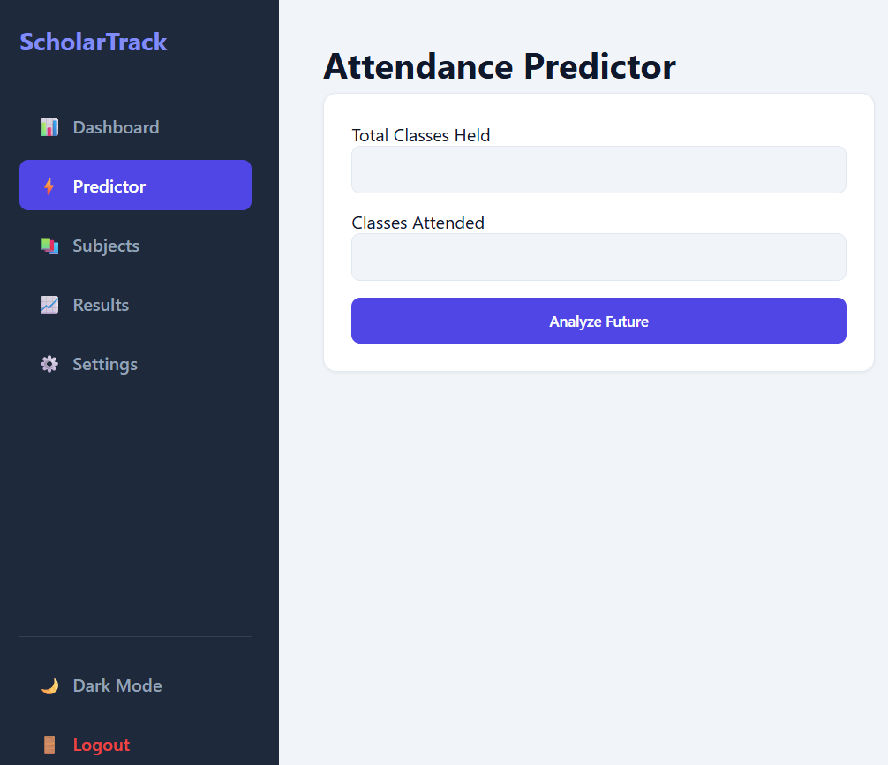
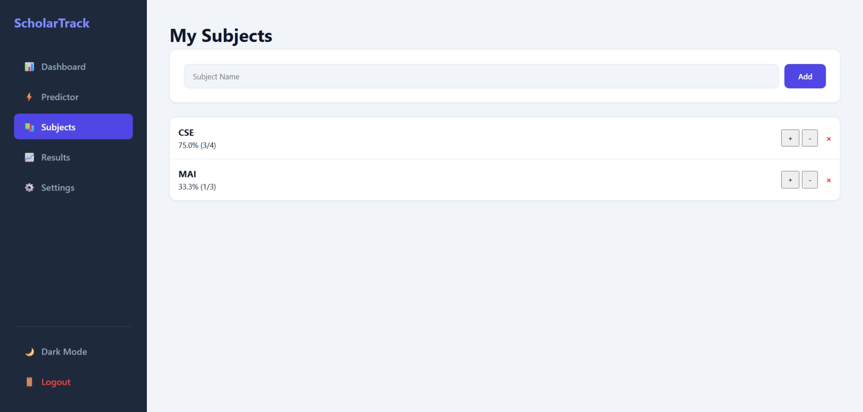
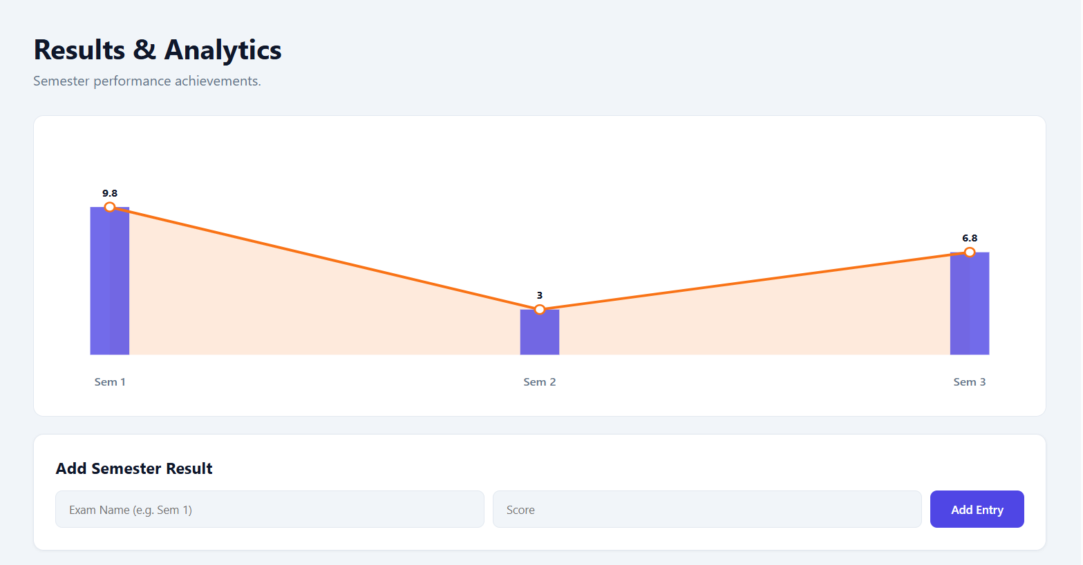
Screenshots for FWD & DSA

Slide 14
Conclusion
The ScholarTrack Pro Smart Attendance Companion provides an efficient and user-friendly solution for managing academic attendance digitally.
• The system allows students to track subject-wise attendance, monitor performance, and maintain required attendance levels through a centralized dashboard.
The ScholarTrack Pro Smart Attendance Companion provides an efficient and user-friendly solution for managing academic attendance digitally.
• The system allows students to track subject-wise attendance, monitor performance, and maintain required attendance levels through a centralized dashboard.
Overall, ScholarTrack simplifies attendance monitoring and supports students in maintaining academic compliance effectively.

Slide 15
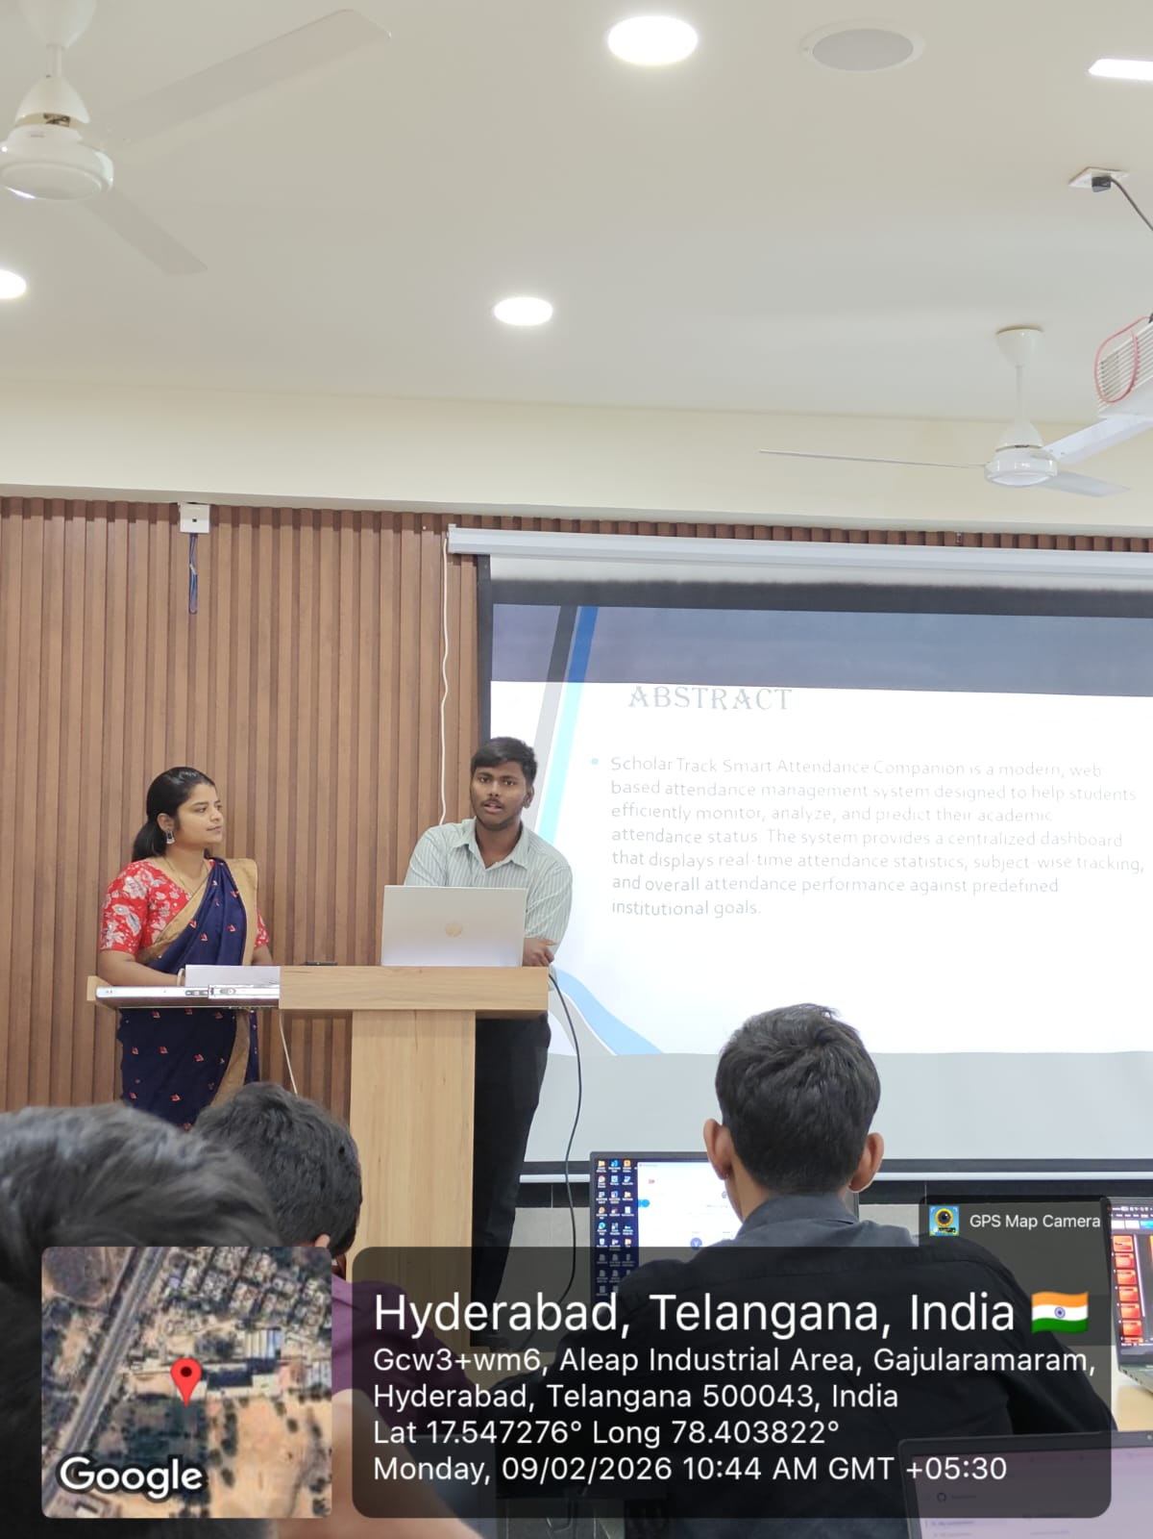
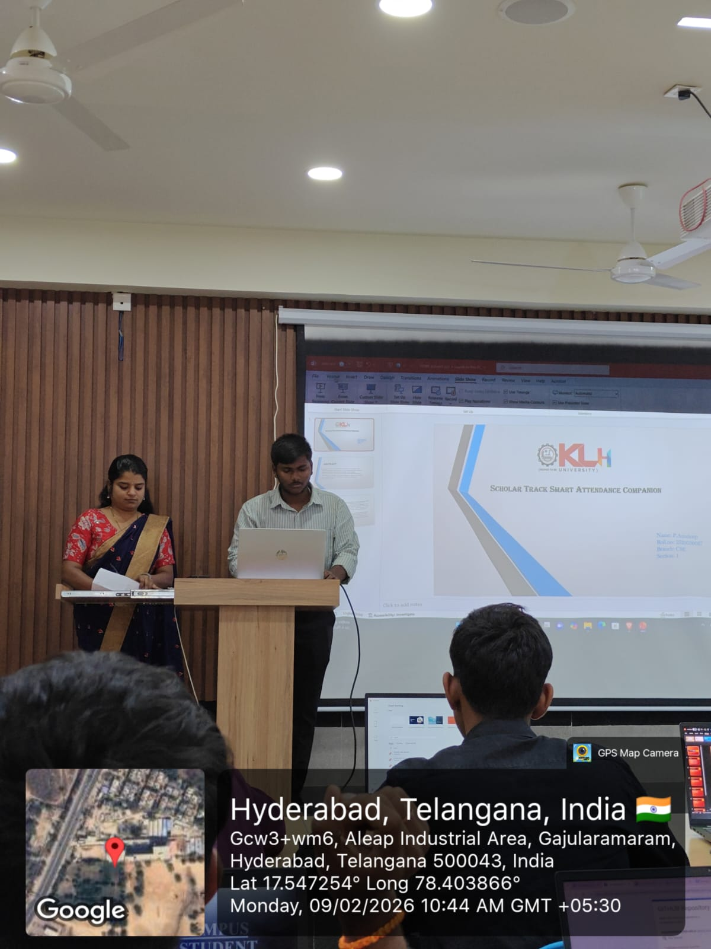
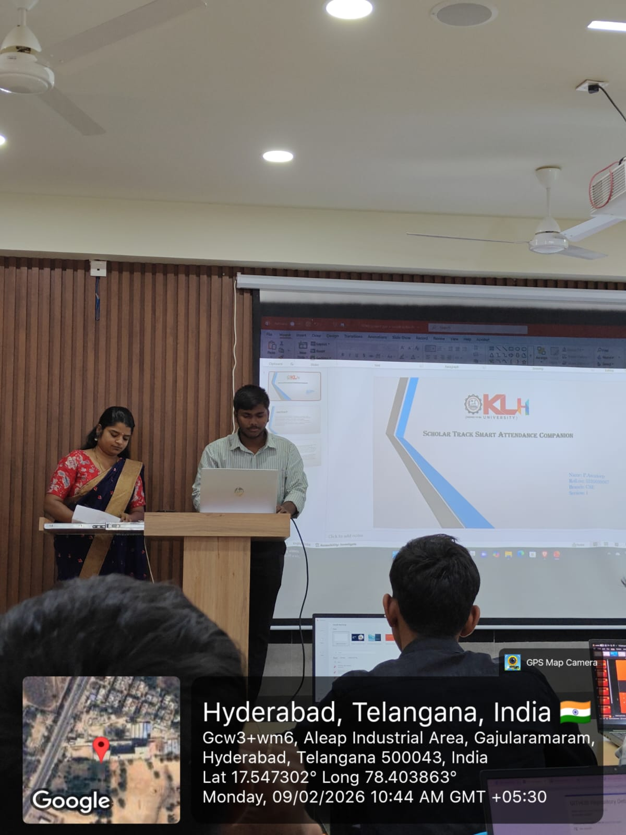
Geo- Tag Photos

Slide 16
THANK YOU

